Slide 1
Intro to Mobile Game Development
Windows  iOS  Android  … and more!
By Shahed Chowdhuri
Sr. Technical Evangelist
WakeUpAndCode.com
@shahedC
Notes:
Title Page: Intro to Mobile Game Development Windows  iOS  Android  … and more!
By Shahed Chowdhuri
Sr. Technical Evangelist
Blog: WakeUpAndCode.com
Twitter: @shahedC

Slide 2
Agenda
Introduction
> Visual Tools
> Visual + Programming
> Programming
Next Steps
Notes:
Agenda
Introduction
> Visual Tools
> Visual + Programming
> Programming
Next Steps

Slide 3
Introduction
Notes:
Introduction

Slide 4
My Background
Period | Background/Experience
1997 – present | Microsoft web/software development
2011 | XNA games on XBLIG 2D Math Panic Angry Zombie Ninja Cats
2012 | Tools for XNA developers XBLIG Sales Data Analyzer (OnekSoftLabs.com) XNA Basic Starter Kit (CodePlex)
Online: http://facebook.com/OnekSoftGames
Notes:
My Background
1997 – present: Microsoft web/software development
2011: XNA games on XBLIG
2D Math Panic
Angry Zombie Ninja Cats
2012: Tools for XNA developers
XBLIG Sales Data Analyzer (OnekSoftLabs.com)
XNA Basic Starter Kit (CodePlex)
Online: http://facebook.com/OnekSoftGames

Slide 5
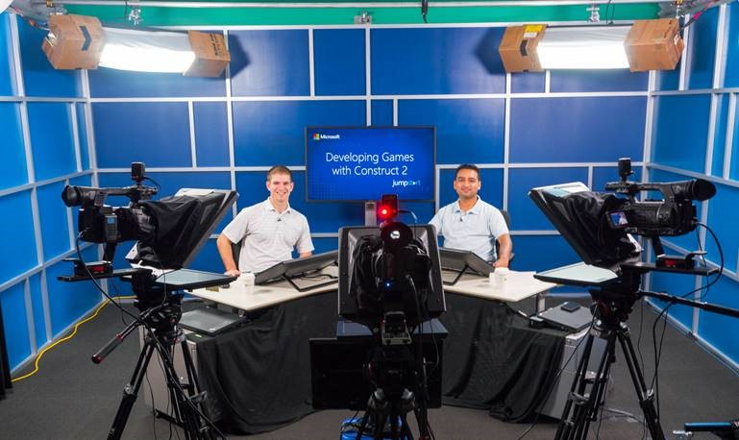
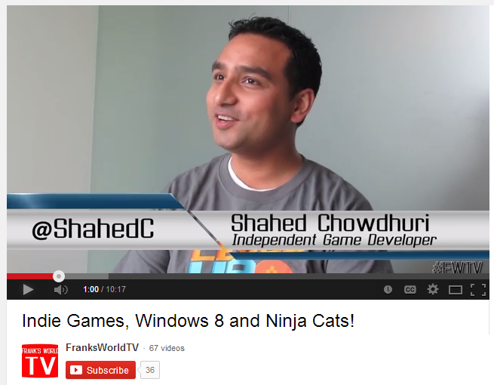
My Background (continued)
Period | Background/Experience
2013 | Ninja Cat Runner on Win8, WP8, Web (Construct 2) Video Q&A with MS Tech Evangelist Frank La Vigne Founder/Admin of FB groups: Construct2, Xbox One & Unity Indie Devs Started Public Speaking in DC area and East Coast
2014 | Public Speaking on Indie Game Development Joined Microsoft as a Sr. Technical Evangelist Gallant Glider on Win8, WP8, Web (Construct 2 → Universal App)
Video Q&A: http://youtu.be/lRjrQPvVOpo
MVA: http://aka.ms/DevGames-Const2
Notes:
My Background (continued) 2013
Ninja Cat Runner on Win8, WP8, Web (Construct 2)
Video Q&A with MS Tech Evangelist Frank La Vigne
Founder/Admin of FB groups: Construct2, Xbox One & Unity Indie Devs
Started Public Speaking in DC area and East Coast
2014
Public Speaking on Indie Game Development
Joined Microsoft as a Sr. Technical Evangelist
Gallant Glider on Win8, WP8, Web (Construct 2 → Universal App)
Video Q&A: http://youtu.be/lRjrQPvVOpo
MVA: http://aka.ms/DevGames-Const2

Slide 6
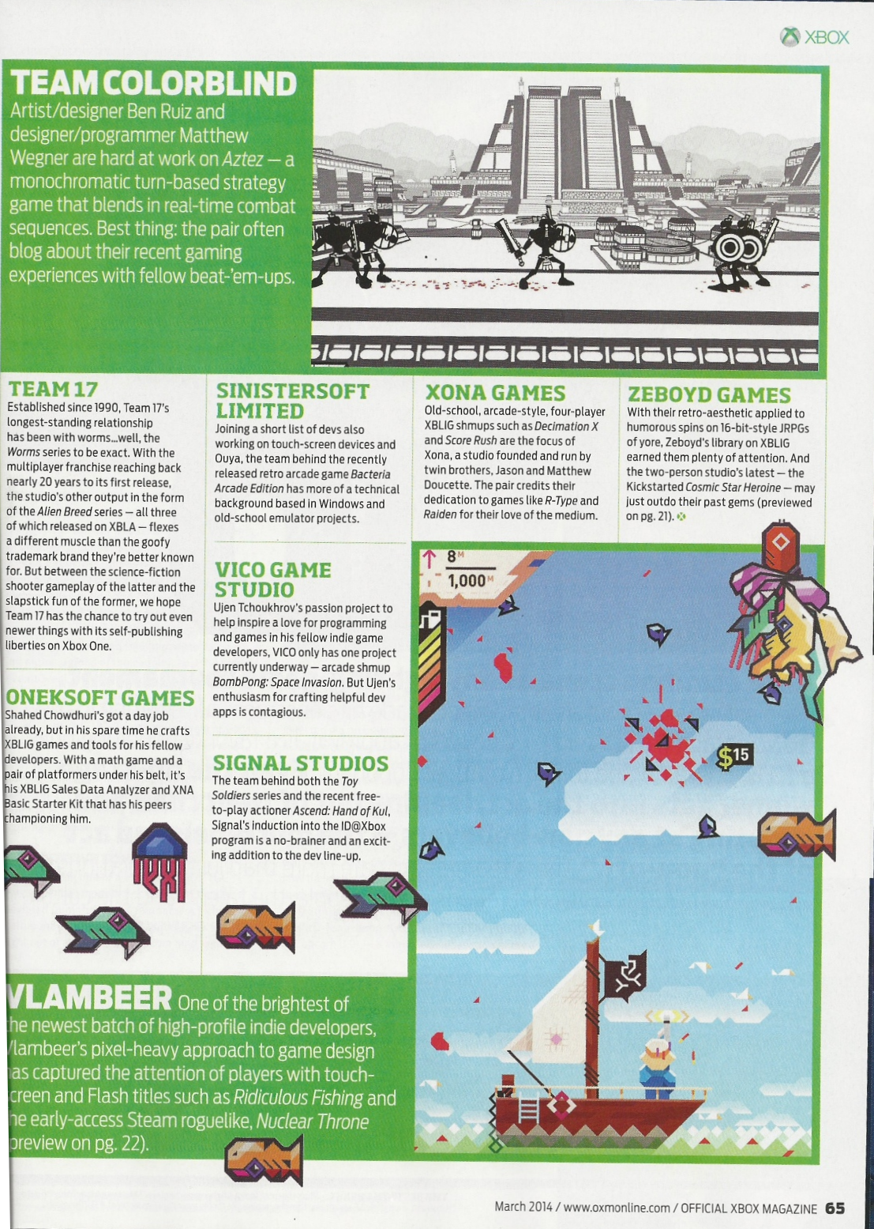
Official Xbox Magazine
`
Source: Official Xbox Magazine, March 2014, Page 65
Notes:
Official Xbox Magazine, March 2014, Page 65
"Shahed Chowdhuri's got a day job already,
but in his spare time he crafts XBLIG games and tools for his fellow developers.”
“With a math game and a pair of platformers under his belt,
it's his XBLIG Sales Data Analyzer and XNA Basic Starter Kit that has his peers championing him."

Slide 7
Tools & Technologies
+
Notes:
Tools & Technologies
Visual Studio 2013
Windows 8
Windows Phone
iOS
Android
Microsoft .NET and Visual C#
Xbox One
Construct2
C++ and DirectX 11.1+
HTML5/CSS/JS
Unity

Slide 8
What is a Mobile Device?
Smartphones
Tablets
Laptops
Netbooks and smaller laptops
Laptop/Tablet hybrids
Notes:
What is a Mobile Device?
Smartphones
Tablets
Laptops
Netbooks and smaller laptops
Laptop/Tablet hybrids

Slide 9
Visual Tools
Notes:
Visual Tools

Slide 10
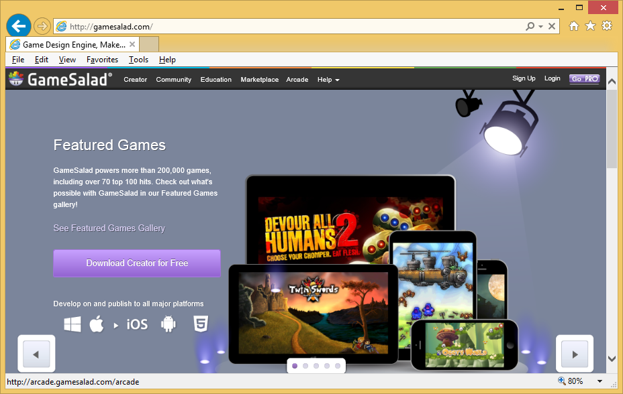
Game Salad
Website: http://gamesalad.com/
Notes:
Game Salad
Website: http://gamesalad.com/

Slide 11
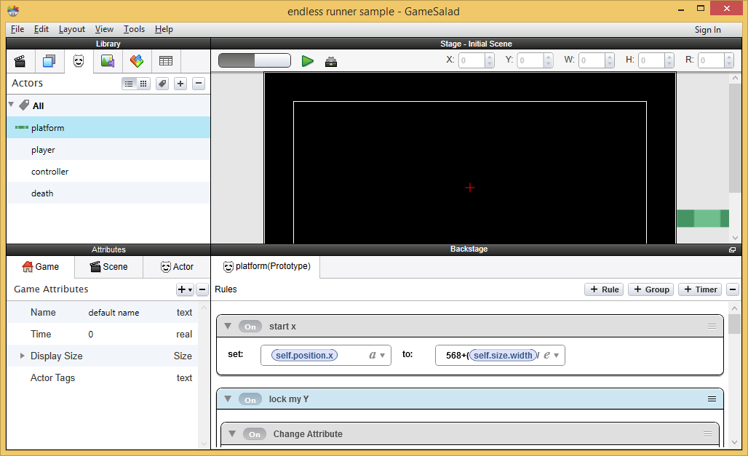
Game Salad UI
Endless runner sample from http://www.jamie-cross.net/?portfolio=gamesalad-endless-runner-overview
Notes:
Game Salad UI
Endless runner sample from http://www.jamie-cross.net/?portfolio=gamesalad-endless-runner-overview

Slide 12
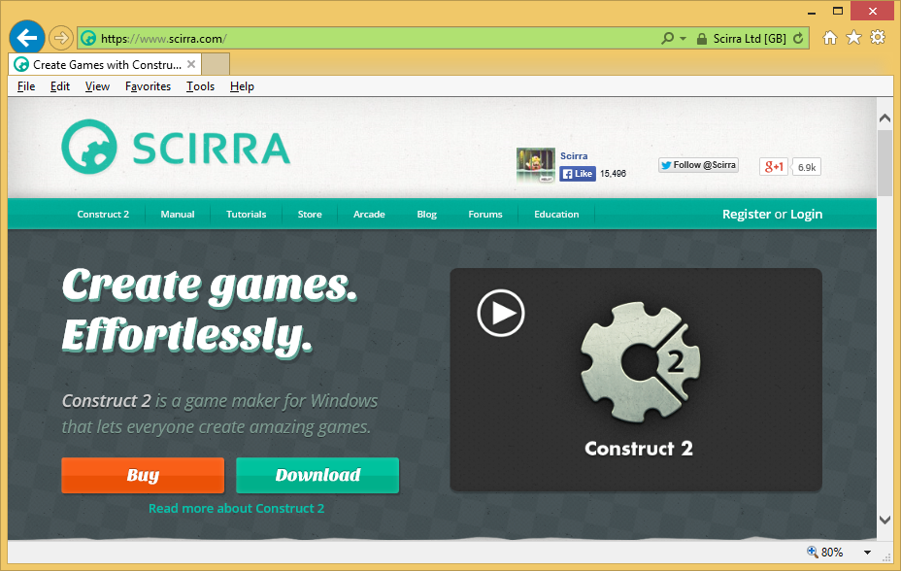
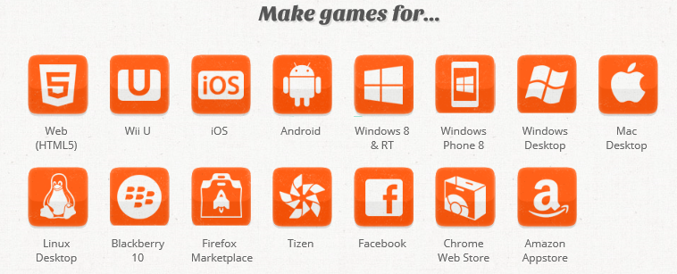
Construct 2
Website: https://www.scirra.com/
Notes:
Construct 2
Website: https://www.scirra.com/

Slide 13
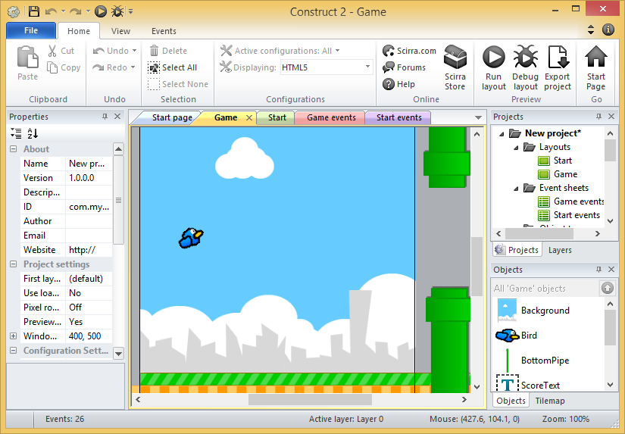
Construct 2 UI
Flapping Bird template (included with Construct 2)
Notes:
Construct 2 UI
Flapping Bird template (included with Construct 2)

Slide 14
Visual + Programming
Notes:
Visual + Programming

Slide 15
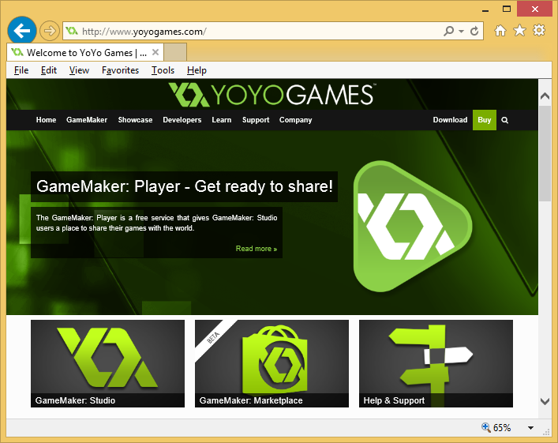
Game Maker
Platforms Supported:
Website: http://www.yoyogames.com/
Language: GML
Notes:
Game Maker
Website: http://www.yoyogames.com/
Language: GML

Slide 16
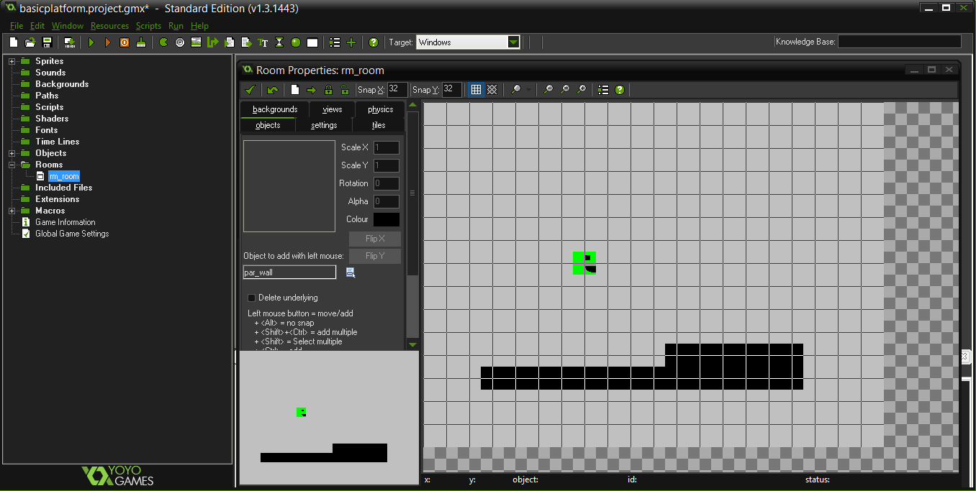
Game Maker UI
Platformer Tutorial from YouTube video: http://www.youtube.com/watch?v=9w4wOCNEa1c
Notes:
Game Maker UI
Platformer Tutorial from YouTube video: http://www.youtube.com/watch?v=9w4wOCNEa1c

Slide 17
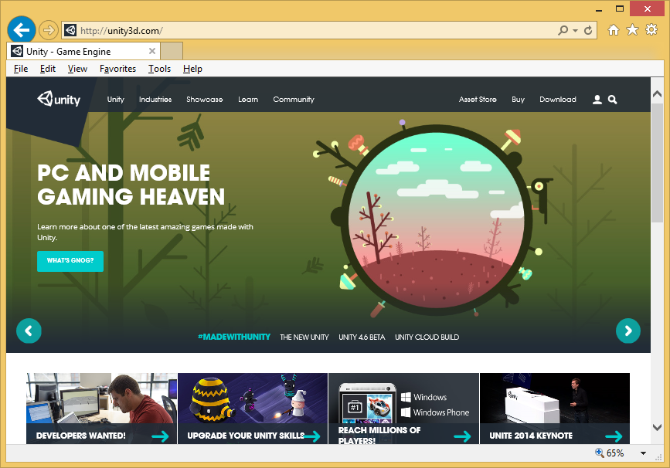
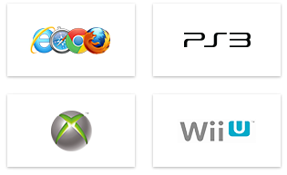
Unity (3D and 2D)
Platforms Supported:
Website: http://unity3d.com/
Languages: C#, JavaScript, Boo
Notes:
Unity (3D and 2D)
Website: http://unity3d.com/
Languages: C#, JavaScript, Boo

Slide 18
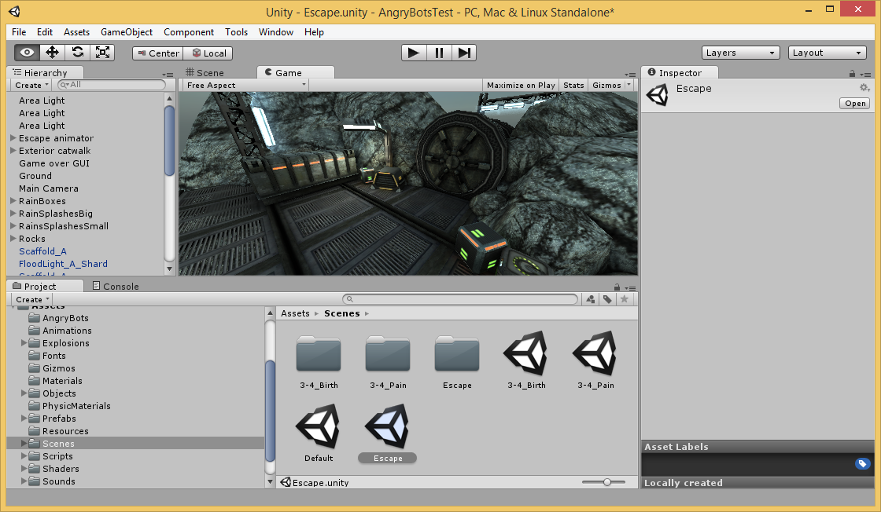
Unity UI
Angry Bots sample project (included with Unity, free in Asset Store)
Notes:
Unity UI
Angry Bots sample project (included with Unity, free in Asset Store)

Slide 19
Programming
Notes:
Programming

Slide 20
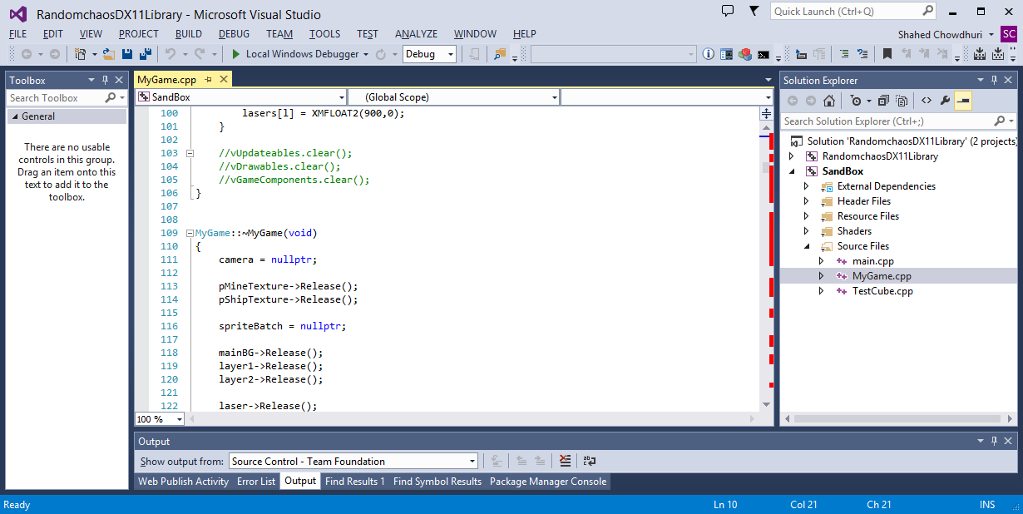
C++ and DirectX (Visual Studio)
Platforms
Supported:
Visual Studio Website: http://www.visualstudio.com/
DirectX Website on MSDN: http://msdn.microsoft.com/directx
Notes:
C++ and DirectX (Visual Studio)
Visual Studio Website: http://www.visualstudio.com/
DirectX Website on MSDN: http://msdn.microsoft.com/directx

Slide 21
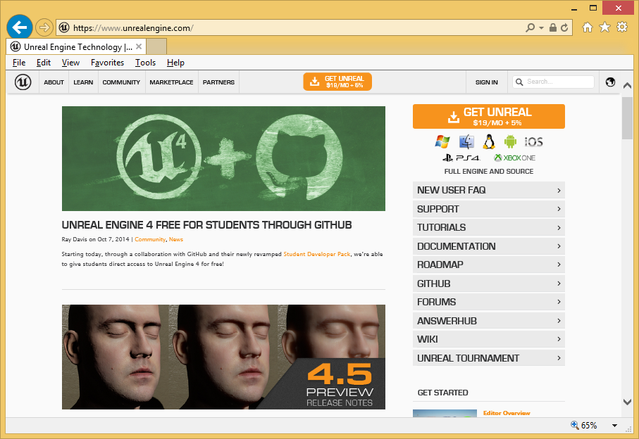
Unreal Engine
Platforms Supported:
Website: https://www.unrealengine.com/
Language: C++
(UnrealScript before v4)
Notes:
Unreal Engine
Website: https://www.unrealengine.com/
Language: C++
(UnrealScript before v4)

Slide 22
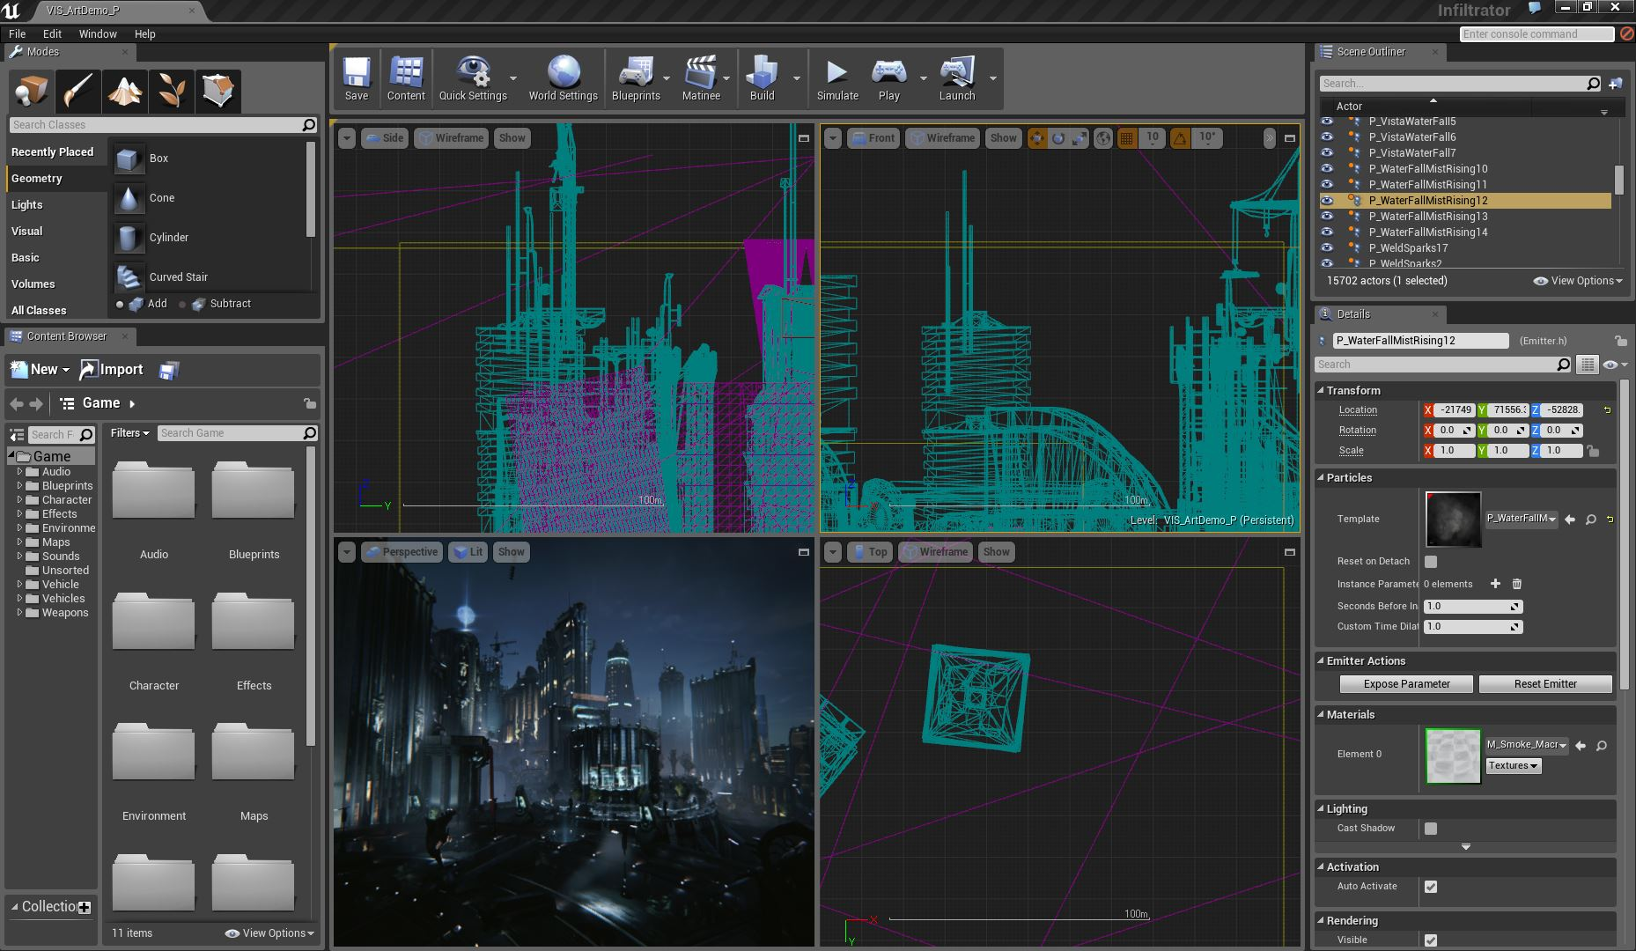
Unreal Engine Editor UI
From Editor Documentation: https://docs.unrealengine.com/latest/INT/Engine/UI/LevelEditor/index.html
Notes:
Unreal Engine Editor UI
From Editor Documentation: https://docs.unrealengine.com/latest/INT/Engine/UI/LevelEditor/index.html

Slide 23
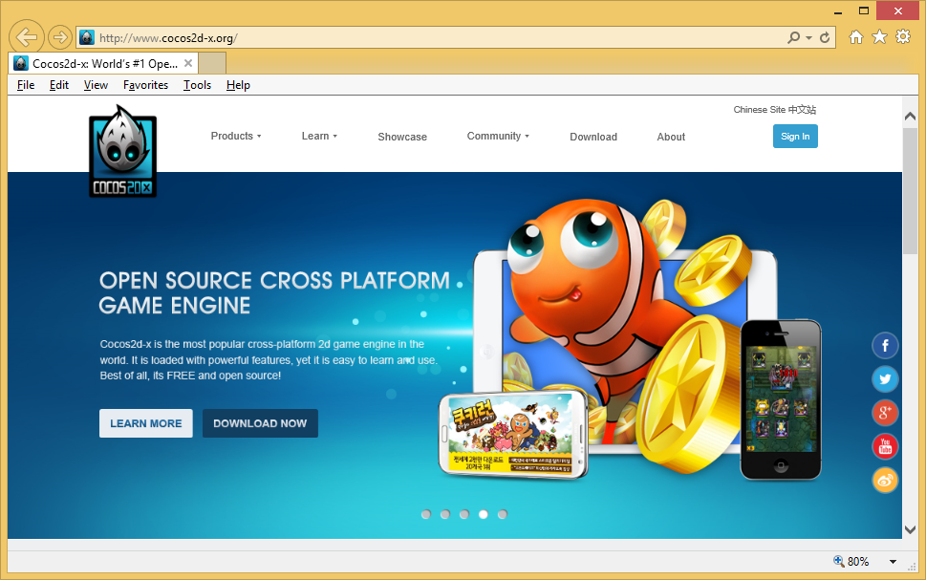
Cocos2d-x
Supported Platforms
& Languages:
Website: http://www.cocos2d-x.org/
Notes:
Cocos2d-x
Website: http://www.cocos2d-x.org/
Supported Platforms
& Languages:
iOS, Android, Windows 8, Windows Phone 8, Windows, Linux, Mac OS X

Slide 24
Next Steps
Notes:
Next Steps

Slide 25
More information:
Construct 2:
Index page: http://wakeupandcode.com/construct2/
Facebook group: https://www.facebook.com/groups/construct2devs/
Unity (3d or 2d):
Index Page: http://wakeupandcode.com/unity/
Facebook group: https://www.facebook.com/groups/UnityIndieDevs/
C++ and DirectX:
Resource List: http://wakeupandcode.com/cpp-directx/
15 Essential Mobile Game Dev Tools:
http://www.develop-online.net/tools-and-tech/15-essential-mobile-game-development-tools/0184480
Top Game Dev Tools: Pros & Cons
http://www.developereconomics.com/top-game-development-tools-pros-cons/
Notes:
More information:
Construct 2:
Index page: http://wakeupandcode.com/construct2/
Facebook group: https://www.facebook.com/groups/construct2devs/
Unity (3d or 2d):
Index Page: http://wakeupandcode.com/unity/
Facebook group: https://www.facebook.com/groups/UnityIndieDevs/
C++ and DirectX:
Resource List: http://wakeupandcode.com/cpp-directx/
15 Essential Mobile Game Dev Tools:
http://www.develop-online.net/tools-and-tech/15-essential-mobile-game-development-tools/0184480
Top Game Dev Tools: Pros & Cons
http://www.developereconomics.com/top-game-development-tools-pros-cons/

Slide 26
Questions?
Notes:
Questions?

Slide 27
Contact
Email: shchowd@microsoft.com  Twitter: @shahedC
Notes:
Contact
Microsoft email: shchowd@microsoft.com
Personal Twitter: @shahedC
Dev Blog: WakeUpAndCode.com

