Slide 1
Publishing Your App/Game
Windows 8.1  Windows Phone 8.1  … and more!
By Shahed Chowdhuri
Sr. Technical Evangelist
WakeUpAndCode.com
@shahedC
Notes:
Title Page: Publishing Your App/Game Windows  Windows Phone  … and more!
By Shahed Chowdhuri
Sr. Technical Evangelist
Blog: WakeUpAndCode.com
Twitter: @shahedC

Slide 2
Agenda
Open Developer Account
> Certificate, Windows Store
> Store Graphics, Package
> Publish!
Windows Phone, Alt Tools
Notes:
Agenda
Open Developer Account
> Certificate, Windows Store
> Store Graphics, Package
> Publish!
Windows Phone, Alt Tools

Slide 3
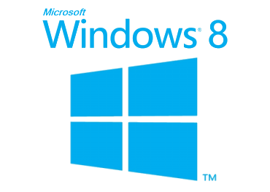
Tools & Technologies
+
Notes:
Tools & Technologies
Visual Studio 2013
Windows 8
Microsoft .NET and Visual C#
Windows Phone
HTML5/CSS/JS
Xbox One
Unity
C++ and DirectX 11.1+
XAML
Construct 2

Slide 4
Open Developer Account
Notes:
Open Developer Account

Slide 5
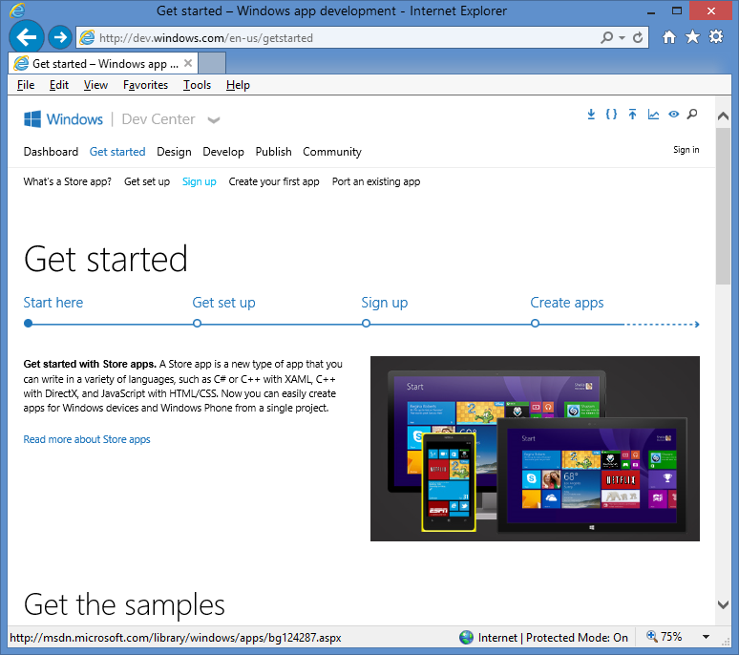
Open Developer Account: Step 1
Sign up for a
developer account on:
http://dev.windows.com
Click “Get Started”
Click “Sign up”

Slide 6
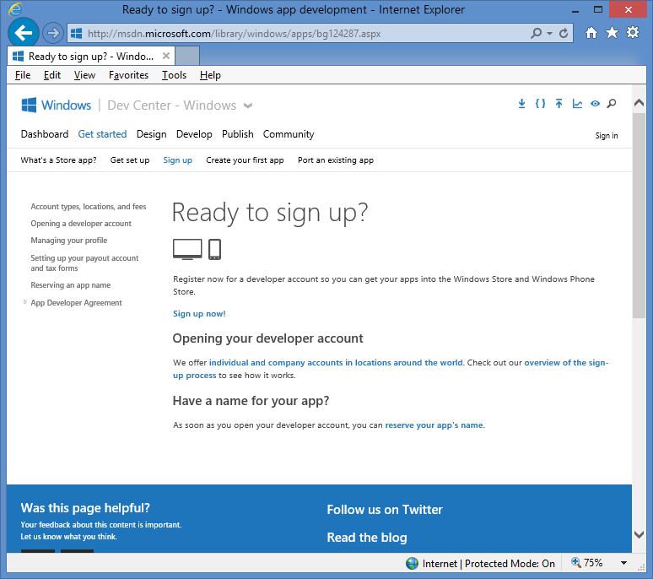
Open Developer Account: Step 2
Follow the onscreen
instructions to
set up your
developer account

Slide 7
Create Certificate
Notes:
Create Certificate

Slide 8
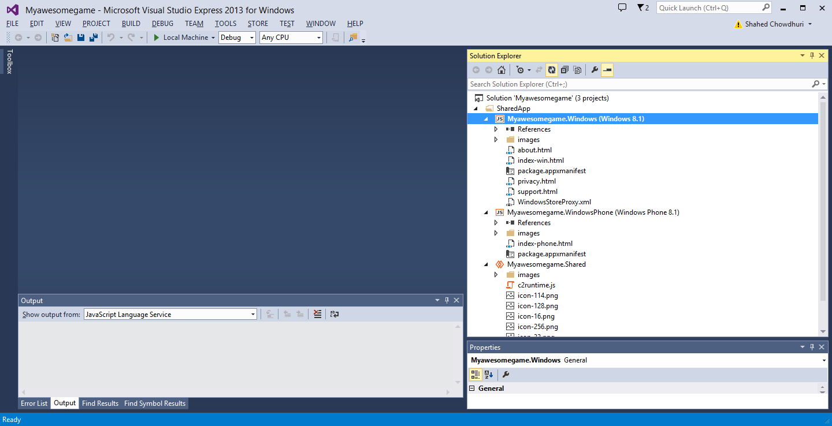
Create Certificate: Step 1
Open your solution
in Visual Studio
NOTE: This example shows Visual Studio Express 2013 for Windows, running on Windows 8.1

Slide 9
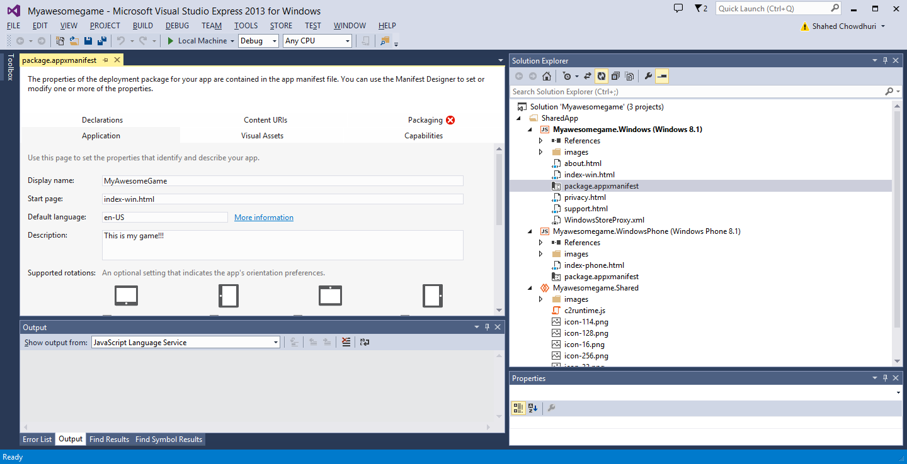
Create Certificate: Step 2
Open the file
“package.appxmanifest”

Slide 10
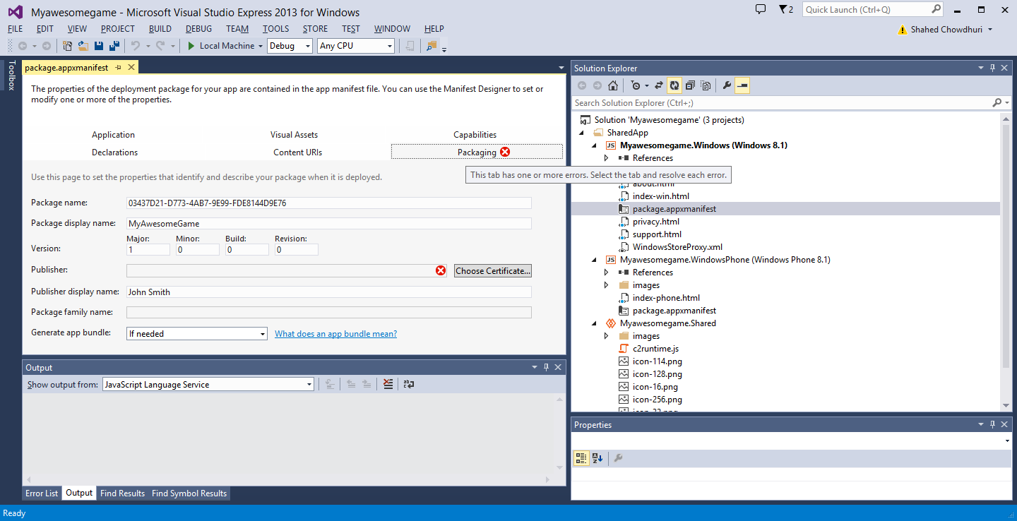
Create Certificate: Step 3
Click on
Packaging tab

Slide 11
Create Certificate: Step 4
Click on Choose
Certificate

Slide 12
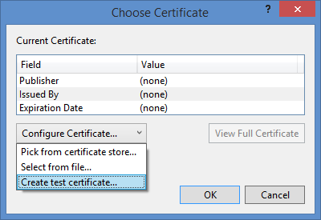
Create Certificate: Step 5
Select
“Create test
Certificate…”
Click “OK”

Slide 13
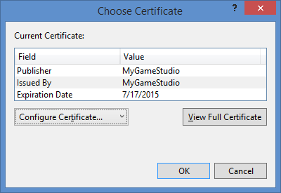
Create Certificate: Step 6
Click “OK”

Slide 14
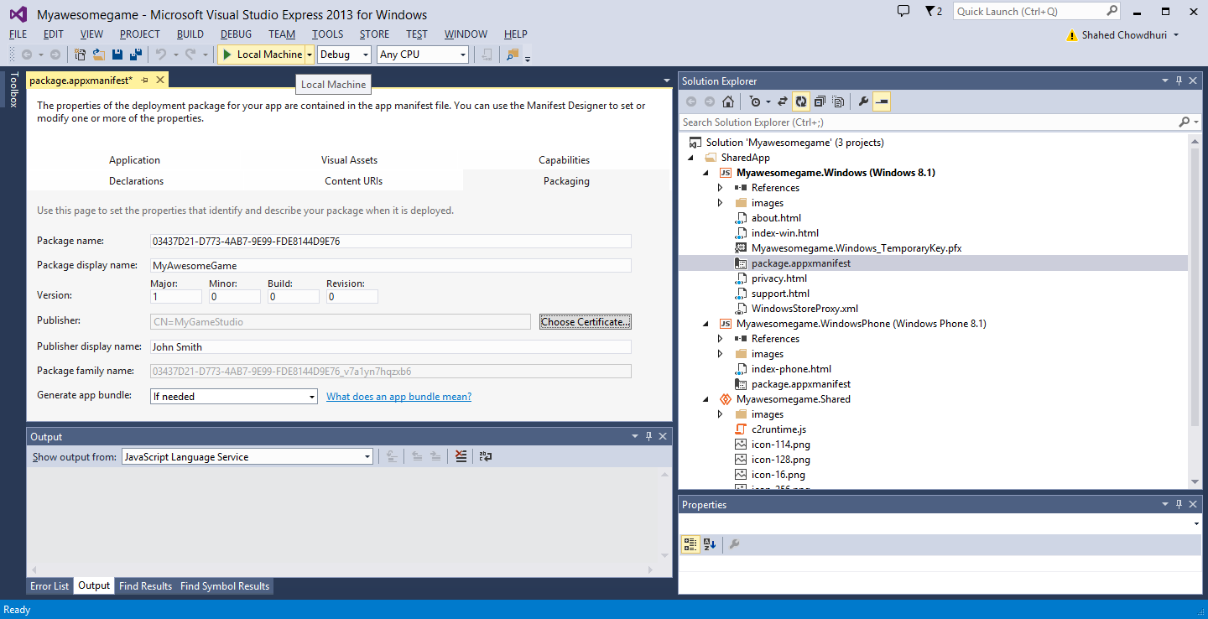
Create Certificate: Step 7
Click “Play” button to run it
NOTE: This step assumes that you’re running Windows 8.1

Slide 15
Associate with Windows Store
Notes:
Associate with Windows Store

Slide 16
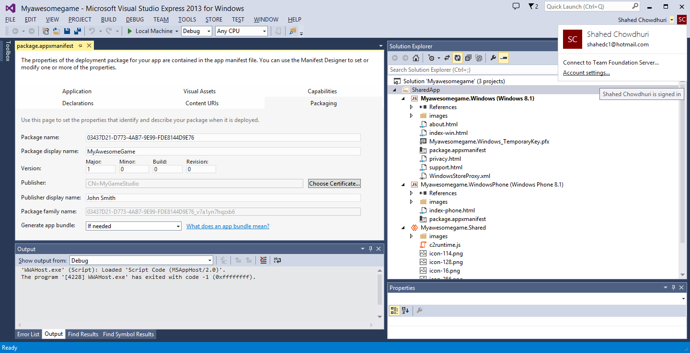
Associate with Windows Store: Step 1
Log in with your
dev account

Slide 17
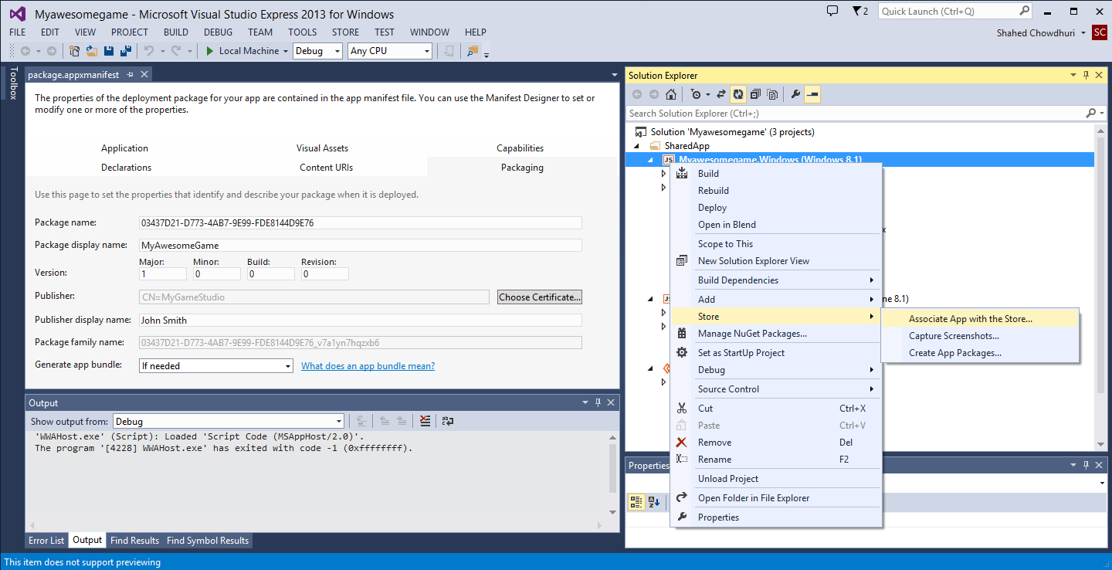
Associate with Windows Store: Step 2
Right-click project,
… then select Store

Slide 18
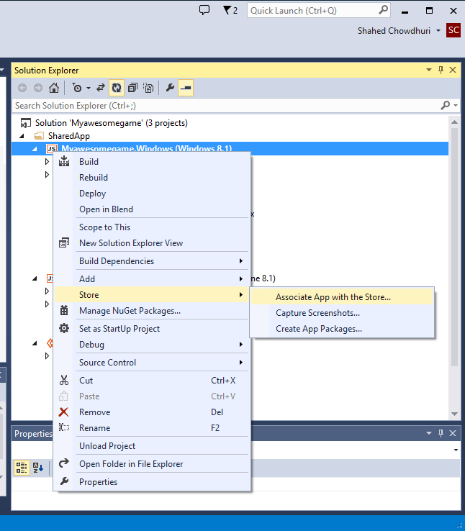
Associate with Windows Store: Step 3
Associate App with the Store…

Slide 19
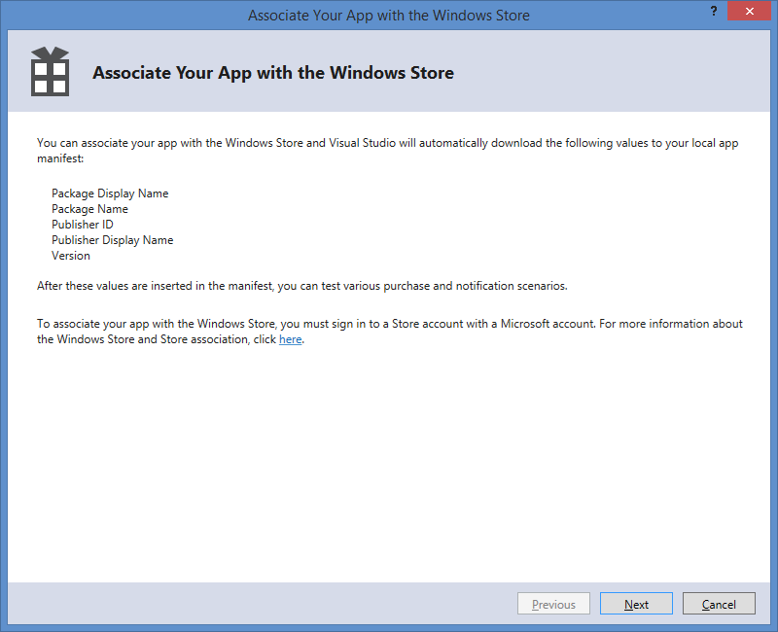
Associate with Windows Store: Step 4
Click Next to Log In
then associate your app
with the Windows Store

Slide 20
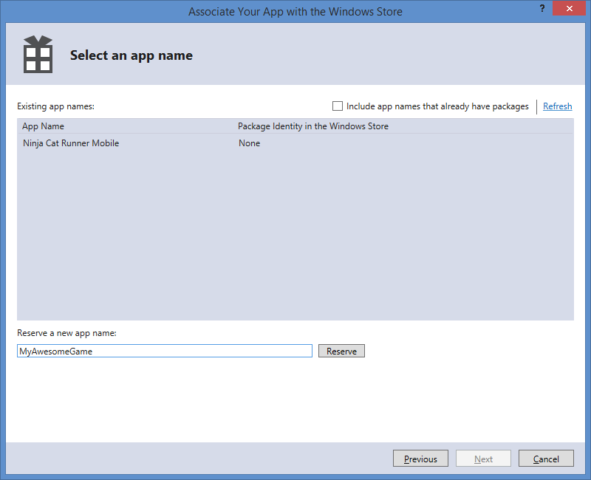
Associate with Windows Store: Step 5
Select an existing
App Name
- OR -
Reserve a new
app name, then
select it

Slide 21
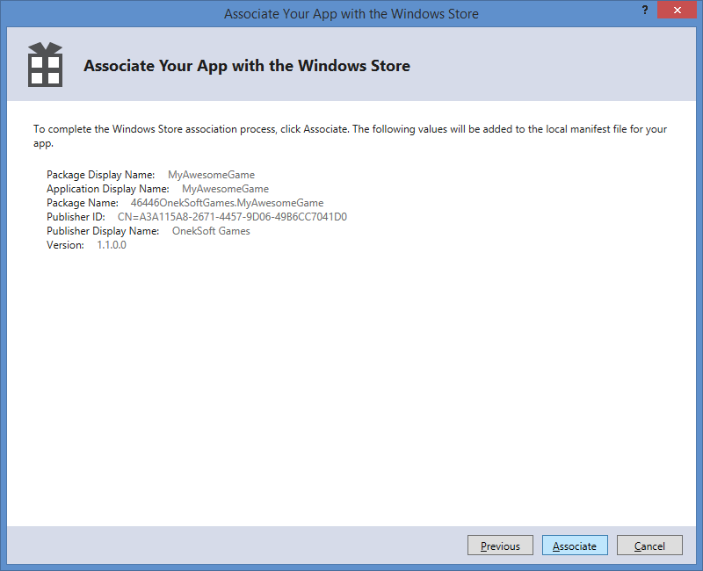
Associate with Windows Store: Step 6
Click “Associate”

Slide 22
Create Store Graphics
Notes:
Create Store Graphics

Slide 23
Create Store Graphics: Step 1
Capture Screenshots

Slide 24
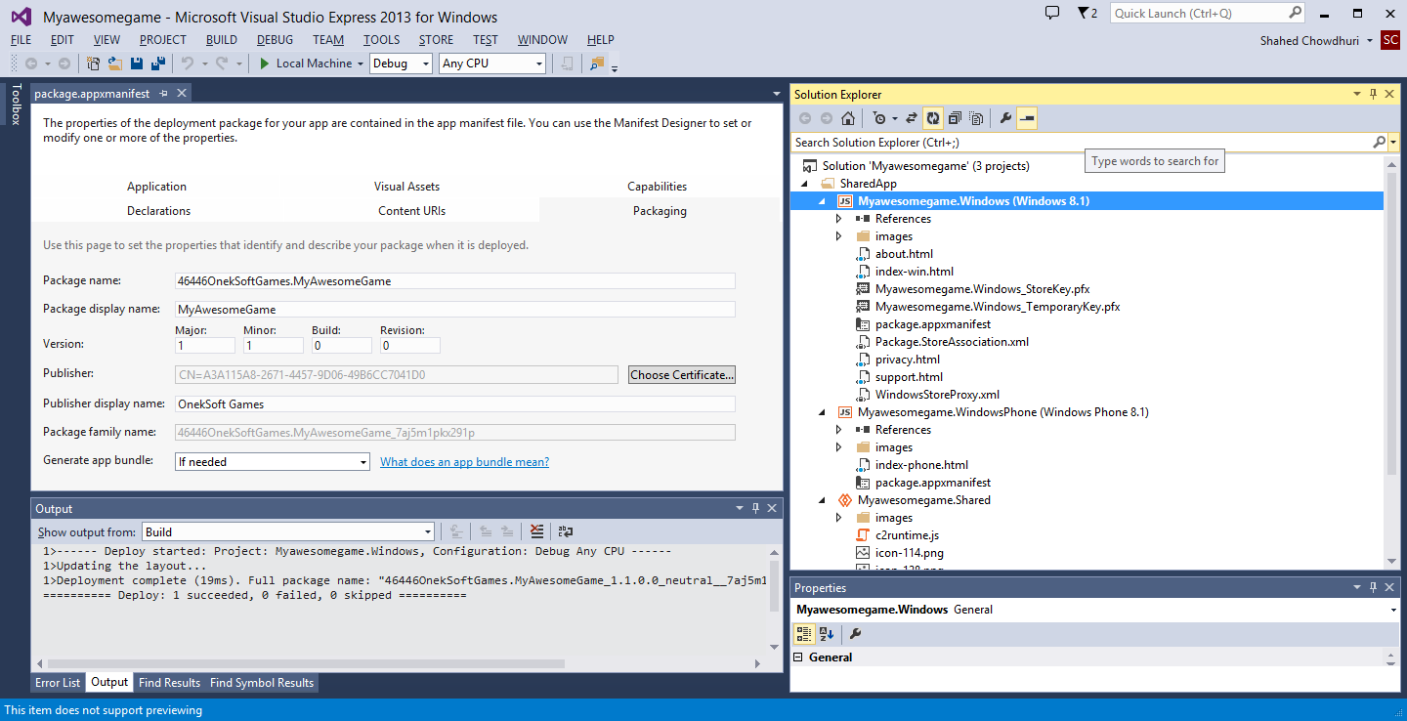
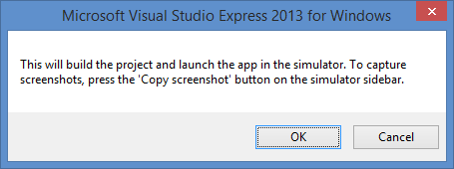
Create Store Graphics: Step 2
Click “OK”

Slide 25
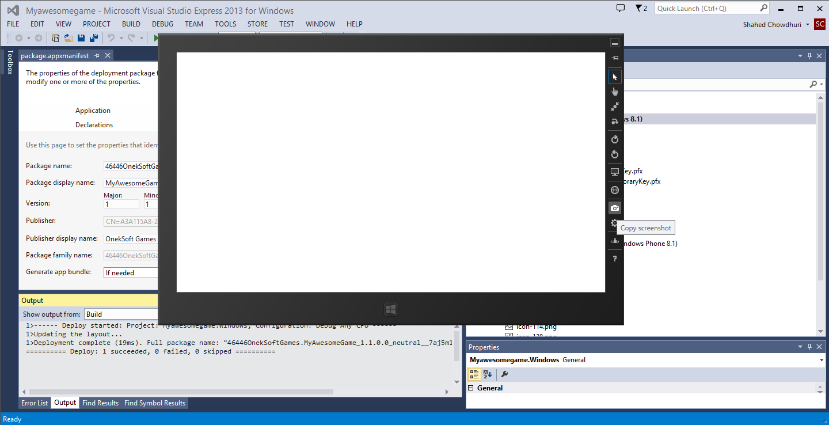
Create Store Graphics: Step 3
Copy Screenshots
in the Simulator

Slide 26
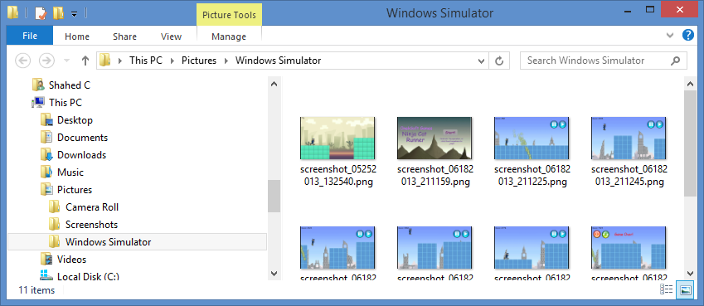
Create Store Graphics: Step 4
Verify the screenshots in your “Pictures” folder,
“Windows Simulator” subfolder

Slide 27
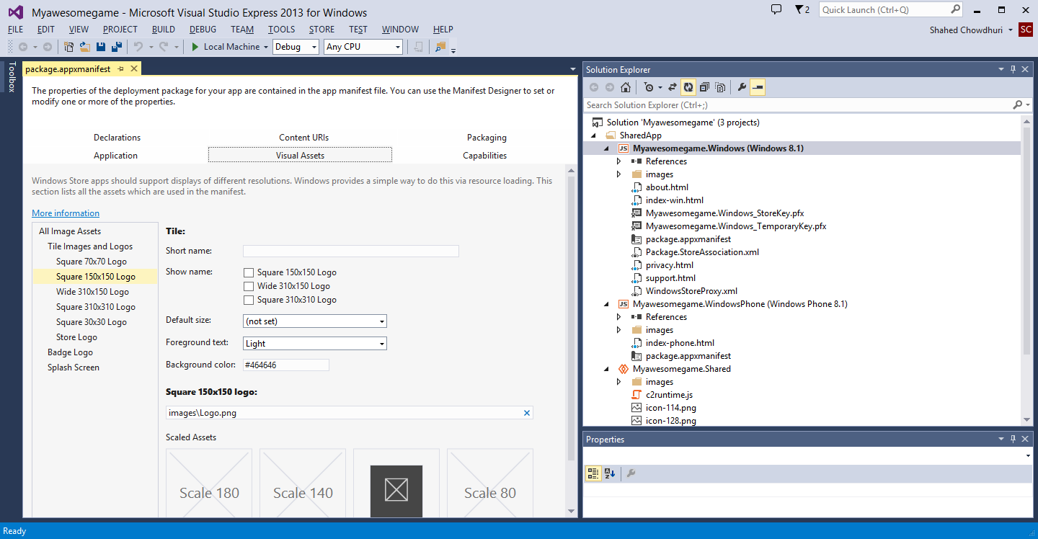
Create Store Graphics: Step 5
Identify
placeholder
images

Slide 28
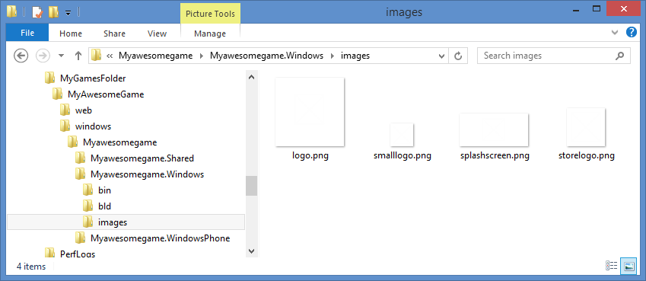
Create Store Graphics: Step 6
Edit or replace these images with your own

Slide 29
Create and Certify Package
Notes:
Create and Certify Package

Slide 30
Create and Certify Package: Step 1
Create App Packages…

Slide 31
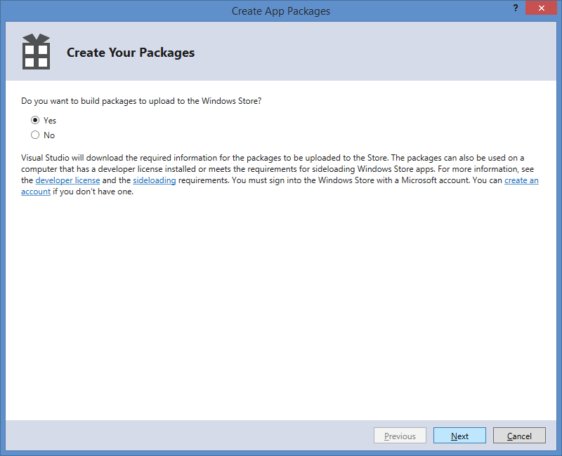
Create and Certify Package: Step 2
Click “Next” to Proceed
(log in if necessary)

Slide 32
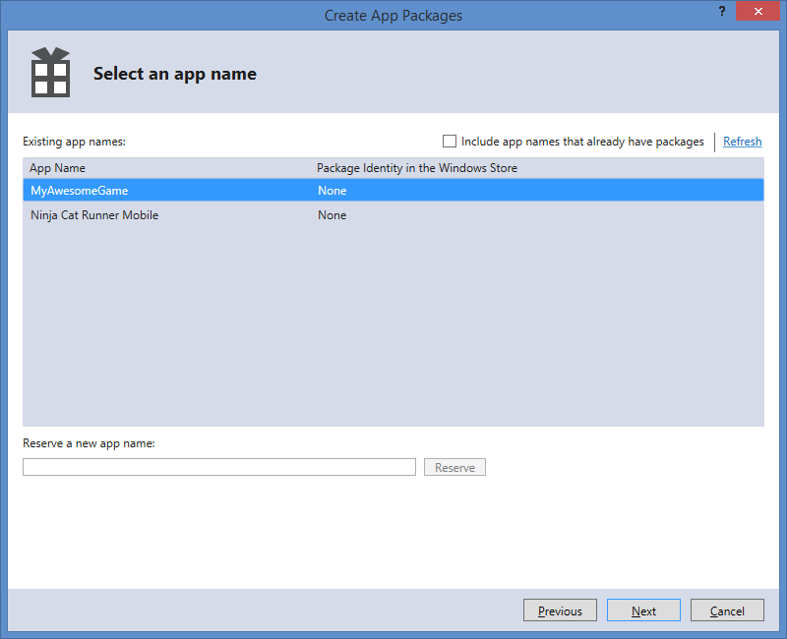
Create and Certify Package: Step 3
Select an existing
App Name
… then, click “Next”

Slide 33
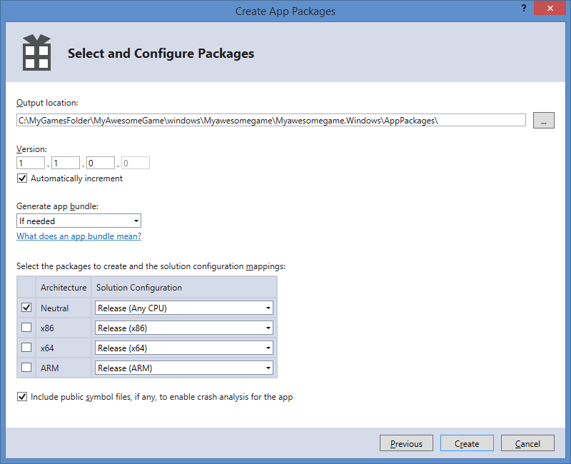
Create and Certify Package: Step 4
Observe the
AppPackages
location
… then, click “Create”

Slide 34
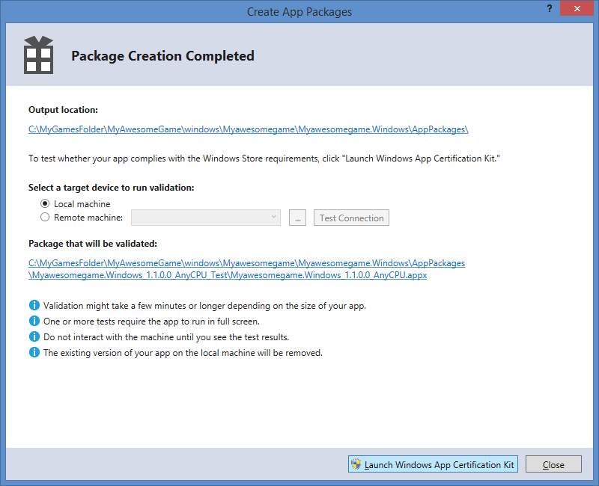
Create and Certify Package: Step 5
Launch
Windows App
Certification Kit

Slide 35
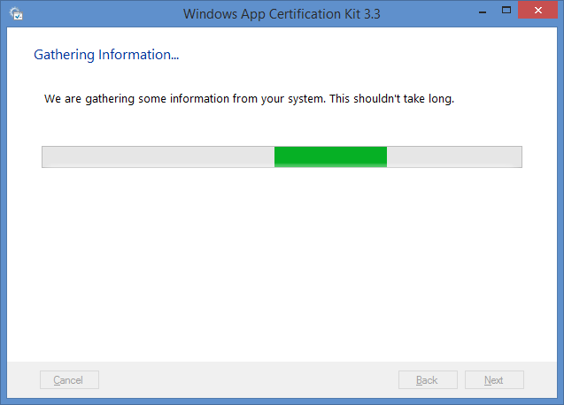
Create and Certify Package: Step 6
Allow the
tool to
gather info

Slide 36
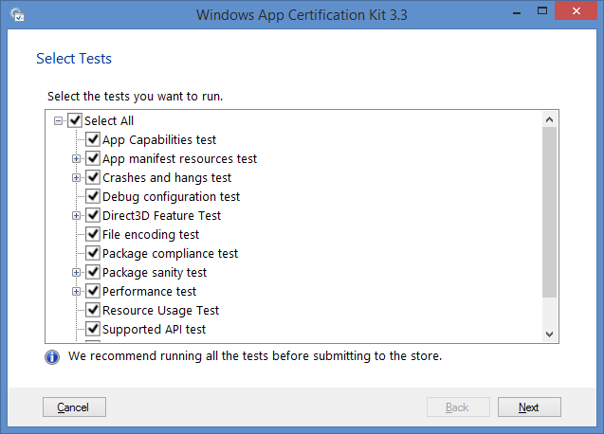
Create and Certify Package: Step 7
Verify that
all tests are
selected

Slide 37
Create and Certify Package: Step 8
Verify that
all tests are
selected
… then, click “Next”

Slide 38
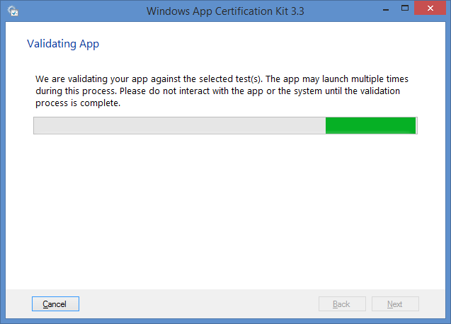
Create and Certify Package: Step 9
Allow the
tool to
run validation

Slide 39
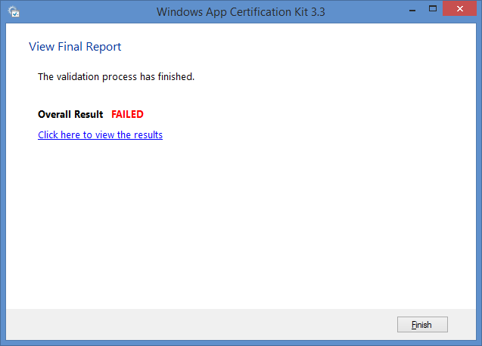
Create and Certify Package: Step 10
If the
Overall Result
says FAILED,
view the results
to fix issues
Click “Finish”
NOTE: Repeat these steps after fixing issues, to submit your app.

Slide 40
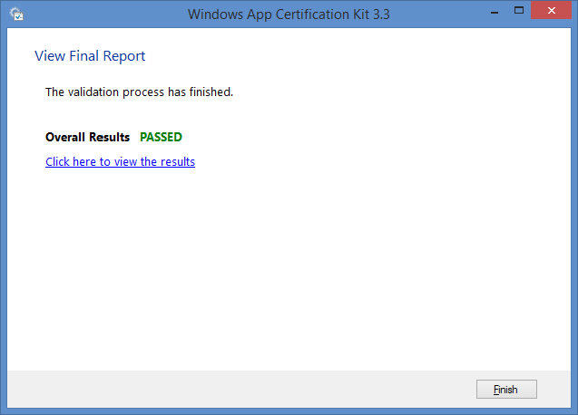
Create and Certify Package: Step 11
If the
Overall Result
says PASSED,
you can proceed
Click “Finish”

Slide 41
Publish Package
Notes:
Publish Package

Slide 42
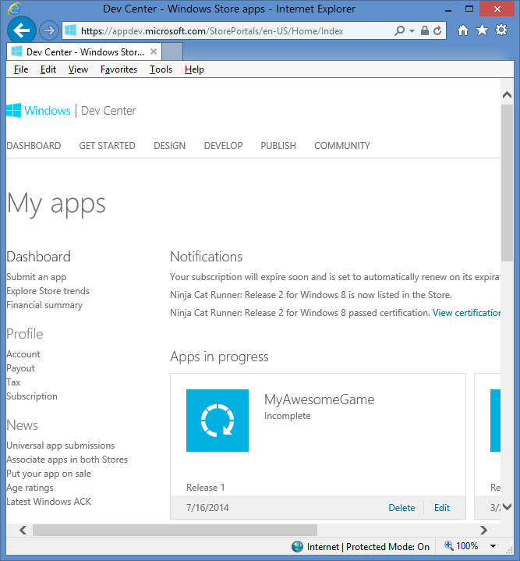
Publish Package: Step 1
In the Dashboard of the
Windows Dev Center…
… click “Edit” for your App

Slide 43
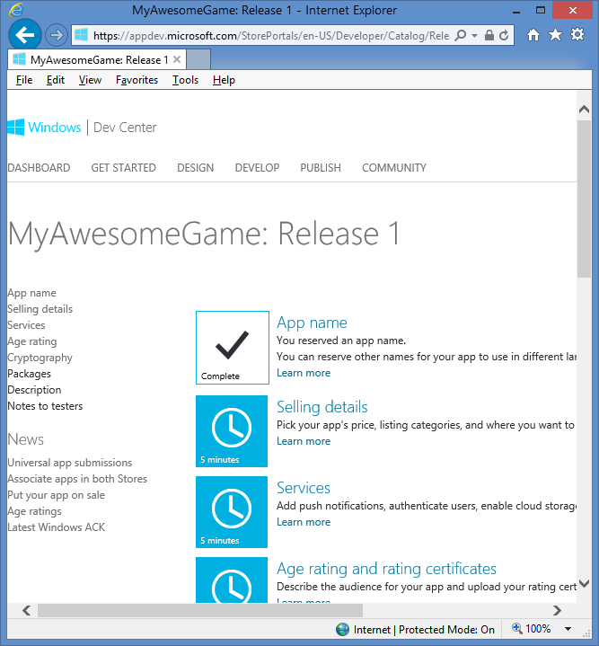
Publish Package: Step 2
Follow the instructions
to fill out the remaining
information about your app

Slide 44
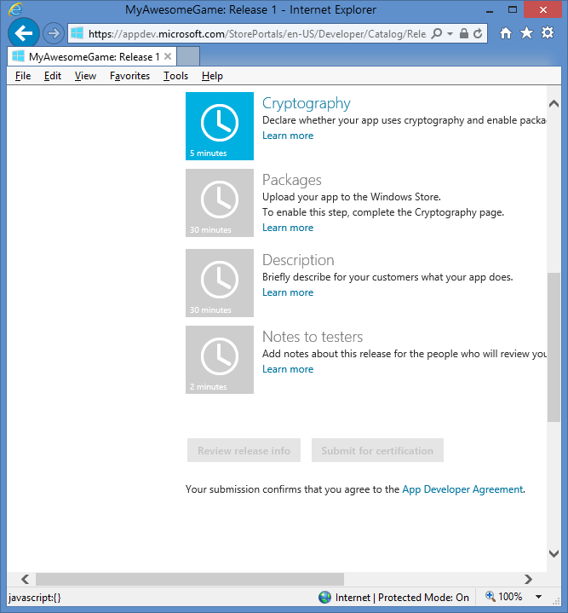
Publish Package: Step 3
Once all the
information
has been
entered, and
the package
has been
uploaded...
… the “Submit for certification” button
will be enabled for you to click on

Slide 45
Windows Phone 8
Notes:
Windows Phone 8

Slide 46
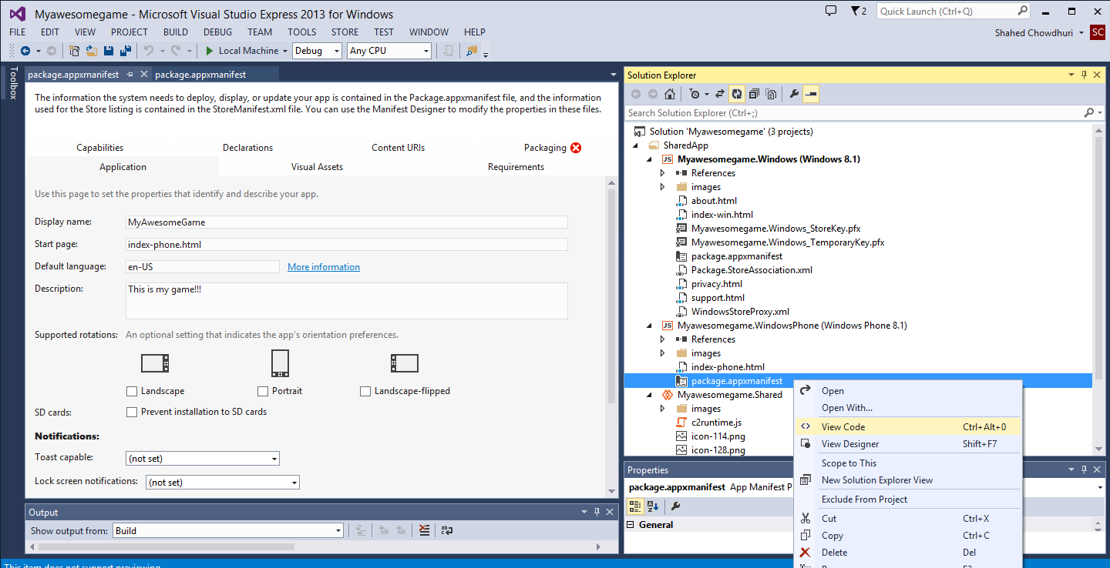
Windows Phone 8: Step 1
Right-click
your WP8 package
file, view code

Slide 47
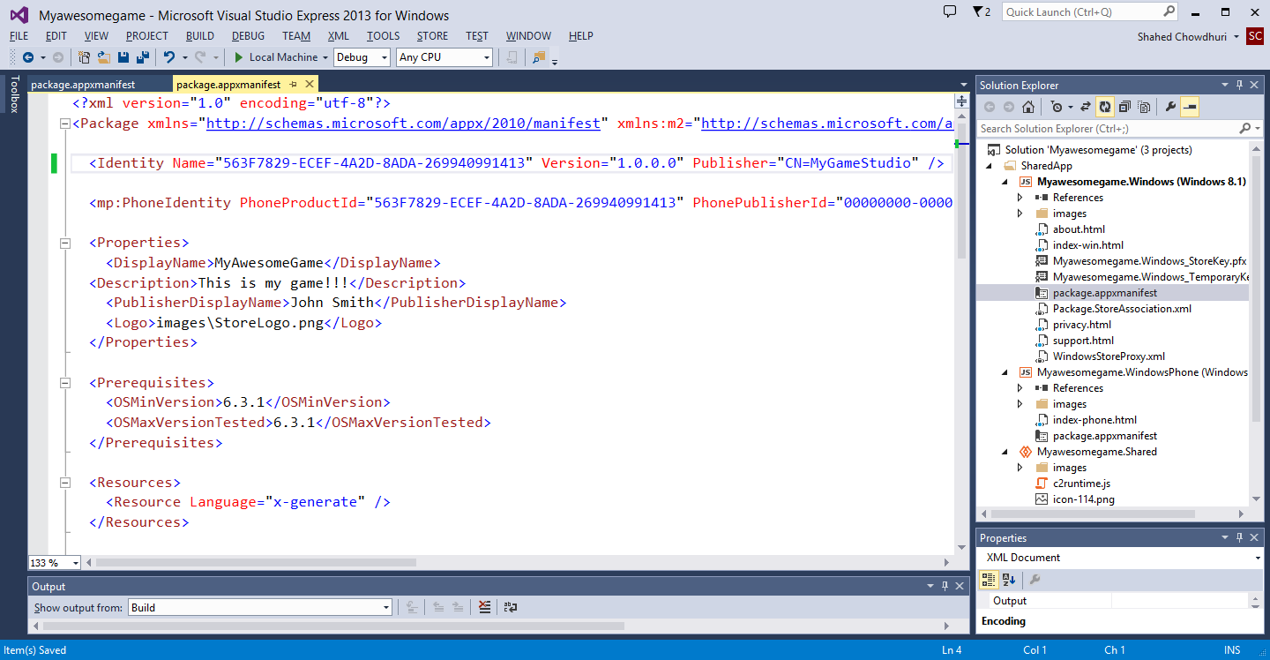
Windows Phone 8: Step 2
Manually add a
Publisher value to
<Identity> section,
Prefixed by “CN=“
e.g. “CN=MyGameStudio”
NOTE: this is a workaround for a bug that may cause Publisher to be missing.

Slide 48
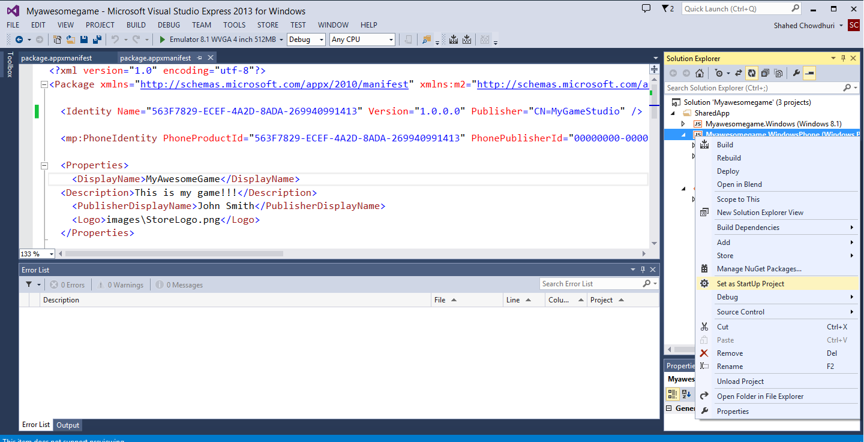
Windows Phone 8: Step 3
Right-click the Windows Phone project,
… then click “Set as StartUp Project”

Slide 49
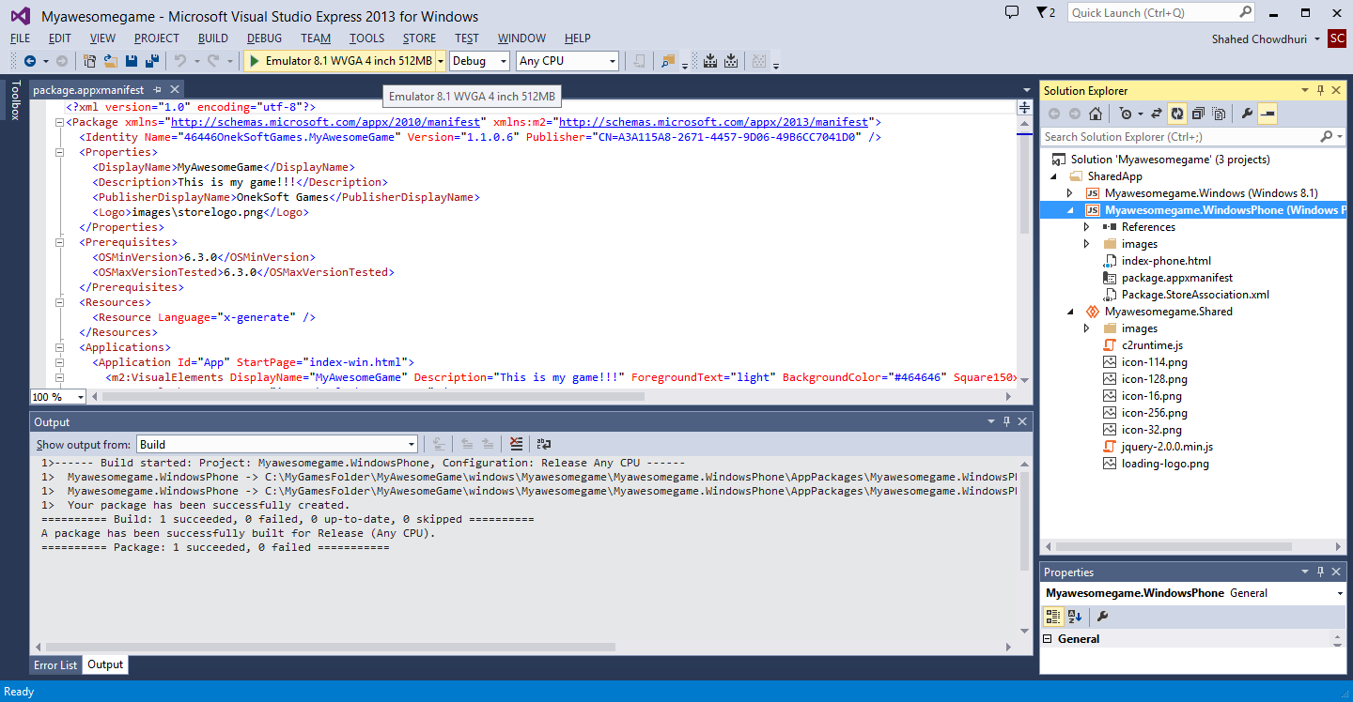
Windows Phone 8: Step 4
Click the “Play” button
to run your app
in the WP8 Emulator

Slide 50
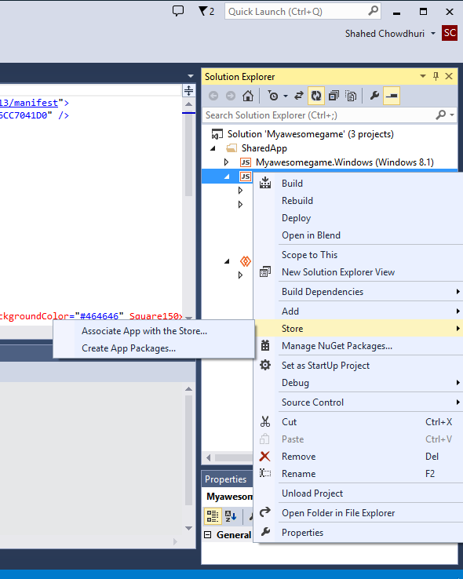
Windows Phone 8: Step 5…
Perform additional steps, similar to Windows 8 publishing:
Associate App with the Store
Create App Packages…
Associate App with the Store
Create App Packages…

Slide 51
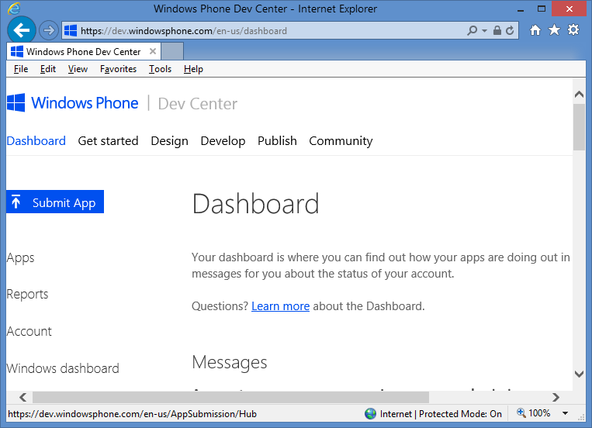
Windows Phone 8: Additional Steps
Go to the Dashboard on http://dev.windowsphone.com to submit your app

Slide 52
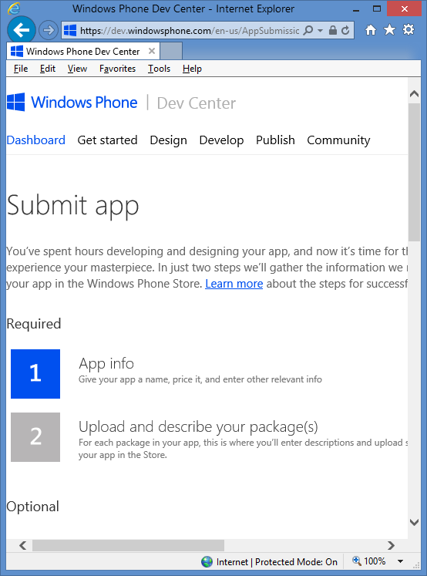
Windows Phone 8: Final Steps
Follow the instructions
to fill out the remaining
information about your app

Slide 53
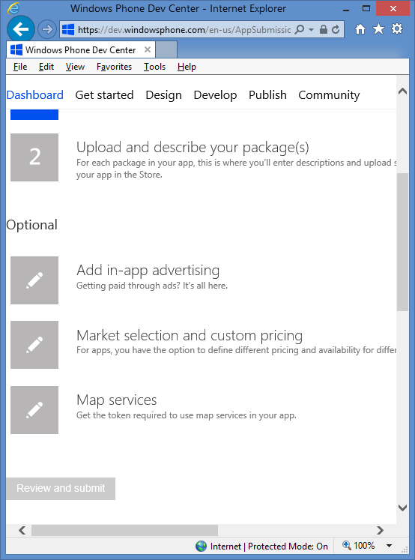
Windows Phone 8: Review & Submit!
Once all the
information
has been
entered, and
the package
has been
uploaded…
… the “Review and Submit” button
will be enabled for you to click on

Slide 54
Alternative Tools
Notes:
Alternative Tools

Slide 55
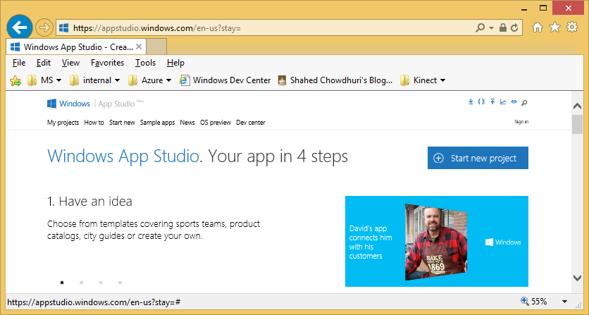
App Studio
App Studio
Link: https://appstudio.windows.com/
Notes:
App Studio
(website)
App Studio
Link: https://appstudio.windows.com/

Slide 56
App Studio in 4 Steps (from App Studio website)
App Studio Tutorial
Link: http://social.technet.microsoft.com/wiki/contents/articles/24933.create-a-universal-application-with-windows-app-studio.aspx
Notes:
App Studio in 4 Steps (from App Studio website)
Have an idea
Add content
Choose style
Use It!
App Studio Tutorial
Link: http://social.technet.microsoft.com/wiki/contents/articles/24933.create-a-universal-application-with-windows-app-studio.aspx

Slide 57
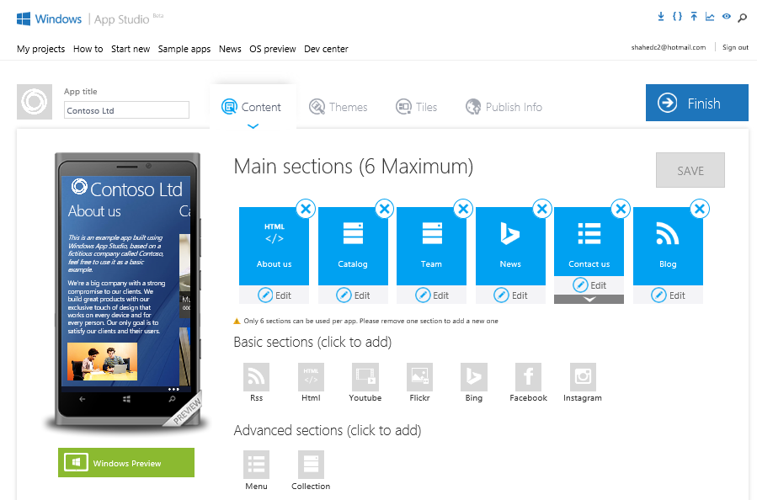
Build Your App in Your Browser
Click Finish
When Done
Notes:
Build Your App in Your Browser
(screenshot of App Studio UI)
Click Finish When Done

Slide 58
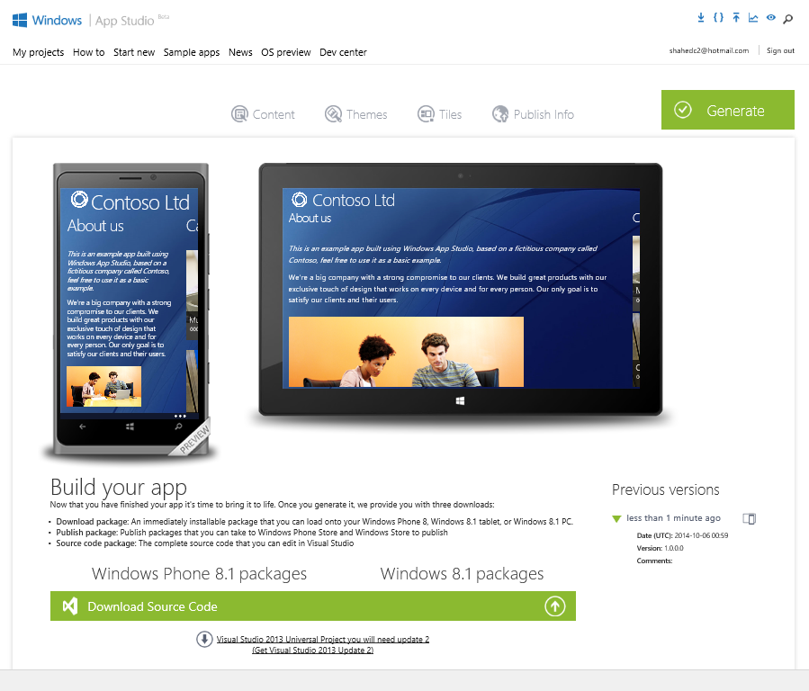
Generate & Download
Download Source Code
Notes:
Generate & Download
(screenshot of App Studio UI)
Download Source Code

Slide 59
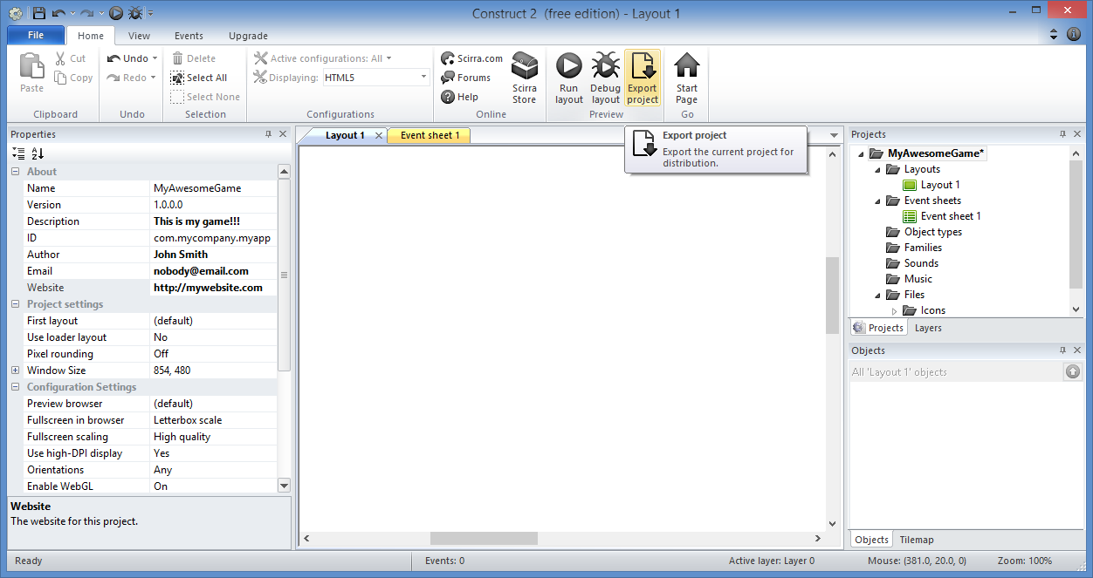
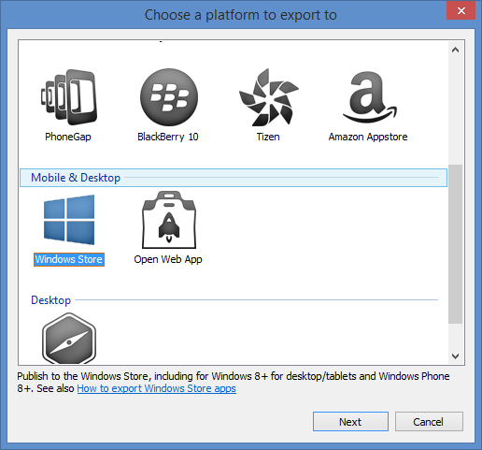
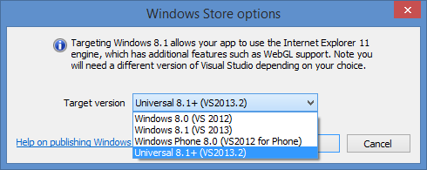
Construct 2
More information:
Index Page: http://WakeUpAndCode.com/construct2
Exporting & Publishing: http://wakeupandcode.com/construct-2-exporting-and-publishing-to-web-windows-8-and-windows-phone-8/
Notes:
Construct 2
(screenshot of Construct 2 UI for Exporting to Windows Universal format)
More information:
Index Page: http://WakeUpAndCode.com/construct2
Exporting & Publishing: http://wakeupandcode.com/construct-2-exporting-and-publishing-to-web-windows-8-and-windows-phone-8/

Slide 60
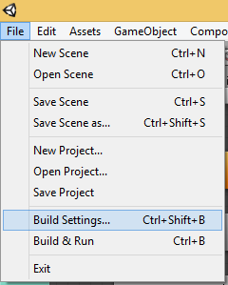
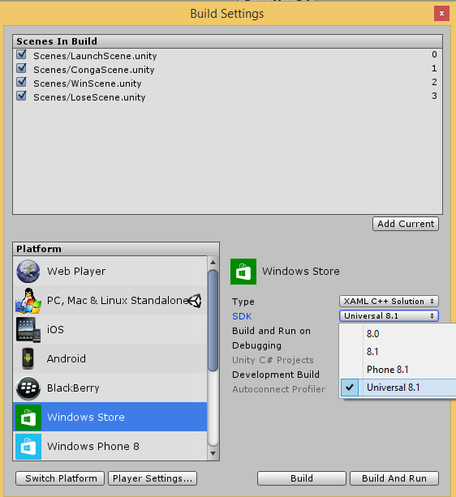
Unity
More Information
Index Page: http://WakeUpAndCode.com/unity
Universal Apps in Unity: http://blogs.unity3d.com/2014/08/07/introducing-universal-windows-applications-in-unity/
Notes:
Unity
(screenshot of Unity for setting Build Settings to Windows Universal format)
More Information
Index Page: http://WakeUpAndCode.com/unity
Universal Apps in Unity: http://blogs.unity3d.com/2014/08/07/introducing-universal-windows-applications-in-unity/

Slide 61
What About Xbox One?
Notes:
What About Xbox One?

Slide 62
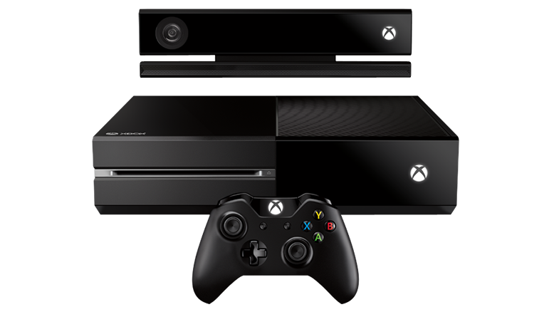
Xbox One!
Apply:
http://xbox.com/id
Discuss:
http://facebook.com/groups/XboxOneIndieDevs
FAQ:
http://tinyurl.com/idxboxfaq

Slide 63
Questions?
Notes:
Questions?

Slide 64
Contact
Email: shchowd@microsoft.com  Twitter: @shahedC
Notes:
Contact
Microsoft email: shchowd@microsoft.com
Personal Twitter: @shahedC
Dev Blog: WakeUpAndCode.com

