Slide 1
Capturing Your Audience with Kinect
Featuring: Speech Bubbles for Kinect v2
By Shahed Chowdhuri
Sr. Technical Evangelist
WakeUpAndCode.com
@shahedC
Notes:
Title Page: Capturing Your Audience with Kinect Featuring: Speech Bubbles for Kinect v2
By Shahed Chowdhuri
Sr. Technical Evangelist
Blog: WakeUpAndCode.com
Twitter: @shahedC

Slide 2
Agenda
Introduction
> Theory
> Code
> Demo
Next Steps
Notes:
Agenda
Introduction
> Theory
> Code
> Demo
Next Steps

Slide 3
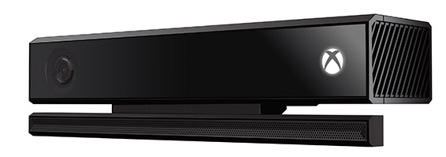
Tools & Technologies
Notes:
Tools & Technologies
Visual Studio 2013
Windows 8
Microsoft .NET and Visual C#
Kinect v2
JavaScript

Slide 4
Introduction
Notes:
Introduction

Slide 5
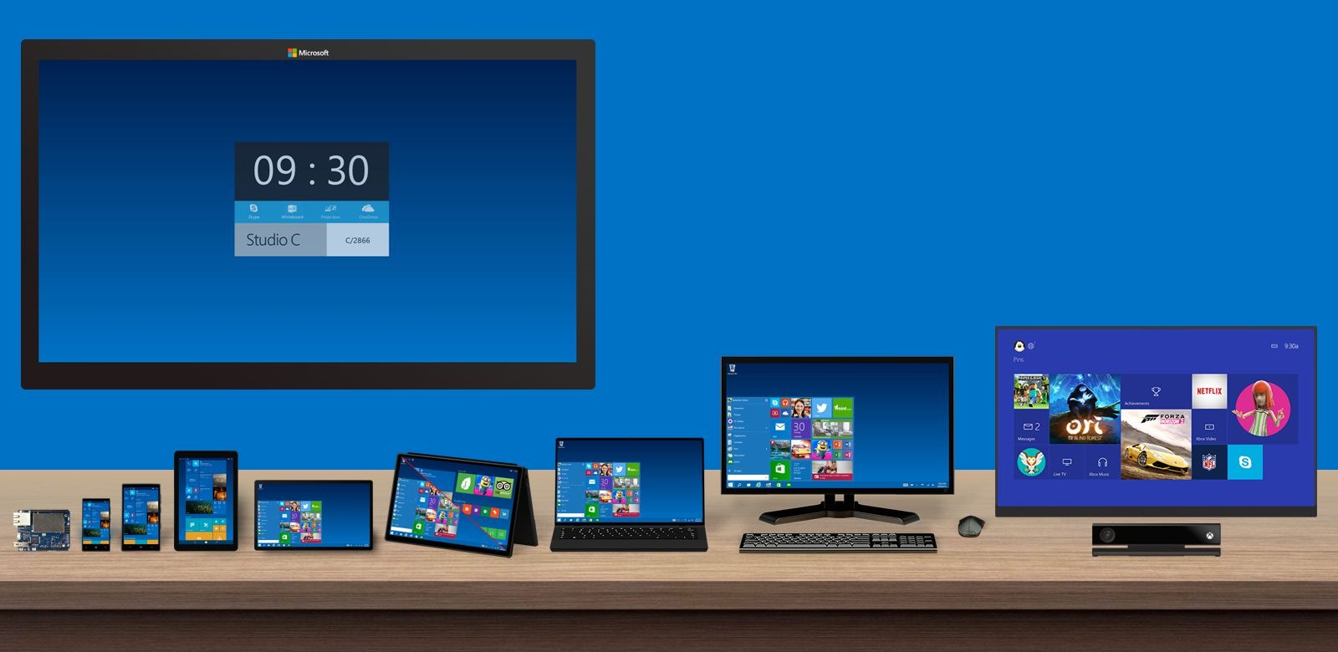
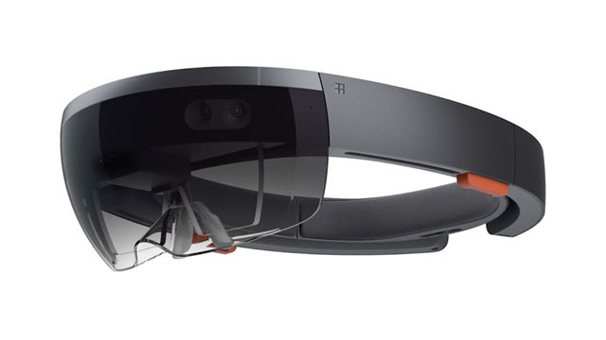
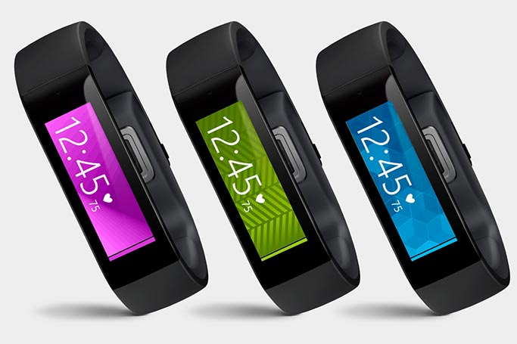
Capturing Your Audience…

Slide 6
Capturing Your Audience… with Kinect!
Source: http://WakeUpAndCode.com/hackumbc

Slide 7
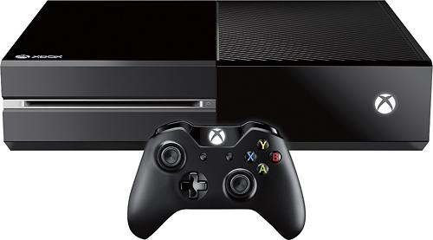
What is Kinect?
Depth Sensor
Power Light
RGB Camera
IR Emitters
Microphone Array

Slide 8
What’s New in v2?

Slide 9
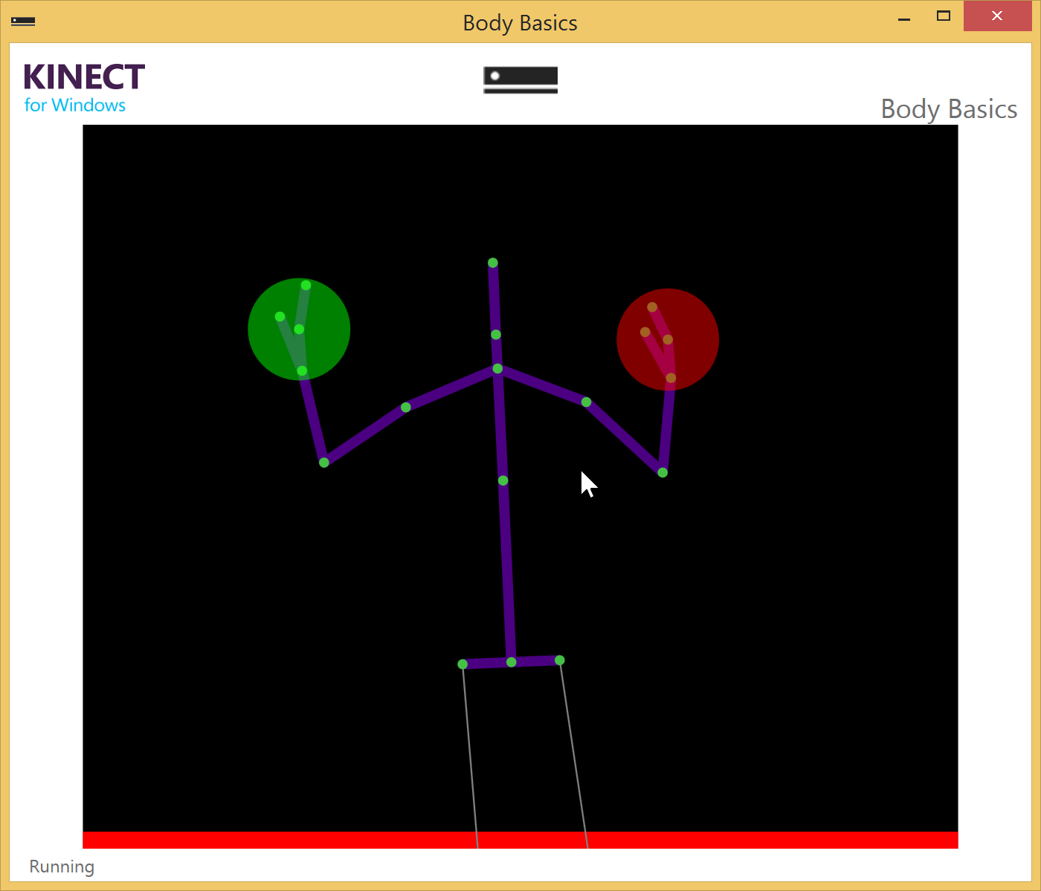
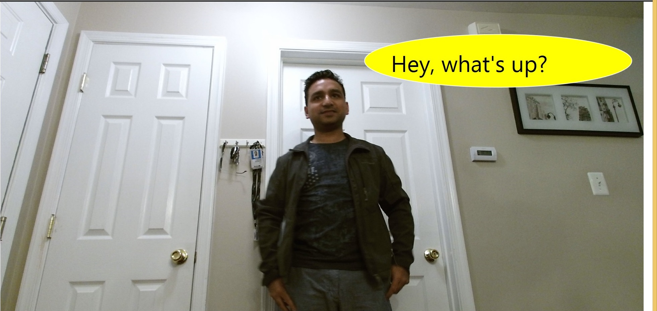
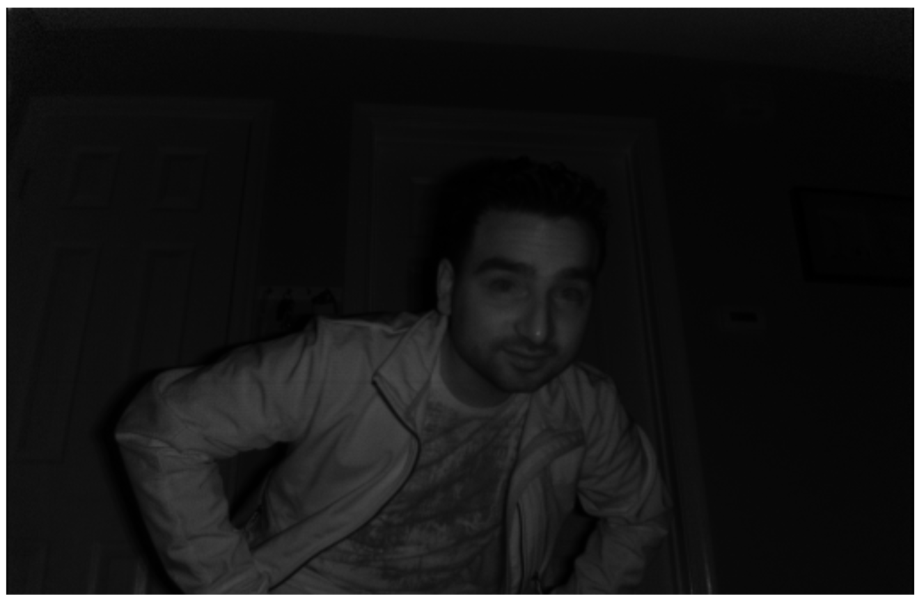
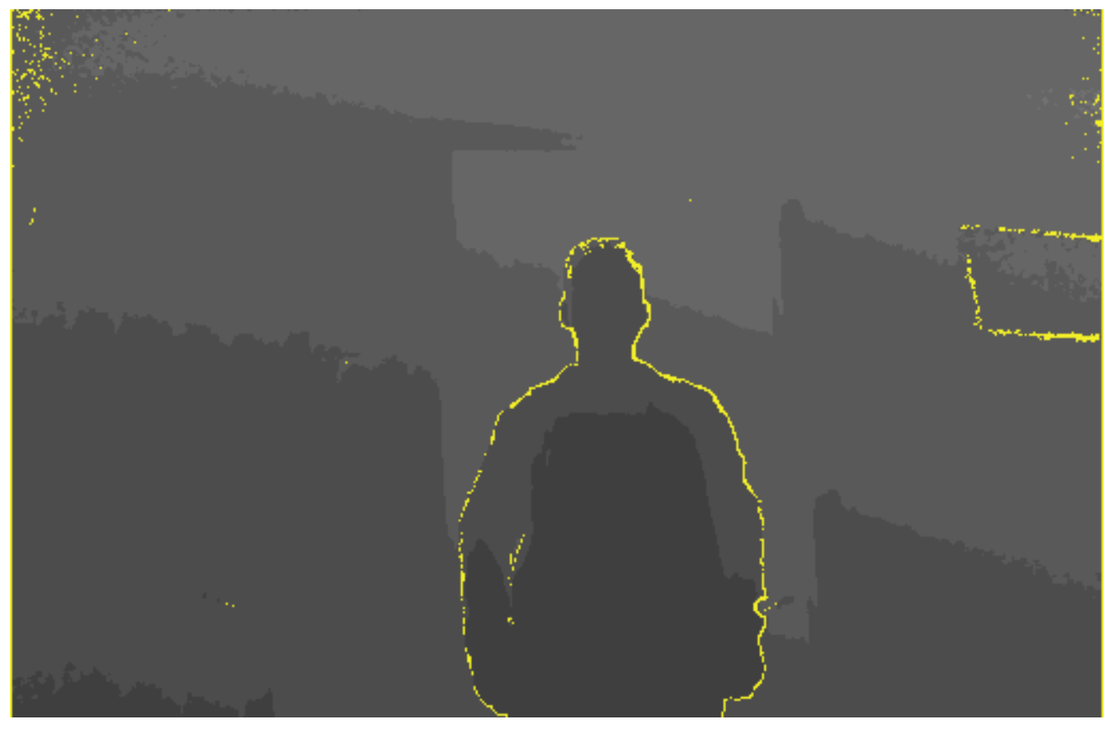
What’s New in v2?
1080p color camera
Improved depth
Better infrared
More joints

Slide 10
Color Camera: What’s New
1080p @ 30 fps
1920 x 1080
3x depth fidelity
Wider view

Slide 11
Depth Sensor: What’s New
Lighting-independent
0.5 to 8 meters
No more short range mode

Slide 12
InfraRed: What’s New?
Better infrared
Ambient light removed
512x424 @ 30fps

Slide 13
Body Tracking
25 skeletal joints
Up to 6 people
Hand states on 2 bodies
open/closed, lasso
Joint rotation

Slide 14
Reading Stream/Frame Data

Slide 15
How Do You Get the Data?
Sensor
→
Source
→
Frame
→
Data

Slide 16
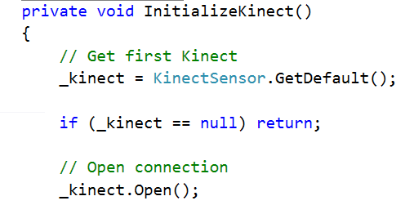
Detect the Sensor
Detect the sensor

Slide 17
Capture the Source
Open a “Reader” to capture the Source

Slide 18
Acquire a Frame
Acquire a Color Frame

Slide 19
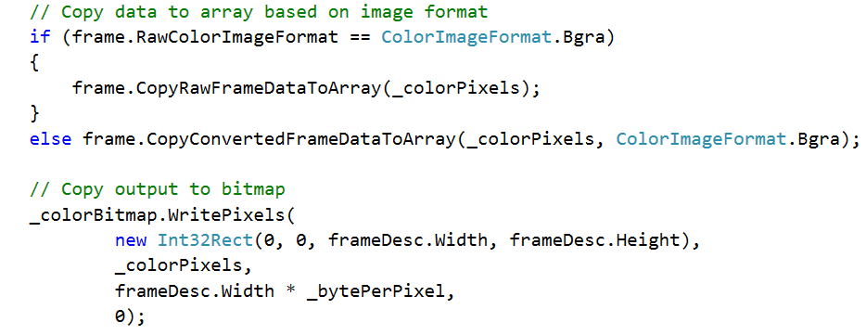
Process the Data
Draw Pixel Data

Slide 20
Mapping Coordinates

Slide 21
Acquiring Body Frames to Draw Joints
Acquire Body Frame
Draw Joints

Slide 22
Using the Coordinate Mapper
Get 2D point
Draw Comic Bubble in 2D coordinates

Slide 23
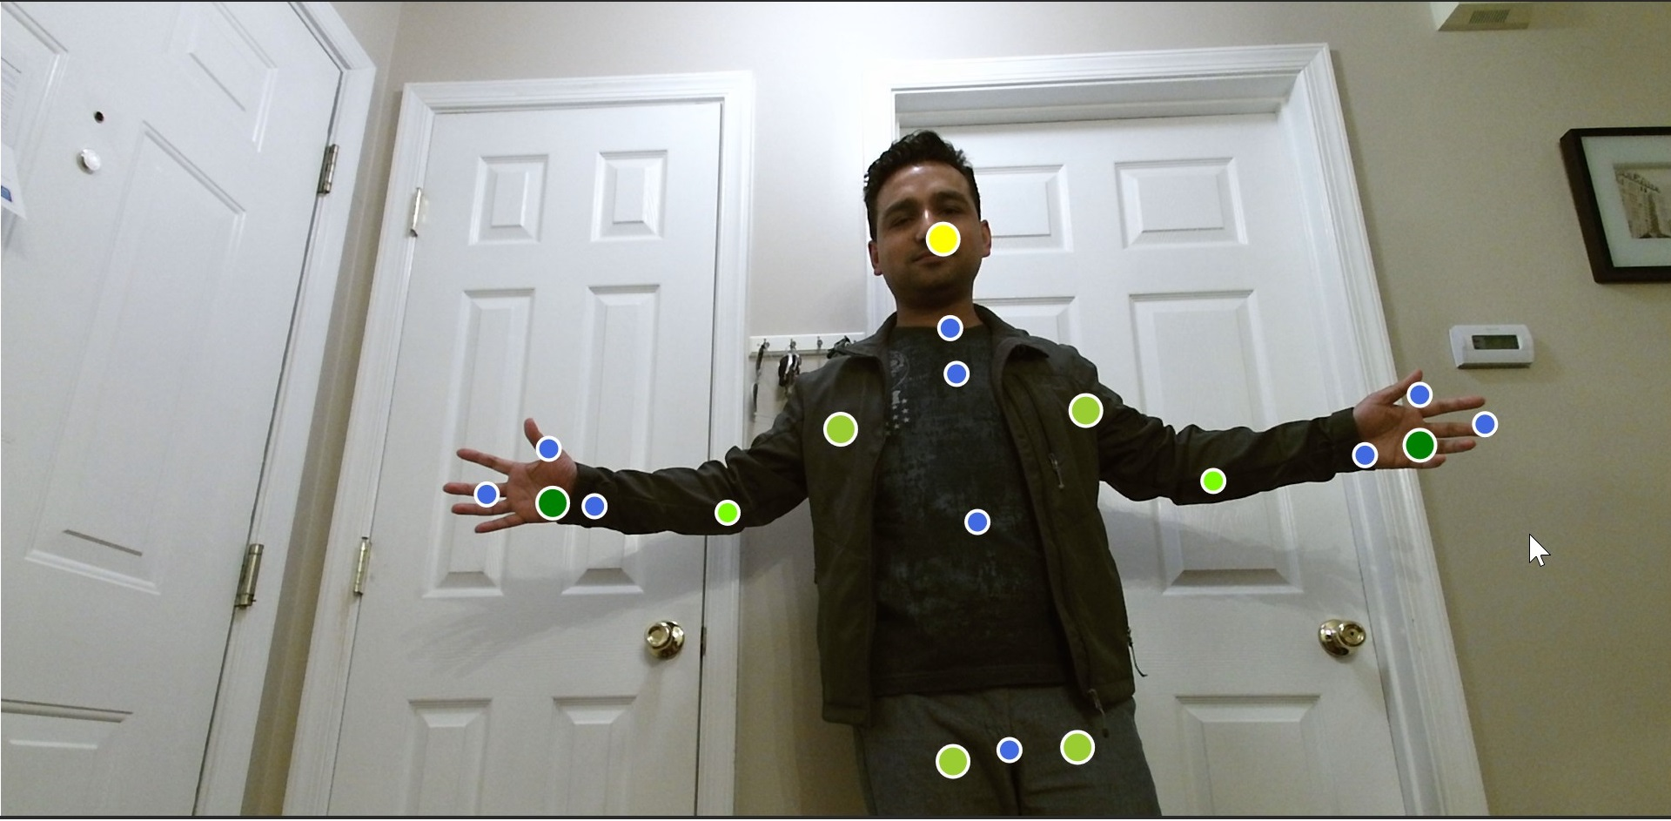
Start Drawing!
offset from joint
on the joints

Slide 24
Facial Expressions

Slide 25
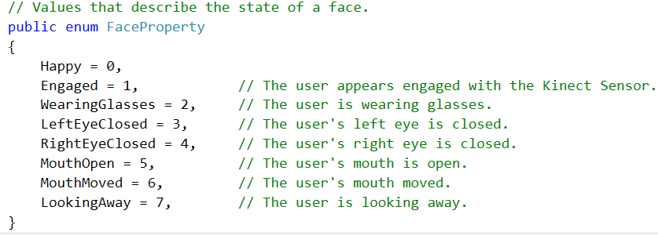
Possible Facial Expressions

Slide 26
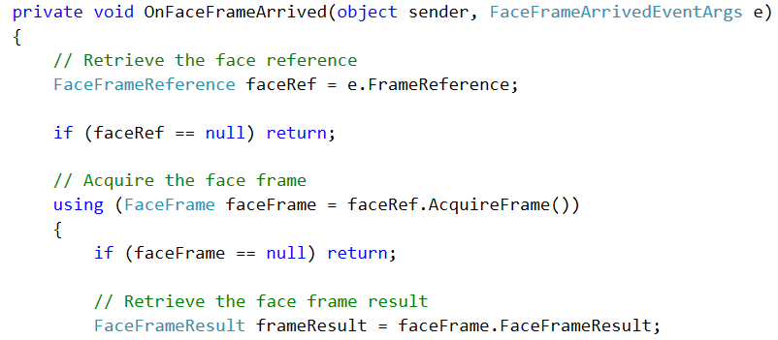
Capturing Frame Results
acquire frame

Slide 27
Determine Results
Reference: Tom Kerkhove’s “First Look at Expressions”:
https://github.com/KinectingForWindows/G2KExpressions

Slide 28
Use Case: Speech Bubbles!

Slide 29
Speech Bubbles for Kinect v2
Demo

Slide 30
What’s Next?

Slide 31
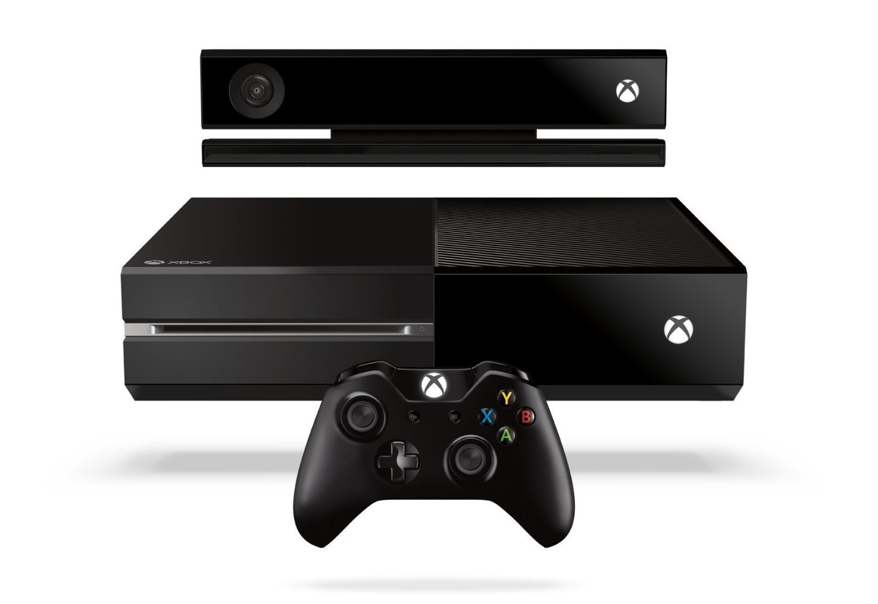
What’s Next?
Windows Store App, Unity Pro plugin, Xbox One

Slide 32
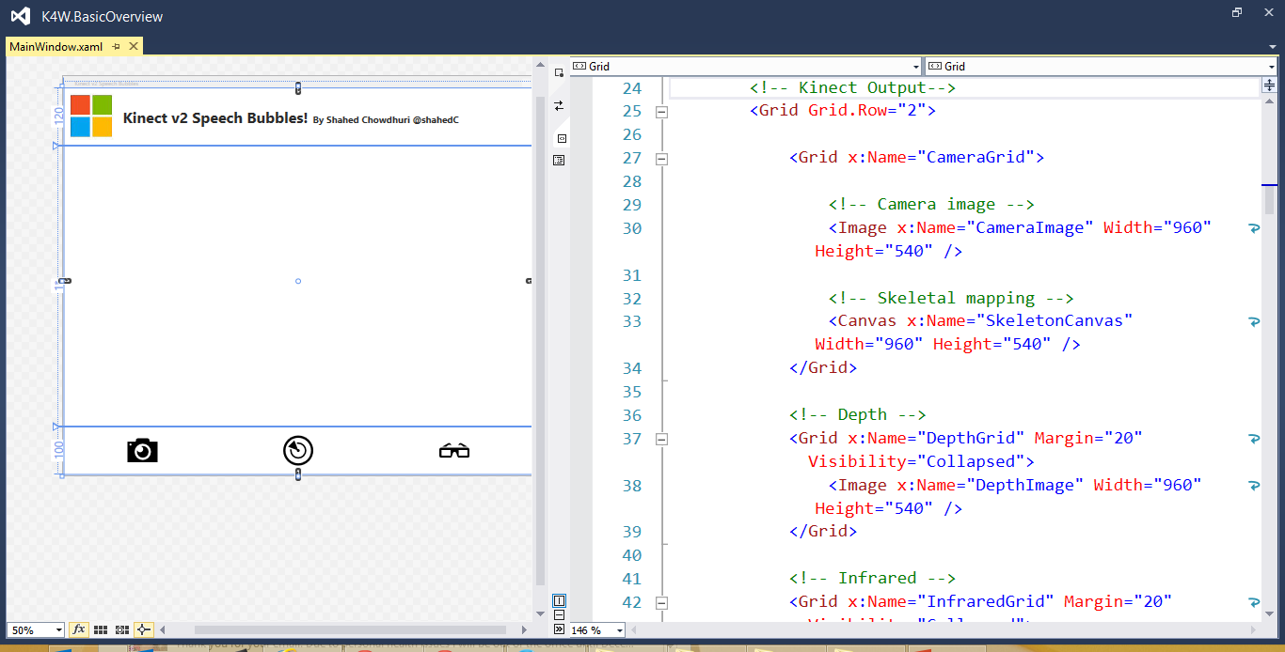
Technology Choices
Windows
C# & XAML/WPF
C++ & DirectX
HTML5/JS (store only)
Unity
C#
JavaScript

Slide 33
Resources/Links:
Get Kinect v2 for Windows (requires USB3 port and Windows 8.1):
http://www.microsoft.com/en-us/kinectforwindows/purchase/
Download Visual Studio 2013 Community Edition:
http://aka.ms/vs2013ce
Download free Kinect for Windows SDK:
http://www.microsoft.com/en-us/kinectforwindows/develop/
Notes:
Resources/Links:
Get Kinect v2 for Windows (requires USB3 port and Windows 8.1):
http://www.microsoft.com/en-us/kinectforwindows/purchase/
Download Visual Studio 2013 Community Edition:
http://aka.ms/vs2013ce
Download free Kinect for Windows SDK:
http://www.microsoft.com/en-us/kinectforwindows/develop/

Slide 34
Resources/Links: (continued)
Get sample code from Kinect MVP Tom Kerkhove:
https://github.com/KinectingForWindows/G2KBasicOverview
https://github.com/KinectingForWindows/G2KExpressions
Get the code for Speech Bubbles:
https://github.com/shahedc/SpeechBubblesForKinect
Watch MVA Video Tutorial, by Ben Lower and Rob Relyea:
http://aka.ms/kinectv2mva
Notes:
Resources/Links: (continued)
Get sample code from Kinect MVP Tom Kerkhove:
https://github.com/KinectingForWindows/G2KBasicOverview
Get the code for Speech Bubbles:
https://github.com/shahedc/SpeechBubblesForKinect
Watch MVA Video Tutorial, by Ben Lower and Rob Relyea:
http://aka.ms/kinectv2mva

Slide 35
Contact
Email: shchowd@microsoft.com  Twitter: @shahedC
Notes:
Contact
Microsoft email: shchowd@microsoft.com
Personal Twitter: @shahedC
Dev Blog: WakeUpAndCode.com

