Slide 1
Mobile UX Design in the Real World
UX Design Best Practices for Apps/Games & Mobile Websites with Responsive UI
By Shahed Chowdhuri
Technical Evangelist
WakeUpAndCode.com
@shahedC
Notes:
Title Page: Mobile UX Design in the Real World UX Design Best Practices for Apps/Games & Mobile Websites with Responsive UI
By Shahed Chowdhuri
Technical Evangelist
Blog: WakeUpAndCode.com
Twitter: @shahedC

Slide 2
Agenda
Intro
> Mobile UI
> Mobile UX
> Mobile Users
What Next?
Notes:
Agenda
Intro
> Mobile UI
> Mobile UX
> Mobile Users
What Next?

Slide 3
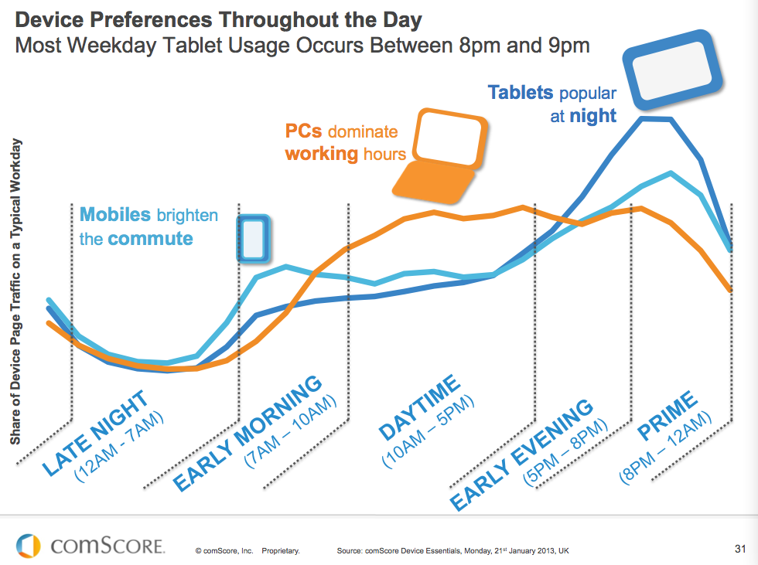
Device Usage
Source: http://www.comscore.com/Insights/Blog/2013_Digital_Future_in_Focus_Series
Notes:
Device Usage Chart
Source: http://www.comscore.com/Insights/Blog/2013_Digital_Future_in_Focus_Series

Slide 4
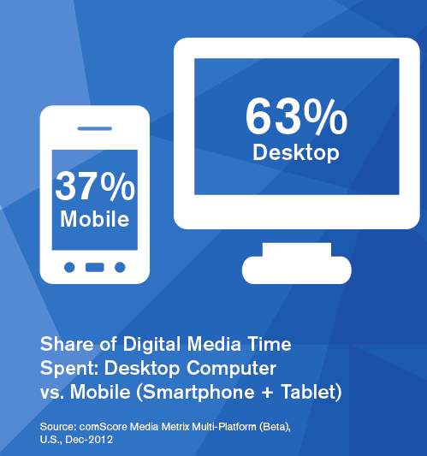
Mobile vs Desktop
Source: http://www.comscore.com/Insights/Blog/2013_Digital_Future_in_Focus_Series
Notes:
Mobile vs Desktop stats
Source: http://www.comscore.com/Insights/Blog/2013_Digital_Future_in_Focus_Series

Slide 5
Spike in Mobile Users
Not just apps, mobile websites too!
Image courtesy of KROMKRATHOG / FreeDigitalPhotos.net
Notes:
Spike in Mobile Users
Not just apps, mobile websites too!
Image courtesy of KROMKRATHOG / FreeDigitalPhotos.net

Slide 6
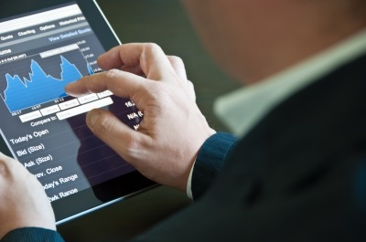
1. Mobile UI
Image courtesy of franky242 / FreeDigitalPhotos.net
Notes:
Mobile UI
Image courtesy of franky242 / FreeDigitalPhotos.net

Slide 7
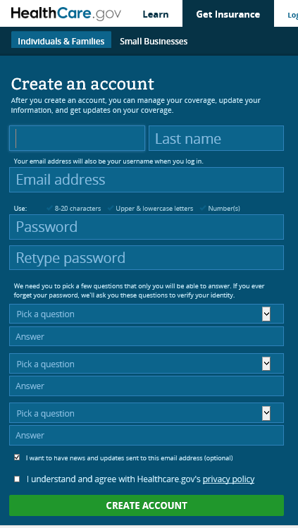
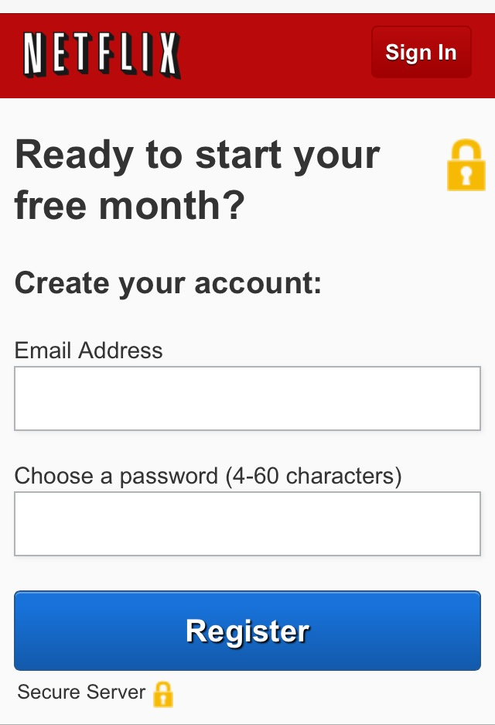
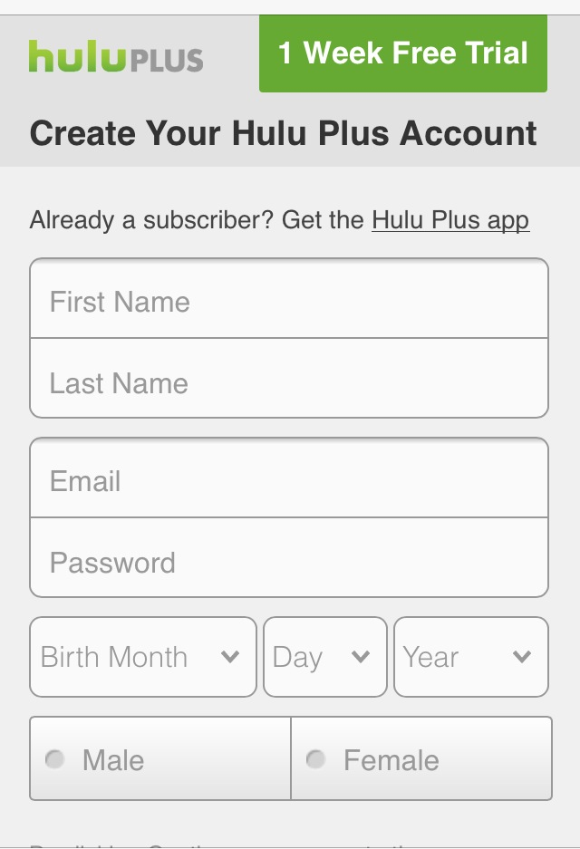
Build a Clean UI
Choose important fields over a cluttered UI
Minimal fields first, then more as necessary
Sources: Netflix.com, Hulu.com, Healthcare.gov
Notes:
Build a Clean UI
Choose important fields over a cluttered UI
Minimal fields first, then more as necessary
Sources: Netflix.com, Hulu.com, Healthcare.gov

Slide 8
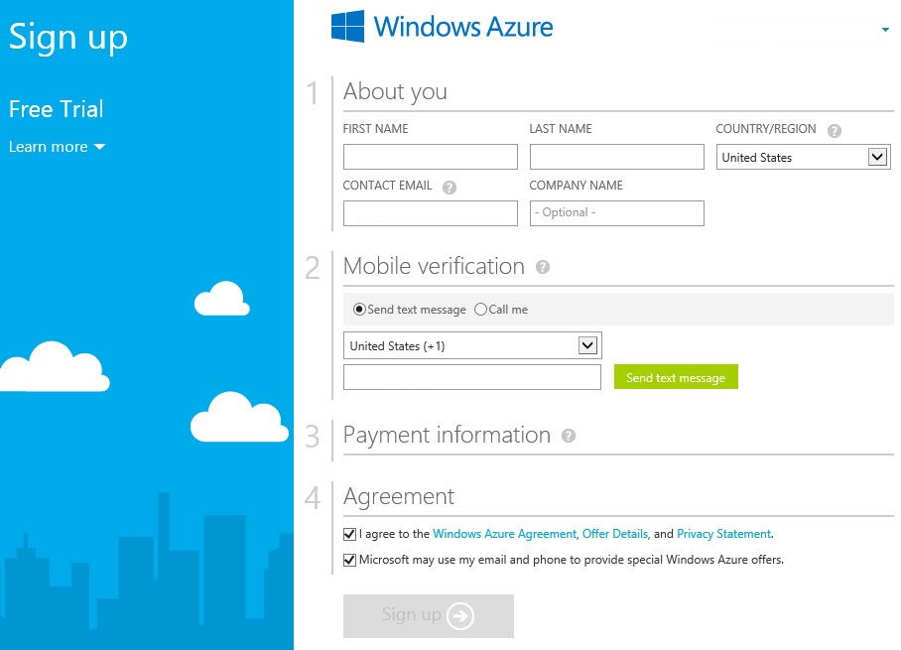
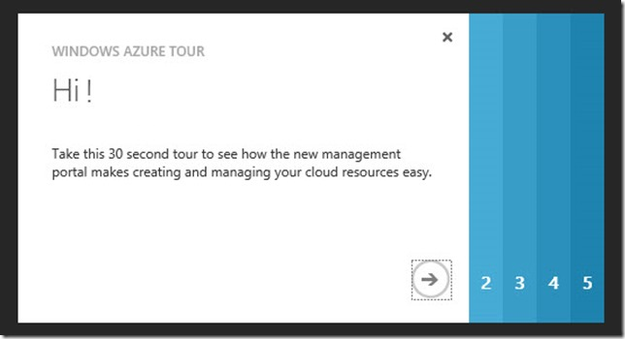
Split Up Into Sections
Split up in the same page, or in a “wizard” UI, with progress indicator
Source: WindowsAzure.com
Notes:
Split Up Into Sections
Split up in the same page, or in a “wizard” UI, with progress indicator
Source: WindowsAzure.com

Slide 9
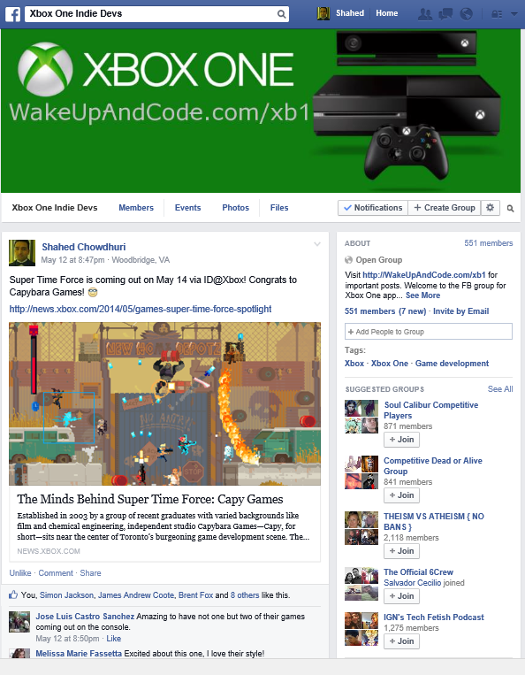
Avoid Page Refreshes
Use AJAX for partial refreshes:
Avoid a full page refresh
Minimize session timeouts
First offered on desktop browsers
Works well on tablets/mobile
e.g. click/touch Like on Facebook
Source: facebook.com/groups/XboxOneIndieDevs
Notes:
Avoid Page Refreshes
Use AJAX for partial refreshes:
Avoid a full page refresh
Minimize session timeouts
First offered on desktop browsers
Works well on tablets/mobile
e.g. click/touch Like on Facebook
Source: facebook.com/groups/XboxOneIndieDevs

Slide 10
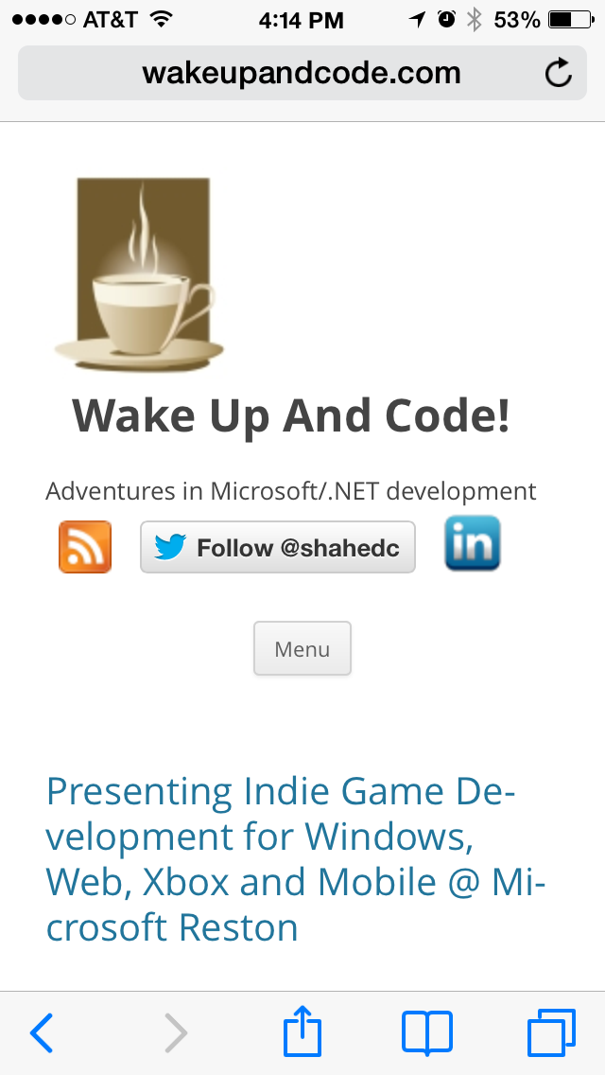
Build a Responsive UI
Test on various devices and screen sizes
Tip: Try Telerik’s App Builder
http://www.telerik.com/appbuilder
Responsive UI (to avoid duplicate efforts)
CSS media queries
Info: http://css-tricks.com/css-media-queries/
Source: WakeUpAndCode.com on iOS7 and WP8
Notes:
Build a Responsive UI
Test on various devices and screen sizes
Tip: Try Telerik’s App Builder
http://www.telerik.com/appbuilder
Responsive UI (to avoid duplicate efforts)
CSS media queries
Info: http://css-tricks.com/css-media-queries/
Source: WakeUpAndCode.com on iOS7 and WP8

Slide 11
2. Mobile UX
Image courtesy of twobee / FreeDigitalPhotos.net
Notes:
2. Mobile UX
Image courtesy of twobee / FreeDigitalPhotos.net

Slide 12
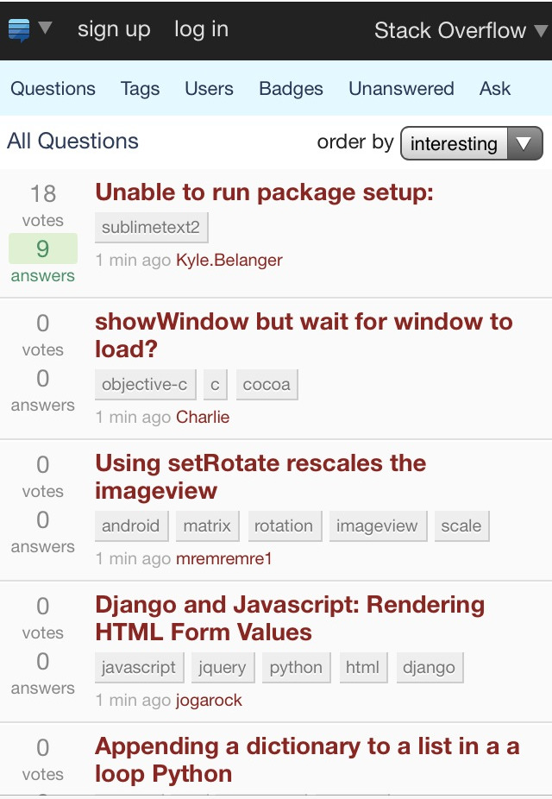
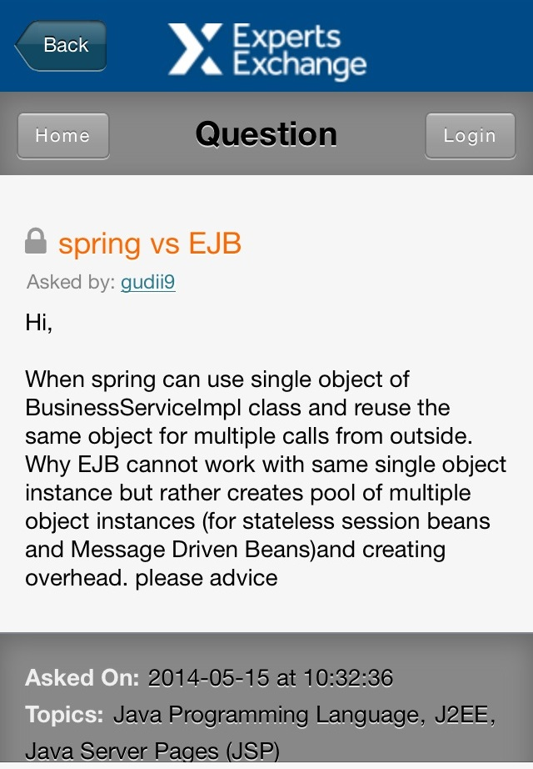
Think About Guest vs Login
Should you require a login?
Sources: StackOverflow.com, Experts-Exchange.com
Notes:
Think About Guest vs Login
Should you require a login?
Sources: StackOverflow.com, Experts-Exchange.com

Slide 13
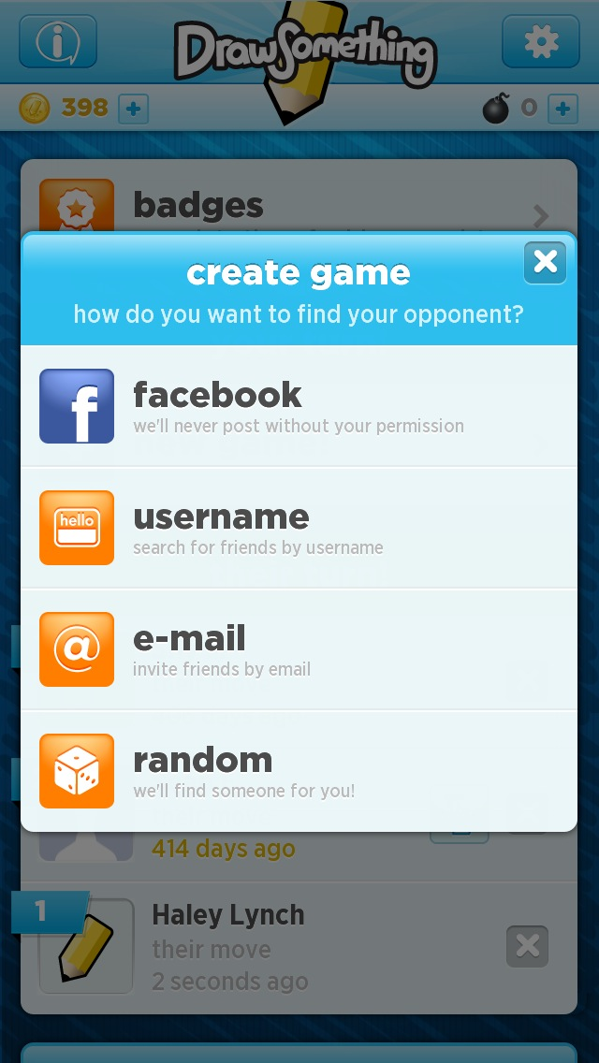
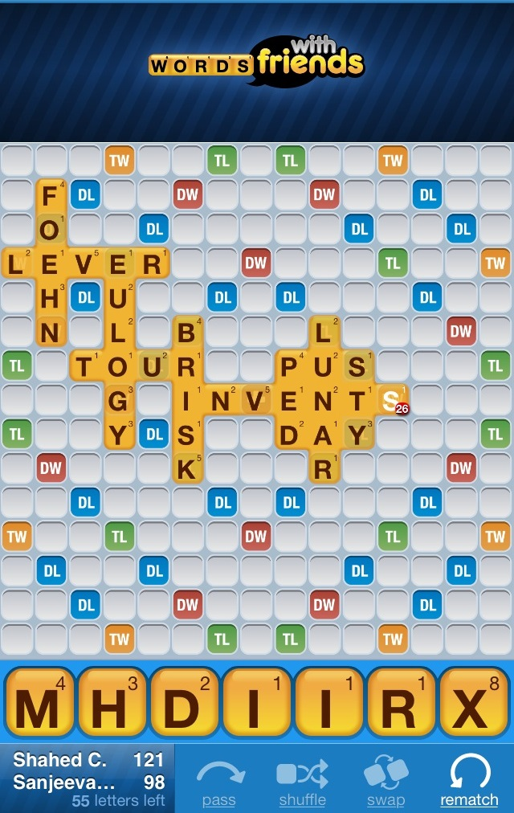
Use Logins to Improve the Experience
Social connections, leaderboards, collaboration, etc
Sources: DrawSomething by OMGPop/Zynga, Words with Friends by Zynga
Notes:
Use Logins to Improve the Experience
Social connections, leaderboards, collaboration, etc
Sources: DrawSomething by OMGPop/Zynga, Words with Friends by Zynga

Slide 14
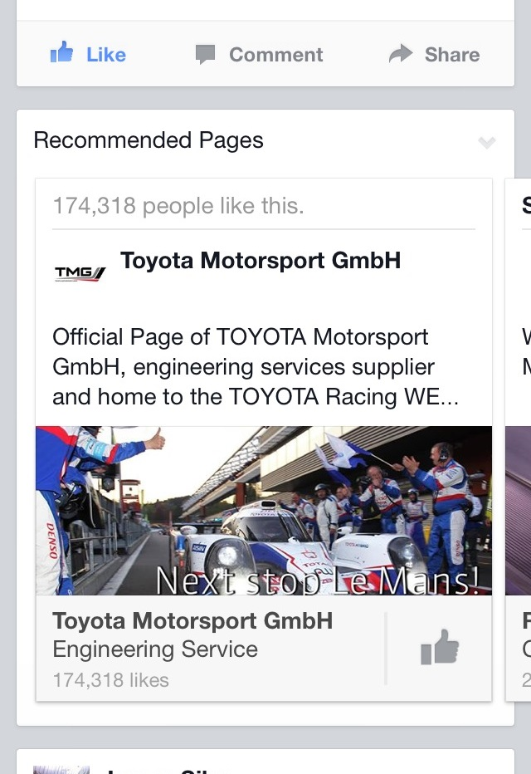
Design for Tablets/Smartphones
Cater to mobile devices
Touch/swipe
Hide some ads, etc
e.g. side-swipe on Facebook
Lightweight tech:
e.g. ASP.NET MVC instead of Web Forms with ViewState
Source: Facebook news feed
Notes:
Design for Tablets/Smartphones
Cater to mobile devices
Touch/swipe
Hide some ads, etc
e.g. side-swipe on Facebook
Lightweight tech:
e.g. ASP.NET MVC instead of Web Forms with ViewState
Source: Facebook news feed

Slide 15
3. Mobile Users
Image courtesy of Ambro/ FreeDigitalPhotos.net
Notes:
3. Mobile Users
Image courtesy of Ambro/ FreeDigitalPhotos.net

Slide 16
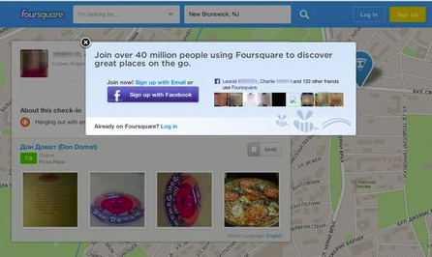
Don’t Be Intrusive
Don’t do popups, popunders, floating popups that are hard to click, etc
Source: http://mattkorostoff.com/article/popup-ads-are-back
Notes:
Don’t Be Intrusive
Don’t do popups, popunders, floating popups that are hard to click, etc
Source: http://mattkorostoff.com/article/popup-ads-are-back

Slide 17
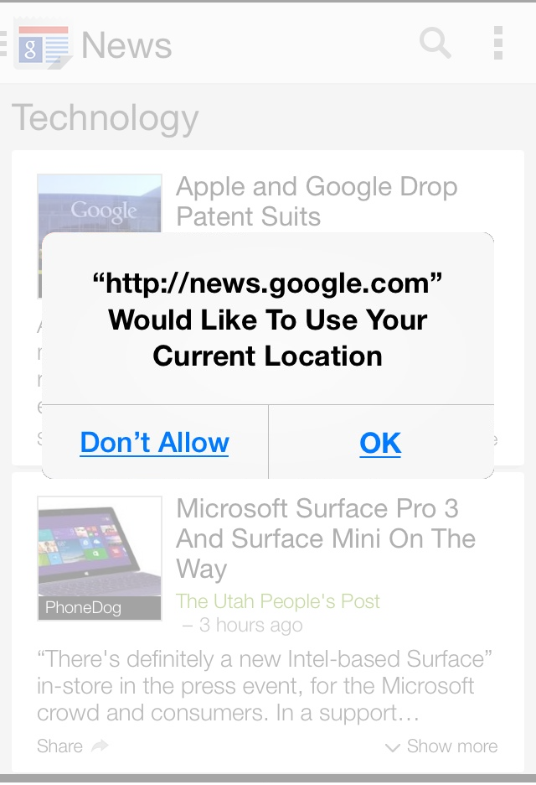
Personalize, but…
Personalize by location if possible (but ask permission)
Privacy and Security are both very important
Source: composite screenshot from news.google.com
Notes:
Personalize, but…
Personalize by location if possible (but ask permission)
Privacy and Security are both very important
Source: composite screenshot from news.google.com

Slide 18
WHAT NEXT?
Image courtesy of Salvatore Vuono / FreeDigitalPhotos.net
Notes:
WHAT NEXT?
Image courtesy of Salvatore Vuono / FreeDigitalPhotos.net

Slide 19
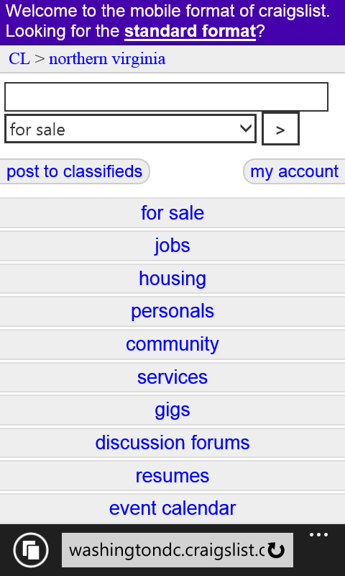
Deliver Form & Function
Focus on delivering functionality but with viable design
Doesn’t always have to be fancy, has to be usable.
Source: washingtondc.craigslist.org/nva on WP8
Notes:
Deliver Form & Function
Focus on delivering functionality but with viable design
Doesn’t always have to be fancy, has to be usable.
Source: washingtondc.craigslist.org/nva on WP8

Slide 20
Include Your Users
Focus on user stories
Create Agile/Scrum work items
Get feedback from users
Business/Home users
Images, courtesy of Ambro & Michal Marcol / FreeDigitalPhotos.net
Notes:
Include Your Users
Focus on user stories
Create Agile/Scrum work items
Get feedback from users
Business/Home users
Left Image, courtesy of Ambro / FreeDigitalPhotos.net
Right Image, courtesy of Michal Marcol / FreeDigitalPhotos.net

Slide 21
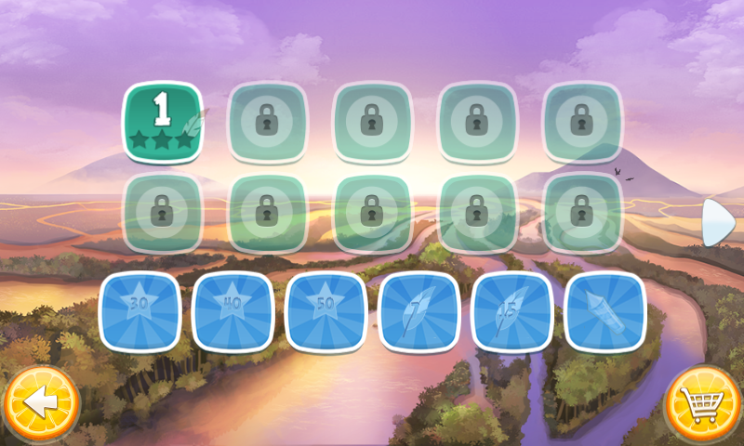
Predict User Behavior
Be consistent, be recognizable, so that users will know what to do
Source: Angry Birds, by Rovio
Source: Twitter app on WP8
Notes:
Predict User Behavior
Be consistent, be recognizable, so that users will know what to do
Sources:
Angry Birds, by Rovio
Twitter app on WP8

Slide 22
Contact
Shahed Chowdhuri
Technical Evangelist
Email: shchowd@microsoft.com
Twitter: @shahedC
Blog: WakeUpAndCode.com
Notes:
Contact
Shahed Chowdhuri
Technical Evangelist
Email: shchowd@microsoft.com
Twitter: @shahedC
Blog: WakeUpAndCode.com

