Slide 1
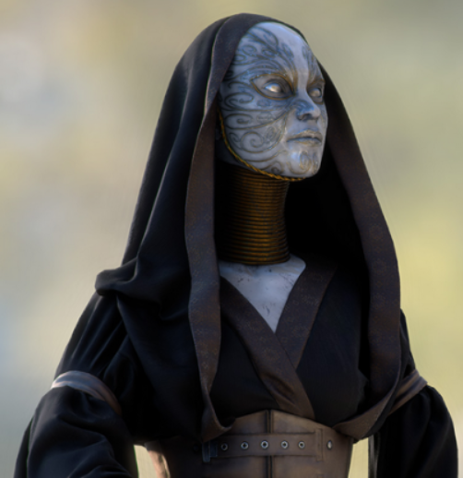
The Game Engine
Unity 2D for VT Hacks 2014

Slide 2
Who ARE WE?
David Crook
Technical Evangelist for Microsoft
Focus on Game and App Development Communities
Background in Enterprise Consulting and Game Development
Hobbies: Brewing Beer, Brazilian Jiu Jitsu
dacrook@Microsoft.com * @DavidCrook1988 * www.IndieDevSpot.com * Skype: DavidCrook1234
Shahed Chowdhuri
Technical Evangelist for Microsoft
App/Game Development & Azure/Cloud Services
Background in Web/Software Dev and indie game development
Hobbies: Kart Racing, Rock Climbing
shchowd@Microsoft.com * @shahedc1 * WakeUpAndCode.com * Skype: Shahed.Chowdhuri

Slide 3
Current Promotions
Best App a Month (BAM!)
http://aka.ms/BAMWashDC
Register your app (or game) with us for BAM to win a Dell Venue Pro Tablet.
Bring your game to Windows.
http://www.wpdevcenteroffers.com/
AthleTECH
Data Analytics
NFL Data back to the 1980’s
Mentoring available.
http://www.imaginecup.com/athletech#?fbid=XyGFUuIcUF2

Slide 4
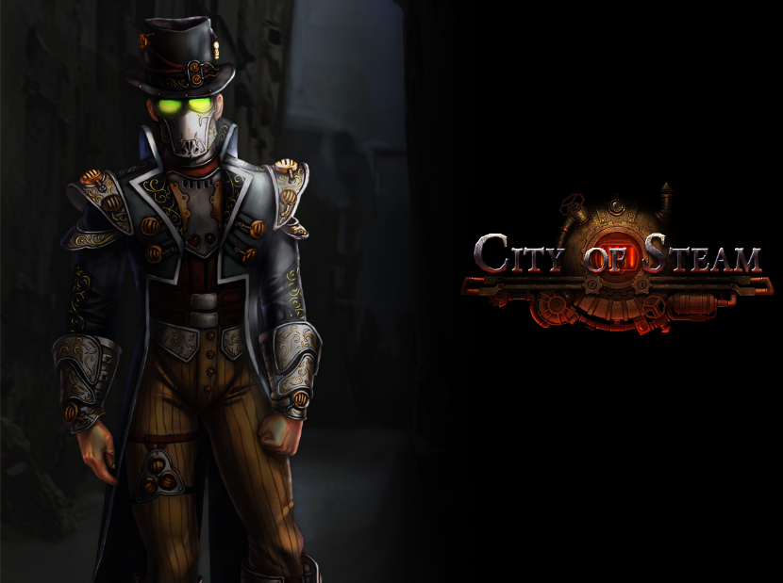
What is a Video Game?
Fun
Creative
Artistic
Musical
Comical
Horrifying
Theatrical Performance
And some code.
…. What do YOU think?
Made with Unity3D

Slide 5
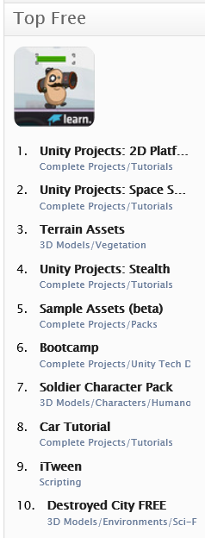
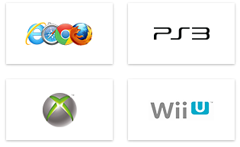
So What is Unity?
Game Engine, for virtually every modern platform
Integrated Development Environment
Extensible
A Store (with free assets too!)
Pretty much just awesome
Official Unity 5 Feature Preview Trailer
https://www.youtube.com/watch?v=dk8gpz0o5TU

Slide 6
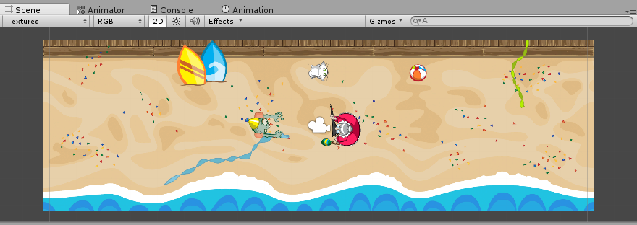
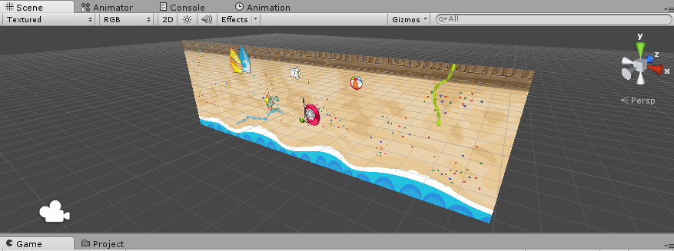
2D Overview
2D is 3D, except the camera always looks straight on moving only in the x and y axis.
3D Objects can still be in 2D Games!
Collider 2D (instead of Collider)
Physics 2D (instead of Physics)
Sprite Renderer
Sorting Layers (Are Great)
Mecanim for sprite(sheets)
Game Objects
Scripting!

Slide 7
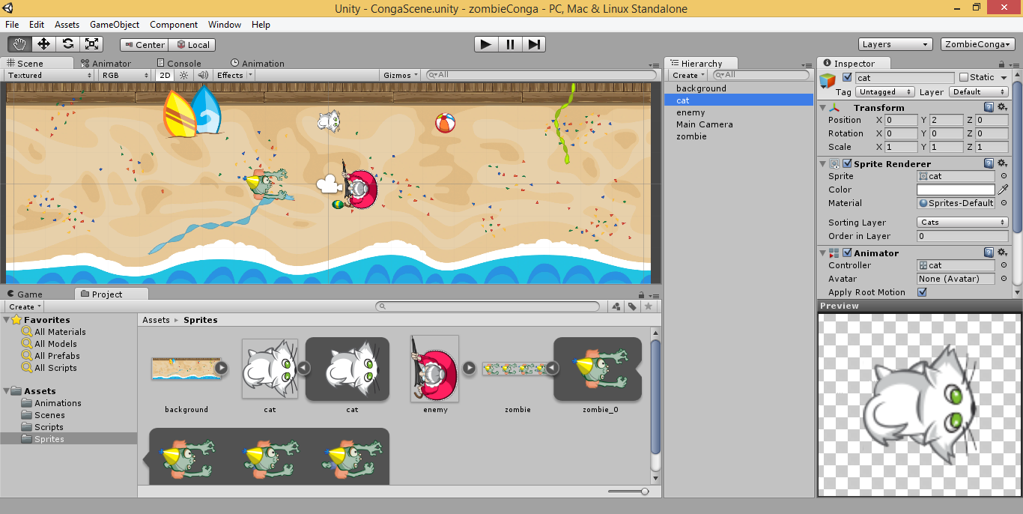
Editor
Scene Object Viewer
Project Viewer
Scene View
Game View
Console
Animator
Animation Tab
Inspector
Layers

Slide 8
Editor - Demo

Slide 9
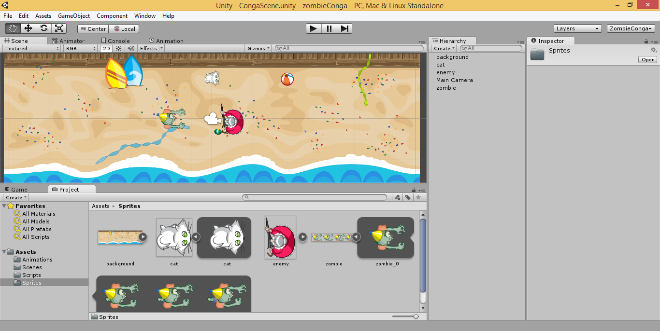
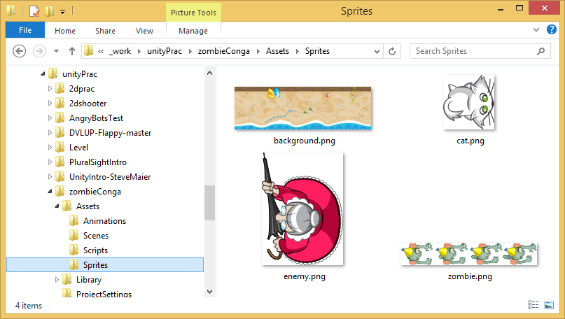
How it Works
Import a Sprite
Give it a Collider 2D (box)
Move it with code(C# or JavaScript)

Slide 10
Demo – How it Works

Slide 11
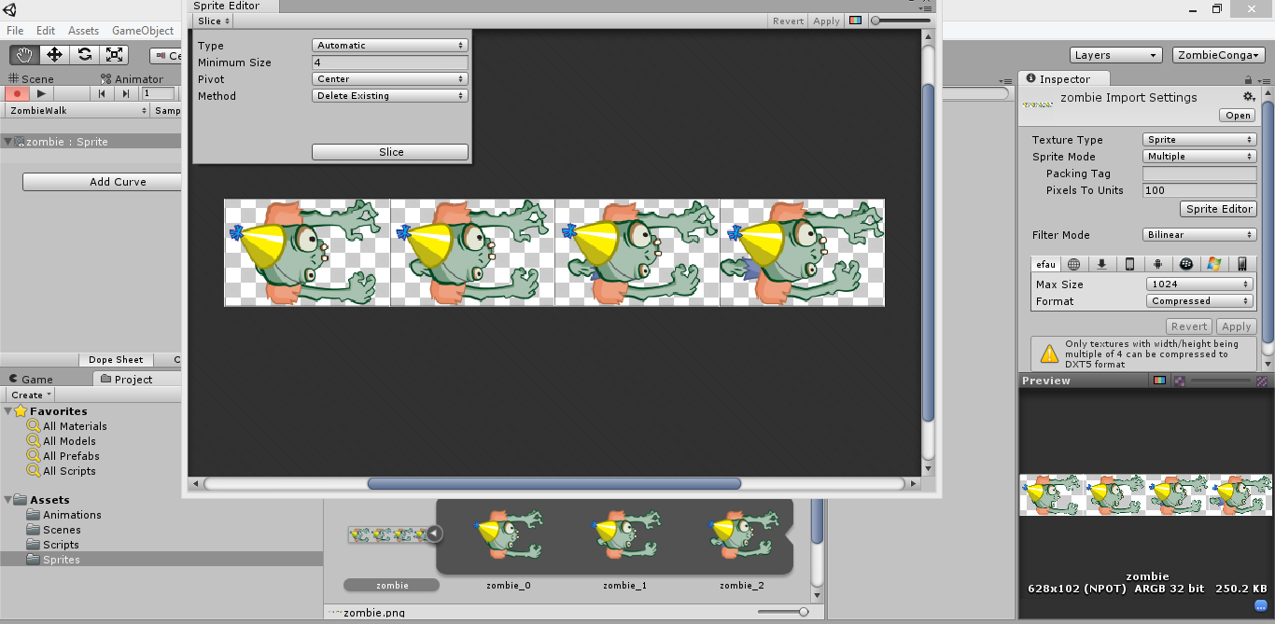
Sprite editor

Slide 12
Demo – Sprite editor

Slide 13
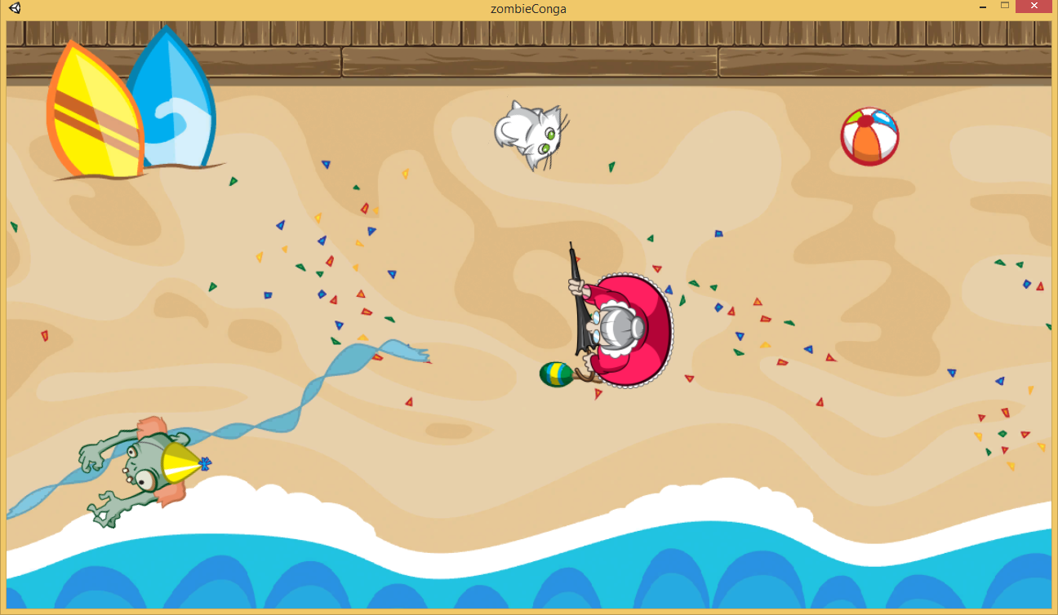
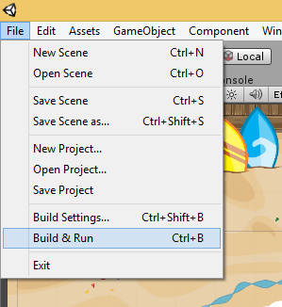
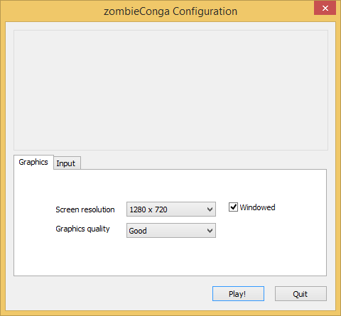
running your game

Slide 14
Demo – RUNNING YOUR GAME

Slide 15
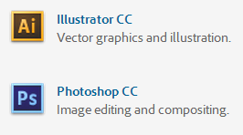
Graphics for your game
FREE!
Gimp
Paint.net
Commercial
Adobe Illustrator
Adobe Photoshop

Slide 16
Audio tools
FL Studio: http://www.image-line.com/flstudio/
Free demo, buy to access all features
Audacity: http://audacity.sourceforge.net/
Free, open-source

Slide 17
What Now?
Build your dream game!
Free assets on the store.
Befriend your friends
Artists, Musicians, Coders, Comedians etc.
Continue your learning!
2D Character Controller Tutorial
Space Shooter Tutorial
Infinite Runner Tutorial
Don’t worry about it, just do it!
Best way to build a game.
Best way to learn.

Slide 18
Current Promotions
Best App a Month (BAM!)
http://aka.ms/BAMWashDC
Register your app (or game) with us for BAM to win a Dell Venue Pro Tablet.
Bring your game to Windows.
http://www.wpdevcenteroffers.com/
AthleTECH
Data Analytics
NFL Data back to the 1980’s
Mentoring available.
http://www.imaginecup.com/athletech#?fbid=XyGFUuIcUF2

Slide 19
Useful links
This presentation
http://WakeUpAndCode.com/downloads
Zombie Conga Tutorial, by Chris LaPollo
http://www.raywenderlich.com/61532/unity-2d-tutorial-getting-started
Unity Tutorials: http://unity3d.com/learn
Free Assets: http://codefoster.com/media

