Slide 1
Game Development with Unity and C#
Windows  Web  Xbox  Mobile
By Shahed Chowdhuri
Senior Technical Evangelist
WakeUpAndCode.com
@shahedC
Notes:
Title Page: Game Development with Unity and C# Windows  Web  Xbox  Mobile
By Shahed Chowdhuri
Technical Evangelist
Blog: WakeUpAndCode.com
Twitter: @shahedC

Slide 2
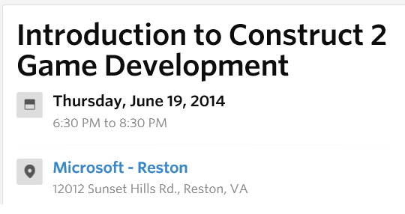
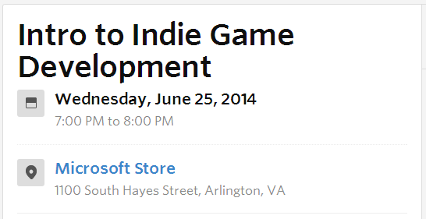
Events & Contests
URL: http://aka.ms/BAMWashDC
(select Windows 8 for platform!)
BAM! Best App a Month for June 2014
URL: http://tinyurl.com/msdcmeetup
Notes:
Events & Contests
BAM! Contest: http://aka.ms/BAMWashDC
VA Tech Hackathon: http://vthacks.com

Slide 3
Agenda
Background + Intro
> UI Basics & Assets
> Moving Around
> Scripts & Animations
> Transitions, Colliders & Triggers
Graphics & Audio, Wrap-Up
Notes:
Agenda
Intro + XNA/XBLIG
> Construct2
> C++ and DirectX
> Unity with C#
Being an Indie in the Real World
* Learn about how you can build games for Windows, Web and Xbox platforms.
* Visual tools like Construct 2, programming with C++ and DirectX, and using your C# experience with Unity.
* Not a deep dive into each topic, but enough info for you to get started and pick a direction.

Slide 4
My Background
Period | Background/Experience
1997 – present | Microsoft web/software development
2011 | XNA games on XBLIG 2D Math Panic Angry Zombie Ninja Cats
2012 | Tools for XNA developers XBLIG Sales Data Analyzer (OnekSoftLabs.com) XNA Basic Starter Kit (CodePlex)
Online: http://facebook.com/OnekSoftGames
Notes:
My Background
1997 – present: Microsoft web/software development
2011: XNA games on XBLIG
2D Math Panic
Angry Zombie Ninja Cats
2012: Tools for XNA developers
XBLIG Sales Data Analyzer (OnekSoftLabs.com)
XNA Basic Starter Kit (CodePlex)
Online: http://facebook.com/OnekSoftGames

Slide 5
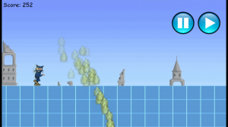
My Background (continued)
Period | Background/Experience
2013 | Ninja Cat Runner on Win8, WP8, Web (Construct2) Video Q&A with MS Tech Evangelist Frank La Vigne Founder/Admin of FB groups: Construct2, Xbox One & Unity Indie Devs Attended ID@Seattle, Microsoft’s first ID@Xbox summit
2014 | Public Speaking on Indie Game Development Joined Microsoft as a Technical Evangelist Attended ID@Chicago Working with Kinect v2
Video: http://youtu.be/lRjrQPvVOpo
Notes:
My Background (continued) 2013
Ninja Cat Runner on Windows 8 (Construct2)
Video Q&A with MS Tech Evangelist Frank La Vigne
Founder/Admin of Xbox One Indie Devs Group (FB)
Attended ID@Seattle, Microsoft’s ID@Xbox summit
2014
Public Speaking on Indie Game Development
Joined Microsoft as a Technical Evangelist
Video: http://youtu.be/lRjrQPvVOpo

Slide 6
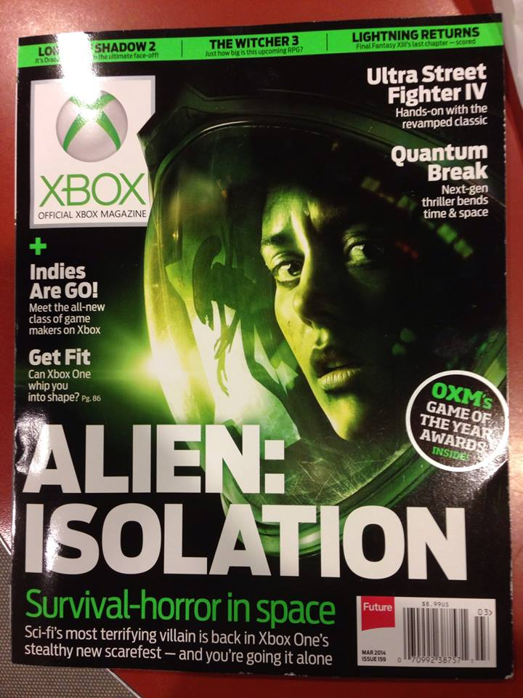
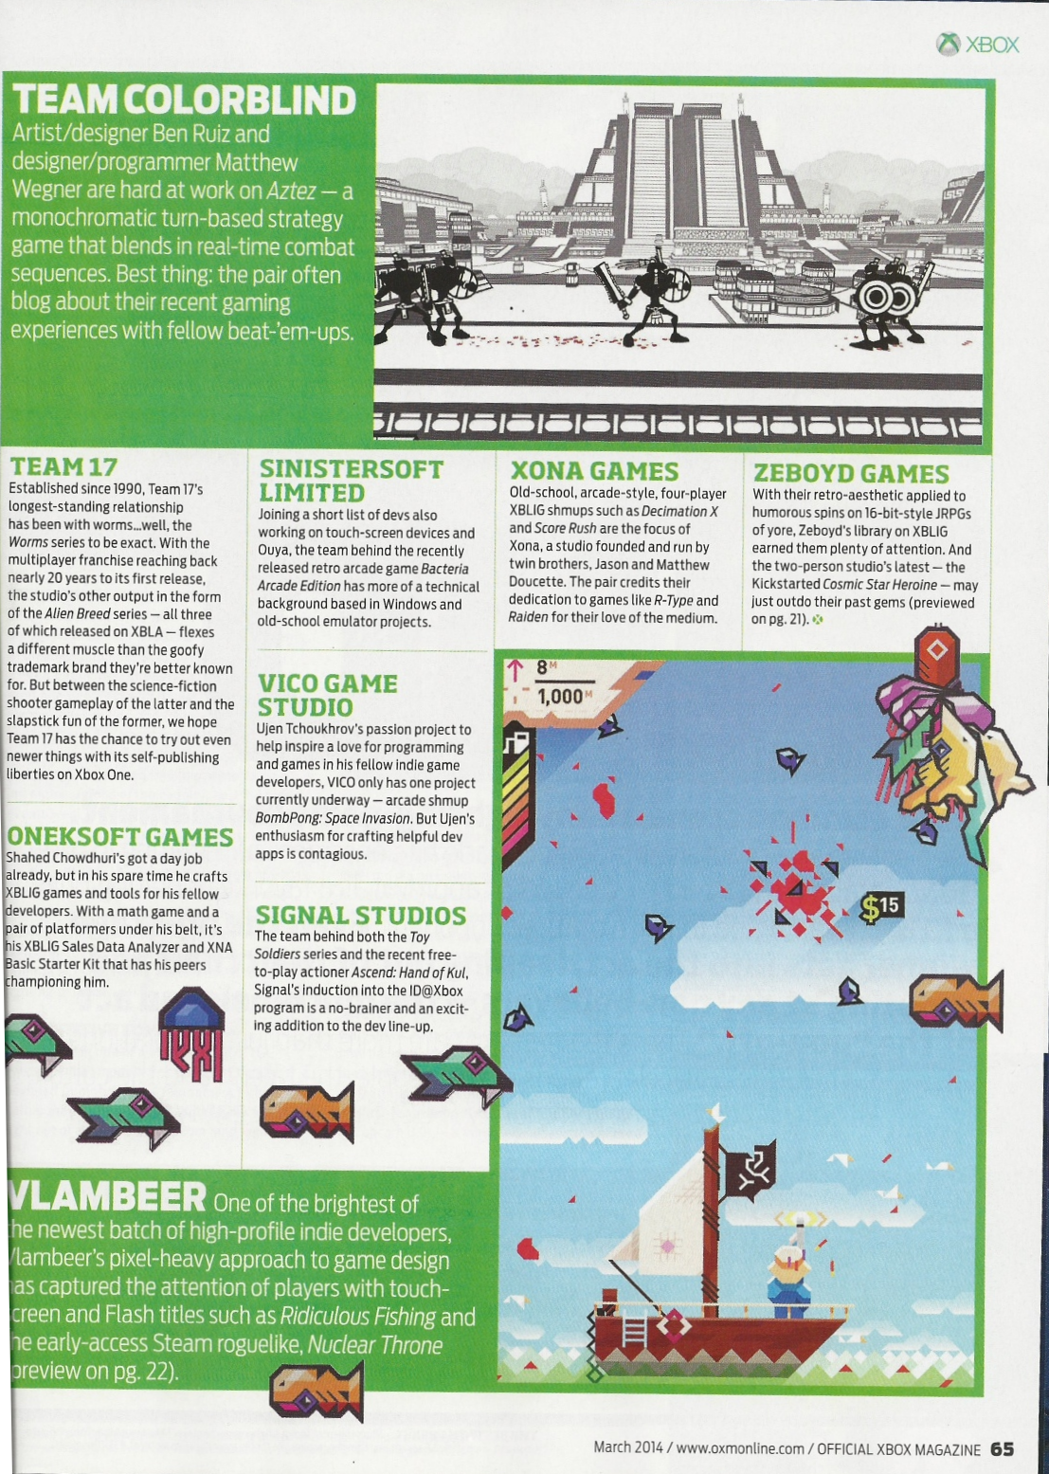
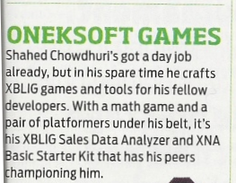
Official Xbox Magazine
`
Source: Official Xbox Magazine, March 2014, Page 65
Notes:
Official Xbox Magazine, March 2014, Page 65
"Shahed Chowdhuri's got a day job already,
but in his spare time he crafts XBLIG games and tools for his fellow developers.”
“With a math game and a pair of platformers under his belt,
it's his XBLIG Sales Data Analyzer and XNA Basic Starter Kit that has his peers championing him."

Slide 7
Tools & Technologies
Notes:
Tools & Technologies
Visual Studio 2013
Windows 8
Microsoft .NET and Visual C#
Xbox One
Construct2
C++ and DirectX 11.1+
HTML5/CSS/JS
Unity
Paint.net
Blender

Slide 8
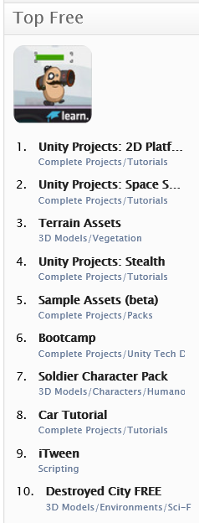
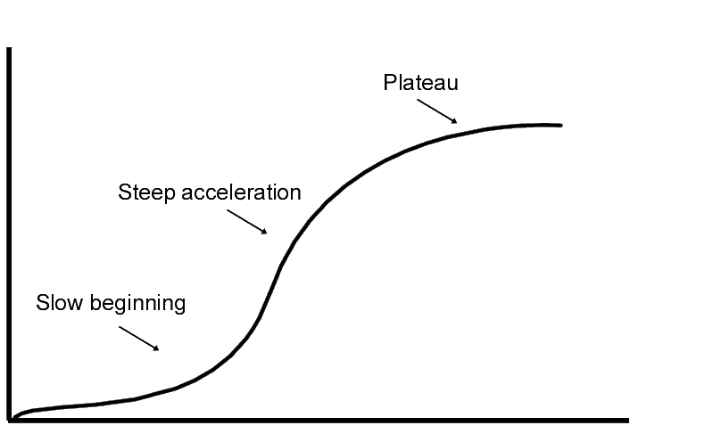
Unity: Things to Know
Learning curve
Create/Import models
Download/purchase models
Asset Store
Publish virtually anywhere!
Notes:
Unity: Things to Know
Learning curve for beginners
Need to create your own models
Or download/purchase pre-built models
Publish to Web, mobile, desktop, consoles

Slide 9
Agenda
Background + Intro
> UI Basics & Assets
> Moving Around
> Scripts & Animations
> Transitions, Colliders & Triggers
Graphics & Audio, Wrap-Up
Notes:
Agenda
Intro + XNA/XBLIG
> Construct2
> C++ and DirectX
> Unity with C#
Being an Indie in the Real World
* Learn about how you can build games for Windows, Web and Xbox platforms.
* Visual tools like Construct 2, programming with C++ and DirectX, and using your C# experience with Unity.
* Not a deep dive into each topic, but enough info for you to get started and pick a direction.

Slide 10
UI Basics & Assets

Slide 11
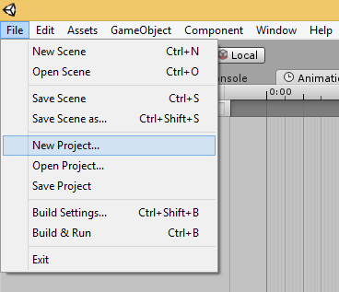
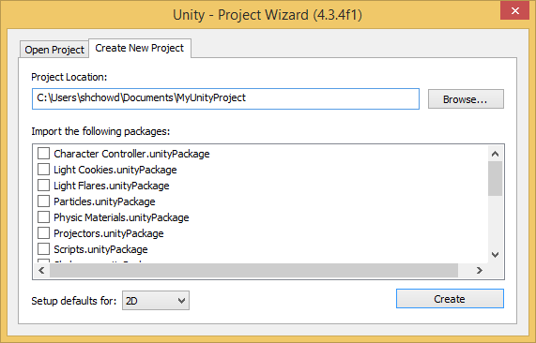
Creating a New 2D Project
Select an empty folder
Click File → New Project
Select 2D in the dropdown
Click the Create button

Slide 12
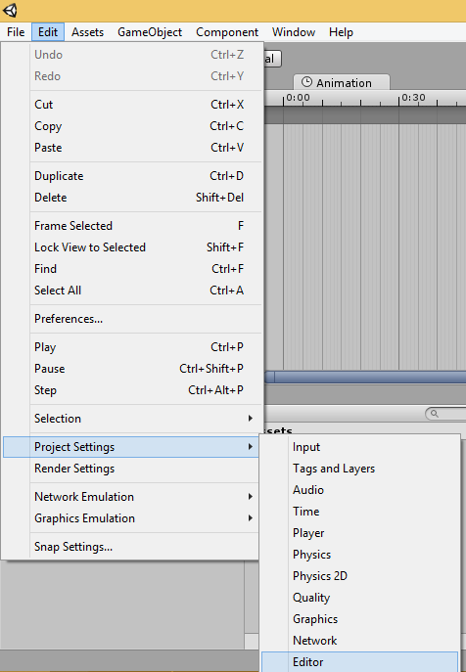
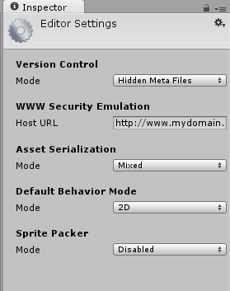
Editor Settings for 2D
Click Edit → Project Settings → Editor
Verify 2D Mode is the default

Slide 13
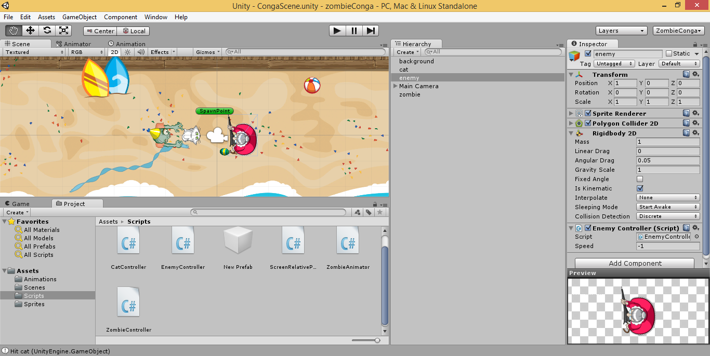
Unity UI: Scene, Hierarchy & Project Assets

Slide 14
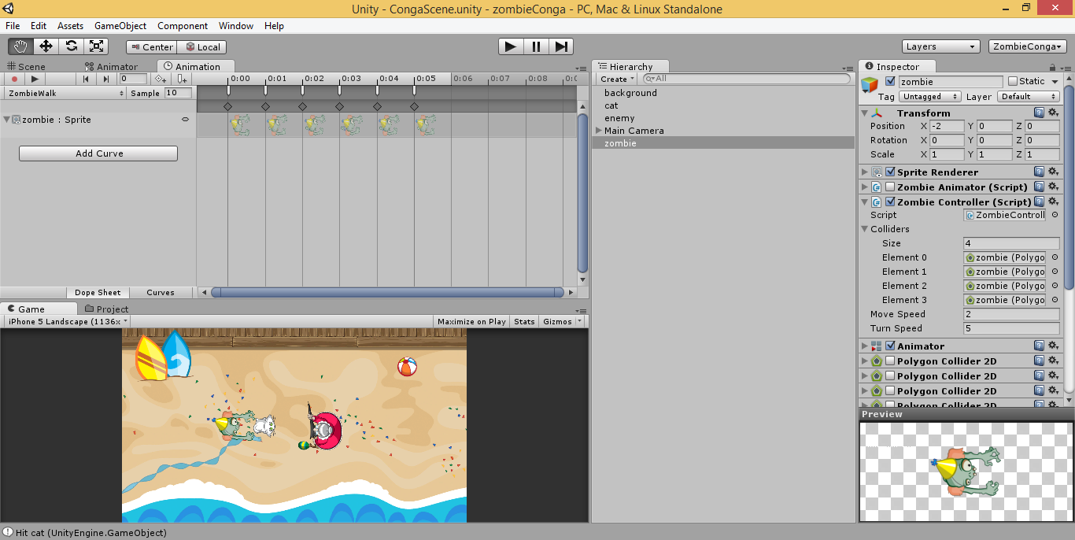
Unity UI: Animation and Game Panels

Slide 15
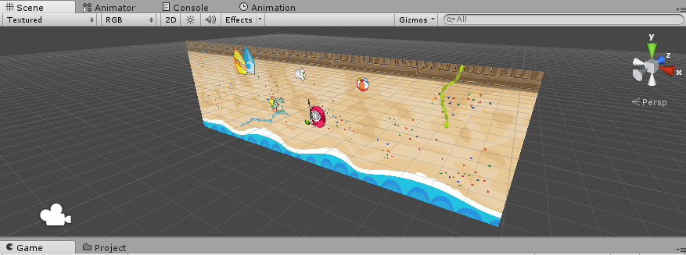
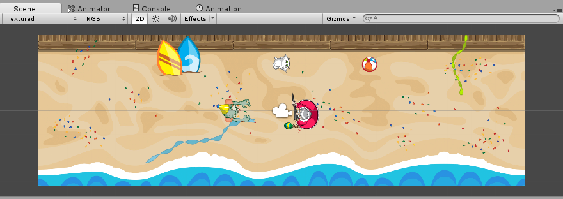
2D Overview
2D is just 3D in orthographic view
Collider 2D & Physics 2D (instead of Collider & Physics)
Sprite Renderer, Sorting Layers
Game Objects and Scripting!
Mecanim for sprite sheets

Slide 16
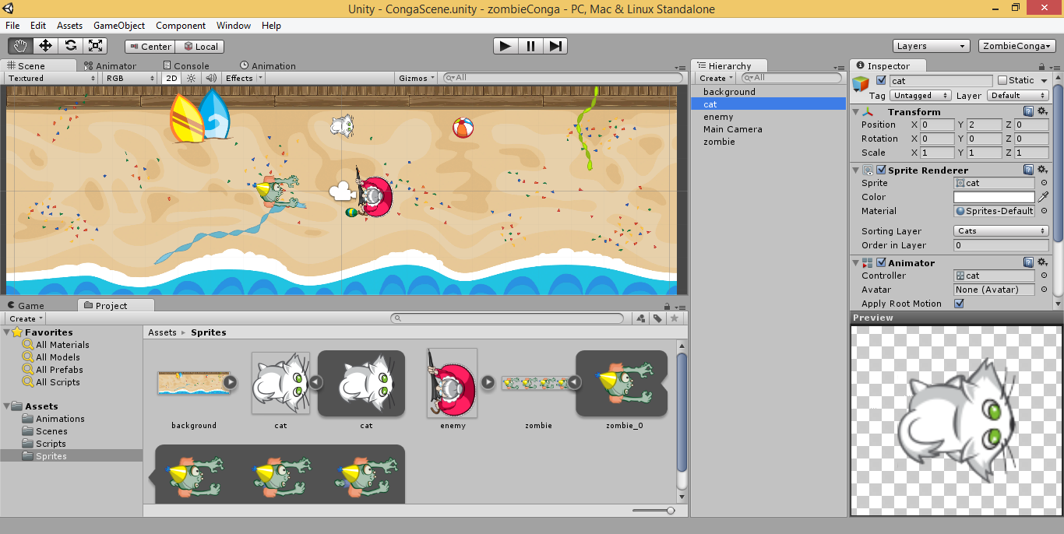
Customizing Your Editor UI
Hierarchy
Project
Scene View
Game View
Console
Animator
Animation
Inspector
Layers

Slide 17
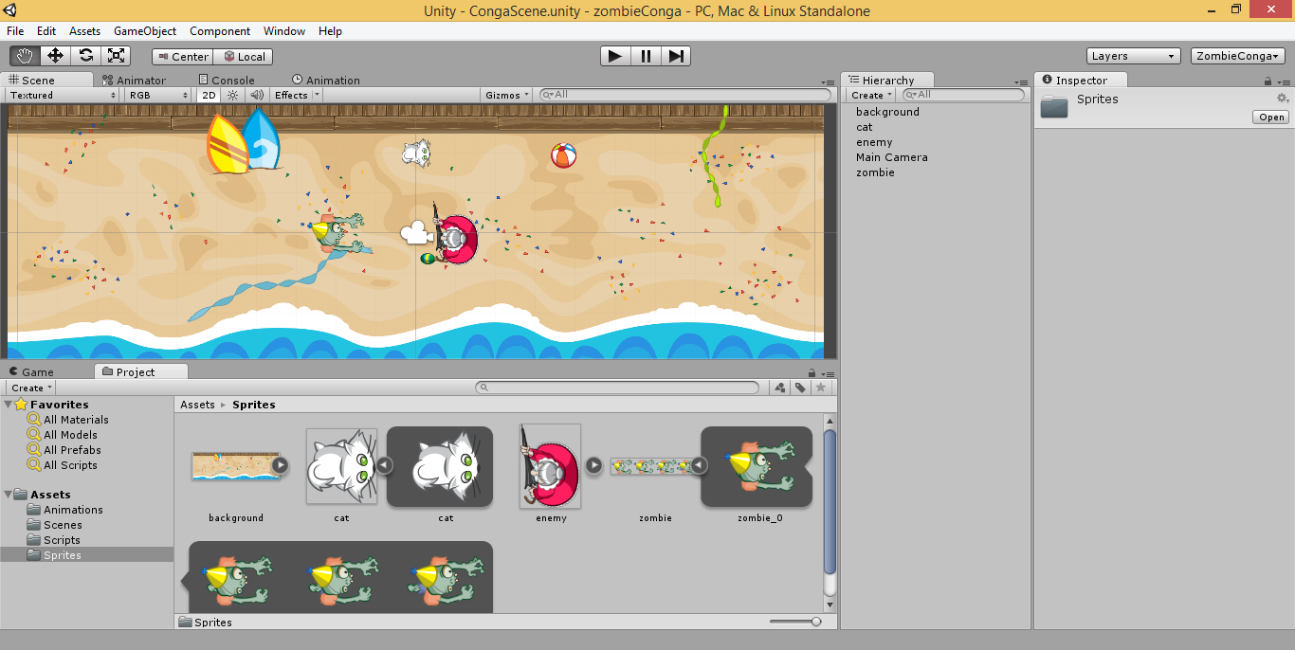
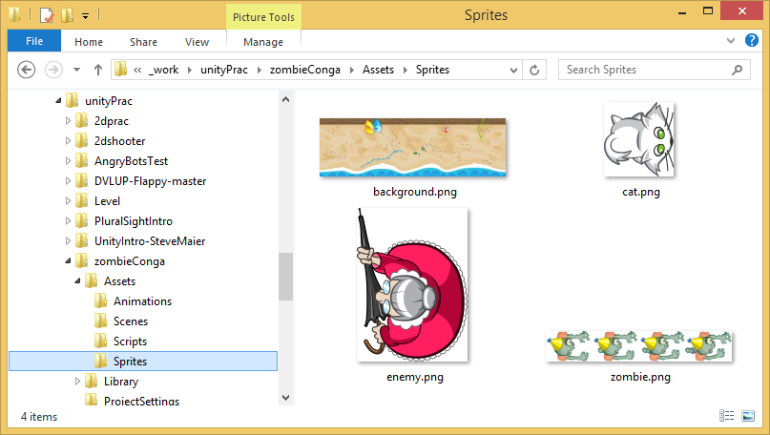
Importing a Sprite
Drag into
the scene
Note: Create Prefabs to reuse instances of an object in your scene.
http://docs.unity3d.com/Manual/Prefabs.html

Slide 18
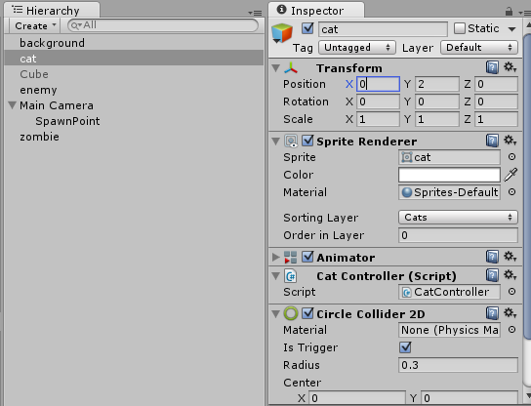
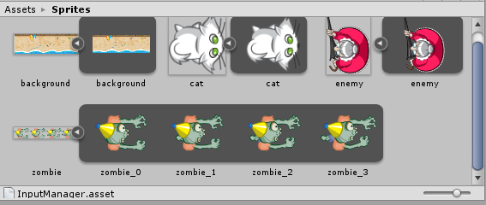
Textures and Sprites
Each texture can have sprites
Set the position/rotation/scale in the Inspector

Slide 19
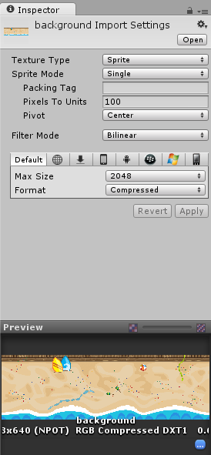
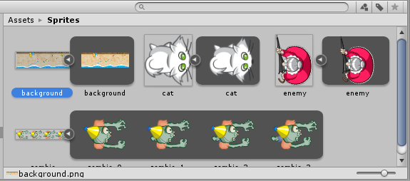
Background Import Settings

Slide 20
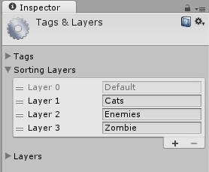
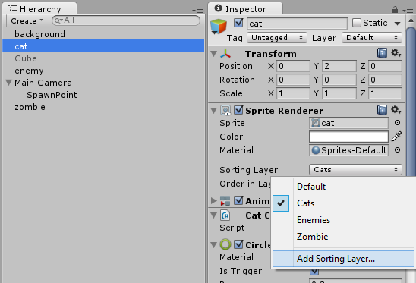
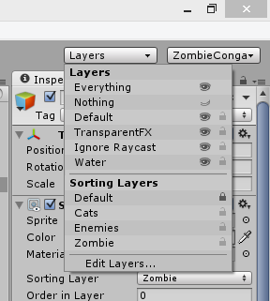
Sorting Layers
Add Layers via Sprite Renderer
Lock Layers

Slide 21
Moving Around

Slide 22
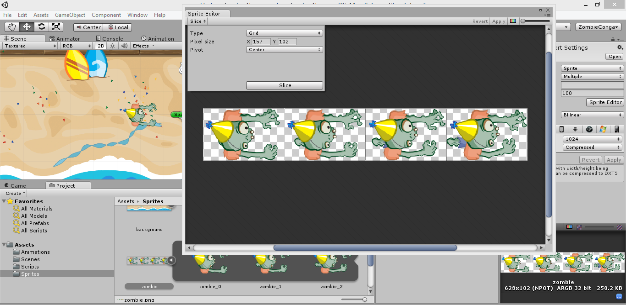
Sprite Editor

Slide 23
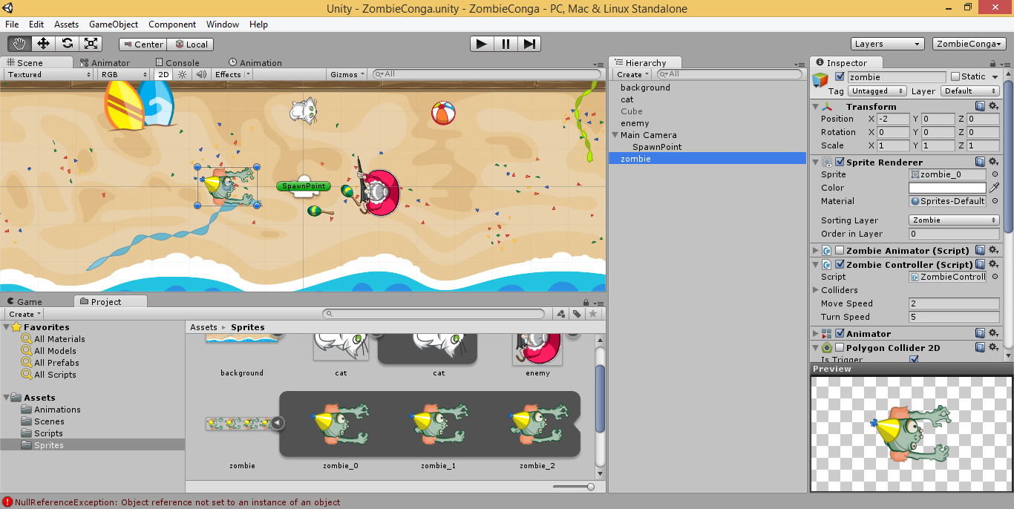
Adding Components

Slide 24
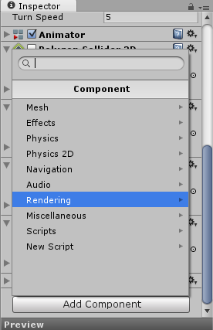
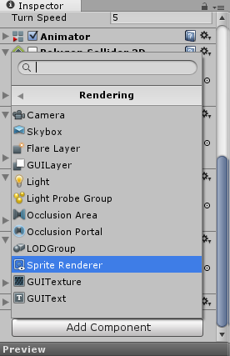
Adding a Sprite Renderer

Slide 25
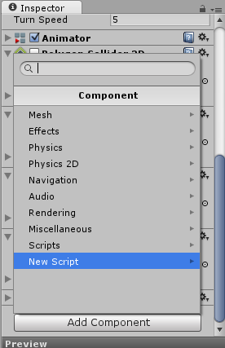
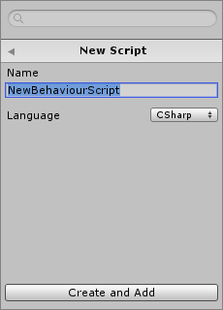
Adding a New Script (C#/JS/Boo)

Slide 26
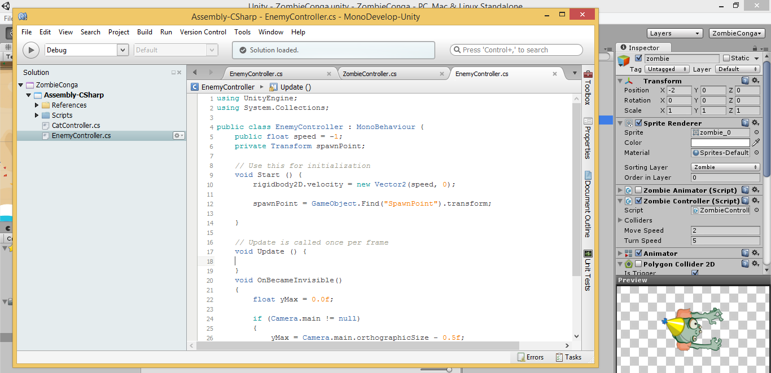
Start() and Update() in your Script

Slide 27
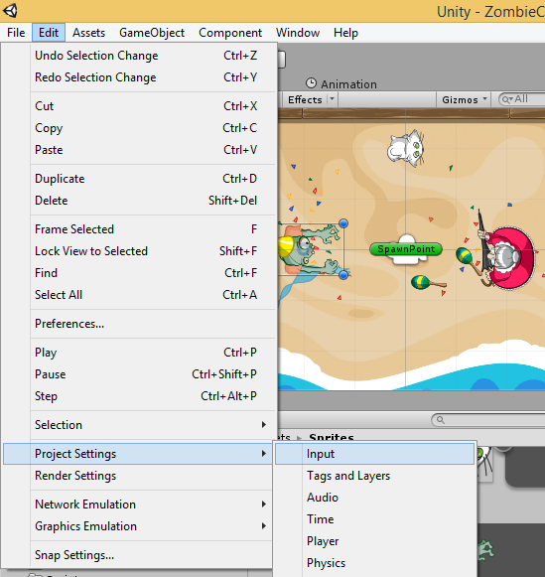
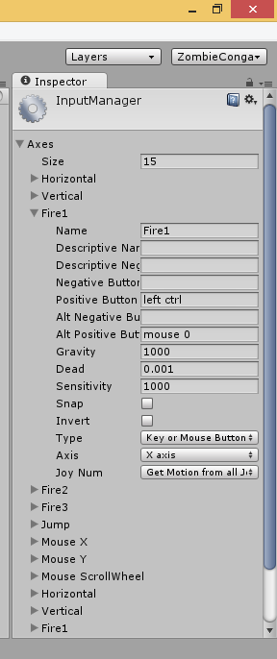
Built-in Input Controls

Slide 28
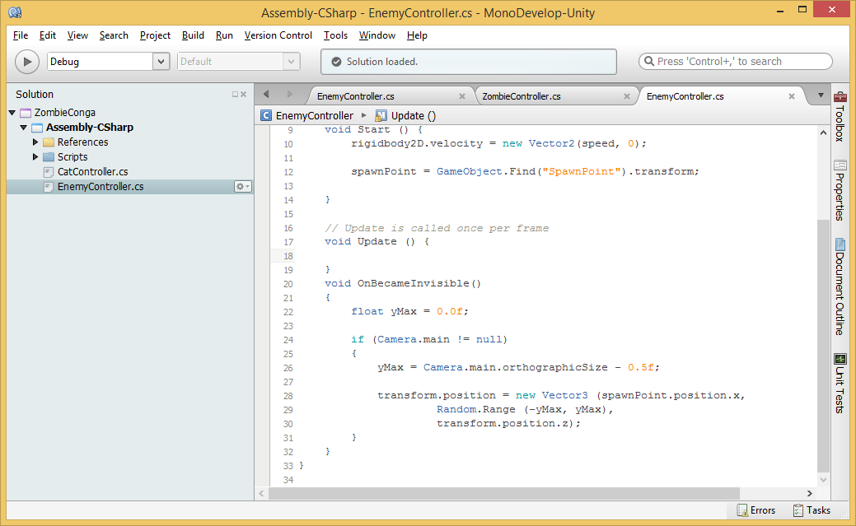
Updating Objects via transform.position

Slide 29
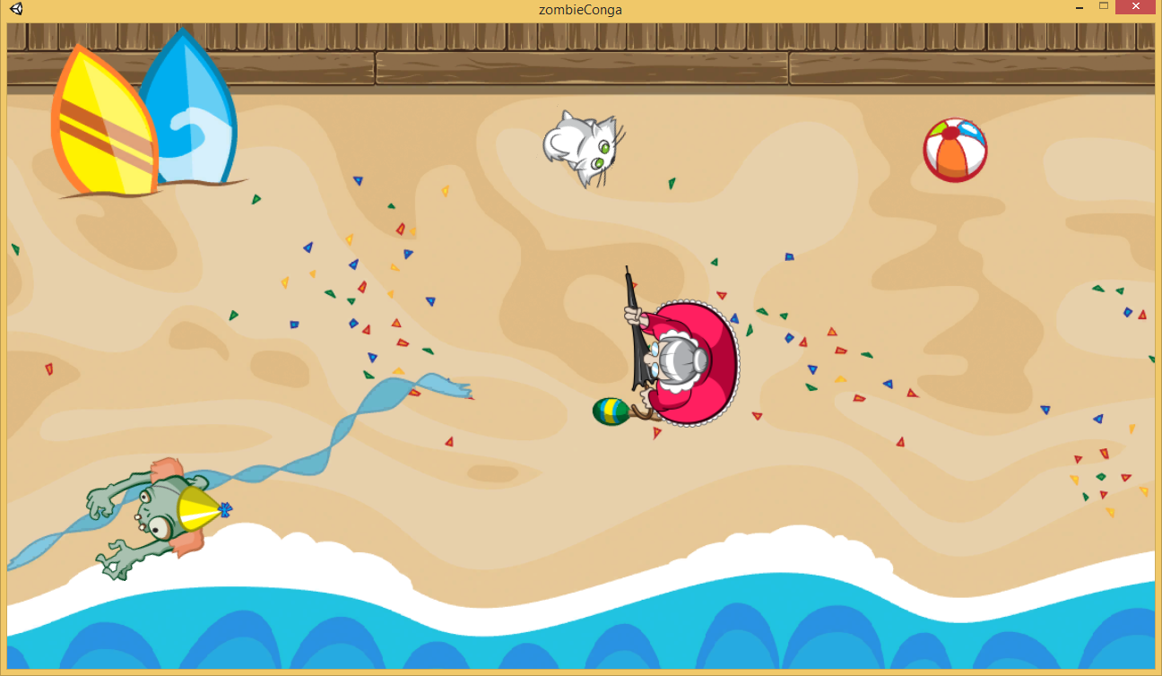
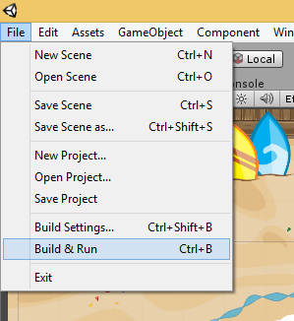
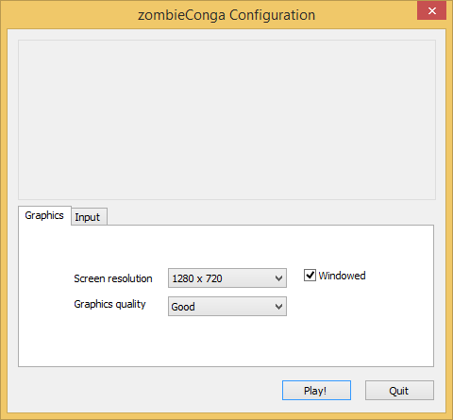
Running Your Game

Slide 30
Scripts & Animations

Slide 31
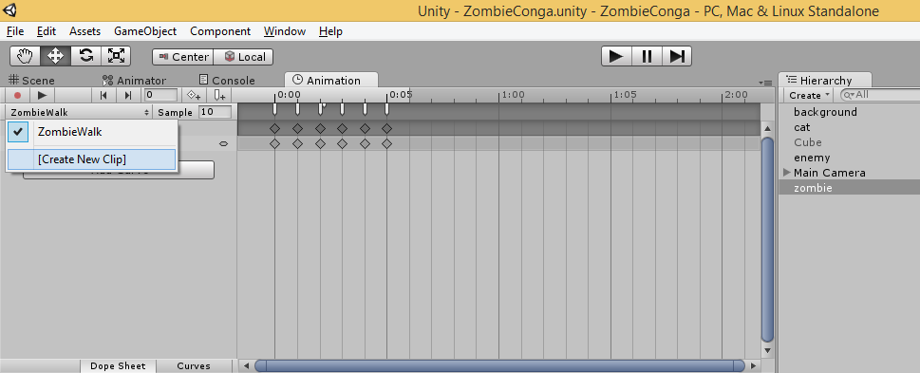
Animation Clips
Create New Clip, Curves, Keyframes

Slide 32
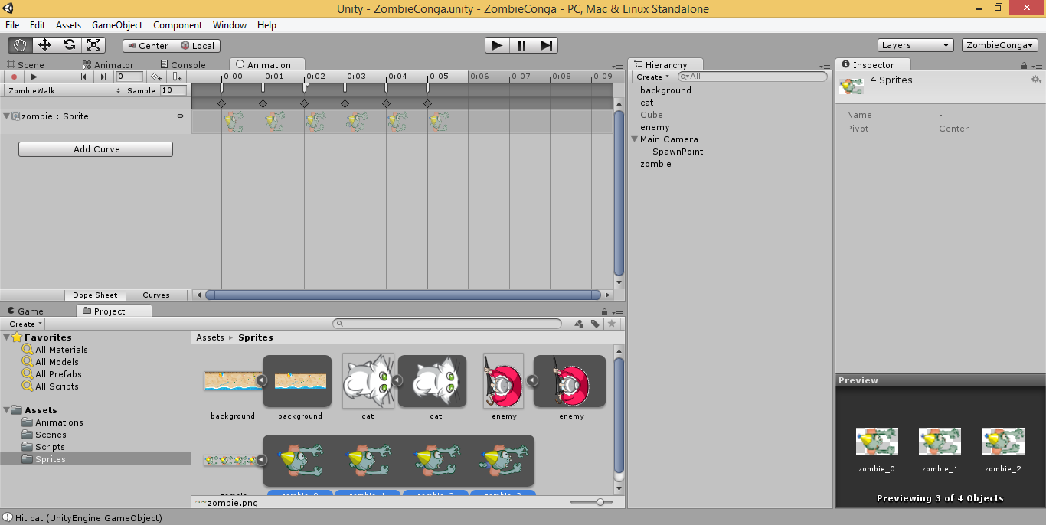
Adding Sprites From a Sprite Sheet
Drag sprites as a group or individually

Slide 33
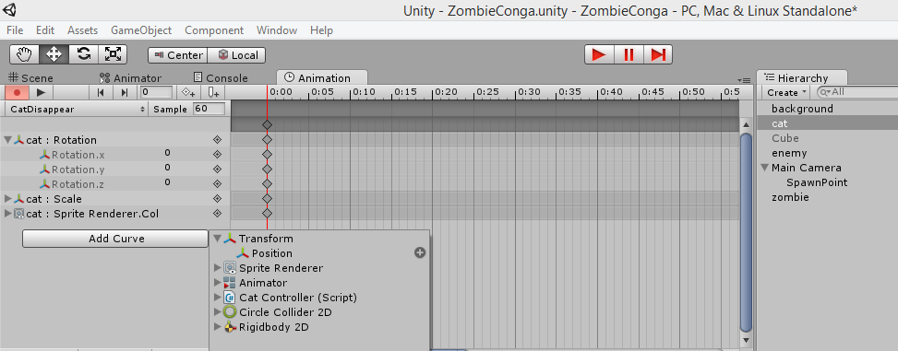
Adding Curves Manually
Change values manually for each keyframe
Create multiple animations, view one at a time

Slide 34
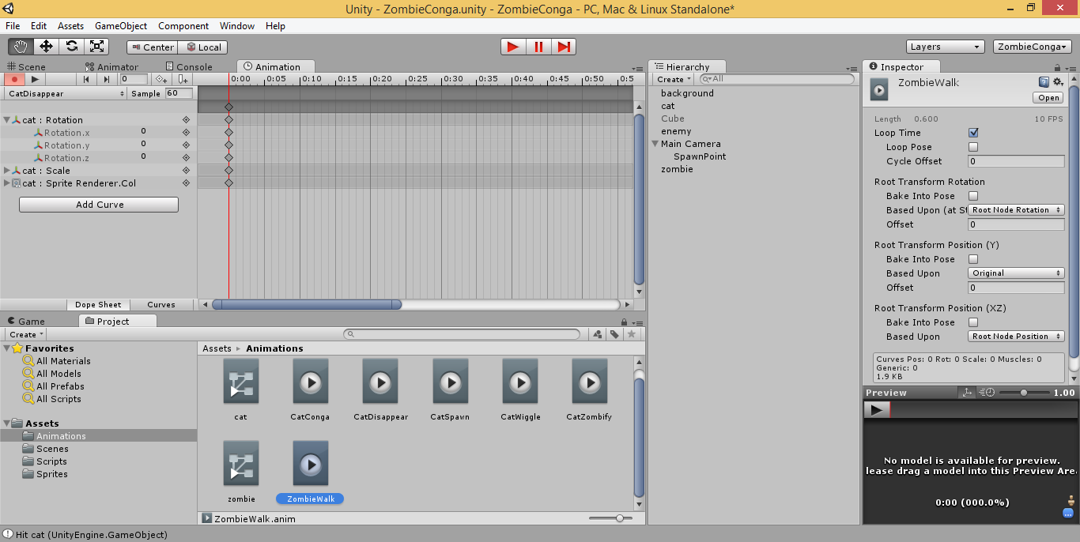
Loop Time for Animations

Slide 35
Transitions, Colliders & Triggers

Slide 36
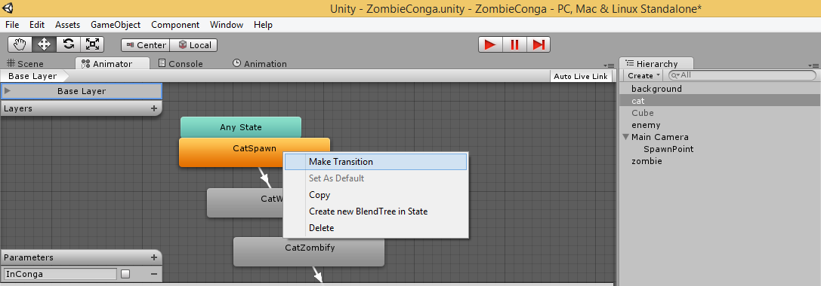
Animator Tab
Create transition from between animations
Right-click a state to Make Transition
Add parameters and set values

Slide 37
Conditions
Click a transition to edit in Inspector
Set Conditions for selected Transition

Slide 38
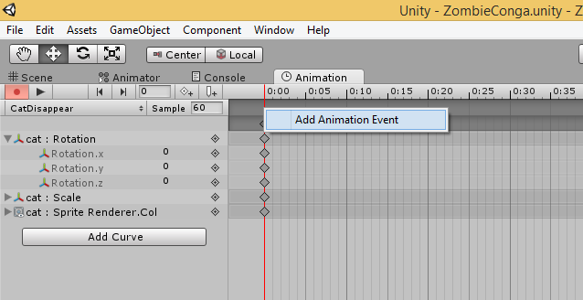
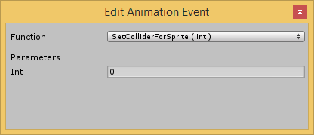
Linking Events to Keyframes
Right-click a keyframe to add animation event
Or select keyframe, and click []+ icon
`
Select function from your code, set parameters

Slide 39
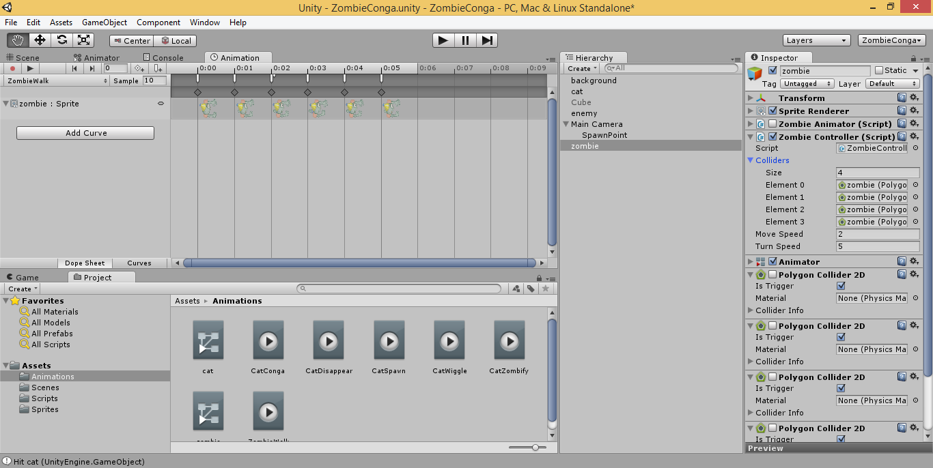
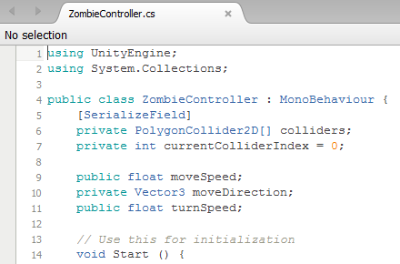
Custom Colliders

Slide 40
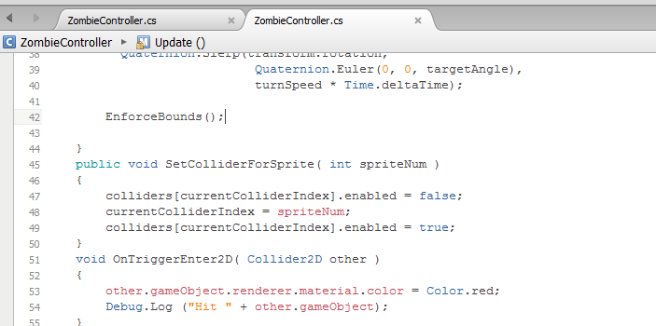
Enabling Triggers in 2D Colliders
Use OnTriggerEnter2D and OnTriggerExit2D in code

Slide 41
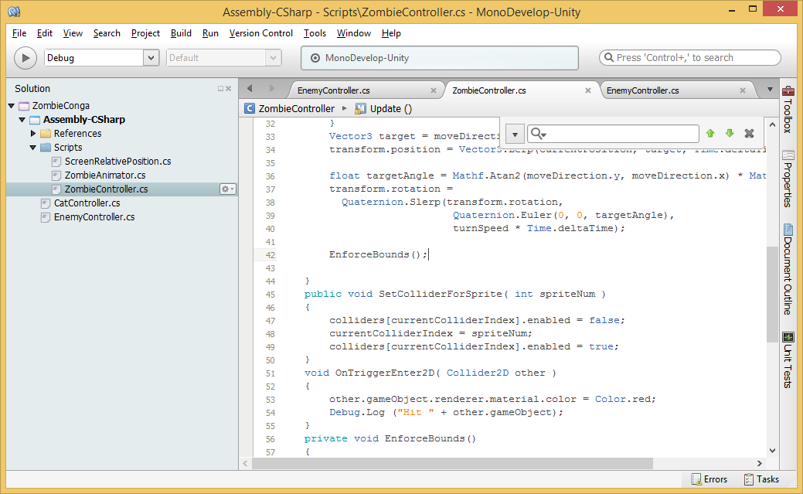
Swapping Colliders at Runtime
Called from
Keyframe
events

Slide 42
Using Empty Objects as Spawn Points
Use a script to control positioning behavior

Slide 43
Updating Gravity Settings
Set Y to 0 (zero) for top-down 2D games

Slide 44
Agenda
Background + Intro
> UI Basics & Assets
> Moving Around
> Scripts & Animations
> Transitions, Colliders & Triggers
Graphics & Audio, Wrap-Up
Notes:
Agenda
Intro + XNA/XBLIG
> Construct2
> C++ and DirectX
> Unity with C#
Being an Indie in the Real World
* Learn about how you can build games for Windows, Web and Xbox platforms.
* Visual tools like Construct 2, programming with C++ and DirectX, and using your C# experience with Unity.
* Not a deep dive into each topic, but enough info for you to get started and pick a direction.

Slide 45
Graphics For Your Game
FREE!
Gimp
Paint.net
Commercial
Adobe Illustrator
Adobe Photoshop

Slide 46
Audio Tools
FL Studio: http://www.image-line.com/flstudio/
Free demo, buy to access all features
Audacity: http://audacity.sourceforge.net/
Free, open-source

Slide 47
Useful Links
This presentation
http://WakeUpAndCode.com/downloads
Zombie Conga Tutorial, by Chris LaPollo
http://www.raywenderlich.com/61532/unity-2d-tutorial-getting-started
Unity Tutorials: http://unity3d.com/learn
Free Assets: http://codefoster.com/media

Slide 48
For More Info:
Xbox One Indie Devs:
http://facebook.com/groups/XboxOneIndieDevs
http://WakeUpAndCode.com/xb1
Unity Indie Devs:
http://facebook.com/groups/UnityIndieDevs
http://WakeUpAndCode.com/unity
Notes:
For more info:
Xbox One Indie Devs:
http://facebook.com/groups/XboxOneIndieDevs
http://WakeUpAndCode.com/xb1
Unity Indie Devs:
http://facebook.com/groups/UnityIndieDevs
http://WakeUpAndCode.com/unity
Construct2 Devs:
https://www.facebook.com/groups/construct2devs

Slide 49
Mecanim for 2D Sprite Animations
https://github.com/Banbury/UnitySpritesAndBones/wiki/Tutorial%3A-Using-Sprites-And-Bones-and-Mecanim-to-animate-a-bird

Slide 50
2D Platformer Overview
http://blogs.unity3d.com/2013/11/12/unity-4-3-2d-game-development-overview/
https://www.youtube.com/watch?v=4qE8cuHI93c

Slide 51
Unity 5 Preview
Official Unity 5 Feature Preview Trailer (jump to 2:10 for 2D)
https://www.youtube.com/watch?v=dk8gpz0o5TU

Slide 52
Agenda
Background + Intro
> UI Basics & Assets
> Moving Around
> Scripts & Animations
> Transitions, Colliders & Triggers
Graphics & Audio, Wrap-Up
Notes:
Agenda
Intro + XNA/XBLIG
> Construct2
> C++ and DirectX
> Unity with C#
Being an Indie in the Real World
* Learn about how you can build games for Windows, Web and Xbox platforms.
* Visual tools like Construct 2, programming with C++ and DirectX, and using your C# experience with Unity.
* Not a deep dive into each topic, but enough info for you to get started and pick a direction.

Slide 53
Contact
Email: shchowd@microsoft.com  Twitter: @shahedC
Notes:
Contact
Web: OnekSoft.com
Email: games@OnekSoft.com
Twitter: @OnekSoftGames
Microsoft email: shchowd@microsoft.com
Personal Twitter: @shahedC
R&D: OnekSoftLabs.com
Dev Blog: WakeUpAndCode.com
FB: http://facebook.com/groups/XboxOneIndieDevs

