Slide 1
Universal Apps for Windows
Windows 8.1  Windows Phone 8.1  … and more!
By Shahed Chowdhuri
Sr. Technical Evangelist
WakeUpAndCode.com
@shahedC
Notes:
Title Page: Universal Apps Windows  Windows Phone  … and more!
By Shahed Chowdhuri
Sr. Technical Evangelist
Blog: WakeUpAndCode.com
Twitter: @shahedC

Slide 2
Thank Our Sponsors without whom Today is not Possible
Platinum
Host
Bronze

Slide 3
Housekeeping…
Respect your speakers and fellow attendees:
Set mobile devices to vibrate or silent
Fill out session evaluations
You must be present to win at the wrap-up

Slide 4
Coming Up…
URL: http://tinyurl.com/msdcmeetup
Hands-On Workshop
Date: Thu Oct 16, 2014
Time: 6:30pm – 8:30pm
Venue: Microsoft – Reston
Address: 12012 Sunset Hills Rd, Reston VA
Instructions: Come up to Room 3062
Notes:
Coming Up…
Meetup
URL: http://tinyurl.com/msdcmeetup
Hands-On Workshop
Date: Thu Oct 16, 2014
Time: 6:30pm – 8:30pm
Venue: Microsoft – Reston
Address: 12012 Sunset Hills Rd, Reston VA
Instructions: Come up to Room 3062

Slide 5
Agenda
Introduction
> Visual Studio
> Alternative Tools
Publishing
Notes:
Agenda
Introduction
> Visual Studio
> Alternative Tools
Publishing
* Learn about how you can build Universal Apps for Windows.
* Use Visual Studio or alternatives like App Studio, Construct 2, Unity.
* Not a deep dive into each topic, but enough info for you to get started and pick a direction.

Slide 6
My Background
Period | Background/Experience
1997 – present | Microsoft web/software development
2011 | XNA games on XBLIG 2D Math Panic Angry Zombie Ninja Cats
2012 | Tools for XNA developers XBLIG Sales Data Analyzer (OnekSoftLabs.com) XNA Basic Starter Kit (CodePlex)
Online: http://facebook.com/OnekSoftGames
Notes:
My Background
1997 – present: Microsoft web/software development
2011: XNA games on XBLIG
2D Math Panic
Angry Zombie Ninja Cats
2012: Tools for XNA developers
XBLIG Sales Data Analyzer (OnekSoftLabs.com)
XNA Basic Starter Kit (CodePlex)
Online: http://facebook.com/OnekSoftGames

Slide 7
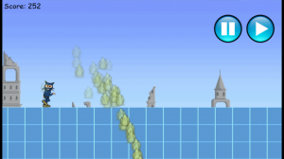
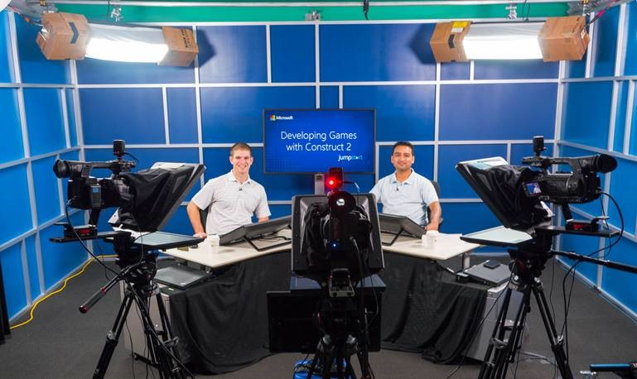
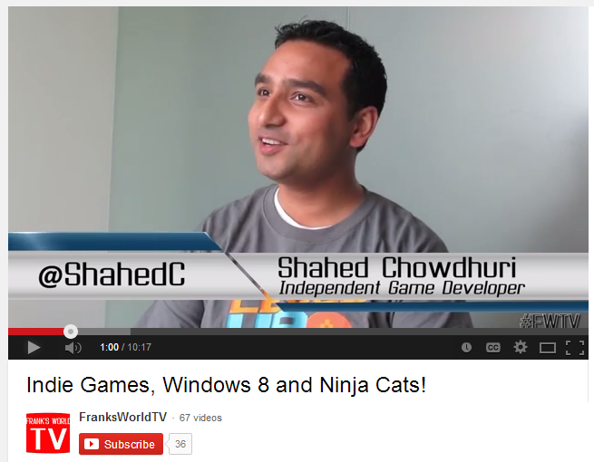
My Background (continued)
Period | Background/Experience
2013 | Ninja Cat Runner on Win8, WP8, Web (Construct 2) Video Q&A with MS Tech Evangelist Frank La Vigne Founder/Admin of FB groups: Construct2, Xbox One & Unity Indie Devs Started Public Speaking in DC area and East Coast
2014 | Started Public Speaking on Indie Game Development Joined Microsoft as a Sr. Technical Evangelist Gallant Glider on Win8, WP8, Web (Construct 2 → Universal App)
Video Q&A: http://youtu.be/lRjrQPvVOpo
MVA: http://aka.ms/DevGames-Const2
Notes:
My Background (continued) 2013
Ninja Cat Runner on Win8, WP8, Web (Construct 2)
Video Q&A with MS Tech Evangelist Frank La Vigne
Founder/Admin of FB groups: Construct2, Xbox One & Unity Indie Devs
Started Public Speaking in DC area and East Coast
2014
Started Public Speaking on Indie Game Development
Joined Microsoft as a Sr. Technical Evangelist
Gallant Glider on Win8, WP8, Web (Construct 2 → Universal App)
Video: http://youtu.be/lRjrQPvVOpo
MVA: http://aka.ms/DevGames-Const2

Slide 8
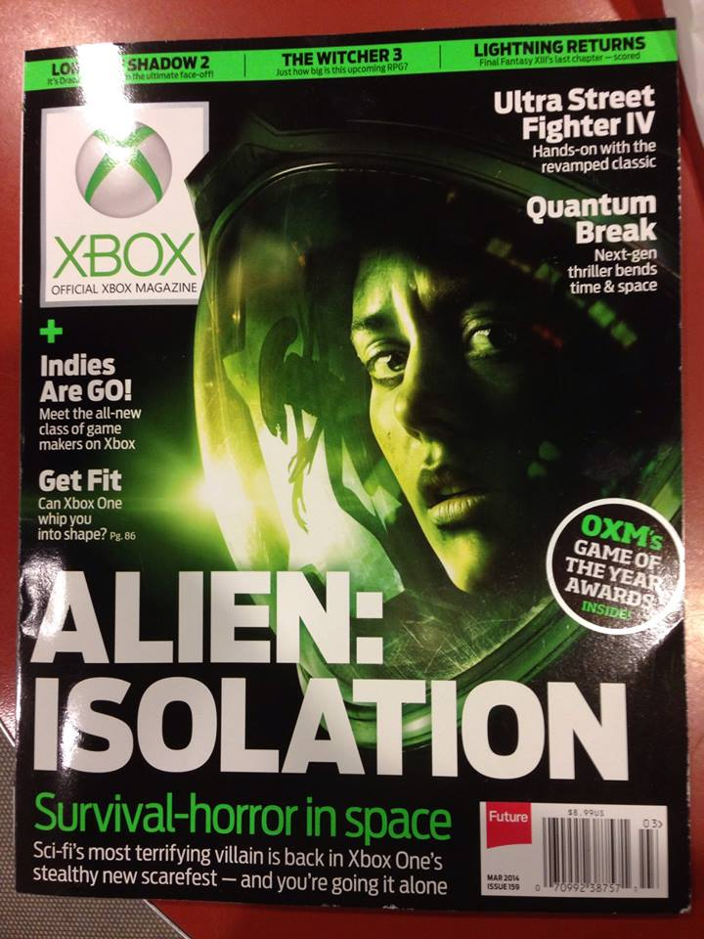
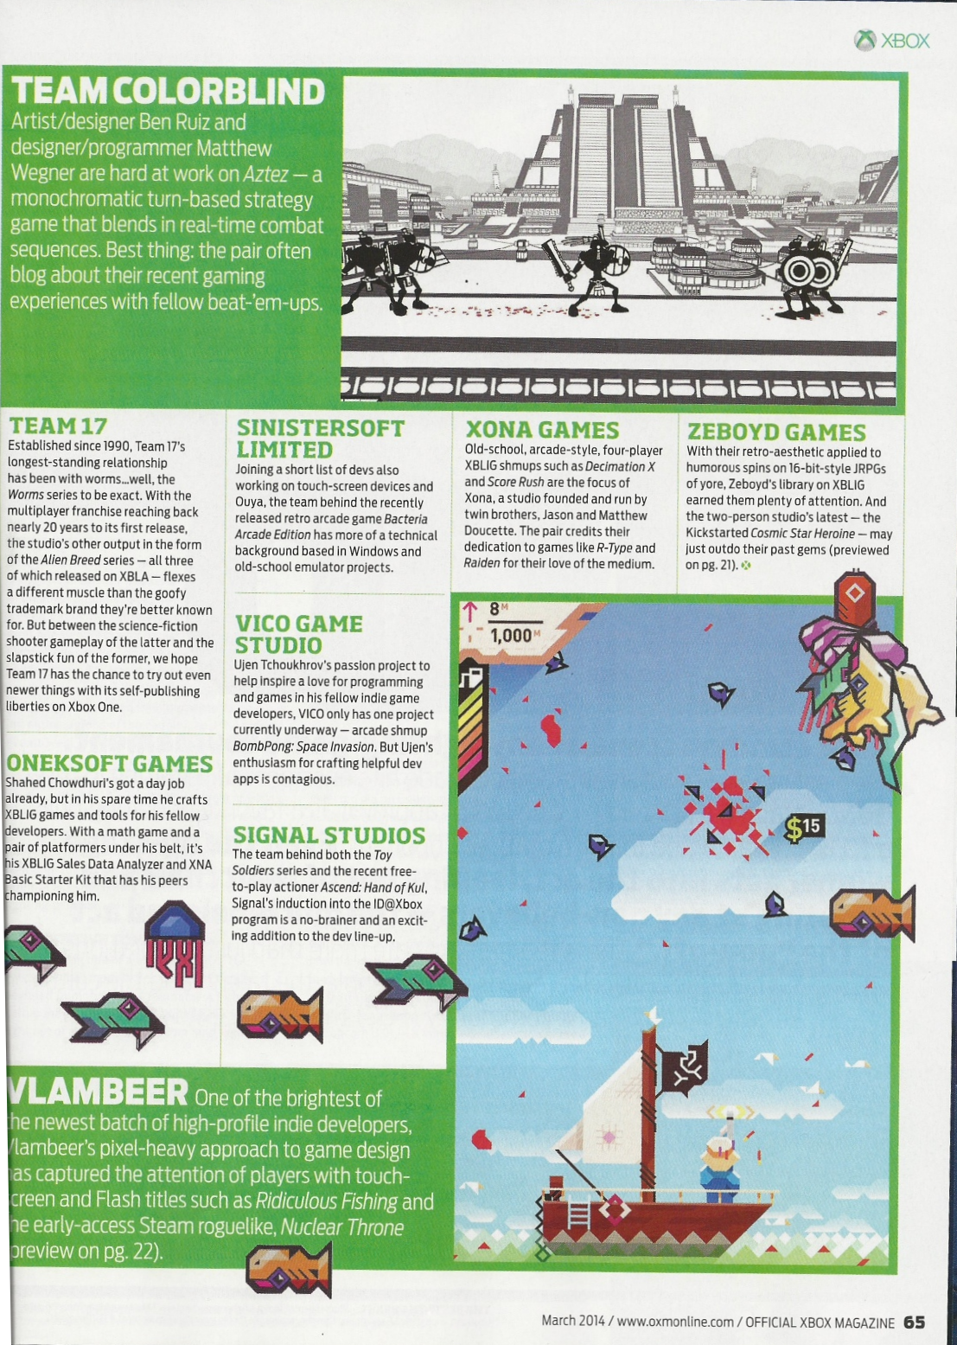
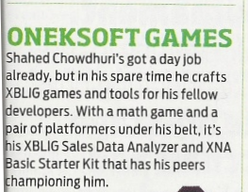
Official Xbox Magazine
`
Source: Official Xbox Magazine, March 2014, Page 65
Notes:
Official Xbox Magazine, March 2014, Page 65
"Shahed Chowdhuri's got a day job already,
but in his spare time he crafts XBLIG games and tools for his fellow developers.”
“With a math game and a pair of platformers under his belt,
it's his XBLIG Sales Data Analyzer and XNA Basic Starter Kit that has his peers championing him."

Slide 9
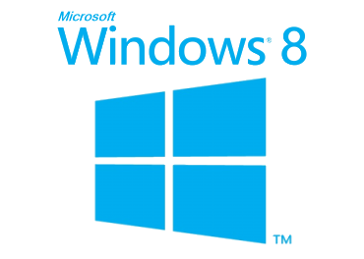
Tools & Technologies
+
Notes:
Tools & Technologies
Visual Studio 2013
Windows 8
Microsoft .NET and Visual C#
Windows Phone
HTML5/CSS/JS
Xbox One
Unity
C++ and DirectX 11.1+
XAML
Construct 2

Slide 10
Introduction
Notes:
Introduction

Slide 11
What is a Universal App?
"Apps that are tailored to people with disabilities"
"Apps that are automatically multi-lingual and culture adherent"
"Apps that can run on all platforms (iOS, Android, Windows)"
"A single app package that will work across Microsoft devices“
None of the Above?
Notes:
What is a Universal App?
"Apps that are tailored to people with disabilities"
"Apps that are automatically multi-lingual and culture adherent"
"Apps that can run on all platforms (iOS, Android, Windows)"
"A single app package that will work across Microsoft devices“
None of the Above?

Slide 12
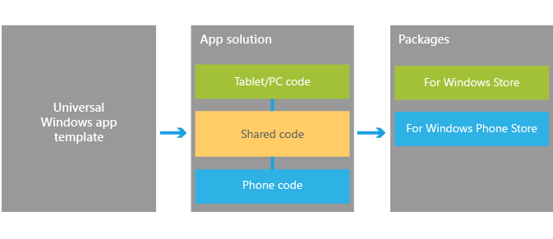
Universal Apps for Windows
Universal Apps for Windows
1 solution
1 shared project (no binary output)
1 project per platform (separate binary output per platform)
Windows, Windows Phone, Xbox One (coming soon!)
Ref: http://dev.windows.com/en-us/develop/Building-universal-Windows-apps
Notes:
Universal Apps for Windows
Universal Apps for Windows
1 solution
1 shared project (no binary output)
1 project per platform (separate binary output per platform)
Windows, Windows Phone, Xbox One (coming soon!)
Ref: http://dev.windows.com/en-us/develop/Building-universal-Windows-apps

Slide 13
Benefits of Universal Apps
Pricing structure – Match Windows Phone pricing on Windows 8
Shared in-app purchases – Buy IAPs only once, on either platform.
Install across devices – Buy app only once, own across platforms
Shared revenue model – Keep 70% of revenue
Unified ad-units for Windows Phone and Windows apps
Ref: http://www.wpcentral.com/what-is-a-universal-windows-app
Notes:
Benefits of Universal Apps
Pricing structure – Match Windows Phone pricing on Windows 8
Shared in-app purchases – Buy IAPs only once, on either platform.
Install across devices – Buy app only once, own across platforms
Shared revenue model – Keep 70% of revenue
Unified ad-units for Windows Phone and Windows apps
Ref: http://www.wpcentral.com/what-is-a-universal-windows-app

Slide 14
Streamlined Development
Notes:
Streamlined Development
(graphic)
UI → App Model → APIs → Tools → Store

Slide 15
Visual Studio
Notes:
Visual Studio

Slide 16
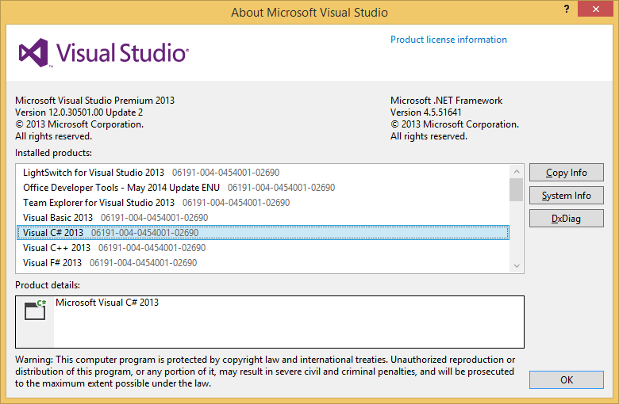
VS 2013 Update 2+
C# and XAML
HTML5 & JavaScript
C++ and DirectX
Notes:
VS 2013 Update 2+
C# and XAML
HTML5 & JavaScript
C++ and DirectX

Slide 17
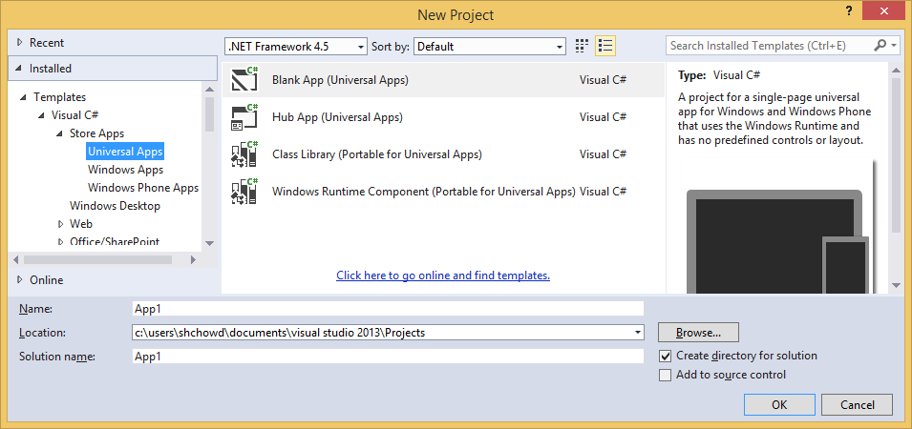
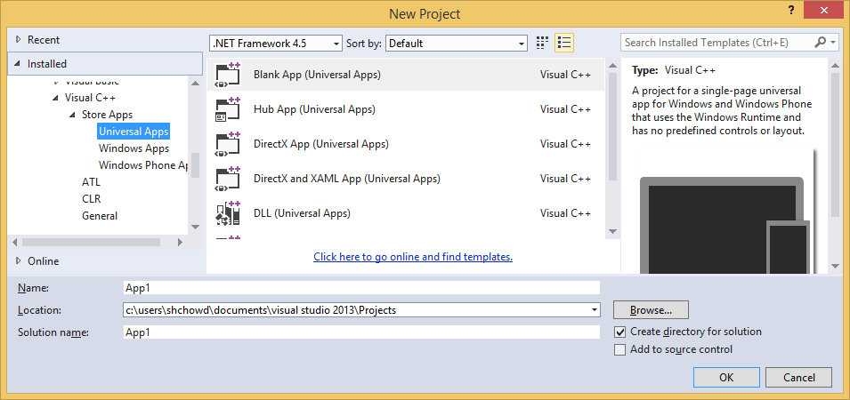
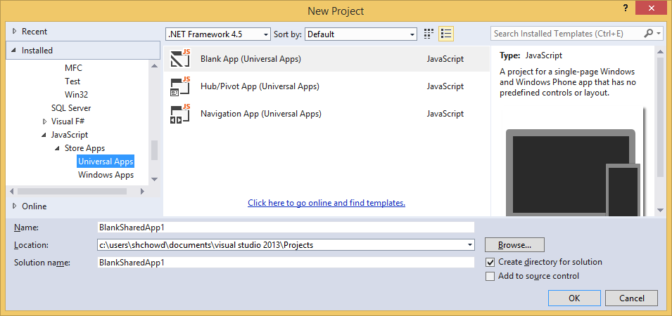
Creating a Universal Project
Notes:
Creating a Universal Project
Look under Store Apps for specific language
C++, C#, JavaScript

Slide 18
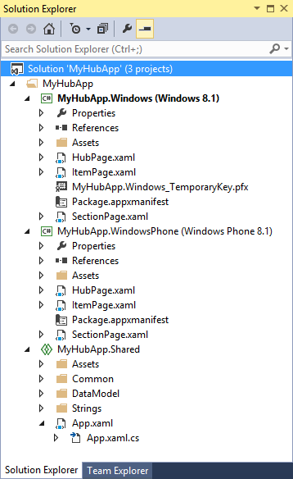
New Project
Windows 8.1 project
Windows Phone 8.1 project
Shared project
Notes:
New Project
Solution Explorer
Windows 8.1 project
Windows Phone 8.1 project
Shared project

Slide 19
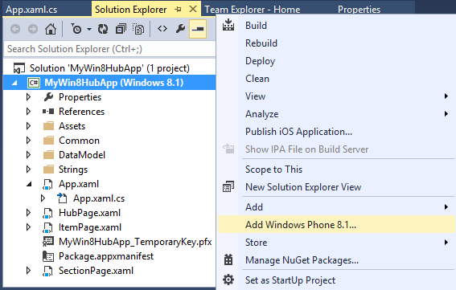
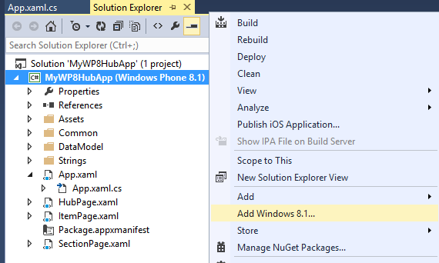
Existing Project
Windows 8.1 project?
Right-click → Add Windows Phone 8.1…
Windows Phone 8.1 project?
Right-click → Add Windows 8.1…
Notes:
Existing Project
Windows 8.1 project?
Right-click → Add Windows Phone 8.1…
Windows Phone 8.1 project?
Right-click → Add Windows 8.1…

Slide 20
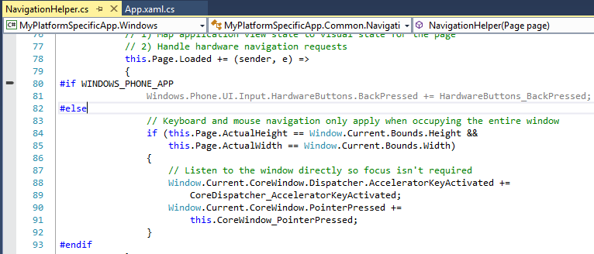
Platform-Specific Code (with conditional compilation)
Reference:
http://blogs.msdn.com/b/visualstudio/archive/2014/04/14/using-visual-studio-to-build-universal-xaml-apps.aspx
Notes:
Platform-Specific Code (with conditional compilation)
C#
WINDOWS_APP
WINDOWS_PHONE_APP
C++
WINAPI_FAMILY_PC_APP
WINAPI_FAMILY_PHONE_APP
Reference:
http://blogs.msdn.com/b/visualstudio/archive/2014/04/14/using-visual-studio-to-build-universal-xaml-apps.aspx

Slide 21
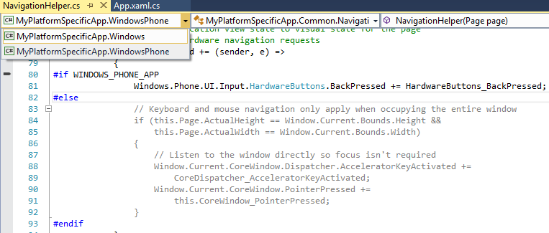
Context Chooser
Reference:
http://msdn.microsoft.com/en-us/library/windows/apps/dn609832.aspx
Notes:
Context Chooser
(top-left dropdown to choose Windows or Windows Phone)
Reference:
http://msdn.microsoft.com/en-us/library/windows/apps/dn609832.aspx

Slide 22
Sharing Code Across Universal Apps
How about using a Portable Class Library (PCL)?
“This type of project has been improved in Visual Studio 2013 Update 2 and now, if we target Windows 8.1 and Windows Phone 8.1, we’ll be able to use all the common APIs.
However, PCL produces a single binary that works as is in all the supported projects. Handling divergent APIs requires using higher-level abstractions, such as dependency injection or IoC containers. We can’t simply use conditional if to define platform specific code.”
Reference:
http://marcominerva.wordpress.com/2014/04/22/how-to-share-code-among-different-universal-windows-apps/
Notes:
Sharing Code Across Universal Apps
How about using a Portable Class Library (PCL)?
“This type of project has been improved in Visual Studio 2013 Update 2 and now, if we target Windows 8.1 and Windows Phone 8.1, we’ll be able to use all the common APIs.
However, PCL produces a single binary that works as is in all the supported projects. Handling divergent APIs requires using higher-level abstractions, such as dependency injection or IoC containers. We can’t simply use conditional if to define platform specific code.”
Reference:
http://marcominerva.wordpress.com/2014/04/22/how-to-share-code-among-different-universal-windows-apps/

Slide 23
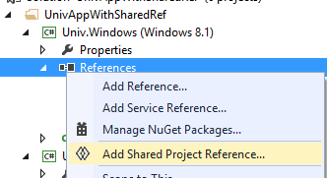
Shared Reference Project
Download & Install “Shared Project Reference Manager” from MSDN:
http://visualstudiogallery.msdn.microsoft.com/315c13a7-2787-4f57-bdf7-adae6ed54450
Add Project to Solution:
Add Class Library for each platform (Win 8.1 & WP 8.1)
Add Shared Project Reference to each Class Library.
Ref: http://marcominerva.wordpress.com/2014/04/22/how-to-share-code-among-different-universal-windows-apps/
Notes:
Shared Reference Project
Download & Install “Shared Project Reference Manager” from MSDN:
http://visualstudiogallery.msdn.microsoft.com/315c13a7-2787-4f57-bdf7-adae6ed54450
Add Project to Solution:
Add Class Library for each platform (Win 8.1 & WP 8.1)
Add Shared Project Reference to each Class Library.

Slide 24
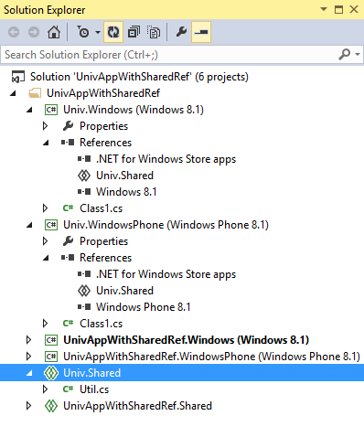
Shared References in Solution Explorer
Class Library for Windows 8.1
with reference to Shared project
Class Library for Windows Phone 8.1
with reference to Shared project
Shared project for Class Libraries
Notes:
Shared References in Solution Explorer
Class Library for Windows 8.1 with reference to Shared project
Class Library for Windows Phone 8.1 with reference to Shared project
Shared project for Class Libraries

Slide 25
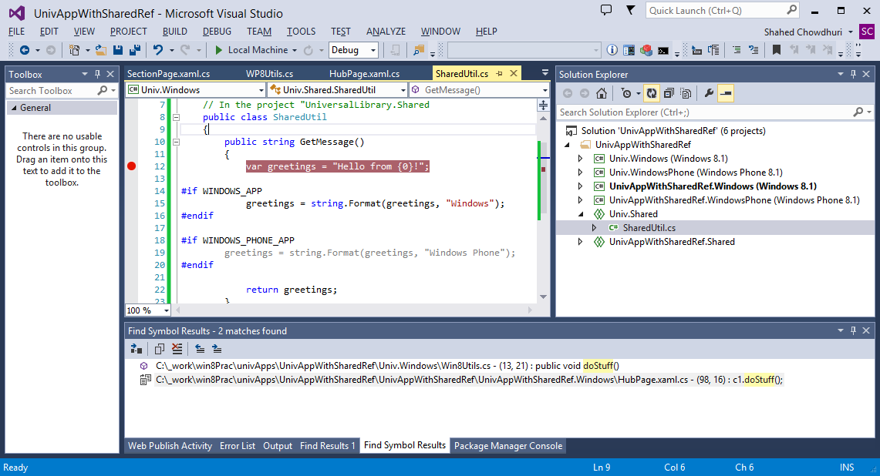
Demo
Notes:
Demo

Slide 26
Alternative Tools
Notes:
Alternative Tools

Slide 27
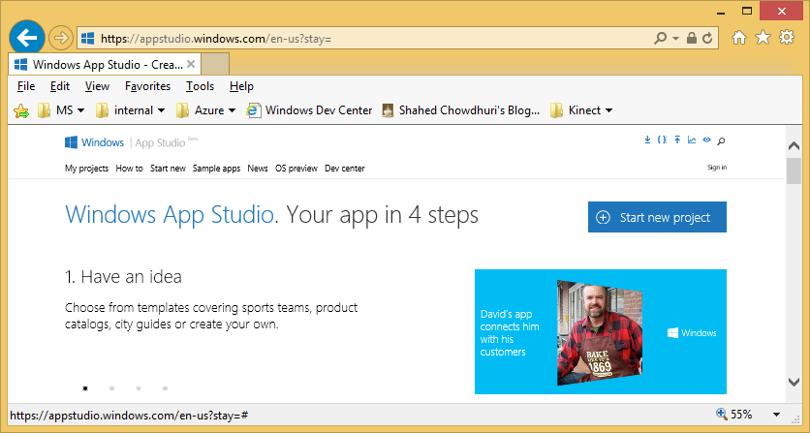
App Studio
App Studio
Link: https://appstudio.windows.com/
Notes:
App Studio
(website)
App Studio
Link: https://appstudio.windows.com/

Slide 28
App Studio in 4 Steps (from App Studio website)
App Studio Tutorial
Link: http://social.technet.microsoft.com/wiki/contents/articles/24933.create-a-universal-application-with-windows-app-studio.aspx
Notes:
App Studio in 4 Steps (from App Studio website)
Have an idea
Add content
Choose style
Use It!
App Studio Tutorial
Link: http://social.technet.microsoft.com/wiki/contents/articles/24933.create-a-universal-application-with-windows-app-studio.aspx

Slide 29
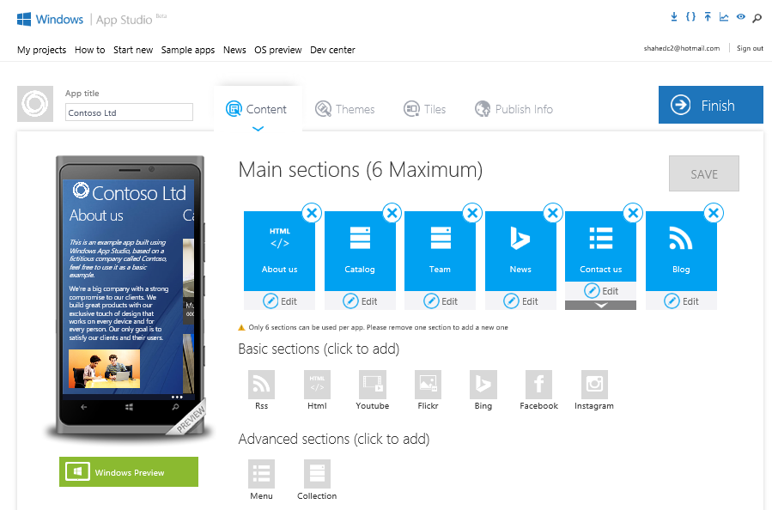
Build Your App in Your Browser
Click Finish
When Done
Notes:
Build Your App in Your Browser
(screenshot of App Studio UI)
Click Finish When Done

Slide 30
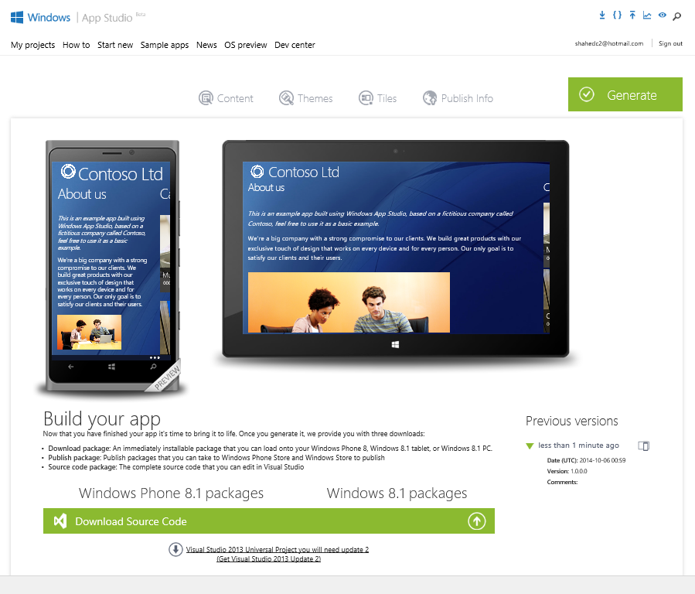
Generate & Download
Download Source Code
Notes:
Generate & Download
(screenshot of App Studio UI)
Download Source Code

Slide 31
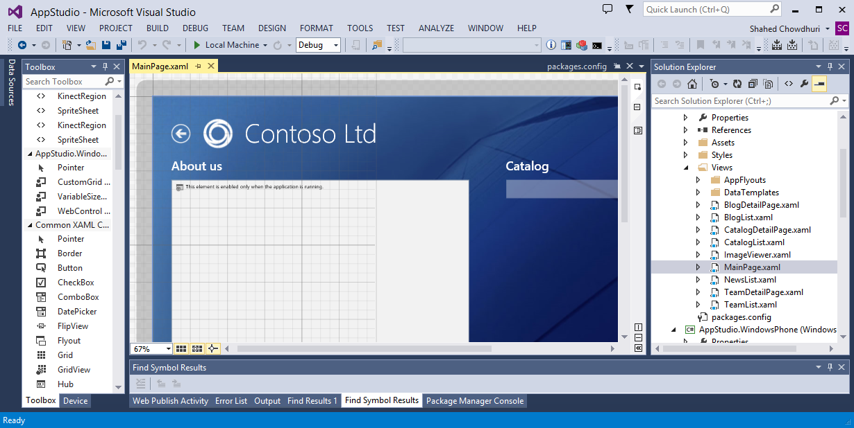
Demo
Notes:
Demo

Slide 32
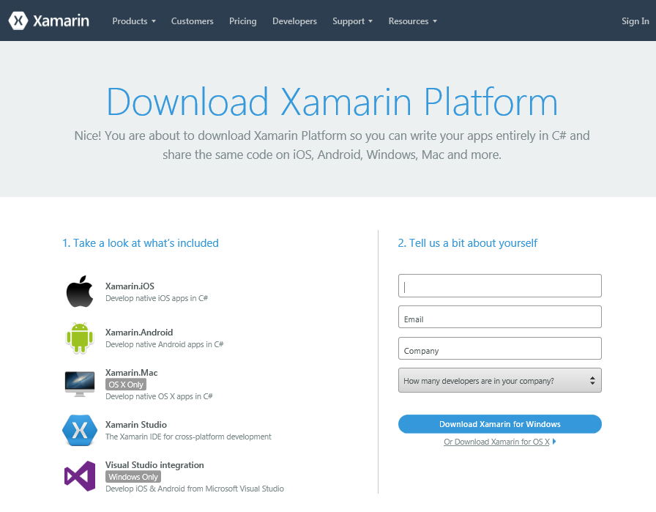
Xamarin
Download:
http://xamarin.com/download
Universal App Tutorials using Xamarin:
Link 1: http://vincenth.net/blog/archive/2014/04/09/how-to-build-xamarin-ios-and-android-apps-with-the-new-universal-windows-app-template-from-visual-studio-2013-update-2.aspx
Link 2: http://blog.falafel.com/porting-a-windows-app-studio-universal-app-to-android-using-xamarin/
Notes:
Download:
http://xamarin.com/download
Universal App Tutorials using Xamarin:
Link 1: http://vincenth.net/blog/archive/2014/04/09/how-to-build-xamarin-ios-and-android-apps-with-the-new-universal-windows-app-template-from-visual-studio-2013-update-2.aspx
Link 2: http://blog.falafel.com/porting-a-windows-app-studio-universal-app-to-android-using-xamarin/

Slide 33
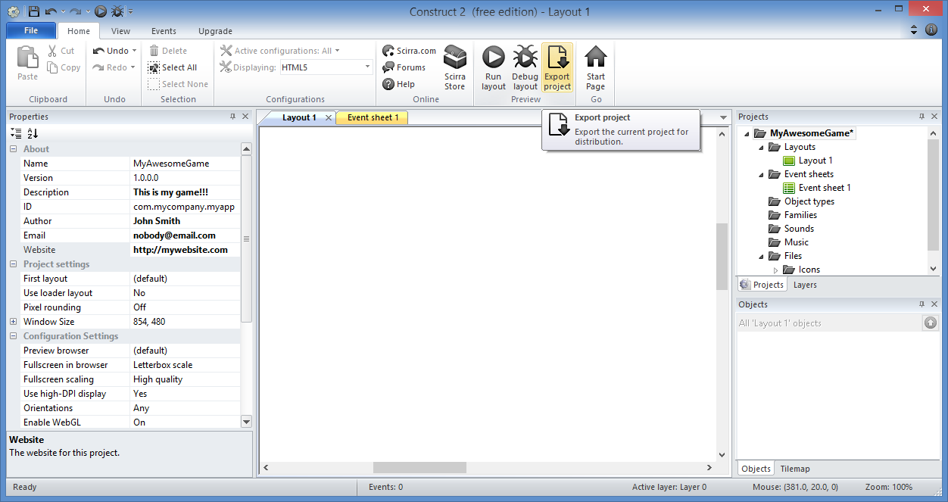
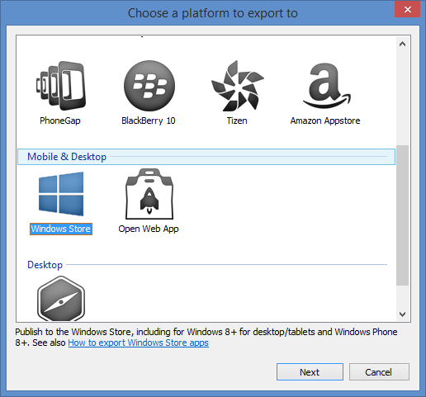
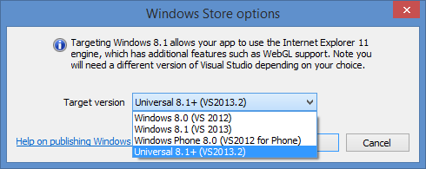
Construct 2
More information:
Index Page: http://WakeUpAndCode.com/construct2
Exporting & Publishing: http://wakeupandcode.com/construct-2-exporting-and-publishing-to-web-windows-8-and-windows-phone-8/
Notes:
Construct 2
(screenshot of Construct 2 UI for Exporting to Windows Universal format)
More information:
Index Page: http://WakeUpAndCode.com/construct2
Exporting & Publishing: http://wakeupandcode.com/construct-2-exporting-and-publishing-to-web-windows-8-and-windows-phone-8/

Slide 34
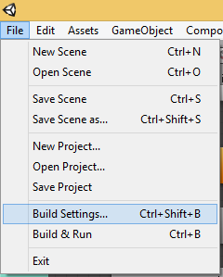
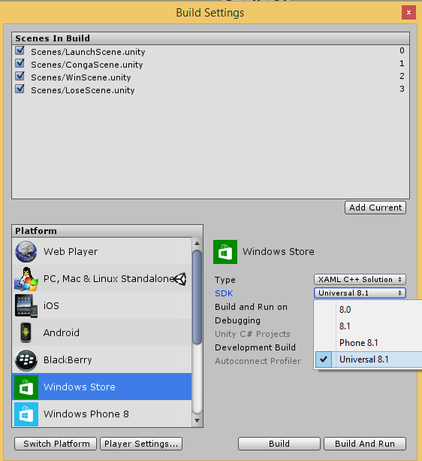
Unity
More Information
Index Page: http://WakeUpAndCode.com/unity
Universal Apps in Unity: http://blogs.unity3d.com/2014/08/07/introducing-universal-windows-applications-in-unity/
Notes:
Unity
(screenshot of Unity for setting Build Settings to Windows Universal format)
More Information
Index Page: http://WakeUpAndCode.com/unity
Universal Apps in Unity: http://blogs.unity3d.com/2014/08/07/introducing-universal-windows-applications-in-unity/

Slide 35
Publishing
Notes:
Publishing

Slide 36
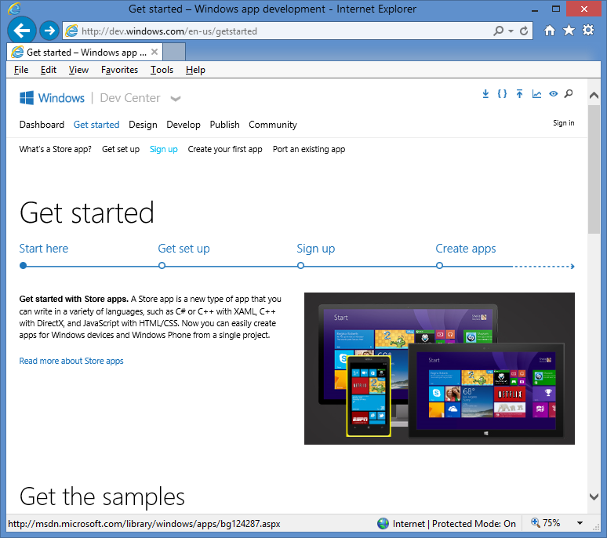
Open Developer Account
Sign up for a
developer account on:
http://dev.windows.com
Click “Get Started”
Click “Sign up”
Notes:
Open Developer Account
Sign up for a
developer account on:
http://dev.windows.com
Click “Get Started”
Click “Sign up”

Slide 37
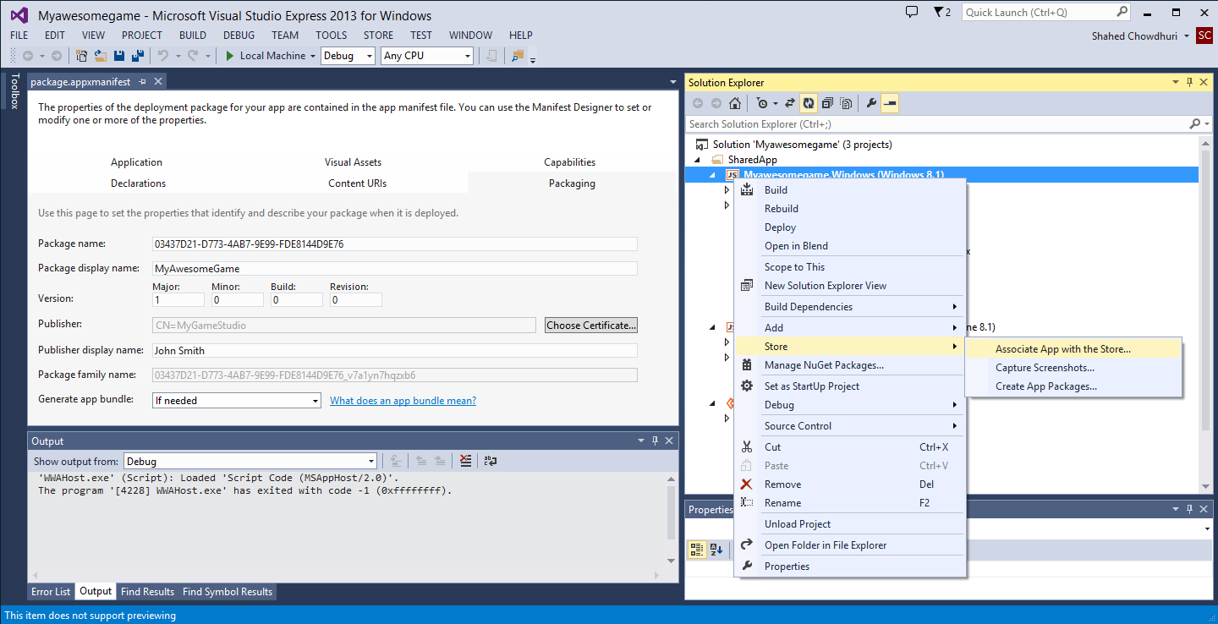
Associate App with the Store
Right-click project,
… then select Store
Notes:
Associate App with the Store
Right-click project… then select Store
Then click Associate App with the Store

Slide 38
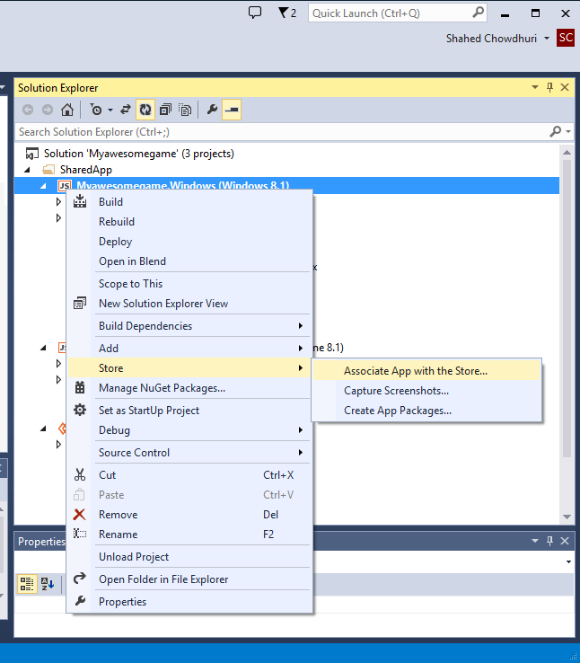
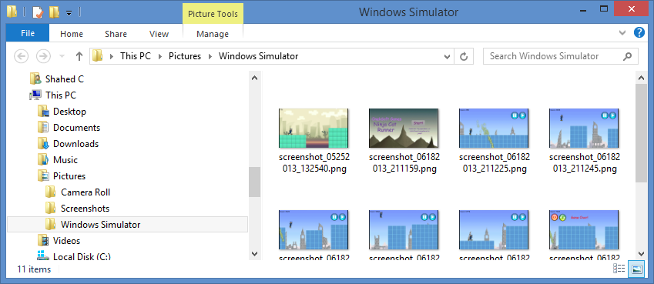
Create Store Graphics
Notes:
Create Store Graphics
Right-click project… then select Store
Then Capture Screenshots…
Go to “Pictures/Windows Simulator” to see screenshots

Slide 39
Create App Package
Create App Packages…
Notes:
Create App Package
Right-click project… then select Store
Then Create App Packages…

Slide 40
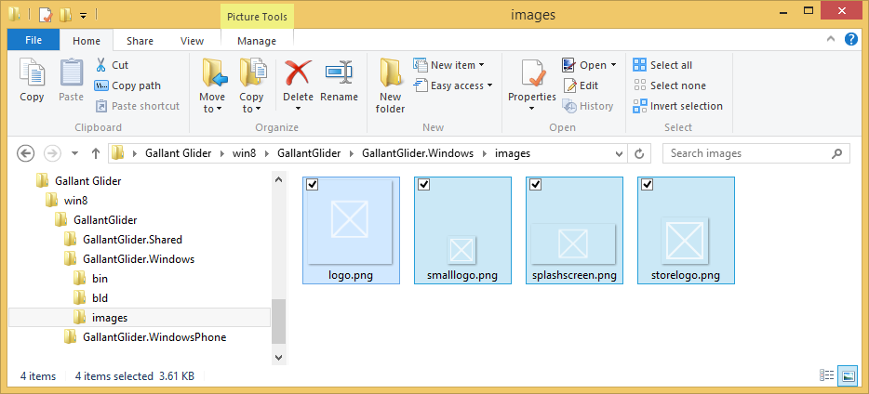
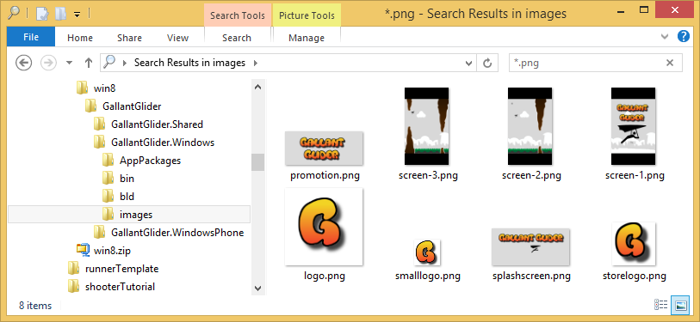
Create Logo/Splash Graphics
Notes:
Create Logo/Splash Graphics
* Replace placeholder graphics in “images” inside .Windows subfolder

Slide 41
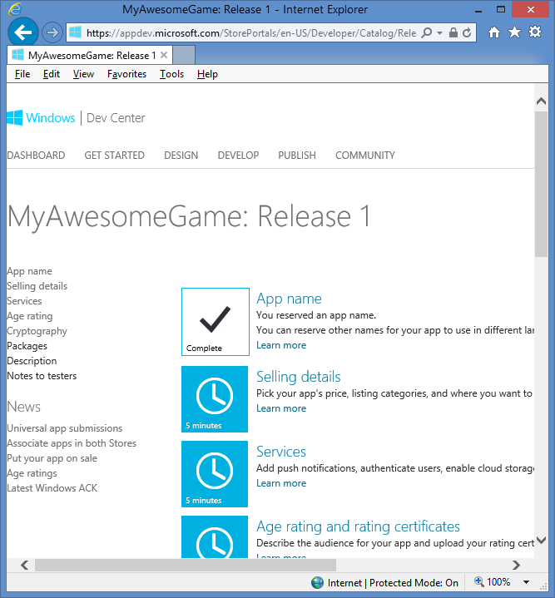
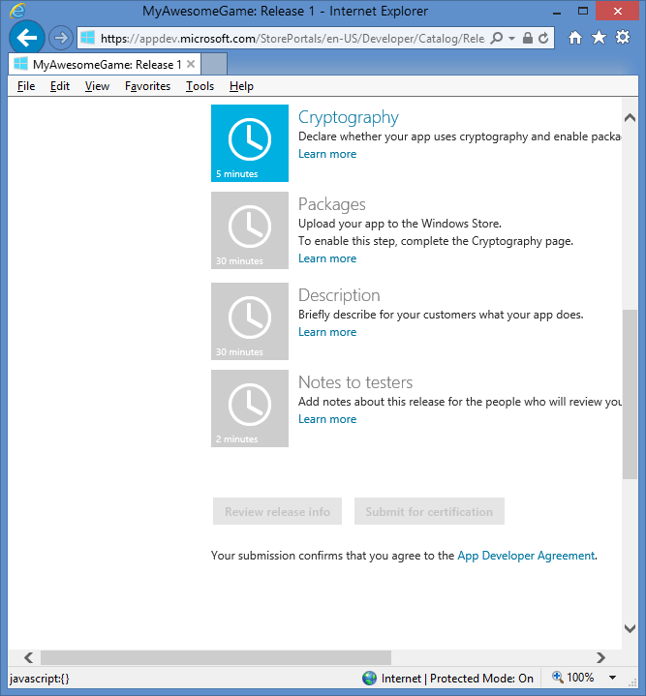
Publish App Package
Submitting to the Windows Store
Notes:
Publish App Package
Submitting to the Windows Store
Fill out info via the Web UI

Slide 42
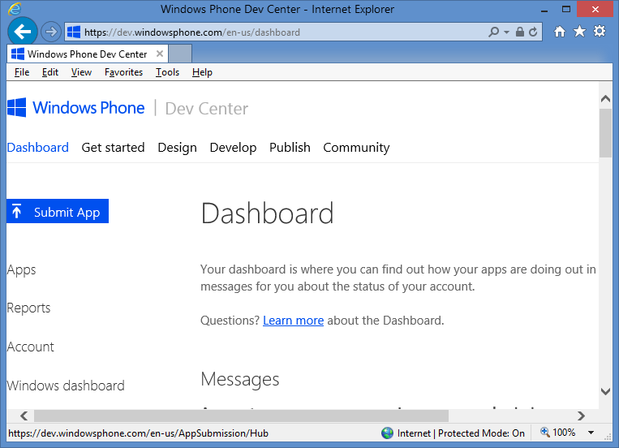
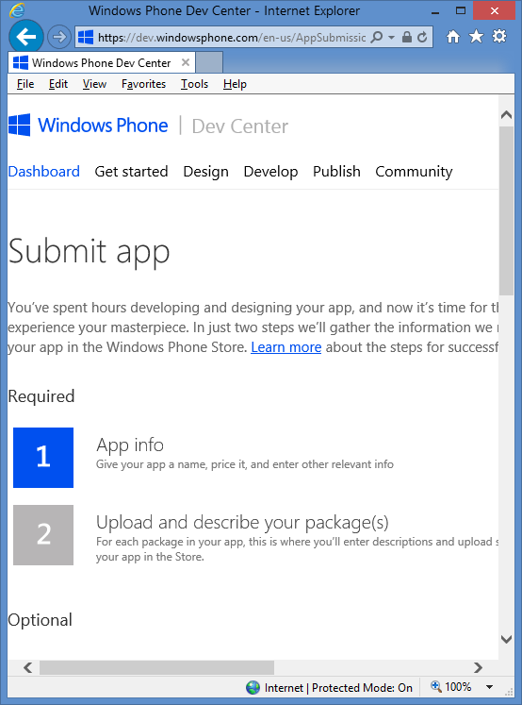
Publish on Windows Phone
Submitting to the Windows Phone Store
Notes:
Publish on Windows Phone
Submitting to the Windows Phone Store
Fill out info via the Web UI

Slide 43
Questions?
Notes:
Questions?

Slide 44
For more info:
Samples on MSDN:
http://code.msdn.microsoft.com/windowsapps/Universal-Windows-app-cb3248c3
MVA:
Live event: http://www.microsoftvirtualacademy.com/liveevents/developing-universal-windows-apps-c-xaml-jump-start (just missed it!)
But stay tuned for archived video!
Blog: http://blog.jerrynixon.com/
Twitter: https://twitter.com/jerrynixon
Wintellect
Blog Post: http://www.wintellect.com/blogs/jprosise/building-universal-apps-with-visual-studio-2013-update-2
Notes:
For more info:
Samples on MSDN:
http://code.msdn.microsoft.com/windowsapps/Universal-Windows-app-cb3248c3
MVA:
Live event: http://www.microsoftvirtualacademy.com/liveevents/developing-universal-windows-apps-c-xaml-jump-start (just missed it!)
But stay tuned for archived video!
Blog: http://blog.jerrynixon.com/
Twitter: https://twitter.com/jerrynixon
Wintellect
Blog Post: http://www.wintellect.com/blogs/jprosise/building-universal-apps-with-visual-studio-2013-update-2

Slide 45
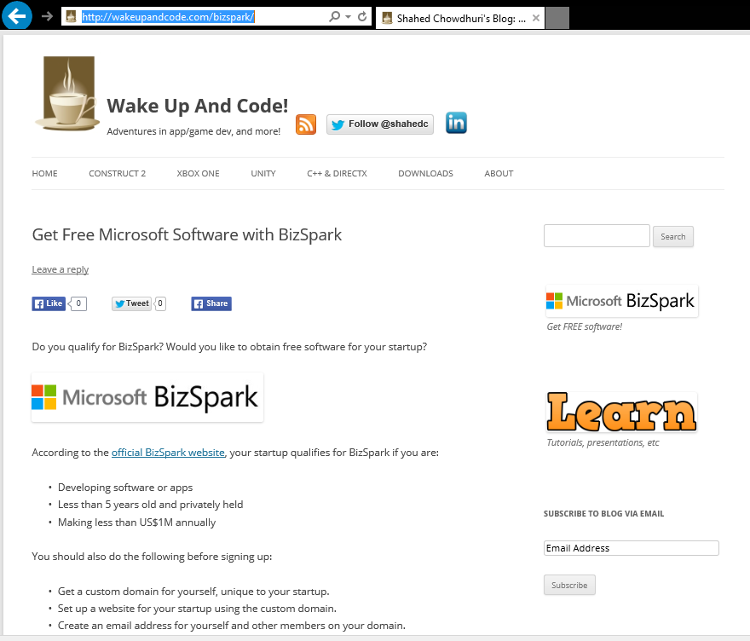
BizSpark
More info:
http://WakeUpAndCode.com/bizspark
Options:
Get event code from flyer
OR
Contact me for pre-approved code

Slide 46
Contact
Email: shchowd@microsoft.com  Twitter: @shahedC
Notes:
Contact
Microsoft email: shchowd@microsoft.com
Personal Twitter: @shahedC
Dev Blog: WakeUpAndCode.com

