Slide 1
What’s New?

Slide 2
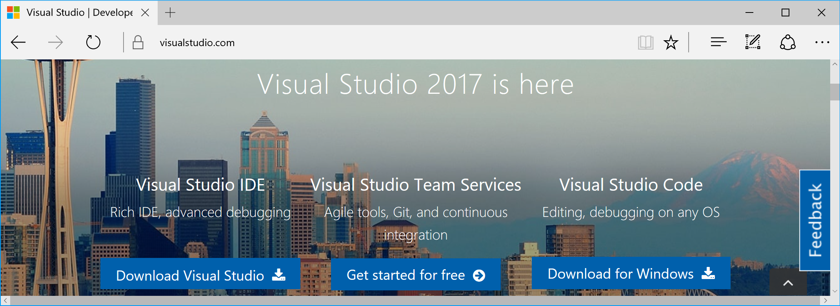
Visual Studio 2017
Downloads: https://www.visualstudio.com

Slide 3
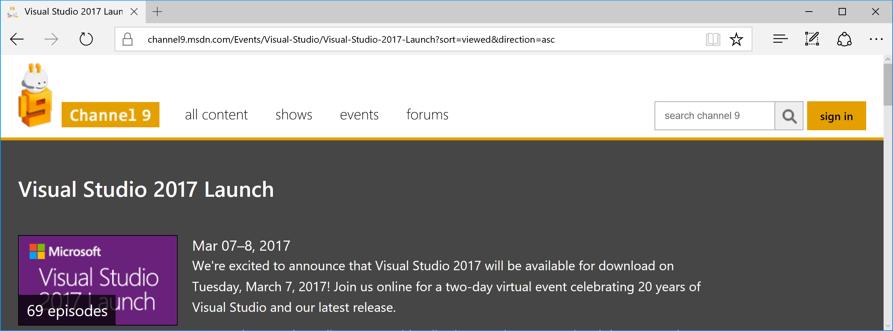
VS2017 Launch Videos
MSDN Ch9: https://channel9.msdn.com/Events/Visual-Studio/Visual-Studio-2017-Launch

Slide 4
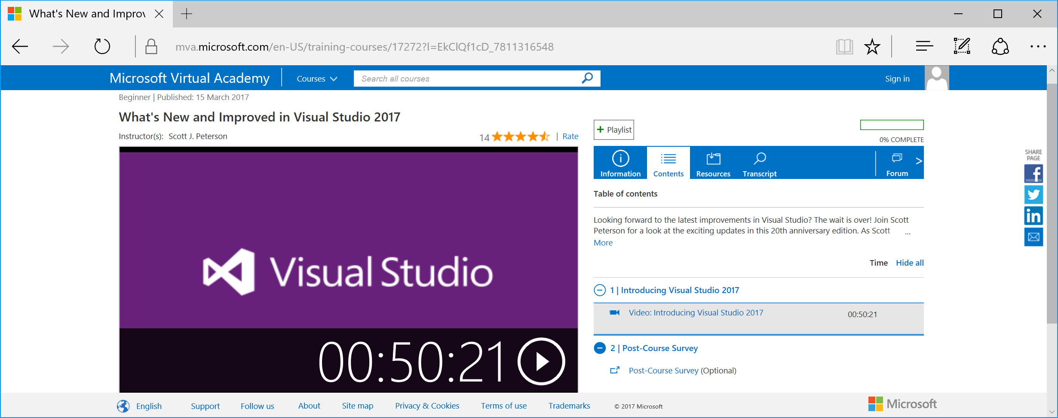
What’s New in VS2017?
MVA: https://mva.microsoft.com/en-US/training-courses/17272

Slide 5
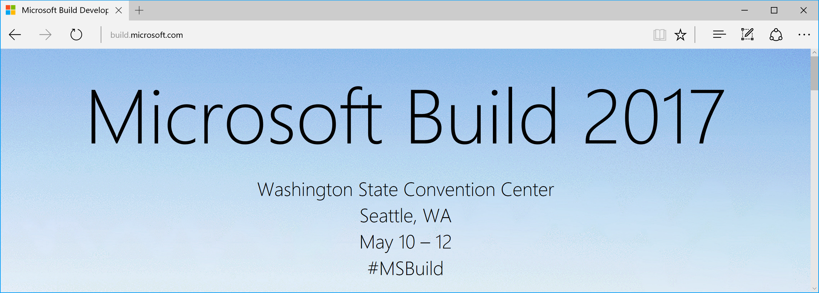
MS Build Conference 2017
Videos & Event Info: http://build.microsoft.com

Slide 6
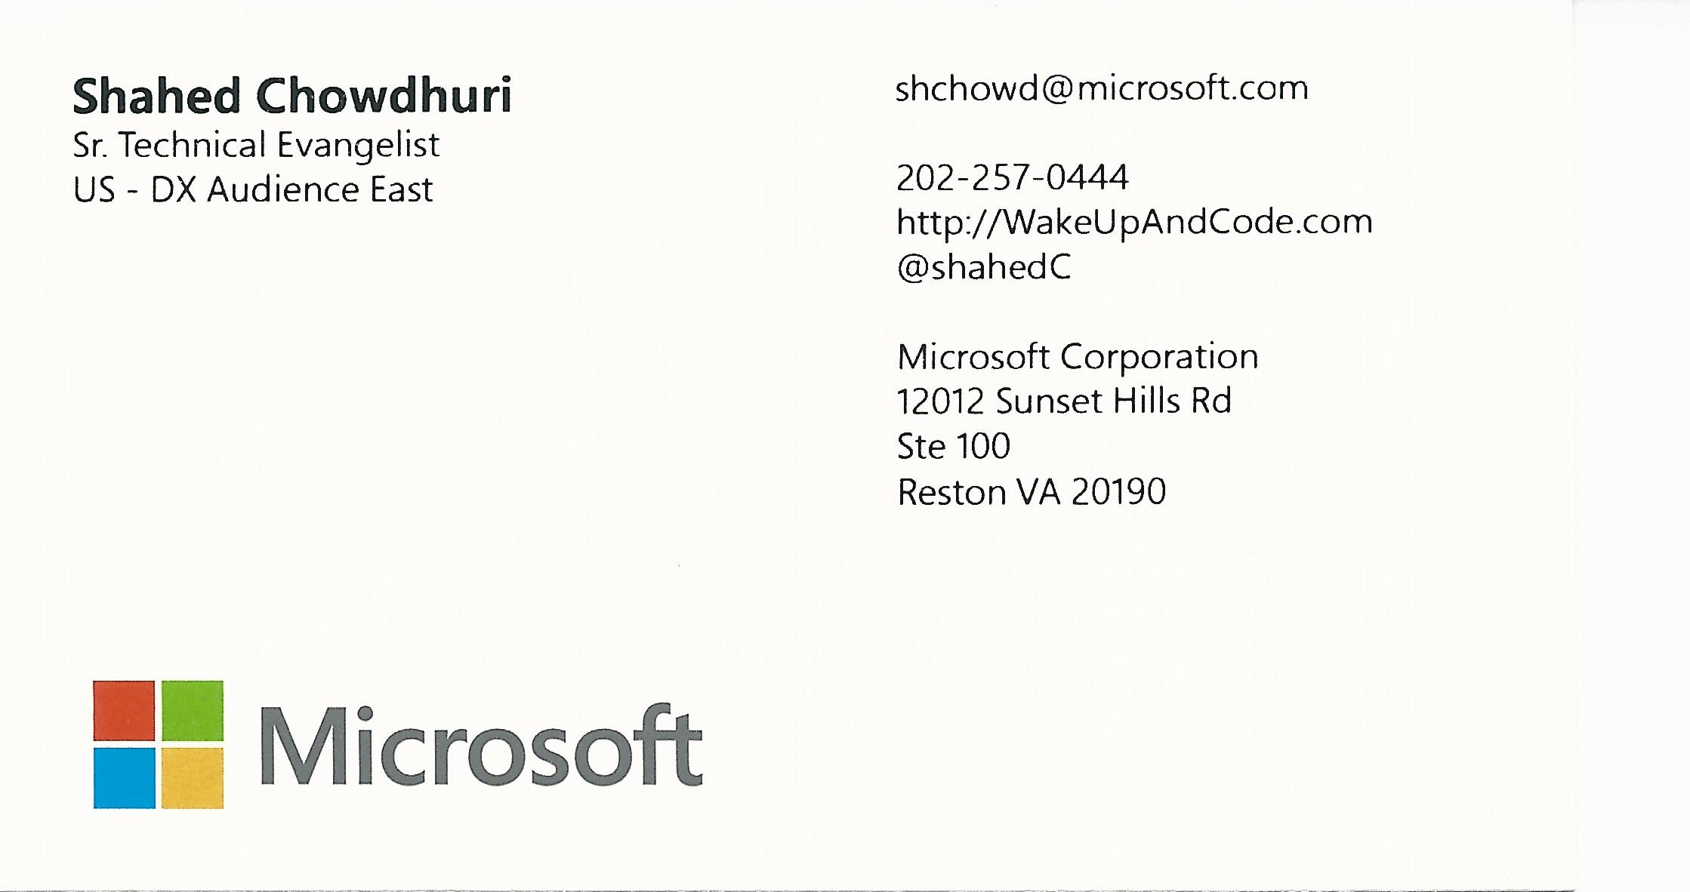
@shahedC
SHAHED CHOWDHURI Sr. Technical Evangelist @ Microsoft Blog: http://WakeUpAndCode.com Shahed.Chowdhuri@Microsoft.com

