Slide 1
Deeper Into
Windows 10 Development
Universal Windows Apps
Shahed Chowdhuri
Sr. Technical Evangelist @ Microsoft
WakeUpAndCode.com

Slide 2
Quick Overview
  One Windows
  Many devices
Windows 10 App Development
  Build 2015
  MSDN Channel 9
  Microsoft Virtual Academy
Demos
  Public projects from Github

Slide 3
Windows Core
The refactored common core
  One hardware platform
  Universal hardware driver
  Standard network and I/O
Desktop
SKU
Phone
SKU
Xbox
SKU
Windows Core
Desktop
Device
Phone
Device
Xbox
Device

Slide 4
One Windows
Desktop
SKU
Mobile
SKU
Xbox
SKU
IoT
SKU
IoT headless
SKU
Surface Hub
SKU
Holographic
SKU
PC
2 in 1
Tablet
Phablet
Phone
Xbox
Band
Raspberry Pi
Surface Hub
HoloLens
Home Automation

Slide 5
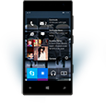
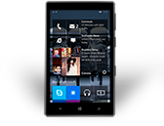
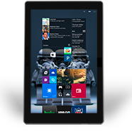
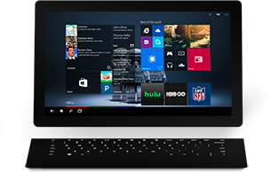
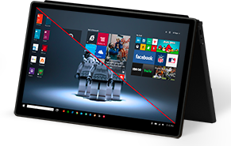
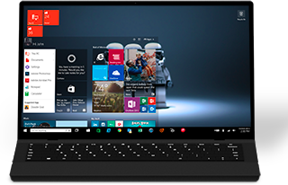
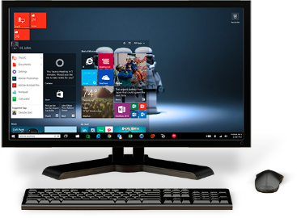
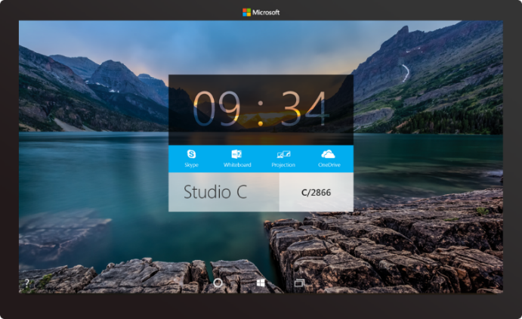

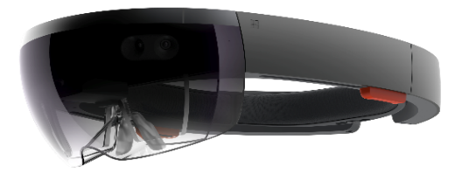

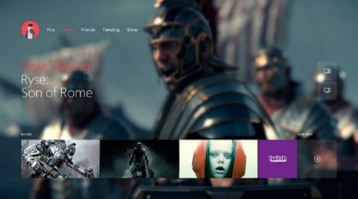

2-in-1s
(Tablet or Laptop)
Classic
Laptop
Desktops
& All-in-Ones
Phone
Phablet
Small Tablet
Large Tablet
Windows 10
Surface Hub
Xbox
Holographic
IoT

Slide 6
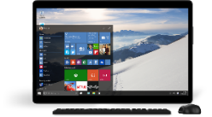
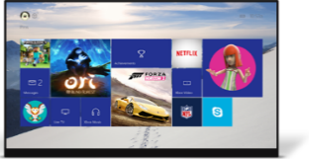
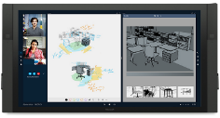




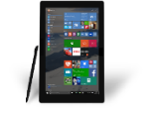












PC
XBox
Mobile
Surface Hub
Devices +IoT
HoloLens
Universal Windows Apps
Multiple device families
Adaptive
User Interface
Reuse Existing Code
Natural
User Inputs
One Store +
One Dev Center
One SDK + Tooling
One Universal Windows Platform

Slide 7
WPF
WF
MFC
XAML
HTML
Bridging technologies
Obj.C
iOS
Java
Android
Web
hosted
Win32
desktop
DirectX
.Net
languages
C++
.Net
languages
C++
& CX
WWA
.Net
runtime
Universal Windows Platform
Windows 10
operating system

Slide 8
Apps don't target Windows 10, apps target the platform

Slide 9
Windows store packaging
Feature | WP XAP 8.1 | WP AppX 8.1 | AppX 8.1 | AppX 10.x
Platform | WP 8.1+ | WP 8.1 | Win 8.1 | Win 10
Device OS Build version targeting |  |  |  | 
Encryption |  |  |  | (not yet)
App Bundles |  |  |  | 
Debug Package Signing |  |  |  | 
Differential Download/Update |  |  |  | 
File Single Instancing |  |  |  | 
External Volume (SD) Installation |  |  |  (Win 10) | 
Shared publisher storage |  |  |  | 

Slide 10
Windows store distribution
 | Windows Phone 7.x, 8.x | Windows 8.x | Windows 10
Hidden apps |  |  | 
Per market pricing |  |  | 
Independent IAP publishing |  |  | 
Betas / flighting |  |  | 
Time based trials |  |  | 
App discounts |  |  | 
Scheduled publish |  |  | 

Slide 11
Considerations
Best practices
  Consider ads during the design phase
  Show video ads during natural breaks
  Associate ads with real up-sides
Worst practices
  Showing ads at app-start
  Interrupt the user’s workflow
  Back-to-back ads

Slide 12
In-app purchases
#if DEBUG
var license = CurrentAppSimulator.LicenseInformation;
if (license.ProductLicenses["AdFree"].IsActive)
{
// already owns
this.ShowAds = false;
}
else
{
var result = await CurrentAppSimulator.RequestProductPurchaseAsync("AdFree");
switch (result.Status)
{
case ProductPurchaseStatus.Succeeded:
case ProductPurchaseStatus.AlreadyPurchased:
this.ShowAds = false;
break;
default:
this.ShowAds = true;
break;
}
}
#else
var license = CurrentApp.LicenseInformation;
...
#endif

Slide 13
The Windows store provides many ways to monetize your app

Slide 14
The XAML UI platform
Windows is standardizing
  New experiences like Start and File Explorer use the XAML UI platform
  The operating system has tremendous performance requirements
Office is standardizing
  The universal suite of Office apps use the XAML UI platform
  Office has tremendous usability and feature requirements
First-party is standardizing
  New and existing MSN apps for Windows use the XAML UI platform
  First party apps push the edge of API capability and availability

Slide 15
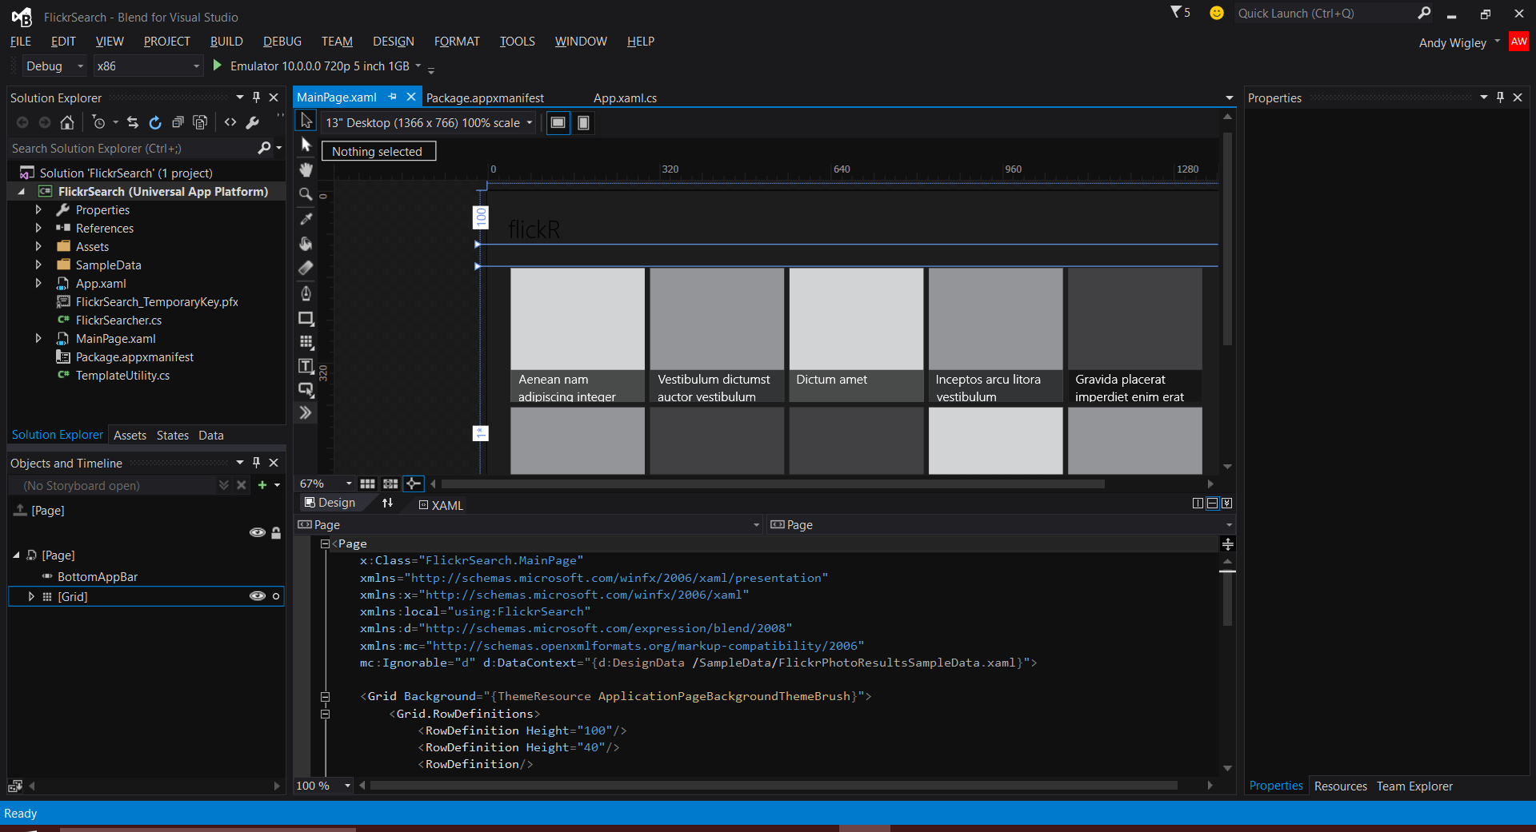
Blend, the XAML developer’s IDE
Visual Studio Shell
  XAML Intellisense
  XAML Peek
  Sync Settings
  Quick launch
Classic Blend
  Resources
  Data
  Storyboards
  States
  Behaviors

Slide 16
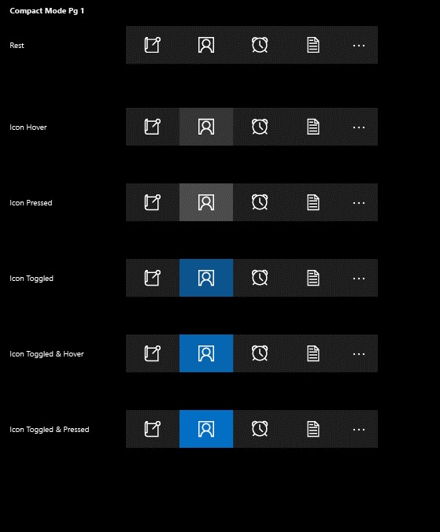
App bars and commands
<AppBar />
<CommandBar />
<AppBarButton Label="" Icon="" />
<AppBarToggleButton IsChecked="" />
<AppBarSeparator />

Slide 17
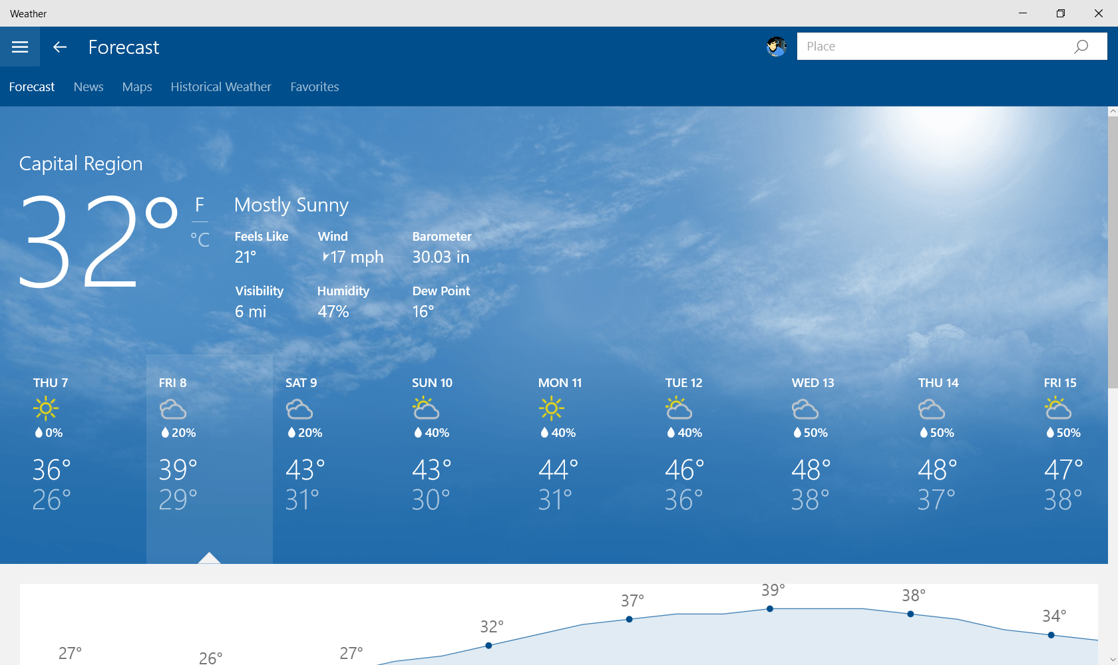

Slide 18
The XAML UI platform is foundational to Windows

Slide 19
x:Bind
Compiled binding
  Bindings are committed at compile-time
Strongly-typed binding
  Duck binding is not supported
Default mode is OneTime
  OneWay and TwoWay are still available
Standard binding approaches
  INotifyPropertyChanged, IObservableVector, INotifyCollectionChanged

Slide 20
Syntax
<TextBox Text="{Binding
Converter
ConverterLanguage
ConverterParameter
ElementName
FallbackValue
Mode
Path
RelativeSource
Source
TargetNullValue
UpdateSourceTrigger}
<TextBox Text="{x:Bind
Converter
ConverterLanguage
ConverterParameter
ElementName
FallbackValue
Mode
Path
RelativeSource
Source
TargetNullValue
UpdateSourceTrigger}

Slide 21
Data Templates
<ListView ItemsSource="{x:Bind ViewModel.Employees}">
<ListView.ItemTemplate>
<DataTemplate x:DataType="model:Employee">
<Grid>
<TextBlock Text="{x:Bind Name}"/>
</Grid>
</DataTemplate>
</ListView.ItemTemplate>
</ListView>

Slide 22
When to use classic binding
Duck Typing
  Text=“{Binding Age}” works for both PersonModel & WineModel
Dictionary graphs
  Use {Binding} with JSON or other untyped objects
Code-behind binding
  Can add/remove {x:Bind} @ runtime
Use in a style
  {x:Bind} can’t be used in a style for setters
  {x:Bind} can be used in a DataTemplate that is defined in the style

Slide 23
x:Bind can meet your binding needs most of the time.

Slide 24
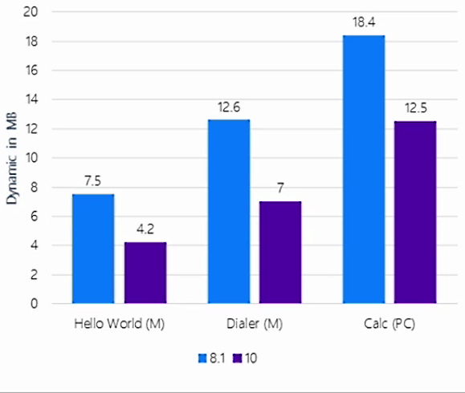
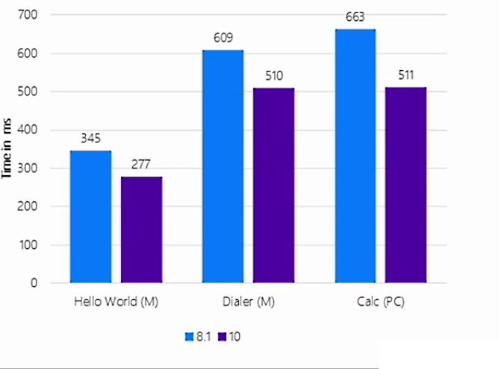
Benefits on the universal platform
Memory
Startup

Slide 25
x:Phase & progressive rendering
  <DataTemplate x:DataType="model:FileItem">
  <Grid Width="200" Height="80">
  <TextBlock Text="{x:Bind DisplayName}" />
  <TextBlock Text="{x:Bind prettyDate}" x:Phase="1"/>
  </Grid>
  </DataTemplate>
Some guidance
  Phase "0" is the default
  Only a few, manageable phases
  Phase numbers don't need to be contiguous

Slide 26
Understanding deferral
Reduce the number of elements at startup
  Declare the UIElement-derived items (or containers) you don't want rendered
4 ways to realize an element
  FindName()
  EnsureElementRealized()
  GetTemplatedChild() (for ControlTemplate)
  Storyboard & VisualStates (because of FindName)
Nothing is free
  A lightweight proxy element is created
  Events are hooked up after realized
  Binding is completed after realized (including x:Bind)

Slide 27
x:Defer example
<StackPanel
x:Name="AdditionalProductPage"
Visibility="Collapsed"
x:DeferLoadStrategy="Lazy">
<!-- so much stuff -->
</StackPanel>

Slide 28
The fastest code is the code you don't run

Slide 29


Adaptive controls

Slide 30


Input intelligence

Slide 31
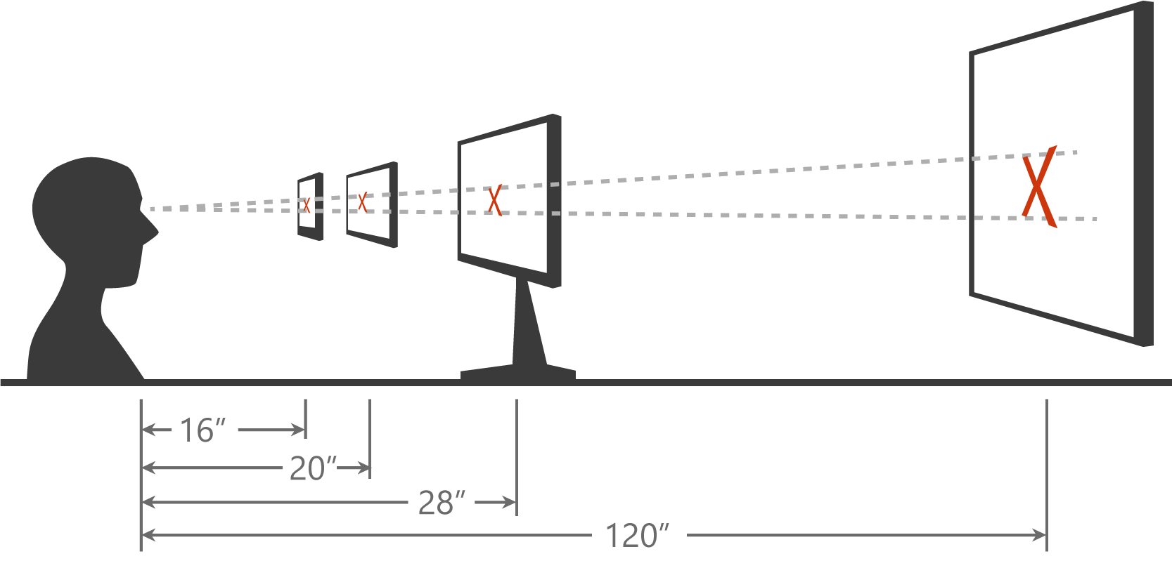
Scaling algorithm

Slide 32
As you design
Adapt to size change
Adapt to input change
Build with effective pixels
Count on the scaling algorithm

Slide 33
Adapt to different devices without targeting each and every device

Slide 34
Visual States
Define XAML views
  Unique layout for distinct states
Simplify animation
  Automatically implement state transitions
Build in Blend
  Design and preview states and transitions

Slide 35
How to set the visual state
VisualStateManager.Goto(element, state, transition)
public MainPage()
{
this.InitializeComponent();
this.SizeChanged += (s, e) =>
{
var state = "VisualState000min";
if (e.NewSize.Width > 1000)
state = "VisualState1000min";
else if (e.NewSize.Width > 800)
state = "VisualState800min";
else if (e.NewSize.Width > 500)
state = "VisualState500min";
VisualStateManager.GoToState(this, state, true);
};
}

Slide 36
Adaptive triggers
Code-free state transition
Two built-in triggers
  MinWindowHeight (Taller than this)
  MinWindowWidth (Wider than this)
<VisualState x:Name="VisualState500min">
<VisualState.StateTriggers>
<AdaptiveTrigger MinWindowWidth="501" />
</VisualState.StateTriggers>
</VisualState>

Slide 37
Custom adaptive triggers
Build to handle special cases.
public class DeviceFamilyTrigger : StateTriggerBase
{
private string _deviceFamily;
public string DeviceFamily
{
get { return _deviceFamily; }
set
{
var qualifiers = Windows.ApplicationModel.Resources.Core
.ResourceContext.GetForCurrentView().QualifierValues;
if (qualifiers.ContainsKey("DeviceFamily"))
SetActive(qualifiers["DeviceFamily"] == (_deviceFamily = value));
else
SetActive(false);
}
}
}

Slide 38
Developers have many tools to build an adaptive UI

Slide 39
What are Adaptive Apps?
Windows apps adapt to different versions of the platform
Windows apps adapt to different types of devices
Windows apps adapt to different screen sizes
Adaptive UI handles different screens
Adaptive Code can "light up" your app to conditionally execute code only when running on specific device families and/or particular versions of platform/extension APIs
  Conditionally take advantage of unique device capabilities
  Use newer APIs while still supporting down-level clients

Slide 40
Windows 8.1 Universal:
Shared code, two binaries
Windows
Binary
Phone
Binary

Slide 41
Declare Device Family Dependencies
Dependency on a single device family:
<Dependencies>
<TargetDeviceFamily Name="Windows.Universal"
minVersion="10.0.10069.0" maxVersionTested="10.5.0.0" />
</Dependencies>
On more than one:
<Dependencies>
<TargetDeviceFamily Name="Windows.Desktop"
minVersion="10.0.10069.0" maxVersionTested="10.5.0.0" />
<TargetDeviceFamily Name="Windows.Universal"
minVersion="10.0.10069.0" maxVersionTested="10.5.0.0" />
</Dependencies>

Slide 42
Extension SDKs
UWP
UWP
UWP
UWP
Windows Core
Windows Core
Windows Core
Windows Core
Desktop
Mobile
Xbox
More…

Slide 43
The device families you choose determines which APIs you can call freely

Slide 44


Locations where apps can access data
Cloud
Credential Locker
App
App
File Open/Save Picker APIs
Picker Provider apps
Publishers Shared Folder
File System
B/ground Transfer
r/w
r/w
r/w
r/w
Temp
Pictures
Videos
Music
- Direct access needs manifest capabilities
App data Folders
Roaming
App data Folders
App
Known Folders
Local
r/w
App data Folders
r/w
App Package Folder
r/w
Removable
Storage
(SD Card)
r/o

Slide 45





Package and App Data Folders
Package Manager installs all app files into the App package Folder
Read-only access from app
Apps store data in
Local Folder
Settings and properties in the app settings dictionaries
Data in files
Structured data in database files
App Package Folder
Package Manager
Creates root folder
sandboxed to App
Install
DB
Files (r/o)
App Data Folder
App
Creates/Manages
files and settings
WinRT Storage APIs
Local or Roaming
Settings File
DB
Application
Files
Database file

Slide 46
Directly Accessible R/W Data Storage
Windows.Storage.ApplicationData
Windows.Security.
Credentials
New
Roaming
Local
Temp
Publisher Cache
PasswordVault
Folder
Settings
Folder
Settings
Folder
Folder
Credentials
Other devices can access what you put in here
Data roamed cross-device
Limited to 100KB per application
Held in OneDrive storage
Store local data here for use by your application
Can store data up to the limit of the storage on the device
Retained if the application is updated
Use for temporary storage
No guarantee it will still be here next time your program runs
Cleaned up in a low storage condition
Shared storage for apps from same publisher
Declare in app manifest
Credential Locker
Use for secure storage of PasswordCred-ential objects
Data roamed cross-device

Slide 47
KnownFolders
Physical View
Logical View
Internal storage
KnownFolders.PicturesLibrary.
GetFilesAsync()
C:\Users\Public\Pictures\Seattle\
C:\Users\Public\Pictures\Birthday\
StorageFile: Pic01.jpg
C:\Users\Public\Pictures\Pic01.jpg
StorageFile: Pic01.jpg
StorageFile: Pic02.jpg
SD Card (if present)
D:\Pictures\Portland\
D:\Pictures\Birthday\
D:\Pictures\Pic01.jpg
D:\Pictures\Pic02.jpg
D:\Pictures\Hawaii\Pic02.jpg

Slide 48
Provide multiple options for the user to load/save data

Slide 49
Why SQLite?
Worlds’ most popular database
  Widely used on iOS, Android, Python, Mono etc…
  Public Domain
  Small, Fast, Reliable
Rich Features
  Embedded SQL in-process database engine
  Read/writes to ordinary disk files
  Supports multiple tables, indices, triggers and views
  Cross-platform – freely copy database files between 32-bit and 64-bit, or little endian and big endian
Reliable
  Reputation for being very reliable
  Large automated test suite
  All transactions are ACID even if interrupted by system crashes or power failures

Slide 50
Choice of .NET APIs
  SQLitePCL
  SQL statements
  Thin wrapper around the SQLite C API
SQLite-NET
  LINQ syntax
  Lightweight ORM
var db =
new SQLite.SQLiteAsyncConnection(App.DBPath);
var _customer = await
(from c in db.Table<Customer>()
where c.Id == customerId
select c).FirstOrDefaultAsync();
if (customer != null)
{
var Id = _customer.Id;
var Name = _customer.Name;
}
using (var conn = new SQLiteConnection("demo.db"))
{
Customer customer = null;
using (var statement = conn.Prepare(
"SELECT Id, Name FROM Customer WHERE Id = ?"))
{
statement.Bind(1, customerId);
if (SQLiteResult.DONE == statement.Step()) {
customer = new Customer() {
Id = (long)statement[0],
Name = (string)statement[1] };
}
}
}
…and others!

Slide 51
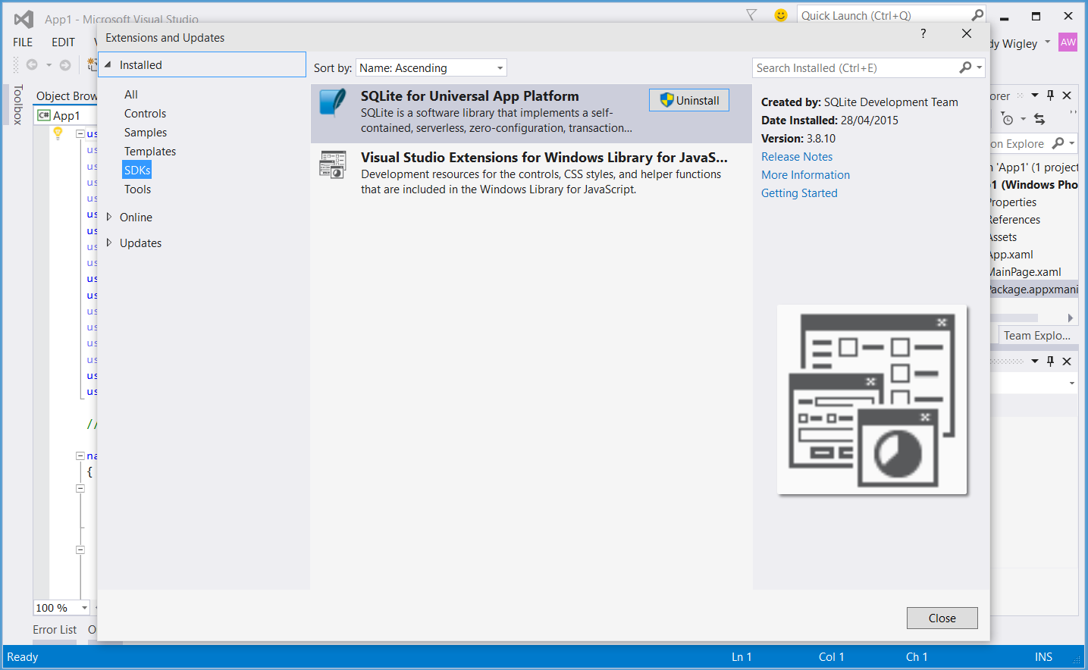
Installing the SQLite Library
Visual Studio Extension (.vsix)
Install from Visual Studio
  Tools – Extensions and Updates…
Or download from SQLite.org

Slide 52
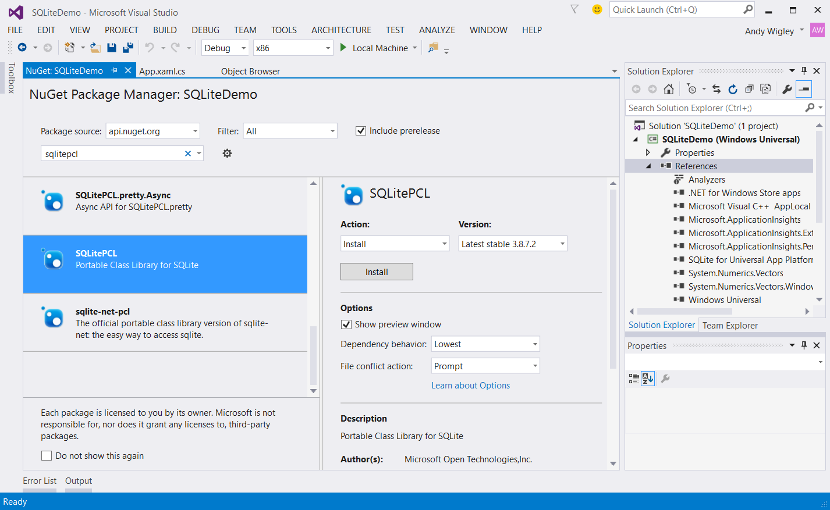
Installing SQLitePCL to your Solution

Slide 53

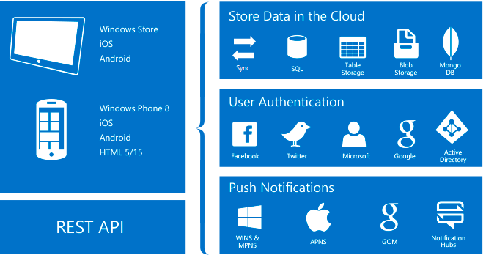
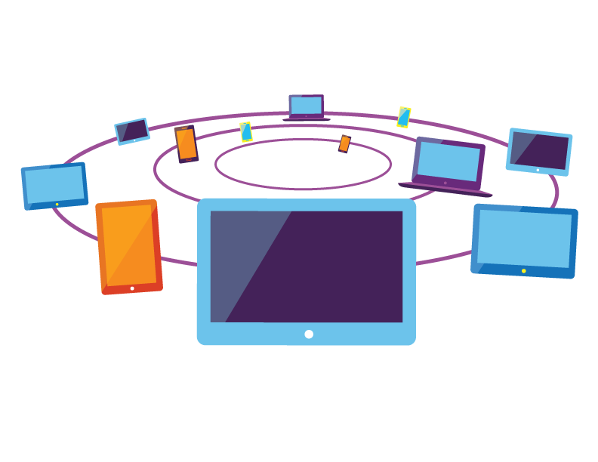
Frameworks that use SQLite
Azure App Service Mobile Apps
Entity Framework 7
01010
00100
10110
00100
Easy to implement offline data sync uses SQLite for local data storage
Lightweight ORM. Supports offline data sync using SQLite for local data storage
See BUILD session 2-693 Entity Framework 7
http://channel9.msdn.com/Events/Build/2015/2-693

Slide 54
SQLite provides a convenient option for your app

Slide 55
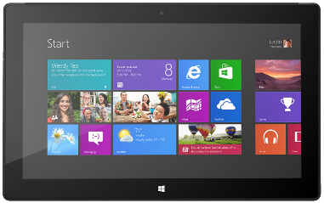
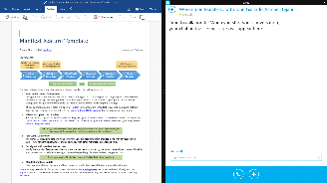
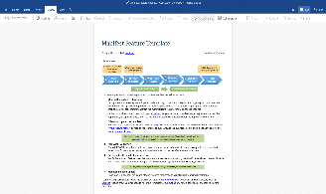
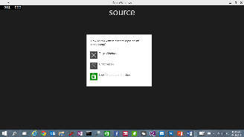

Enhanced App to App in Windows 10
Launch a *specific* app
Send file token, send data
Launch for Results
App Services

Slide 56
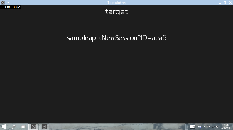


URI Activation++
Invoke a specific app
var options = new LauncherOptions();
options.TargetApplicationPackageFamilyName = "24919.InstapaperIt";
var launchUri = new Uri("instapaper:?AddUrl=http%3A%2F%2Fbing.com");
await Launcher.LaunchUriAsync(launchUri, options);

Slide 57
URI Activation++
Send Files
var options = new LauncherOptions();
options.TargetApplicationPackageFamilyName = "24919.InstapaperIt";
var token = SharedStorageAccessManager.AddFile (gpxFile);
ValueSet inputData = new ValueSet();
inputData.Add("Token", token);
var launchUri = new Uri("instapaper:?AddUrl=http%3A%2F%2Fbing.com");
await Launcher.LaunchUriAsync(launchUri, options, inputData);

Slide 58
Query URI Support
Discover if app already installed to handle a Uri
var queryUri = new Uri("instapaper:");
await Launcher.QueryUriSupportAsync(queryUri, LaunchUriType.LaunchUri);
var queryUri = new Uri("instapaper:");
string packageFamilyName = "24919.InstapaperIt";
await Launcher.QueryUriSupportAsync(queryUri, LaunchUriType.LaunchUriForResults, packageFamilyName);
?

Slide 59

App Services
Covered in separate module
Client App A
App with App Service
Client App B
Background Task

Slide 60
Apps on Windows 10 can communicate in new ways

Slide 61
String resources
{ project }/Strings
  Off the root, this is a convention
{ project }/Strings/en-US
  Matching the local identifier
{ project }/Strings/en-US/Resources.resw
  Resource file with localized strings

Slide 62
Resource loader
Access strings directly
  Dialogs, errors, validate
async void Alert(string messageId)
{
var loader = Windows.ApplicationModel.Resources.ResourceLoader.GetForCurrentView();
var title = loader.GetString(string.Format("{0}.Title", messageId));
var message = loader.GetString(string.Format("{0}.Message", messageId));
var button = loader.GetString(string.Format("{0}.Button", messageId));
var dialog = new ContentDialog
{
Title = title,
Content = message,
PrimaryButtonText = button
};
await dialog.ShowAsync();
}

Slide 63
Multilingual app toolkit
Support for XLF (version 1.2) files
  Typical format for custom, translation houses
Inside Visual Studio
  Microsoft translator service (machine learning)
  Microsoft’s professionally translated strings (originally built for Office)
Outside Visual Studio
  Free community tool

Slide 64
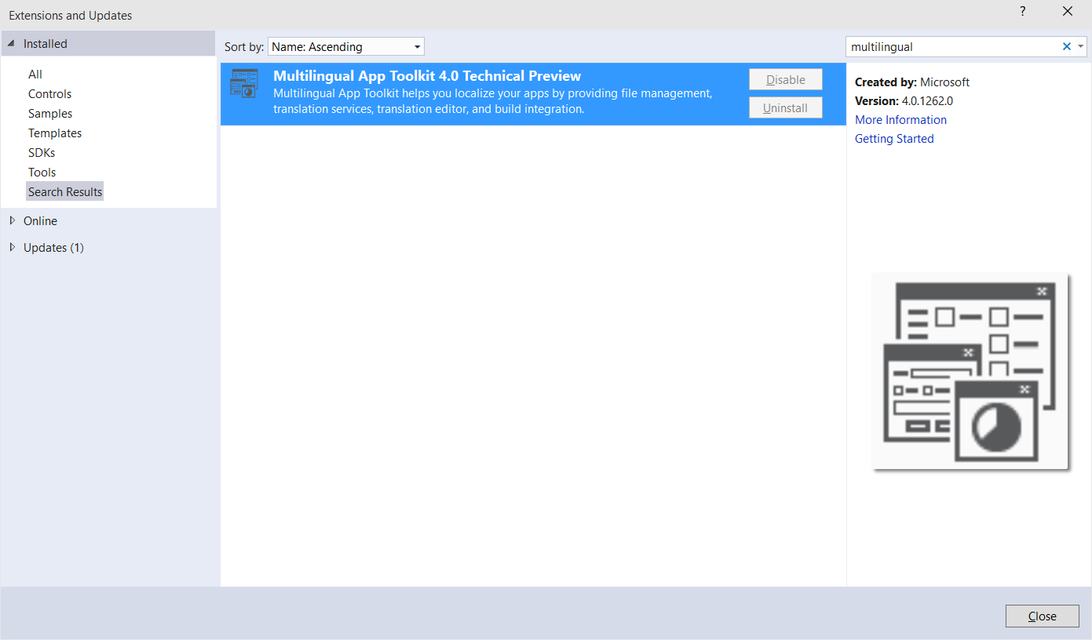
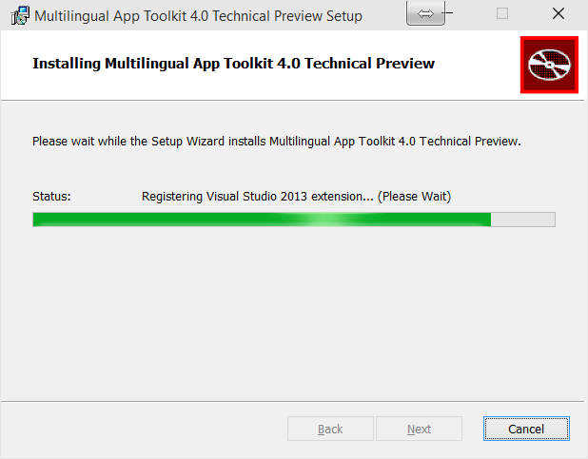

Slide 65
Localizing your app will help you succeed in more regions & locales

Slide 66
App Lifecycle
Background task executes
Running
app
Suspended
app
Terminated
app
Suspending
Low memory
Resuming

Slide 67
Handling suspension
public App()
{
this.InitializeComponent();
this.Suspending += (s, e) =>
{
// Save data
};
this.Resuming += (s, e) =>
{
// Load data
};
}

Slide 68
Extended execution
Requesting extended execution
  There is no guarantee resources are available
  Extended execution has no UI
Scenario “I have data this time”
  Handle the Revoked event (1 second warning)
Scenario “I’m a special kind of app”
  These apps run indefinitely
Special kinds of apps
  Turn-by-turn (location tracking) app
  Audio & VOIP application

Slide 69
Requesting extension in suspend
private async void OnSuspending(object sender, SuspendingEventArgs args)
{
var deferral = e.SuspendingOperation.GetDeferral();
using (var session = new ExtendedExecutionSession{ Reason = ExtendedExecutionReason.SavingData })
{
session.Description = "Upload Data";
session.Revoked += (s, e) => { Log("Save incomplete"); };
try
{
if (await session.RequestExtensionAsync() == ExtendedExecutionResult.Denied)
// takes 3 seconds
UploadBasicData();
else
// takes 8 seconds
await UploadDataAsync(session);
Log("Save complete");
}
catch { Log("Save failed"); }
finally { deferral.Complete(); }
}
}

Slide 70
Understanding the App Life Cycle facilitates a smoother experience

Slide 71
Building a background task
Respect cost
  BackgroundWorkCostValue.High means the task should not do work
Handling cancelation
  Tasks can be cancelled by the app or operating system heuristics
Running in deferral
  Background tasks do not have to operate asynchronously
Progress feedback
  Progress is a numeric value

Slide 72
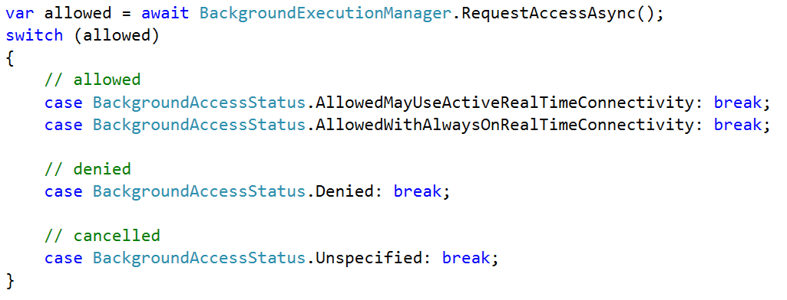
Request Background Permission

Slide 73
System condition(s) [ if? ]
User Present
  If the user is present
User Not Present
  If the user is not present
Internet Available
  If the internet is available
Internet Not Available
  If the internet is not available
Session Connected
  If the user is logged in
Session Disconnected
  If the user is not logged in
Free Network Available
  If a non-metered network is available
Work Cost Not High
  If background resources are plentiful

Slide 74
Host tasks in foreground process
  tt
Default process
In process
App Container
Default process
  Hosted in separate process
  Separate memory cap
App Container
app.exe
app.exe
Core
Application
Core
Application
In-process
  Simplified communication
  Shares memory caps
  Foreground app starts in app.exe
  Background task starts in app.exe
backgroundtaskhost.exe
backgroundtaskhost.exe
Background
Task
Background
Task

Slide 75
Background tasks can extend capabilities of your app

Slide 76
App Services
Client App A
App with App Service
Background Task
Client App B

Slide 77

Scenario: Bar Code Scanning
Bar Code decoding App Service
Image bytes in ValueSet or FileToken
Decoded data

Slide 78

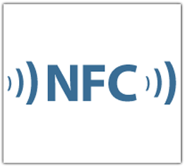

Scenario: Enterprise suite of apps
Client App A
App Service
Maintains Inventory cache
Interact with cloud services
Client App B
App Service
Proximity Reading Services

Slide 79
Can I restrict access to my App Service?
Build your own caller validation mechanisms on top of app services
Simplest is for service provider to whitelist callers based on their PackageFamilyName
  PackageFamilyName of caller is passed with every request
Possible to build more complicated caller validation mechanisms on top of ValueSets once a connection has been established
  Whitelist could be followed by explicit X.509 certificate exchange

Slide 80
App services provides another way for applications to communicate with each other

Slide 81







11
E
Always up-to-date
Update frequently
Single doc model
Always up-to-date
Update frequently
Single doc model
10
9
8
7
Q
14
12
13
34
35
Firefox
5
Chrome

Slide 82

11
E
Ever Green Engine
Update frequently
Single doc model
Always up-to-date
Update frequently
Single doc model
Ever Green Engine
Update frequently
Single doc model
10
9
8
7
Q
14
13
34
35
Firefox
5
Chrome

Slide 83

User-Agent Strings
Firefox
Mozilla/5.0 (Windows NT 10.0; WOW64; rv:35.0) Gecko/20100101 Firefox/35.0
Safari
Mozilla/5.0 (Macintosh; Intel Mac OS X 10_10_1) AppleWebKit/600.1.25 (KHTML, like Gecko) Version/8.0 Safari/600.1.25
Chrome
Mozilla/5.0 (Windows NT 10.0; WOW64) AppleWebKit/537.36 (KHTML, like Gecko) Chrome/40.0.2214.93 Safari/537.36
Mozilla/5.0 (Windows NT 10.0; WOW64) AppleWebKit/537.36 (KHTML, like Gecko) Chrome/39.0.2171.71 Safari/537.36 Edge/12.0

Slide 84
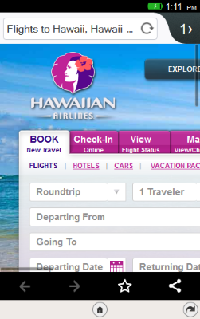
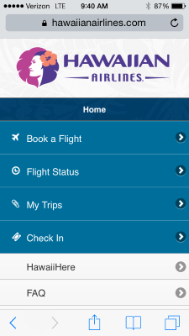



Slide 85
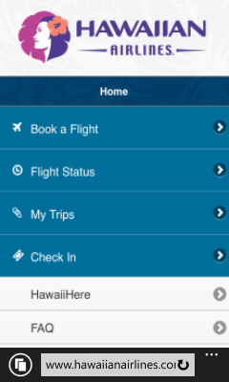

Slide 86
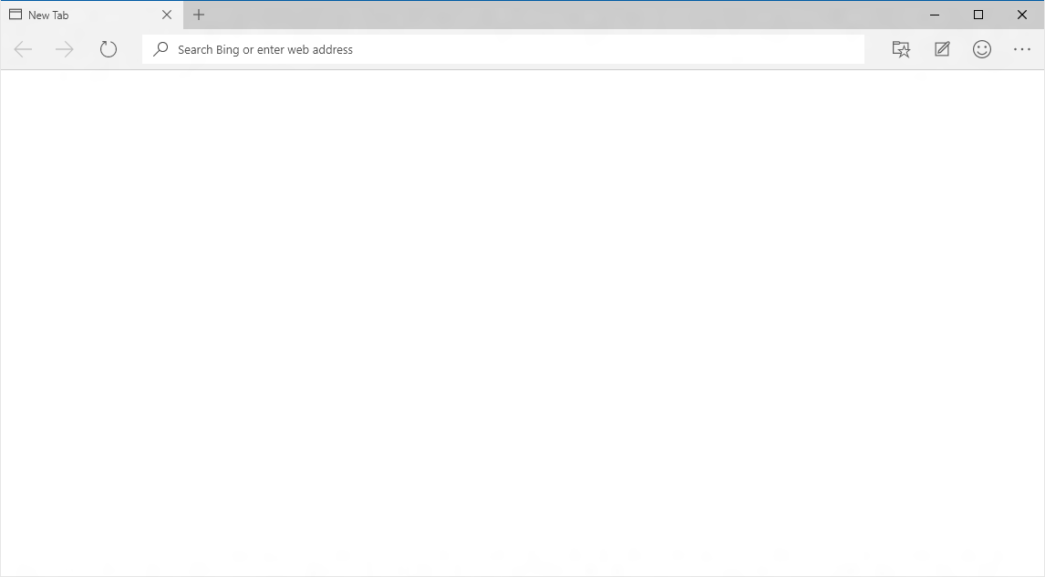
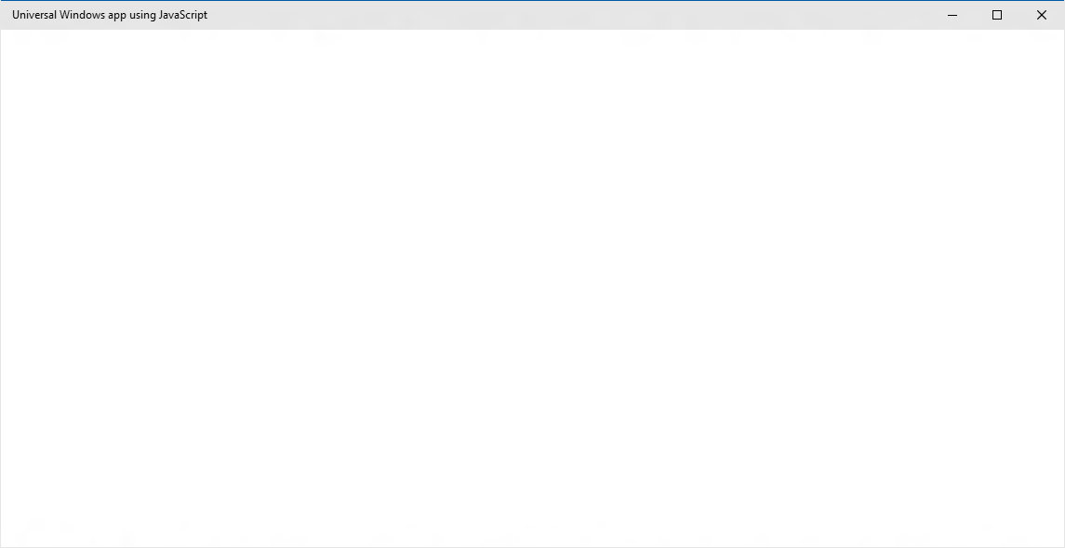
EdgeHTML.dll
Chakra
Packaged content
Offline first
Hosted content
Always up-to-date

Slide 87
Edge enables a better web/app experience

Slide 88
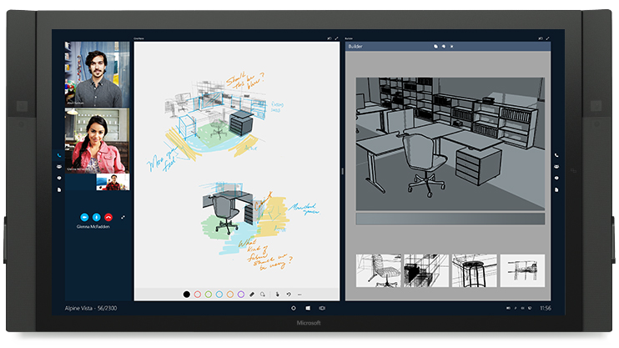
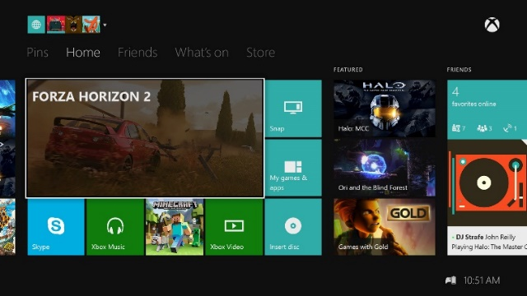
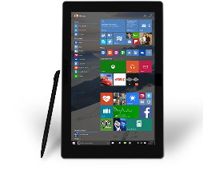
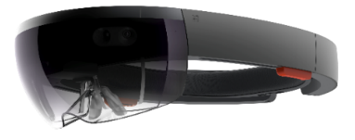

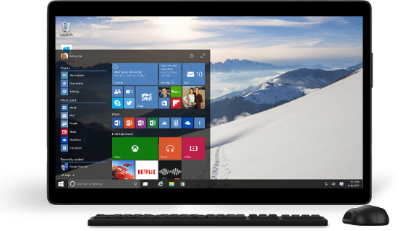
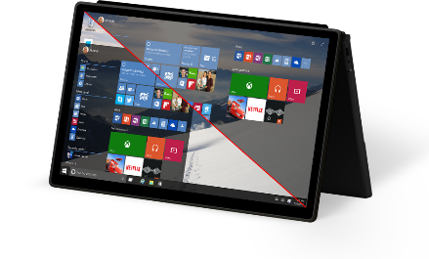
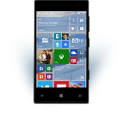
Mobile Experiences - not just mobile devices
The Experience you want on the device you want
User is the center of the experience, not the device.
Available on the right device at the right time
Input model optimized for the experience.
Enabling Mobile Experiences with Universal Apps
User

Slide 89
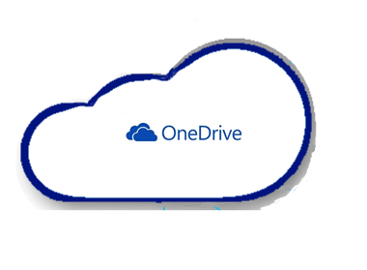
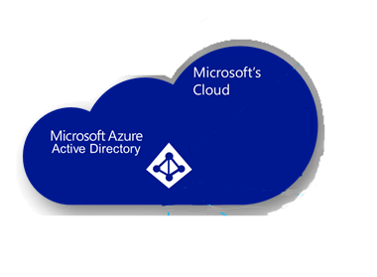


OS Settings Roaming in Windows 10
OS settings roam to OneDrive for MSA identity
OS settings roam to OneDrive for Business for AAD identity
OS settings (personalization, accessibility, language, Spartan/IE support, credentials vault, etc) roam with the primary account

Slide 90
App Settings Roaming in Windows 10
App settings roam to OneDrive for apps acquired from the consumer store
App settings roam to OneDrive for Business for apps acquired from the corporate store
Whether the primary account is AAD or MSA, user can acquire apps from both the consumer and (if available) the corporate store

Slide 91

Roaming Data
Other clients are notified of updated data via Windows Notification Service. If app is running when sync occurs, an event is raised.
Sync engine transfers data periodically based on triggers (user idle, battery, network, etc.)
/
PFN 12345
Roaming
folder
Roaming
settings
OneDrive (MSA identity) stores up to 100kb of roaming data per app (not included in user quota). If app exceeds the limit, sync stops.
UWP app – PFN 12345
UWP app – PFN 12345
Roaming
Local
Temp
Temp
Local
Roaming
App writes data using standard file/settings APIs.

Slide 92
Create shared mobile experiences whatever the device

Slide 93
Navigation with Frame.Navigate
Send to a type
Pass a string
Navigation service
  Part of Template 10 project template
private void Goto2(object sender, Windows.UI.Xaml.RoutedEventArgs e)
{
var app = App.Current as Common.BootStrapper;
var nav = app.NavigationService;
nav.Navigate(typeof(Views.Page2), "My parameter value");
}

Slide 94
Navigation parameters
Page.OnNavigatedTo()
  Standard in Windows
ViewModel.OnNavigatedTo
  With Template 10 project template
public override void OnNavigatedTo(string parameter,
NavigationMode mode, IDictionary<string, object> state)
{
this.Parameter = parameter?.ToString() ?? "Empty";
}

Slide 95
Back button
Essentially same as Phone 8.1
  Back navigates back within app, then to previous app
  UAP apps request the optional, shell-drawn back button
With one improvement
  Backing out does not close the app
And, a new scenario for tablet
  In split screen, there is a [back stack] for each side of the screen
Windows.UI.ViewManagement.ApplicationView.GetForCurrentView().IsShellChromeBackEnabled = true;
Windows.UI.Core.SystemNavigationManager.GetForCurrentView().BackRequested += HandleBack;

Slide 96
Back support
Support gestures
  Windows + backspace
  Hardware back button
  Keyboard back button
  Mouse back button
  (Template 10)
Opt-in to back in Windowed mode
  Automatic in immersive
Some guidance
  Don’t strand users
  Don’t hijack back

Slide 97
Navigation is easier to develop across device families

Slide 98
Options for Network/Cloud Services
Better to use high-level frameworks and services where available
  Use Microsoft Azure App Services to build a cloud backend services, but use WebRoles, WorkerRoles, Queues etc if you need more flexibility
  Use Microsoft Azure Notification Hubs to send notifications from backend services in preference to writing low-level networking code to achieve this
  Use BackgroundTransfer to download/upload files
  Use Web Account Manager to perform OAuth2 authentication against Internet identity providers
  Use HttpClient for low level HTTP networking

Slide 99
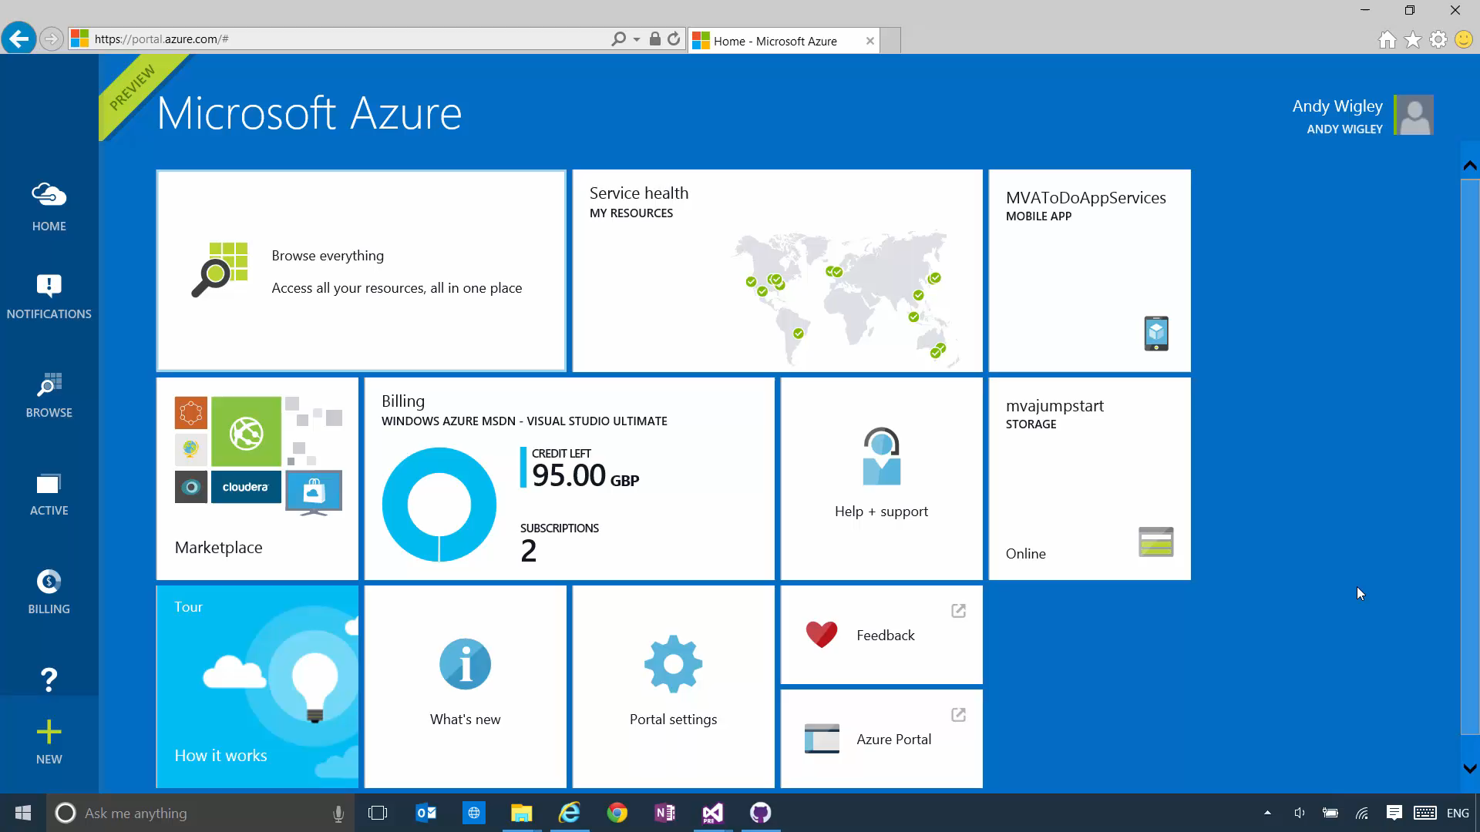

Slide 100


Web Account Manager
Identity/Service Provider
App
Web Account Manager
Browser
Microsoft Web Account Provider
Web Account Provider
Contoso Web Account Provider
Web Account Provider
YOUR

Slide 101
The filter pipeline
Your code
This is also a filter
Your app
HttpClient
GetAsync
GetBufferAsync
GetInputStreamAsync
GetStringAsync
PostAsync
PutAsync
SendRequestAsync
503 Retry Filter
Metered Network Filter
Auth Filter
Http Base Protocol Filter
Has in-depth settings
REST / Web Service
HttpRequestMessage
⛭
HttpResponseMessage
HttpContent
String • Stream • Buffer • Multipart • FormUrlEncoded

Slide 102
Use existing network/cloud services to extend your application with little effort

Slide 103



Tile anatomy
Basic State
Semi-Live State
Live State
Plate
Plate
Plate
Content
App Logo
App Logo
App Icon
Badge
Badge
Short Name
Short Name
Short Name
Badge
Badge
App Icon
Short Name
Short Name
Short Name
App Logo
App Logo
Content
Plate
Plate
Plate

Slide 104
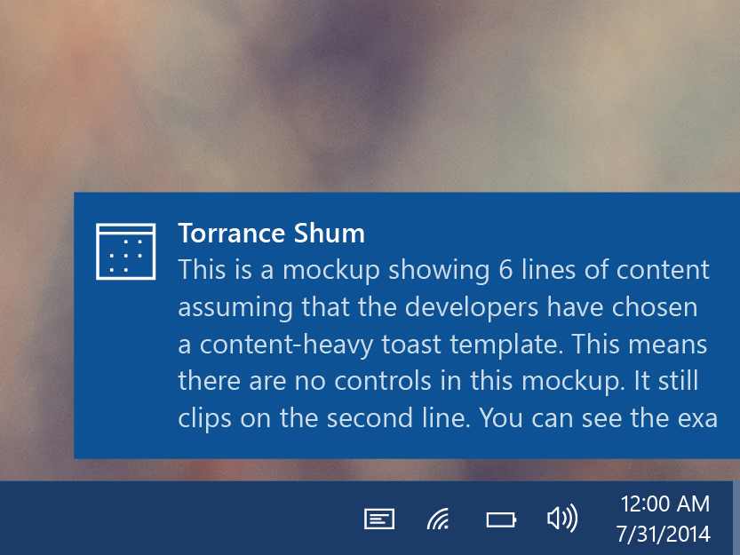
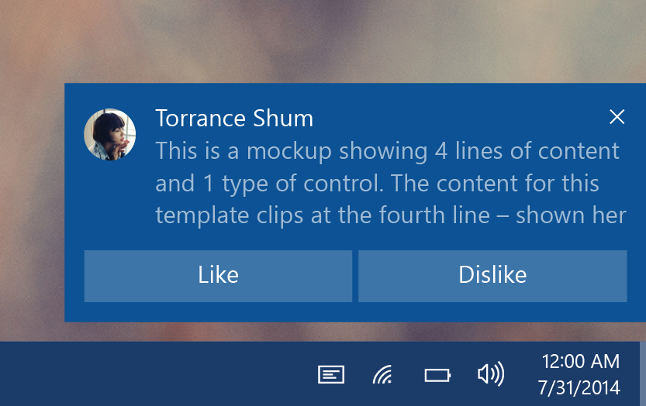
Toasts
Glance (consume)
  See new information from your apps.
Act (chase, or take actions)
  Toasts invite you to begin or complete a task.
  The toast is the app’s door by chasing (clicking) it.
  Additional actions enable users to perform simple tasks without context switching.

Slide 105


Toast states
Collapsed state
  Action center chevron
  Mobile default
Expanded state
  Action center chevron
  Desktop default

Slide 106






Interactive toast
Desktop
Mobile

Slide 107
Tiles and toast notifications keep your users engaged

Slide 108



Windows 8.0/8.1 Store Apps
Minimal code update required
Responsive UX Design/Implementation
Windows 8.0
Windows 10

Slide 109
Windows Phone 8.1 Store Apps (WinRT)
Windows Phone 8.1
Windows 10
Minor code updates for UAP APIs
Design UX for multiple form factors

Slide 110
Windows 8.1 Universal Apps
Merge UX
Refactor to single code-base & to target UAP APIs
Windows 8.1
Windows 10
Windows Phone 8.1

Slide 111


Windows Phone Silverlight Apps
Port the UI Silverlight -> Windows XAML
Rewrite code to target UAP APIs*
Design UX for multiple form factors
Windows Phone 7.5/7.8
Windows 10
Windows Phone 8.0
Windows Phone 8.1*
*Silverlight on Windows Phone 8.1 can be a mix of Silverlight and WinRT APIs

Slide 112
Win8 apps will run on Win10, but porting to UWP puts your app on more device families

Slide 113

App to App Communication
URI/Protocol Activation
Launcher.LaunchUriAsync(new Uri("sampleapp:?ID=aea6"));
Launcher.LaunchFileAsync(file);
Data in Uri/File
User/OS chooses target
More on this in module 3.02 App to App Communication

Slide 114


Share Contract
DataTransferManager.ShowShareUI();
Share DataPackage
User chooses target

Slide 115

Drag and Drop
Extended for “Windowed” Apps
<!-- XAML -->
<Grid AllowDrop="True" DragOver="Do_DragOver" Drop="Do_Drop" …>
…
</Grid>
File Explorer
My App

Slide 116





Desktop Share UX Changes In W10
Windows 8.x
Windows 8.x app running on Windows 10

Slide 117
Many apps will be a share source
Only a few will be a share target

Slide 118
Next Steps:
Start Here:
    https://dev.windows.com/en-us/downloads/windows-10-developer-tools
      Get Windows 10: http://microsoft.com/windows
      Get Visual Studio 2015: http://aka.ms/vs2015ce
MVA video series:
    http://aka.ms/mva-win10-dev

Slide 119
GitHub
UWP Samples:
    https://github.com/Microsoft/Windows-universal-samples
Template10:
    https://github.com/Windows-XAML/Template10
MVA Samples:
    https://github.com/Windows-XAML/201505-MVA
Project Upgrade Utility:
    http://aka.ms/uwp-projectupgradeutility

Slide 120
Build 2015
Introducing the Windows 10 App Model
    https://channel9.msdn.com/Events/Build/2015/2-617
What's New in XAML for Universal Windows Apps
    https://channel9.msdn.com/Events/Build/2015/2-629
Game Developers: Get the Most Out of Windows 10
    https://channel9.msdn.com/Events/Build/2015/2-637

Slide 121

Contact
Email: shchowd@microsoft.com  Twitter: @shahedC
Notes:
Contact
Microsoft email: shchowd@microsoft.com
Personal Twitter: @shahedC
Dev Blog: WakeUpAndCode.com

