Slide 1
Azure Functions
Serverless Architecture in the Cloud
Shahed Chowdhuri
Microsoft Corporation
@shahedC
WakeUpAndCode.com

Slide 2
Intro
Notes:
Introduction

Slide 3
What’s with the Cloud?
  Hosting models
  On Premises
  Infrastructure
  (as a Service)
  Platform
  (as a Service)
  Software
  (as a Service)
  Applications
Applications
  You manage
Applications
Applications
  You scale, make resilient and manage
  You scale, make
  resilient & manage
Data
Data
Data
Data
Runtime
Runtime
Runtime
Runtime
  Scale, resilience and
  management by vendor
Middleware
Middleware
Middleware
  Scale, resilience and
  management by vendor
Middleware
O/S
O/S
O/S
O/S
Virtualization
Virtualization
  Managed by vendor
Virtualization
Virtualization
Servers
Servers
Servers
Servers
Storage
Storage
Storage
Storage
Networking
Networking
Networking
Networking

Slide 4
Where does Serverless fit in?
  Infrastructure
  (as a Service)
  Platform
  (as a Service)
  Serverless
  On Premises
  You manage
  Software
  (as a Service)
Functions
Functions
Functions
Functions
  Applications
Applications
  You manage
Applications
Applications
Applications
  You scale, make resilient and manage
  You scale, make
  resilient & manage
Data
Data
Data
Data
Data
Runtime
Runtime
Runtime
  Scale, resilience and mgmt by vendor
Runtime
Runtime
  Scale, resilience and
  management by vendor
Middleware
Middleware
Middleware
Middleware
Middleware
O/S
O/S
O/S
O/S
O/S
Virtualization
Virtualization
  Managed by vendor
Virtualization
Virtualization
Virtualization
Servers
Servers
Servers
Servers
Servers
Storage
Storage
Storage
Storage
Storage
Networking
Networking
Networking
Networking
Networking

Slide 5


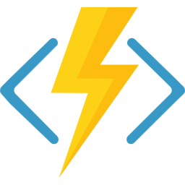
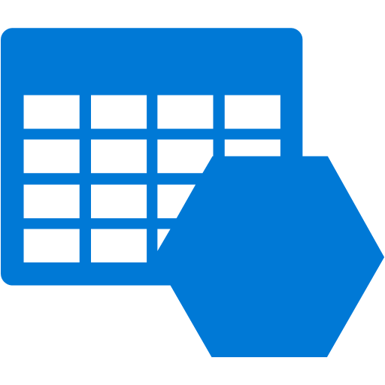


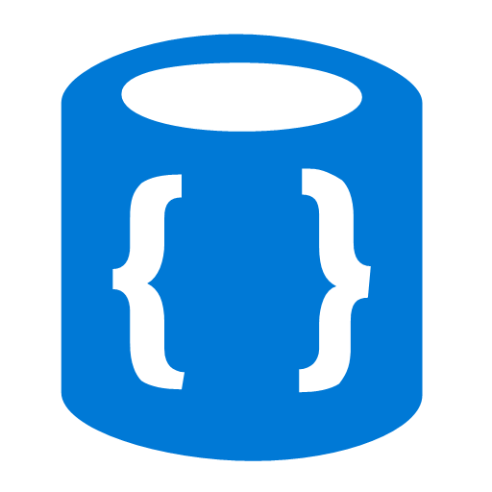


Azure Functions
Events
Code
Outputs
React to timers, HTTP, or events from your favorite Azure services, with more on the way
Author functions in C#, F#, Node.JS, Java, and more
Send results to an ever-growing collection of services
Source: https://myignite.techcommunity.microsoft.com/sessions/65889
Notes:
Originally presented at Ignite 2018 by:
Fabio Cavalcante
Eduardo Laureano
Source: https://myignite.techcommunity.microsoft.com/sessions/65889

Slide 6



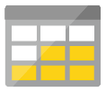




Full integration with Azure ecosystem
Functions is the center piece of the Serverless platform
Development
Platform
IDE support
Event Grid
Functions
Logic Apps
Manage all events that can trigger code or logic
Execute your code based on events you specify
Design workflows and orchestrate processes
Integrated DevOps
Local development
Monitoring
Database
Storage
Analytics
Intelligence
Security
IoT
Visual debug history

Slide 7
Functions 2.0 – What’s New
New Functions Quickstarts by Language
Updated runtime built on .NET Core 2.1
.NET Functions loading changes
New extensibility model
  Decoupled from language providers and bindings
Run code from a package
Tooling updates: CLI, Visual Studio & VS Code
Durable Functions (GA)
Consumption mode SLA

Slide 8

Assembly Isolation - Bindings: 2.0 Model
Azure Functions Host – Functions 2.0
Host Assembly Load Context (default)
Function Assembly Load Context
Job host
Functions Assemblies
Runtime dependencies
Bindings
WindowsAzure.Storage 9.3.1
Functions dependencies
WindowsAzure.Storage 9.5.0
WindowsAzure.Storage 9.3.1
public static Run(…, CloudBlockBlob blob,…))
{
//Function code...;
}

Slide 9
Dev + Hosting
Notes:
Introduction

Slide 10
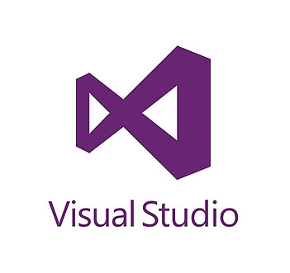
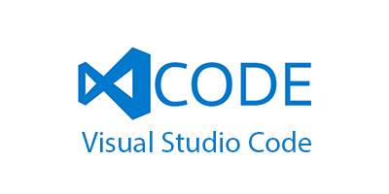
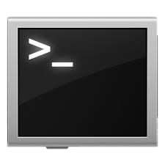
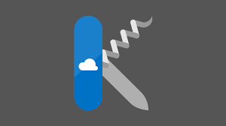
Azure Functions Tooling Options
Visual Studio
VS Code
CLI
Portal
Deployment Options

Slide 11
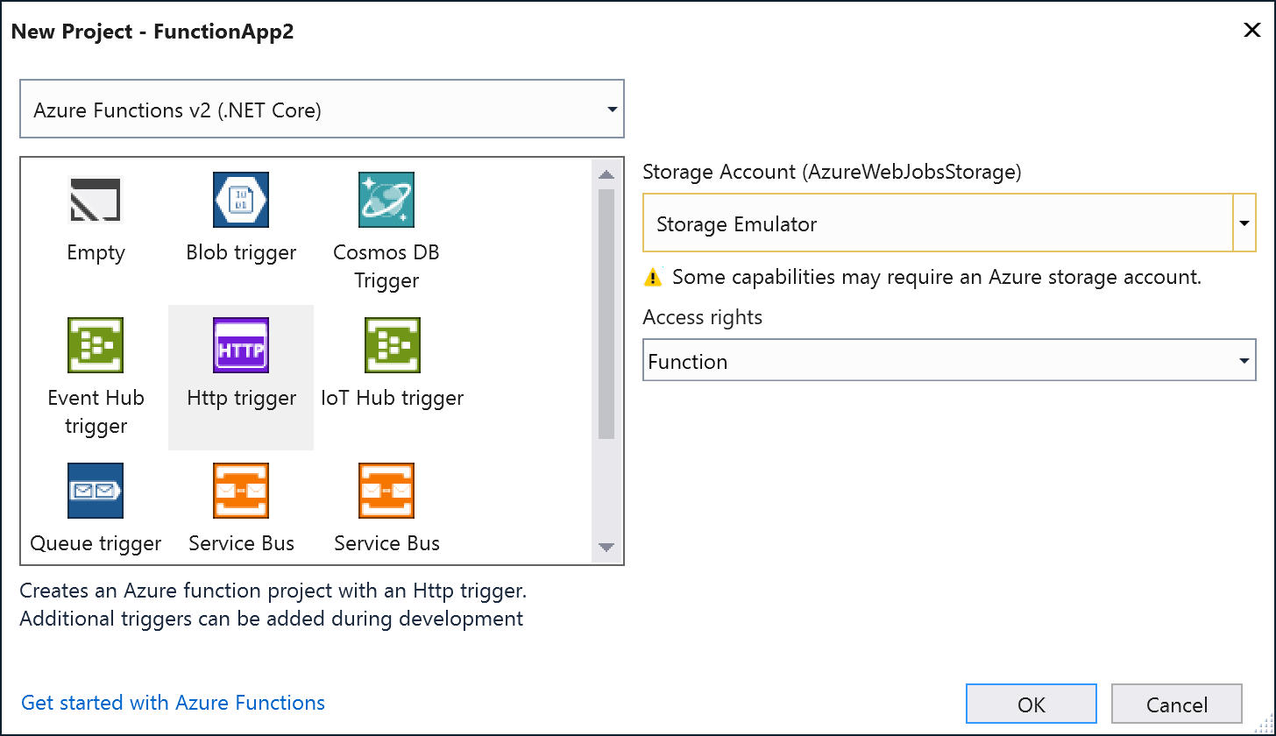
Visual Studio → File | New Project

Slide 12
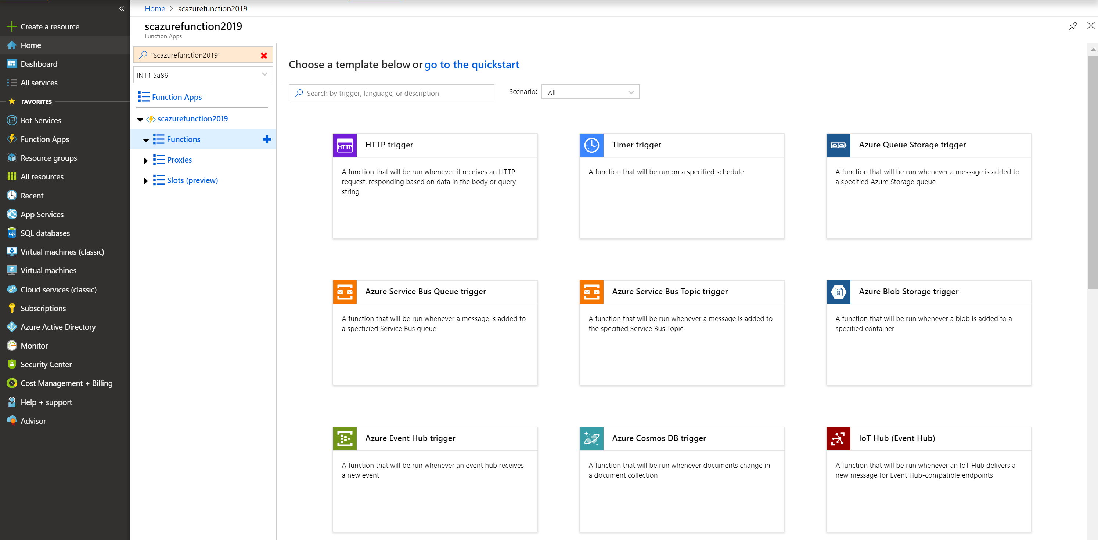
Azure Portal → Function App

Slide 13


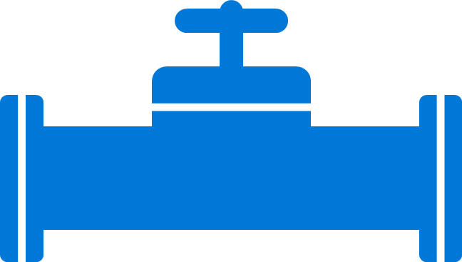
Boost development efficiency
Use triggers to define how functions are invoked
Avoid hardcoding with preconfigured JSON files
Build serverless APIs using HTTP triggers
Connect to data with input and output bindings
Bind to Azure solutions and third-party services
Use HTTP bindings in tandem with HTTP triggers
Triggers
Bindings
Define one API surface for multiple function apps
Create endpoints as reverse proxies to other APIs
Condition proxies to use variables
Debug C# and JavaScript functions locally
Use debugging tools in Azure portal, VS, and VS Code
Proxies
Local debugging
Save time with built-in DevOps
Deploy functions using App Service for CI
Leverage Microsoft, partner services for CD
Integrate with Azure Application Insights
Get near real-time details about function apps
See metrics around failures, executions, etc.
CI/CD
Monitoring
Notes:
Additional information
Triggers and bindings – https://docs.microsoft.com/en-us/azure/azure-functions/functions-triggers-bindings
Monitoring—https://azure.microsoft.com/en-us/services/application-insights/
Local debugging—https://docs.microsoft.com/en-us/azure/azure-functions/functions-run-local#run-functions-locally
CI/CD—https://docs.microsoft.com/en-us/azure/azure-functions/functions-continuous-deployment
Run locally—https://docs.microsoft.com/en-us/azure/azure-functions/functions-run-local
Proxies—https://docs.microsoft.com/en-us/azure/azure-functions/functions-proxies

Slide 14
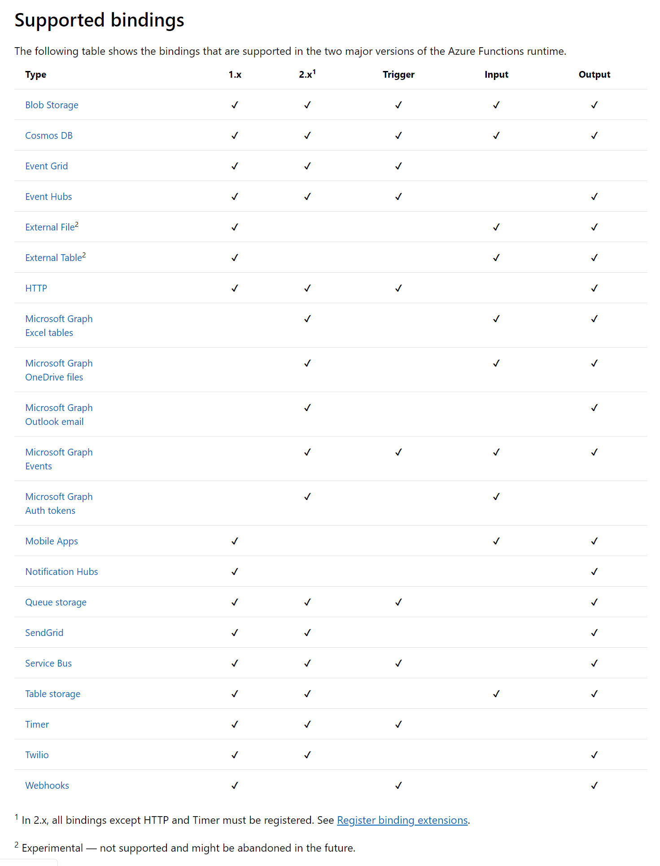

Slide 15
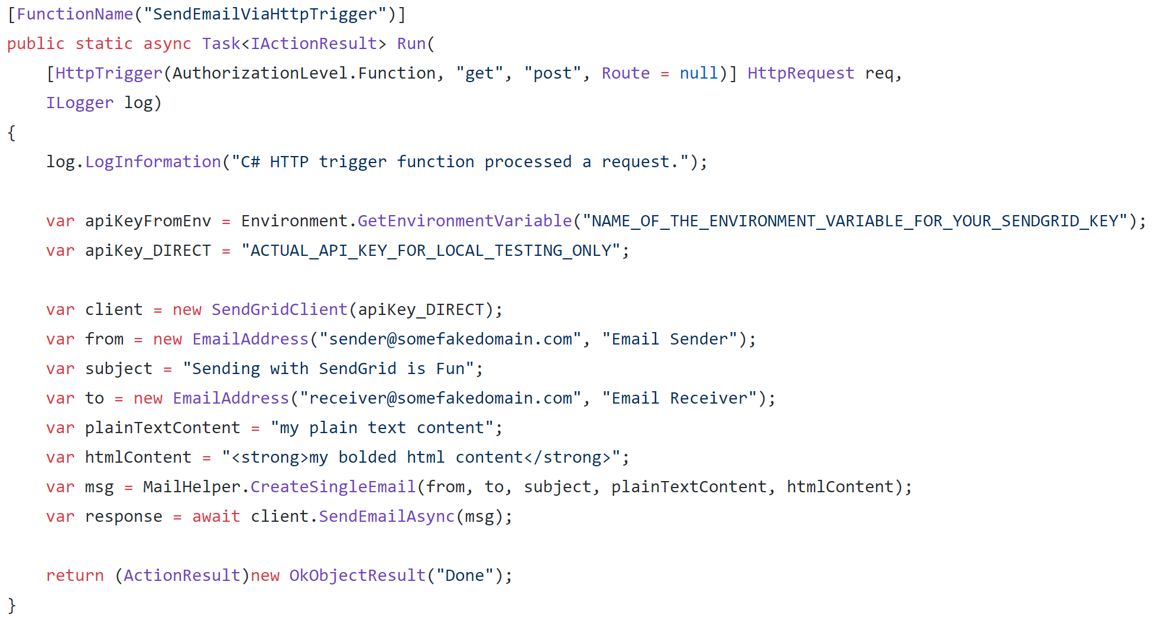
Sending Emails with SendGrid
https://sendgrid.com/docs/for-developers/sending-email/v3-csharp-code-example

Slide 16
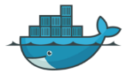
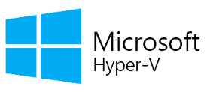
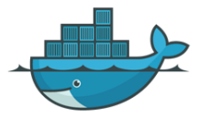
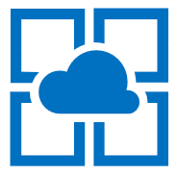

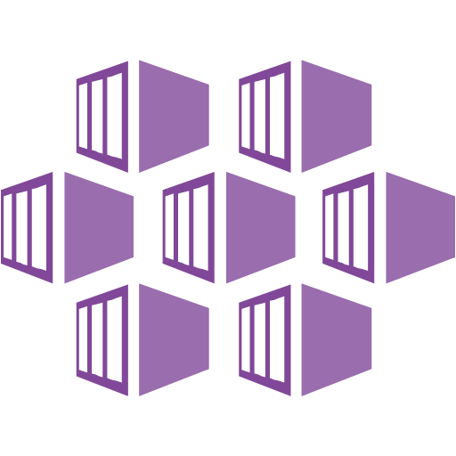





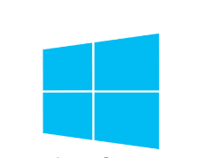





Functions Hosting Models
Serverless Functions
Serverless
Linux Functions
Functions
Containers
Kubernetes
Functions
Open Source
Hosting
IoT
Functions
On Prem
Functions
Application
Delivery
Execution
Isolation
Infrastructure
Operating System
Azure Managed
Customer Managed

Slide 17
Demo
Notes:
Introduction

Slide 18
Durable Functions
Notes:
Introduction

Slide 19
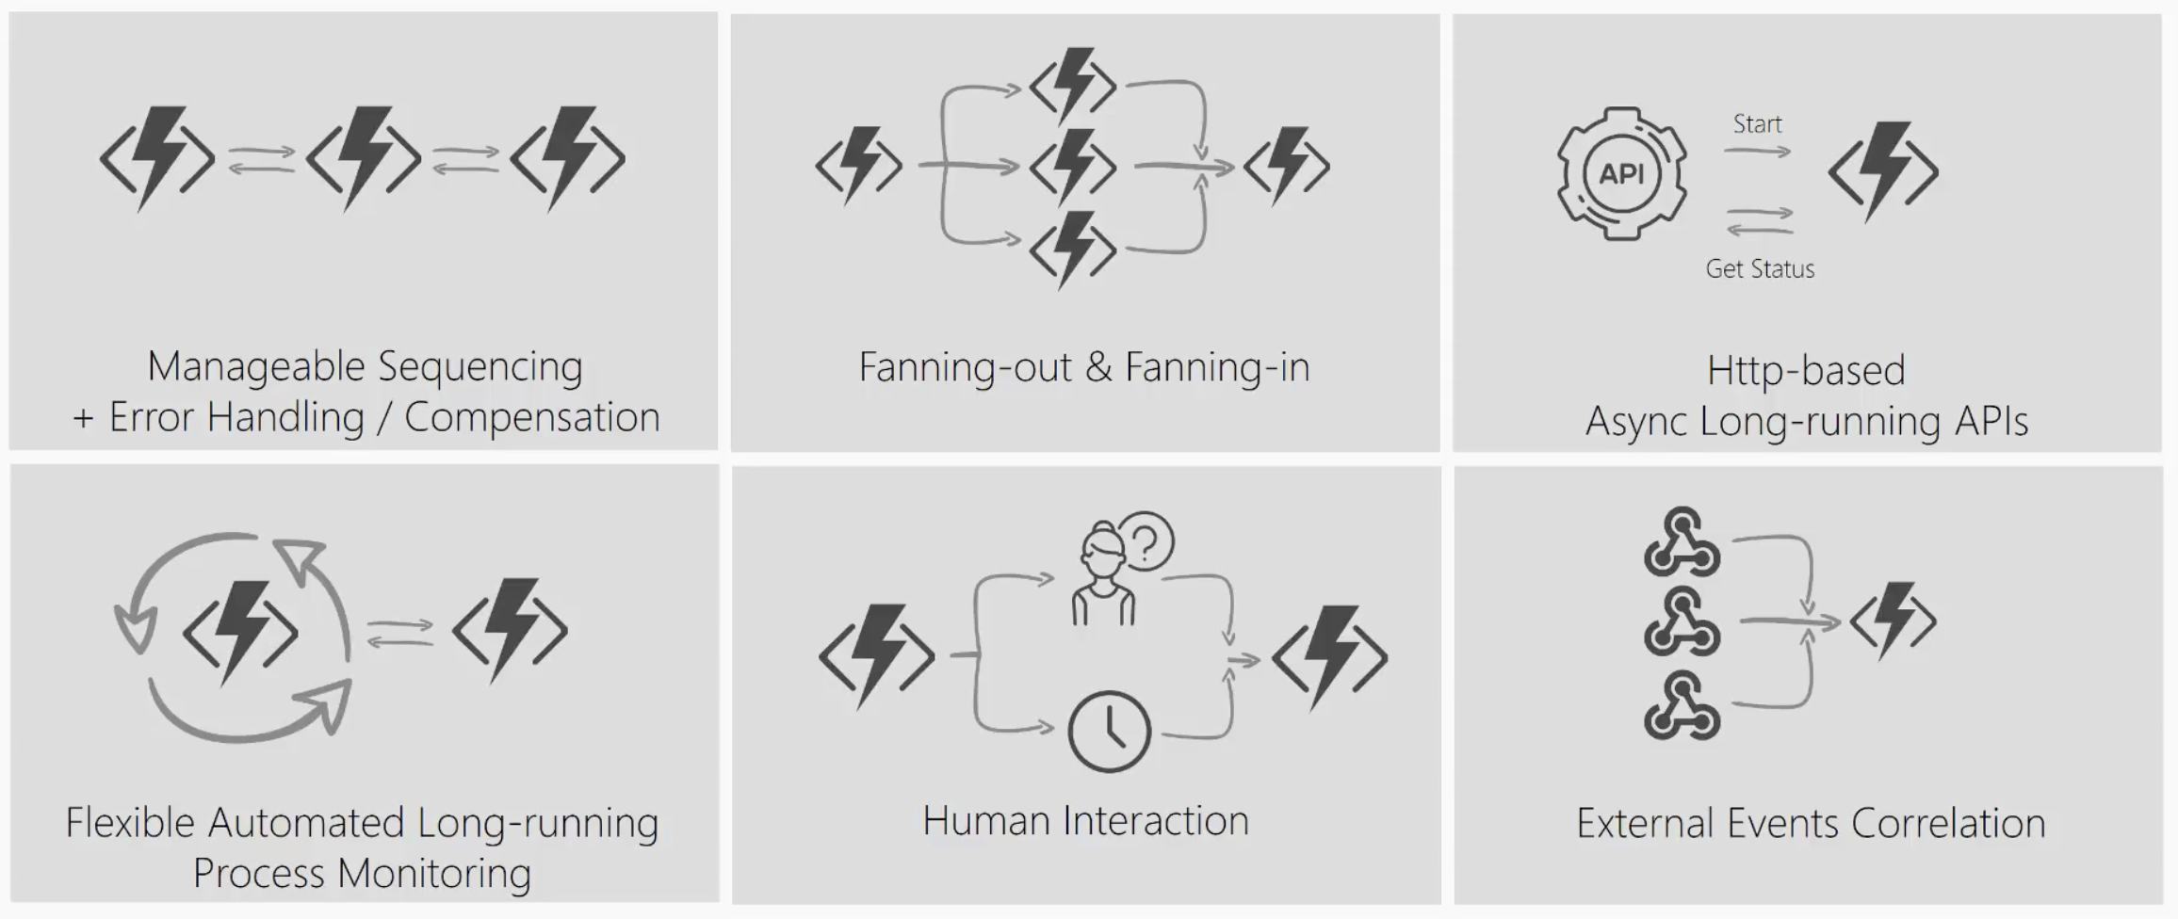
What’s still hard?

Slide 20
Durable Functions
Write long-running orchestrations as a single function while maintaining local state.
Simplify complex transactions and coordination (chaining, etc.) Easily call a Function from another Function, synchronously or asynchronously.
All of the above using code-only. No JSON schemas. No graphical designer.
Announcing: Generally available (v2) - C# and JavaScript

Slide 21
Components
Starter
Function
Orchestrator Function
Activity Function
Activity Function
Activity Function
Starts orchestrations
Coordinates activities
Performs work
OrchestrationClient
OrchestrationContextTrigger
ActivityTrigger

Slide 22
What It Looks Like
Orchestrator Function
// calls functions in sequence
public static async Task<object> Run(DurableOrchestrationContext ctx)
{
try
{
var x = await ctx.CallActivityAsync("F1");
var y = await ctx.CallActivityAsync("F2", x);
return await ctx.CallActivityAsync("F3", y);
}
catch (Exception)
{
// global error handling/compensation goes here
}
}
Activity Functions

Slide 23
Q & A
Notes:
Additional Topics

