Slide 1
What’s Next?
Roadmap for Development
Shahed Chowdhuri
Microsoft Corporation
@shahedC
WakeUpAndCode.com

Slide 2
SignalR
Notes:
Introduction

Slide 3
SignalR for Real-Time Features
https://docs.microsoft.com/en-us/aspnet/core/signalr/

Slide 4
Blazor
Notes:
Introduction

Slide 5
Blazor for Full-Stack C# Web Dev
https://blazor.net

Slide 6
Bot Framework
Notes:
Introduction

Slide 7
Bot Framework for chatbots + AI
https://dev.botframework.com

Slide 8
Azure Services
Notes:
Introduction

Slide 9
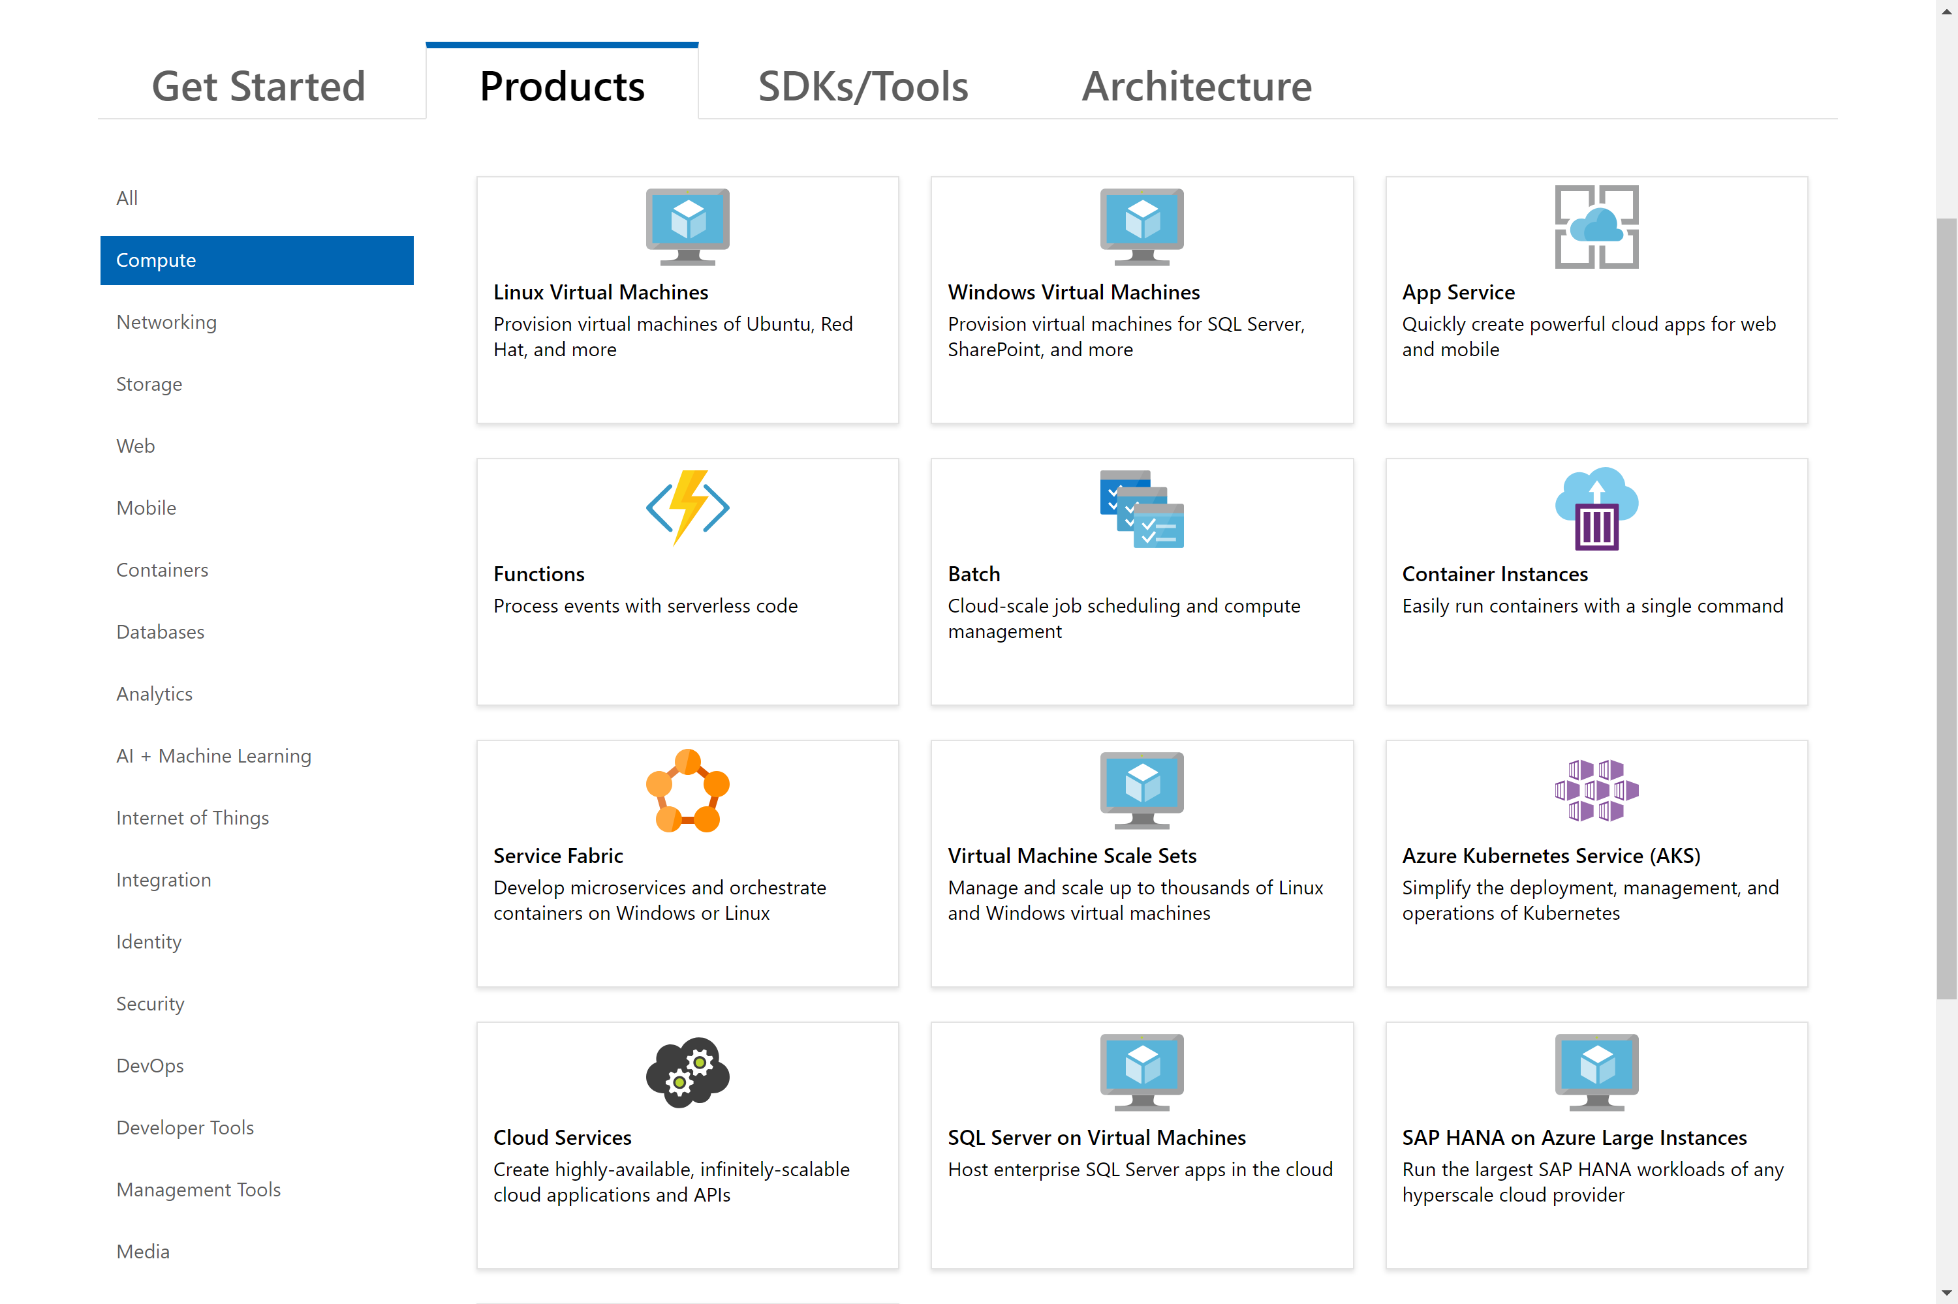
https://docs.microsoft.com/azure

Slide 10
Q & A
Notes:
Additional Topics

