Slide 1
Game Development with Unity 5 and C#
Windows  Web  Xbox  Mobile  … and more!
By Shahed Chowdhuri
Senior Technical Evangelist
WakeUpAndCode.com
@shahedC
Notes:
Title Page: Game Development with Unity 5 and C# Windows  Web  Xbox  Mobile  … and more!
By Shahed Chowdhuri
Technical Evangelist
Blog: WakeUpAndCode.com
Twitter: @shahedC

Slide 2
Agenda
Introduction
> Getting Started
> Choosing a Code Editor
> Getting Started with 3D Objects
> Adding Scripts, Movement, Input
3D & 2D Demos
Notes:
Agenda

Slide 3
Tools & Technologies
Notes:
Tools & Technologies

Slide 4
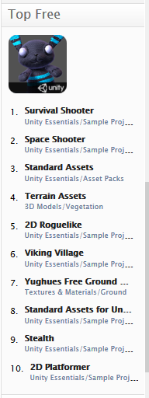
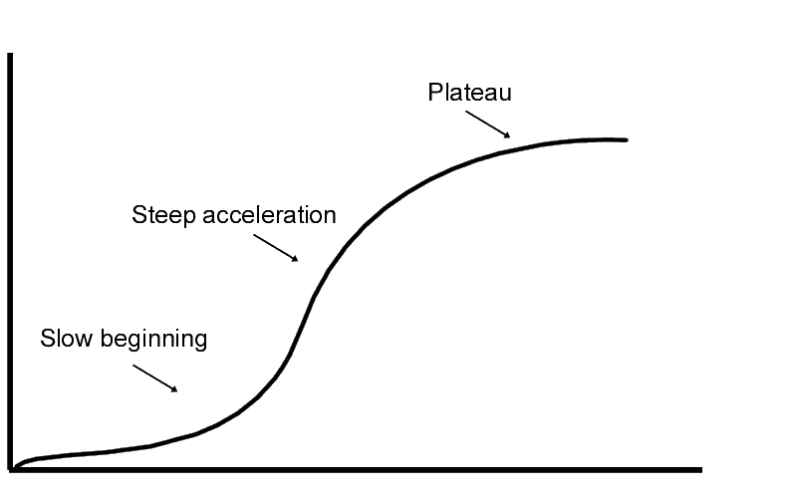
Unity: Things to Know
Learning curve
Create/Import models
Download/purchase models
Asset Store
Publish virtually anywhere!
Notes:
Unity: Things to Know
Learning curve for beginners
Need to create your own models
Or download/purchase pre-built models
Publish to Web, mobile, desktop, consoles

Slide 5
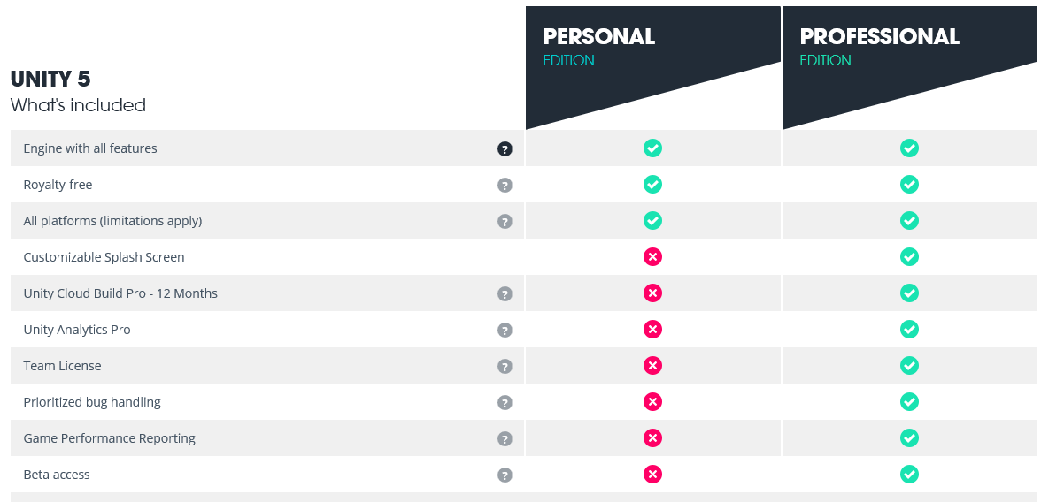
Personal vs Pro

Slide 6
Agenda
Introduction
> Getting Started
> Choosing a Code Editor
> Getting Started with 3D Objects
> Adding Scripts, Movement, Input
3D & 2D Demos
Notes:
Agenda

Slide 7
Getting Started

Slide 8
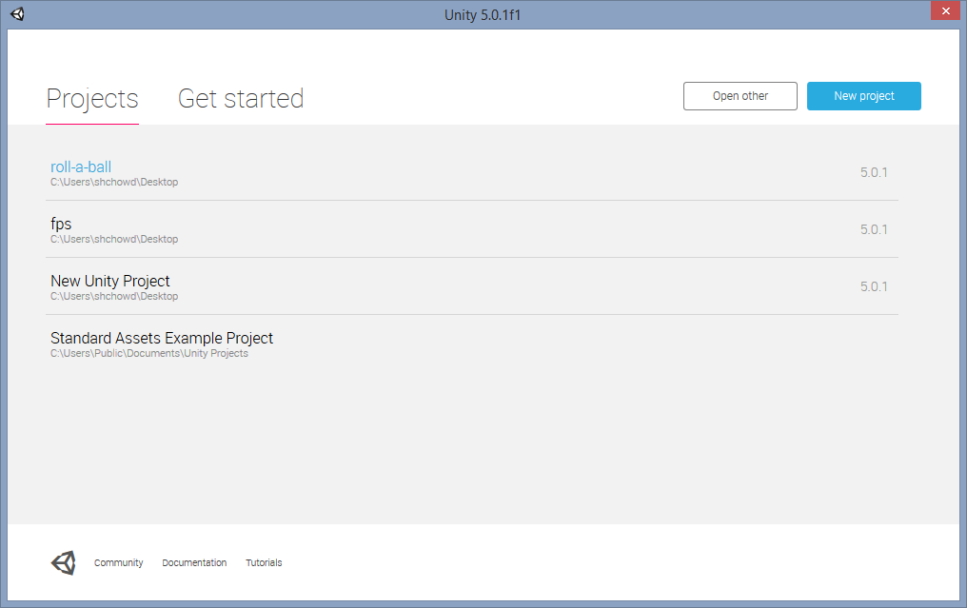
Launching Unity 5
Pick from Recent Projects, click Open Other, or New Project

Slide 9
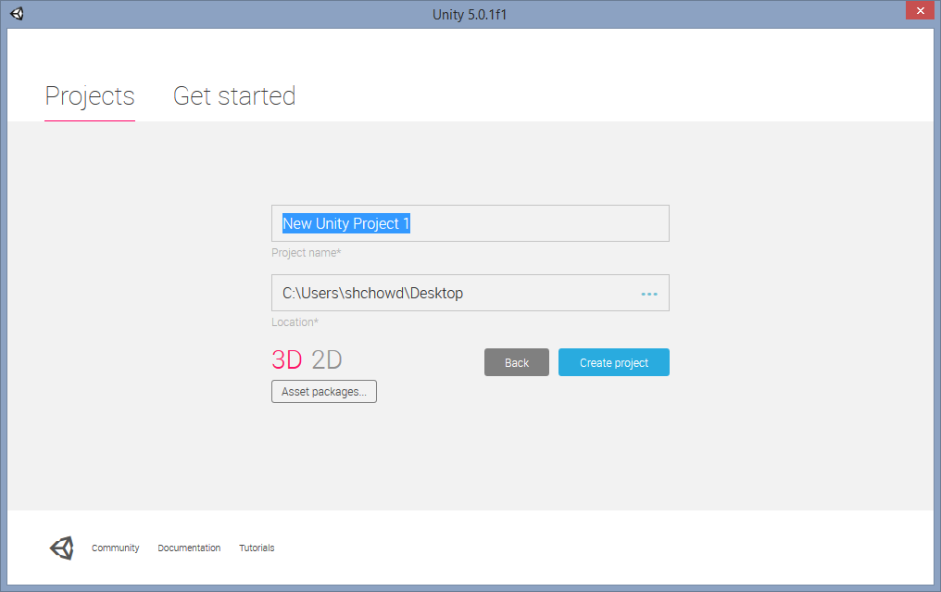
New Project
Name your project, choose 3D/2D, then save it

Slide 10
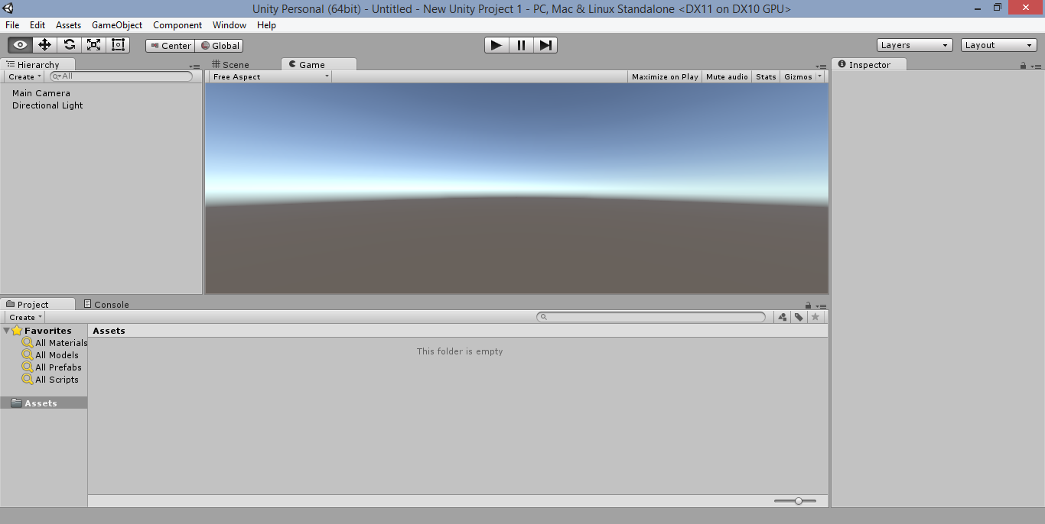
Unity Game Editor

Slide 11
Choosing a Code Editor

Slide 12
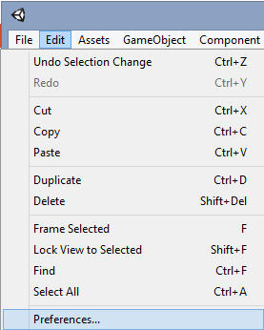
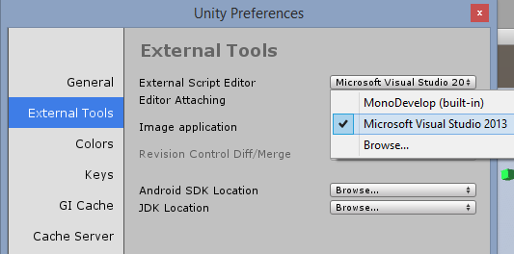
Assign Code Editor
Under External Tools, select your Script Editor
e.g. MonoDevelop or Visual Studio
Click Edit → Preferences
Tip: Browse for devenv.exe in your Program Files folder if you don’t see Visual Studio
"C:\Program Files (x86)\Microsoft Visual Studio 12.0\Common7\IDE\devenv.exe"

Slide 13
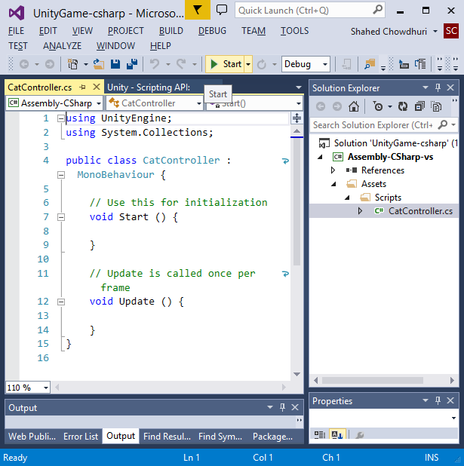
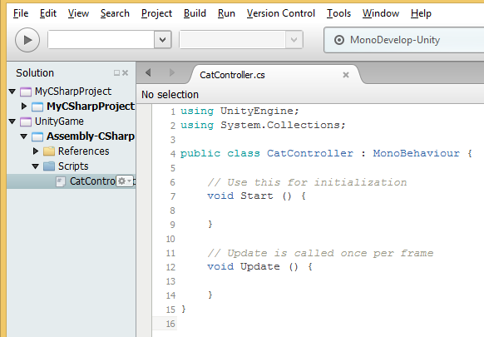
Code Editor UI
Editing a Script should launch MonoDevelop or Visual Studio, etc

Slide 14
Getting Started with 3D Objects

Slide 15
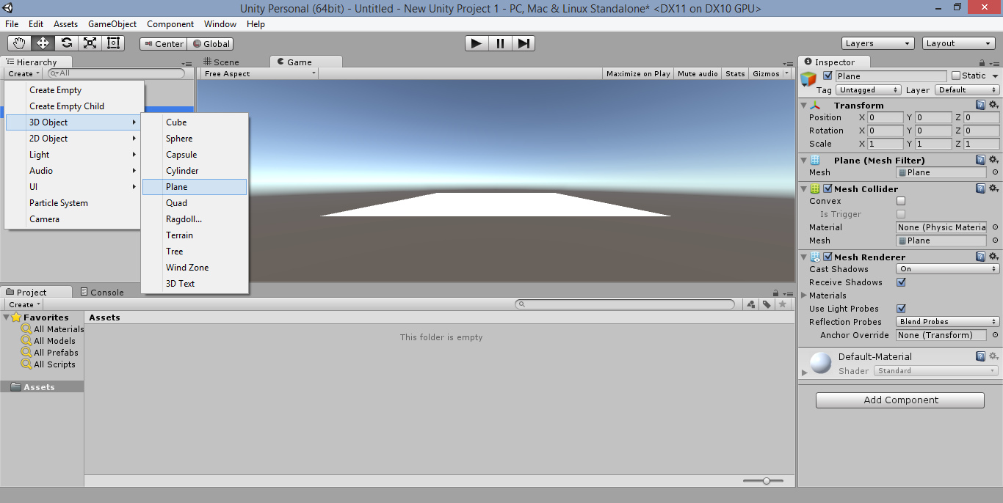
Creating Simple 3D Objects

Slide 16
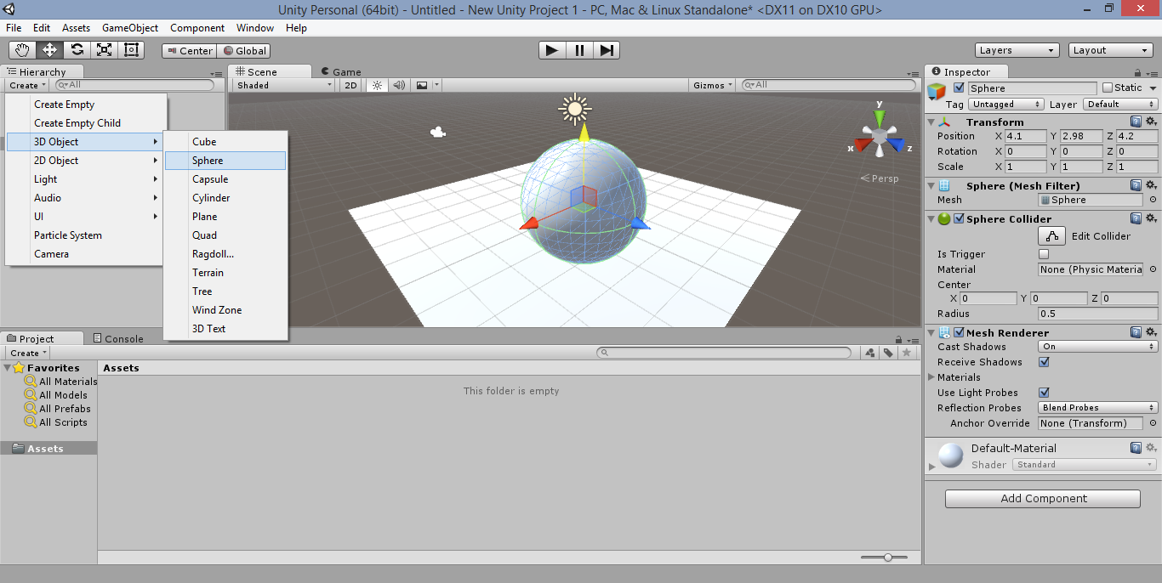
Adding More 3D Objects

Slide 17
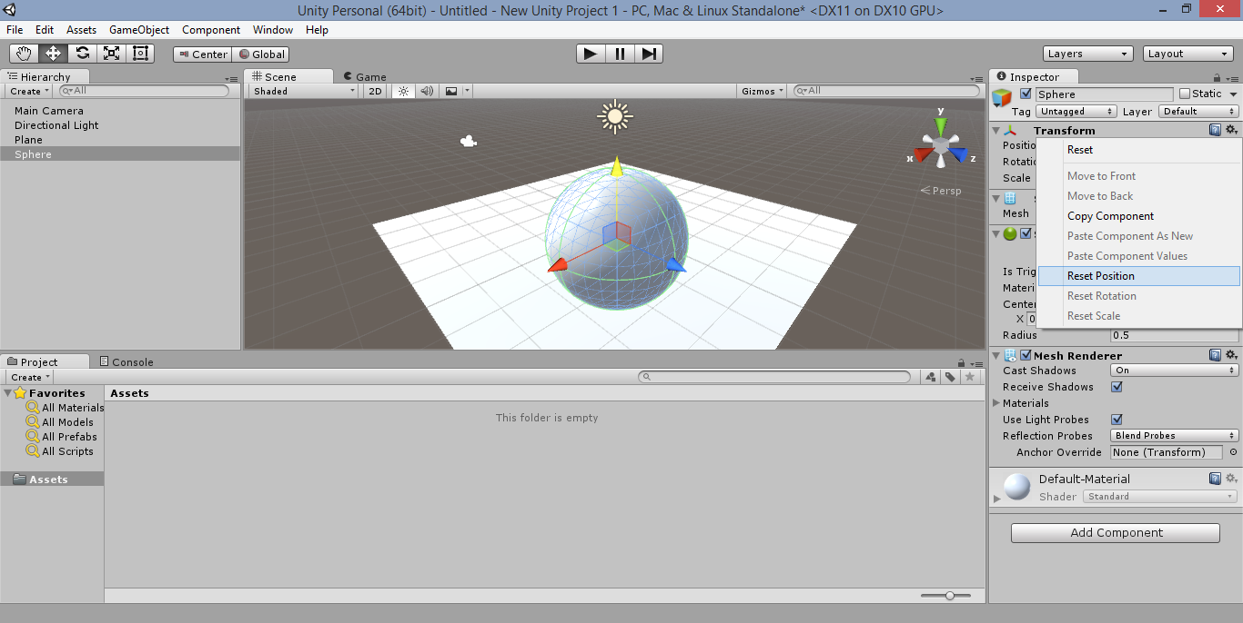
Resetting Objects to Origin (0,0,0)

Slide 18
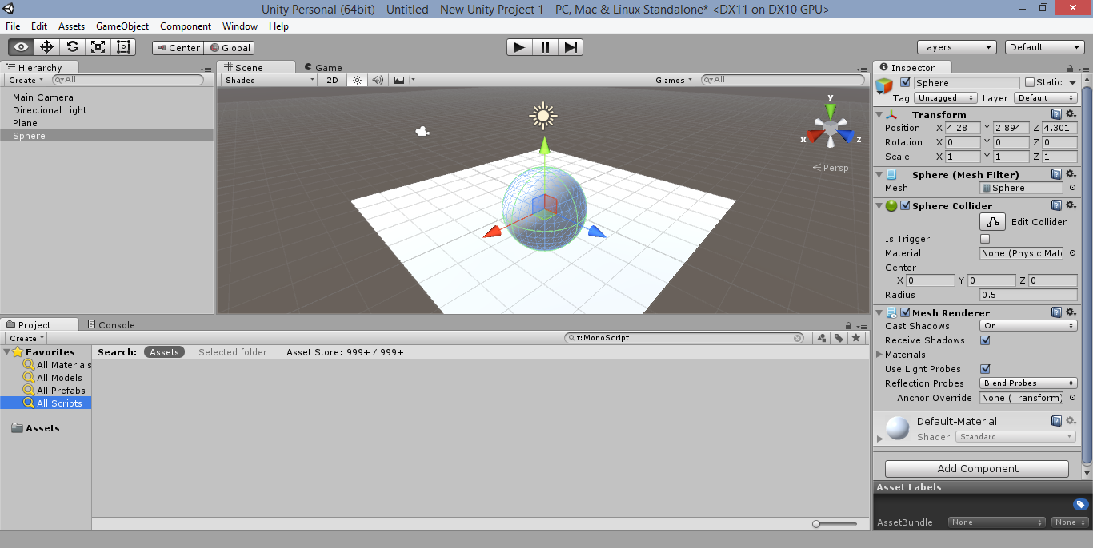
Changing Position, Rotation, Scale

Slide 19
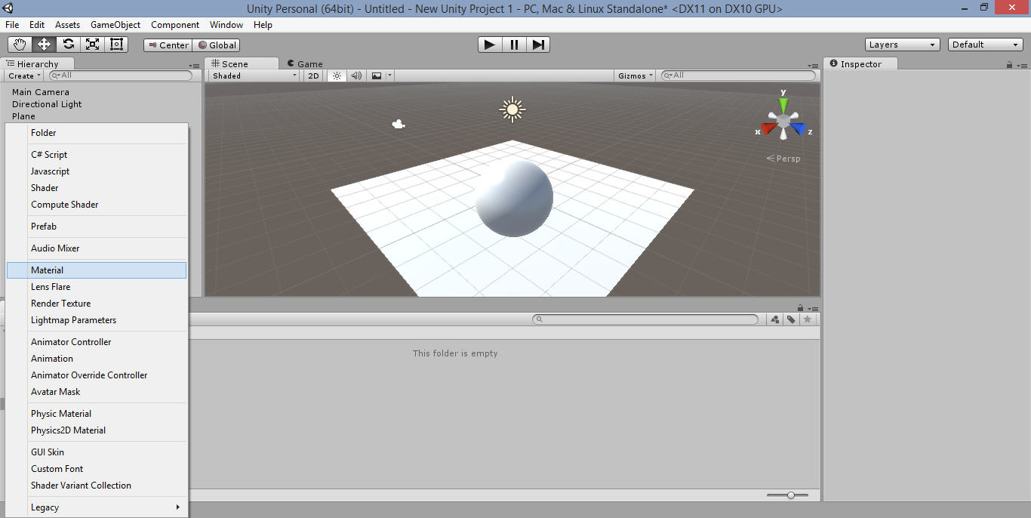
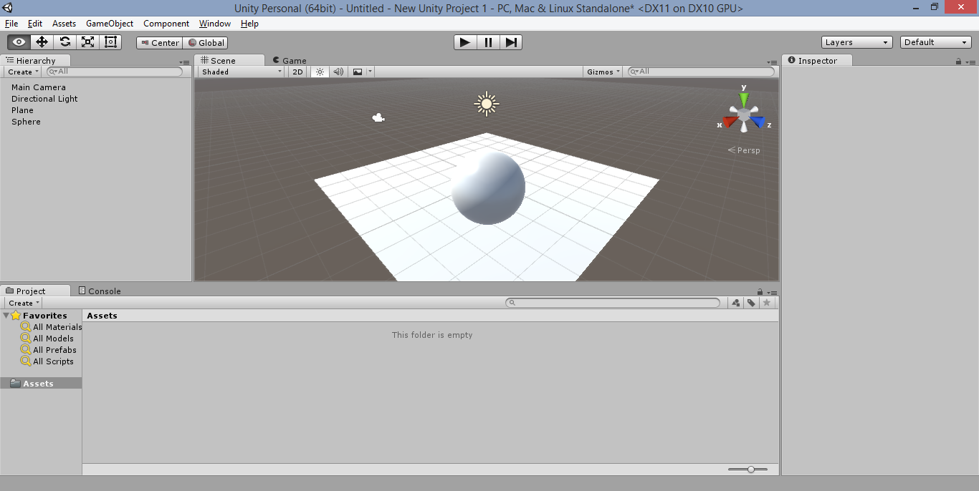
Creating Materials

Slide 20
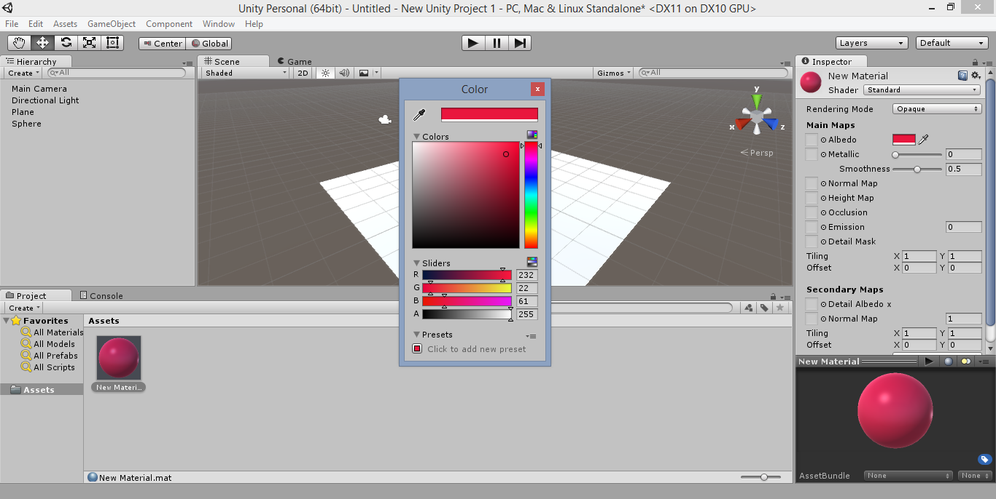
Setting Material Properties

Slide 21
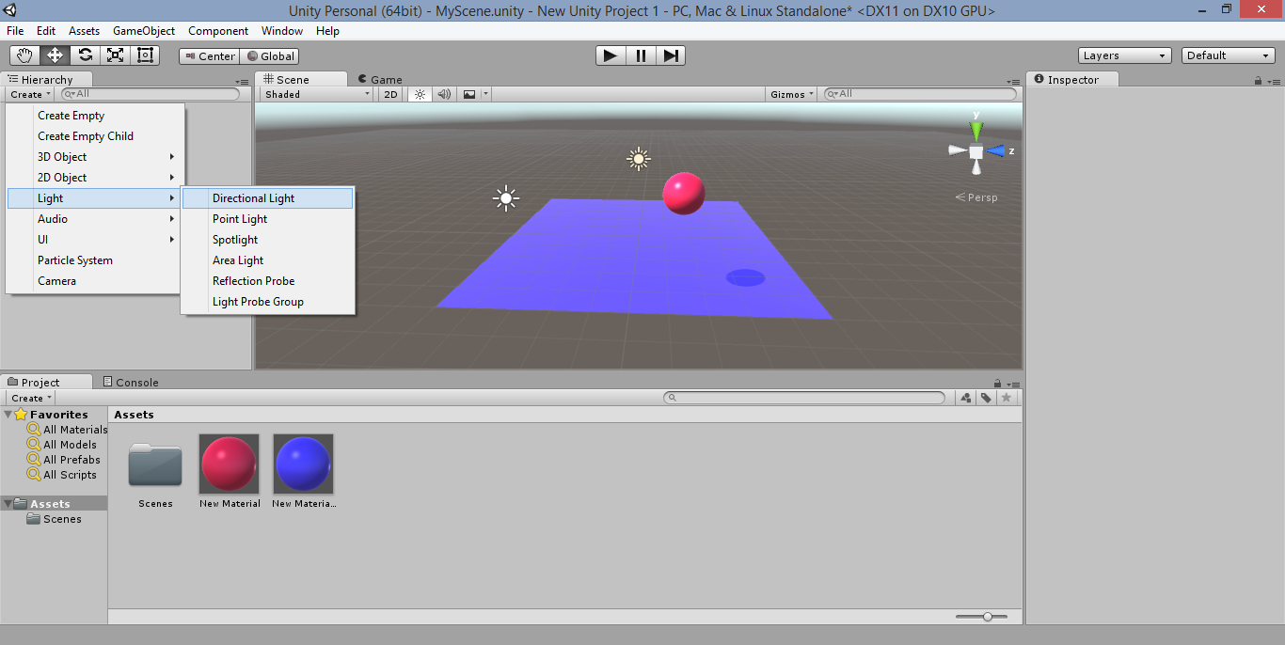
Adding Lights

Slide 22
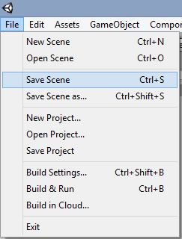
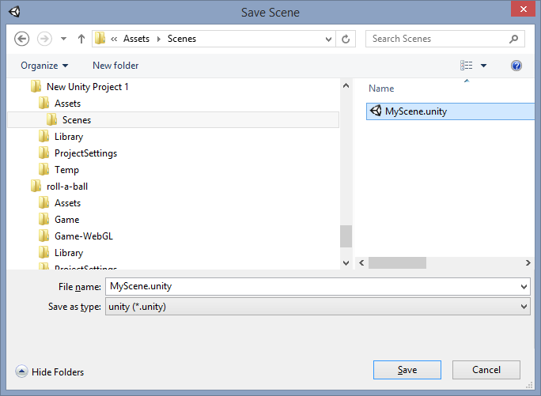
Save Current Scene
Click File → Save Scene
Create “Scenes” folder under Assets
Save scene as .unity file

Slide 23
Adding Scripts, Movement, Input

Slide 24
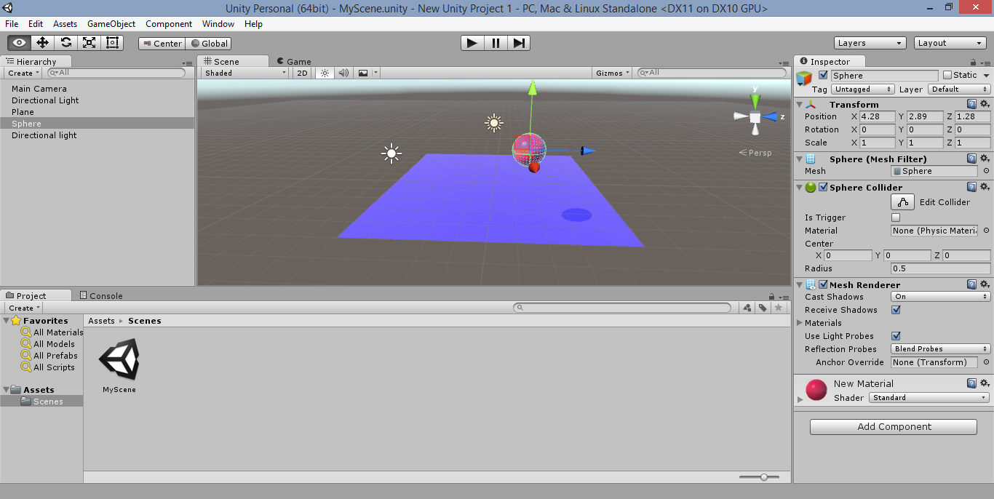
Adding Scripts to an Object

Slide 25
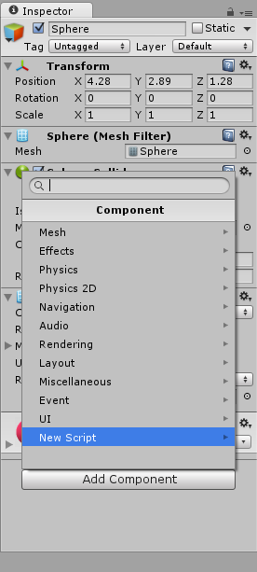
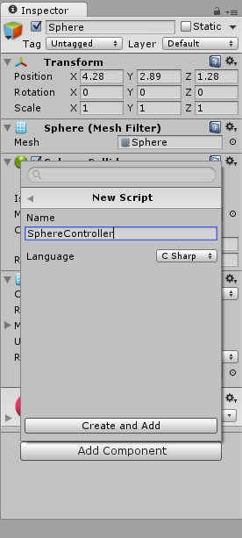
Create and Add a New Script

Slide 26
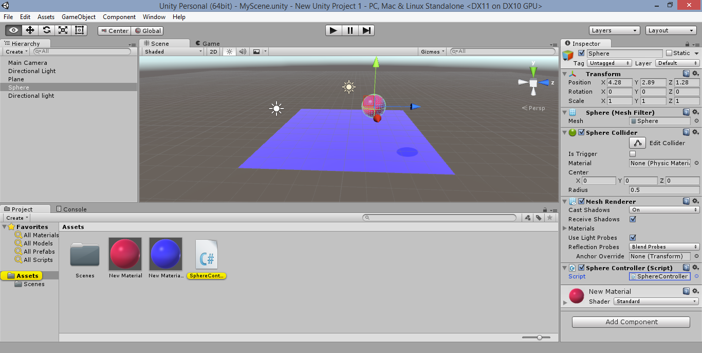
Launch Script File

Slide 27
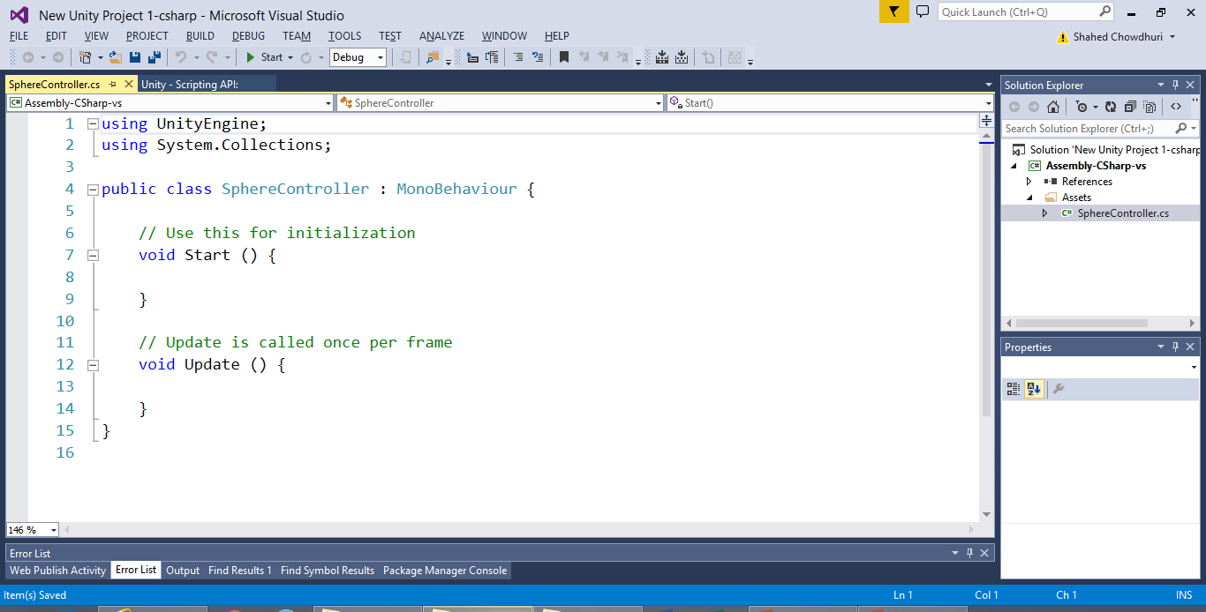
Edit Script Code

Slide 28
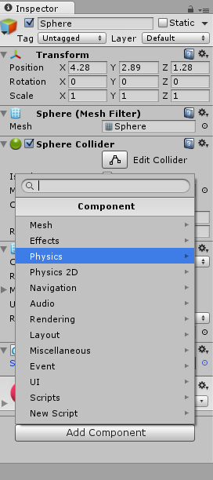
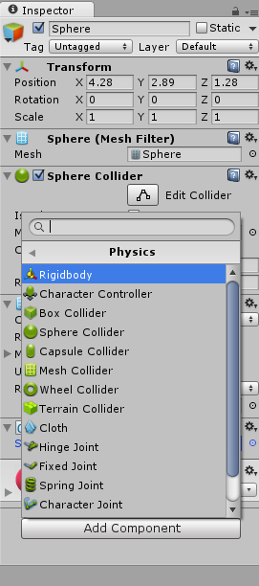
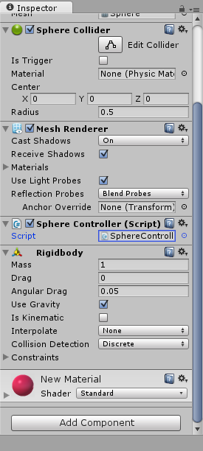
Add Components, e.g. RigidBody

Slide 29
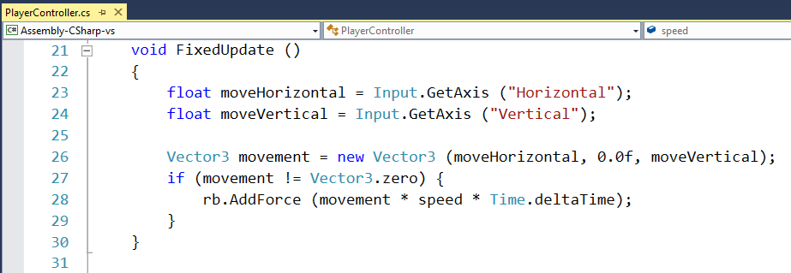
Adding Movement Using Inputs

Slide 30
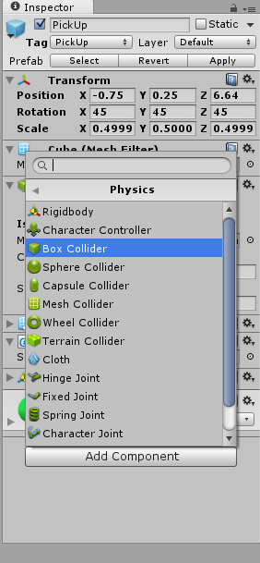
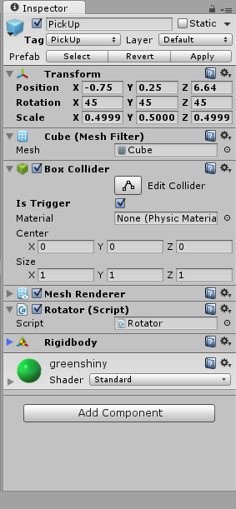
Adding Colliders with Triggers

Slide 31
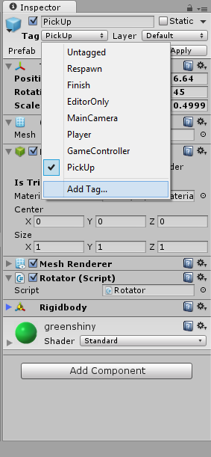
Adding Tags for Objects

Slide 32
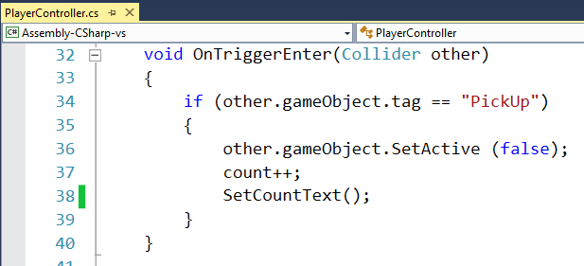
Detecting Collisions

Slide 33
Agenda
Introduction
> Getting Started
> Choosing a Code Editor
> Getting Started with 3D Objects
> Adding Scripts, Movement, Input
3D & 2D Demos
Notes:
Agenda

Slide 34
Demos

Slide 35
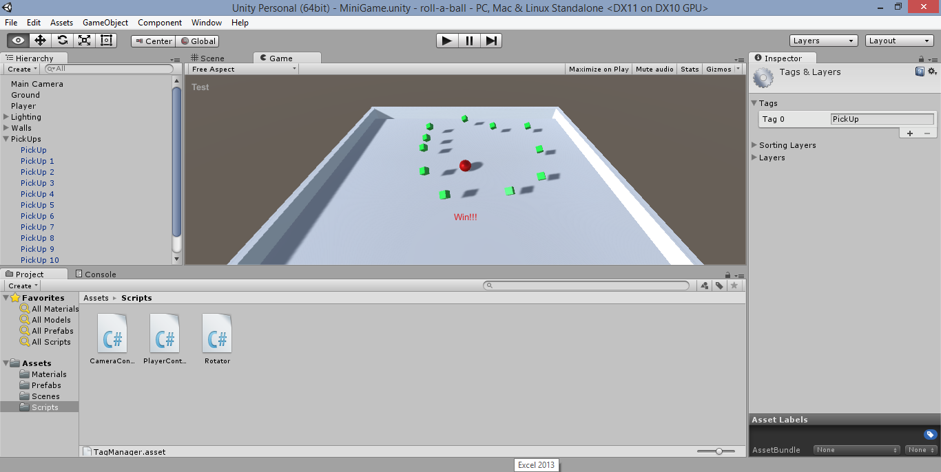
Demo: Roll-a-ball

Slide 36
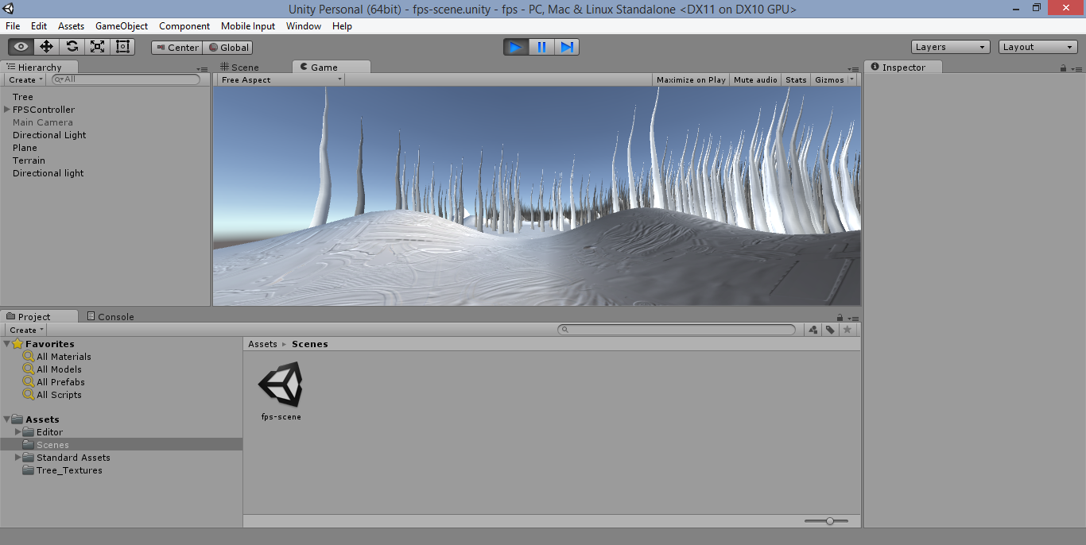
Demo: First Person Game

Slide 37
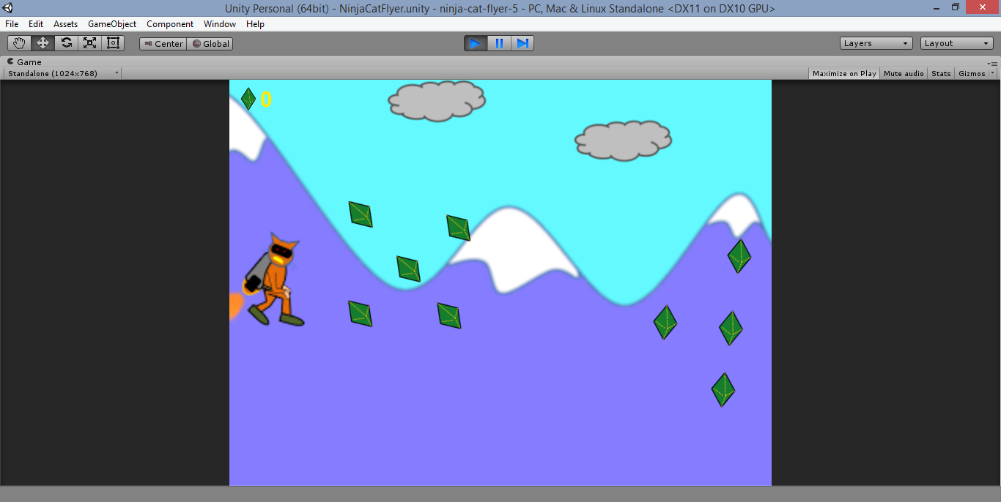
Demo: 2D Game Example

Slide 38
Agenda
Introduction
> Getting Started
> Choosing a Code Editor
> Getting Started with 3D Objects
> Adding Scripts, Movement, Input
3D & 2D Demos
Notes:
Agenda

Slide 39
Useful Links
Learn:
http://unity3d.com/learn
Roll-a-ball:
http://unity3d.com/learn/tutorials/projects/roll-a-ball/introduction
Unity 5 Primer:
https://www.youtube.com/watch?v=6eVfcEYxBPg
Unity 5 In-depth Basics:
https://www.youtube.com/watch?v=Ep0rlBQRcVc
C# Video tutorials:
http://tinyurl.com/csharp-video-tutorials

Slide 40
Roll-a-ball Tutorial Corrections
RigidBody Component needs to be retrieved via GetComponent first (Unity 5 auto-fixes this)
GUIText is a component, not a separate GameObject (video mentions this in popup text)

Slide 41
For More Info:
Unity Indie Devs:
http://facebook.com/groups/UnityIndieDevs
http://WakeUpAndCode.com/unity
Xbox One Indie Devs:
http://facebook.com/groups/XboxOneIndieDevs
http://WakeUpAndCode.com/xb1
Notes:
For more info:
Xbox One Indie Devs:
http://facebook.com/groups/XboxOneIndieDevs
http://WakeUpAndCode.com/xb1
Unity Indie Devs:
http://facebook.com/groups/UnityIndieDevs
http://WakeUpAndCode.com/unity
Construct2 Devs:
https://www.facebook.com/groups/construct2devs

Slide 42
Contact
Email: shchowd@microsoft.com  Twitter: @shahedC
Notes:
Contact
Microsoft email: shchowd@microsoft.com
Personal Twitter: @shahedC
Dev Blog: WakeUpAndCode.com

