Slide 1
Unity 5
Visual Studio Code * Asset Store * FPS * Terrain

Slide 2
Visual Studio Code
Set up on Windows and Mac OS

Slide 3
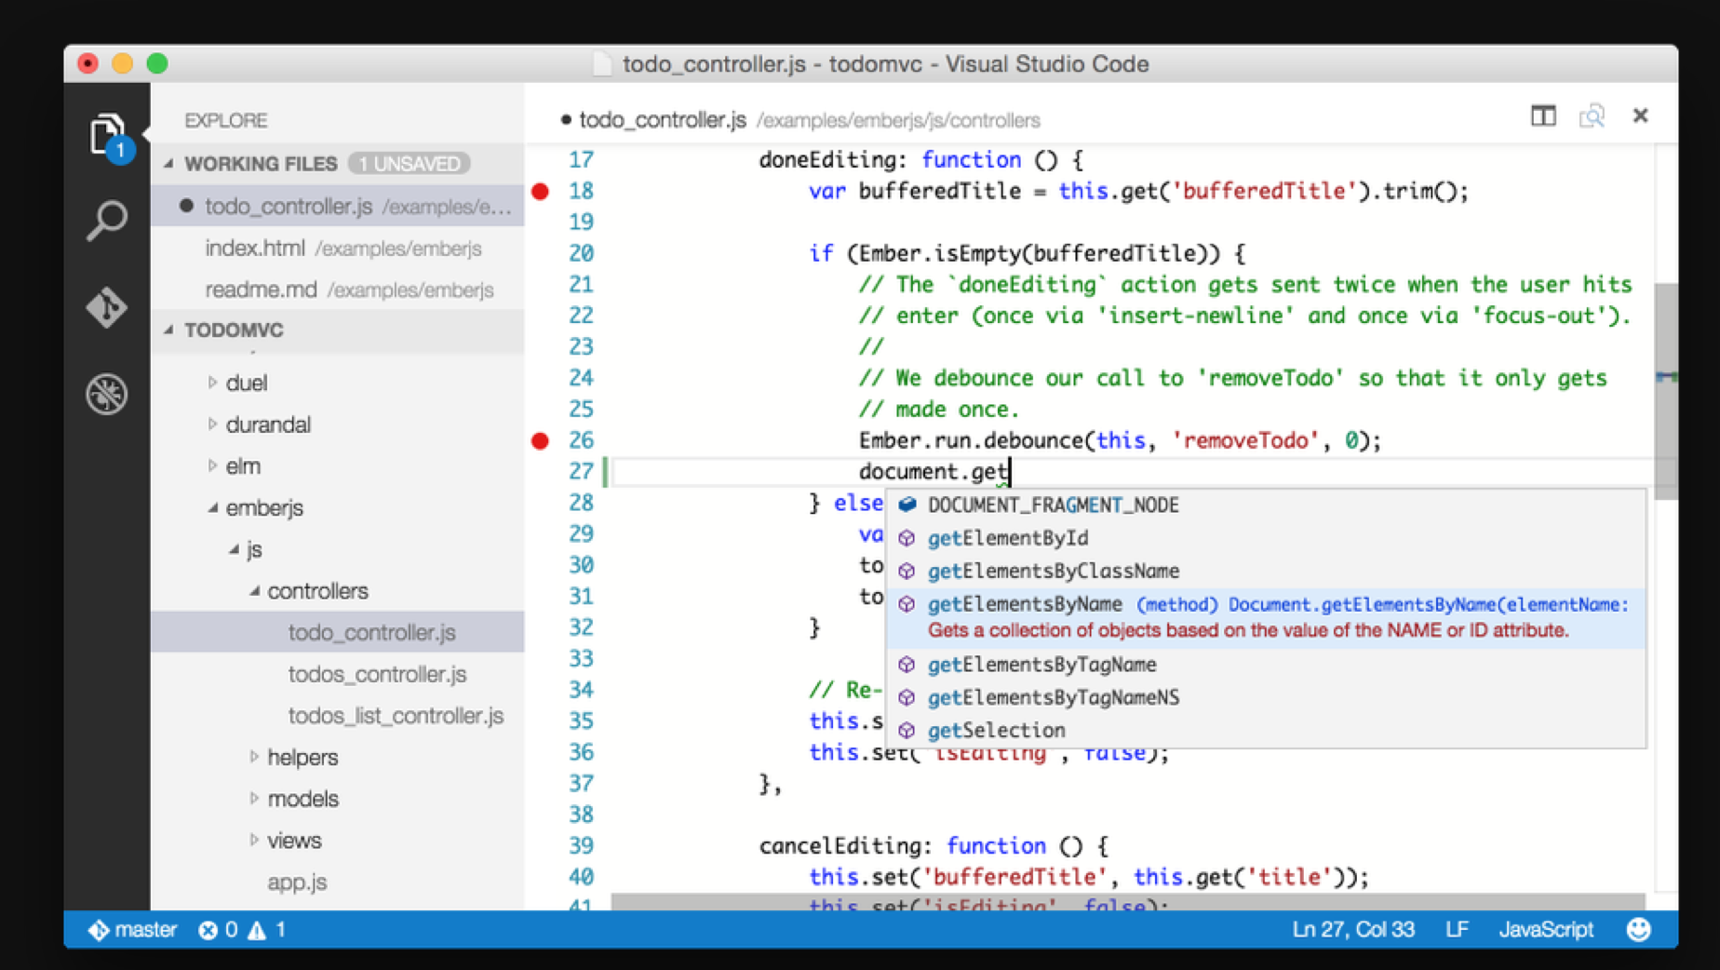
Visual Studio Code
http://code.visualstudio.com

Slide 4
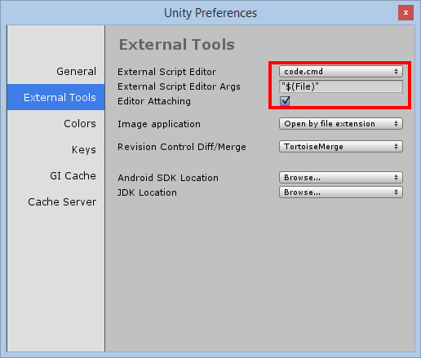
VS Code Setup on Windows
Click Edit → Preferences
External Tools
Browse to:
“C:\Users\<profile>\AppData\Local\Code\Bin\”
Select code.cmd
OPTIONAL:
In VS Code, open the project folder to use Intellisense
http://darkgenesis.zenithmoon.com/configuring-unity3d-to-use-the-new-lightweight-visual-studio-code-editor/

Slide 5
VS Code Setup on Mac
Click Assets → Sync MonoDevelop Project
Open VS Code, pick project folder
Pick a project (-csharp.sln) file
http://unreferencedinstance.com/how-to-integrate-visual-studio-code-with-unity3d-project/

Slide 6
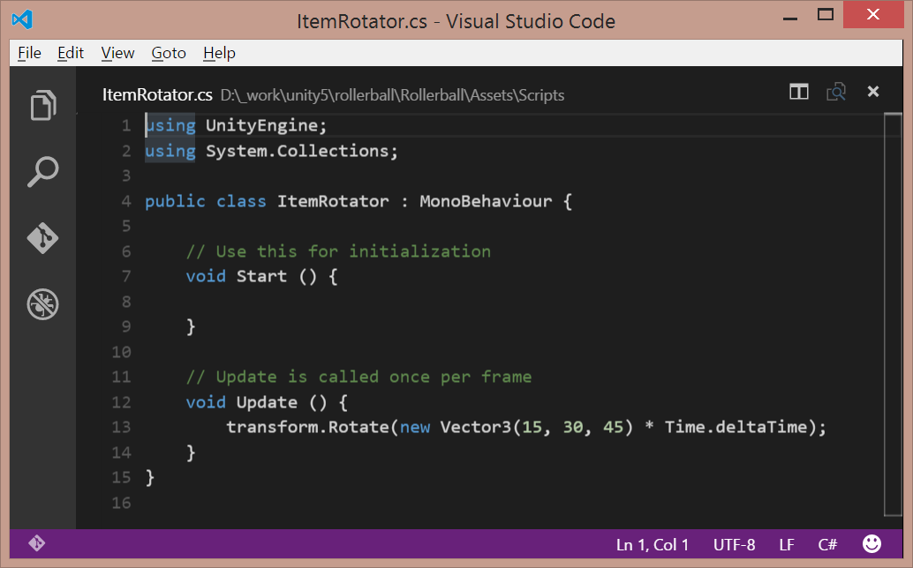
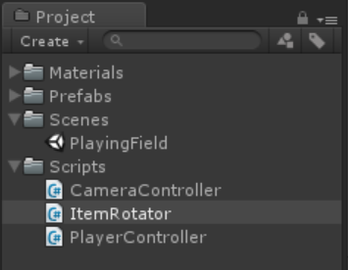
Launch Any Script from Unity
Double-click Script file

Slide 7
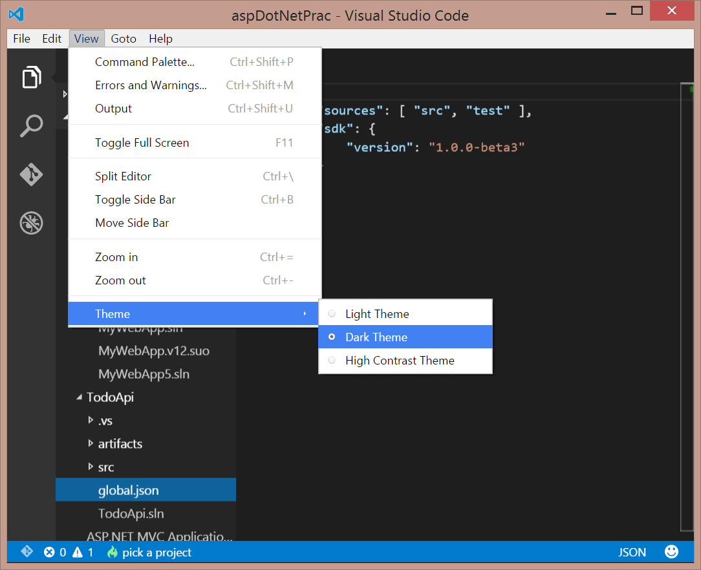
Choose a Theme: Light, Dark, High Contrast
On the top menu,
Click View
Click Theme
Choose a theme:
Light Theme
Dark Theme
High Contrast Theme

Slide 8
Asset Store
Get free/paid assets for your game

Slide 9
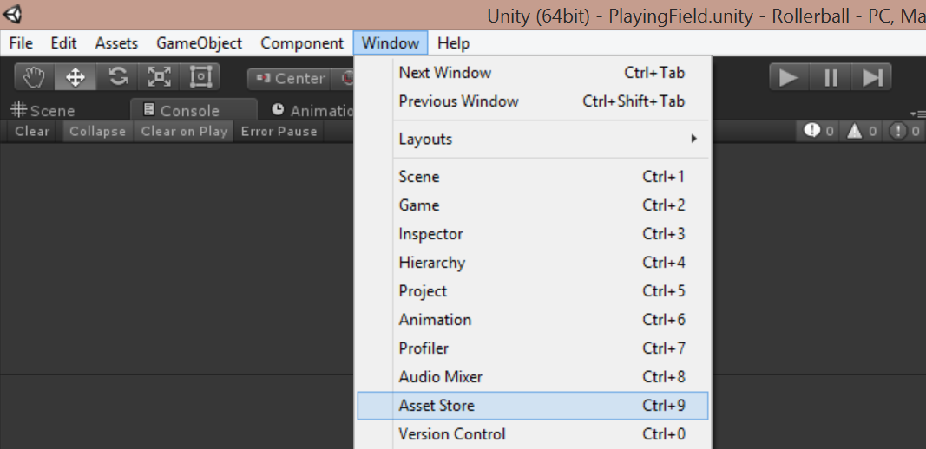
Launch Unity’s Asset Store
On the top menu,
Click Window
Click Asset Store
Shortcut: Ctrl+9

Slide 10
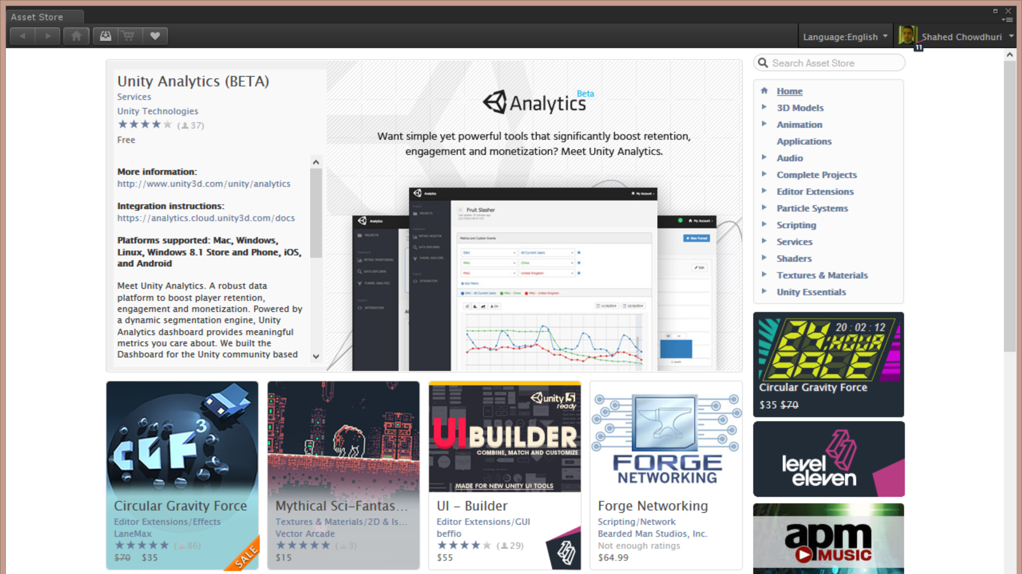
Asset Store Window
Verify that
you’re logged in.

Slide 11
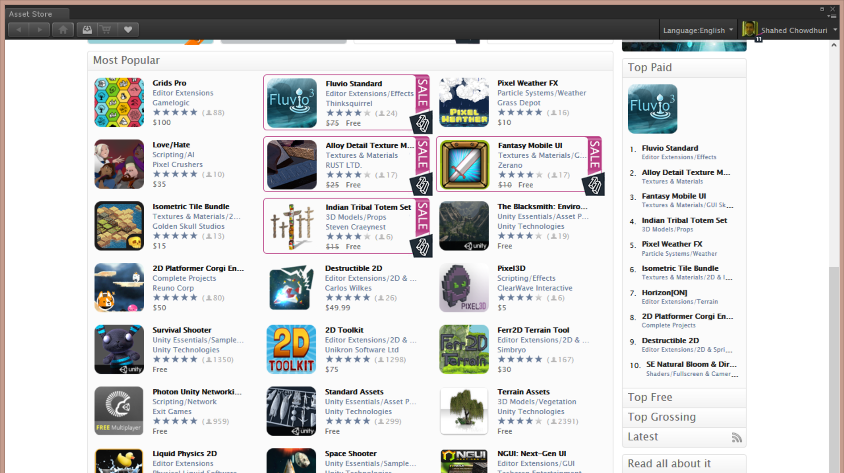
Asset Store: Top Paid
Scroll down
for top charts

Slide 12
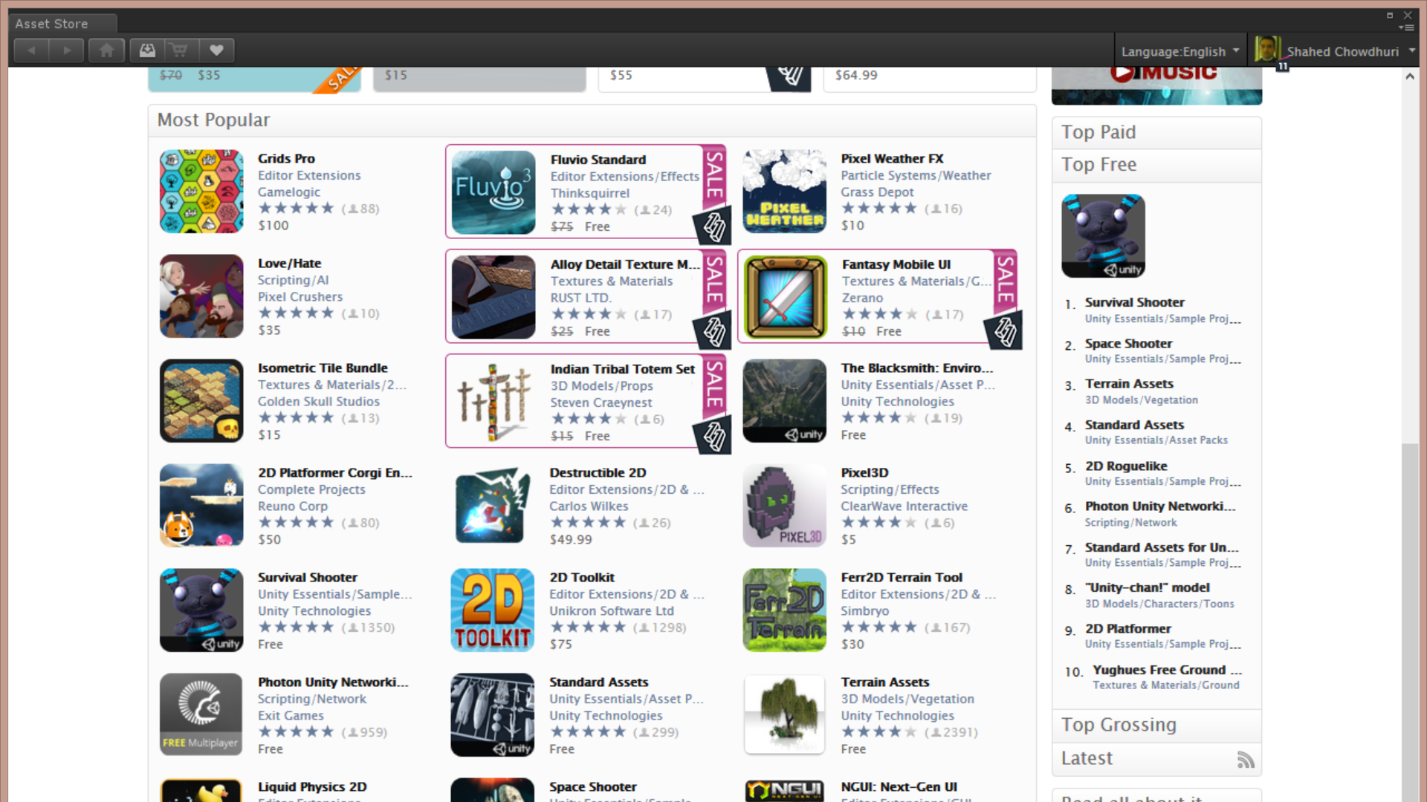
Asset Store: Top Free
Click on
Top Free
(below
Top Paid)

Slide 13
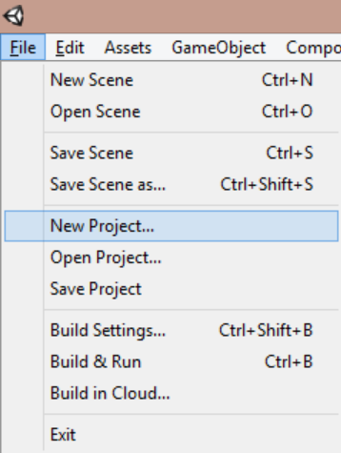
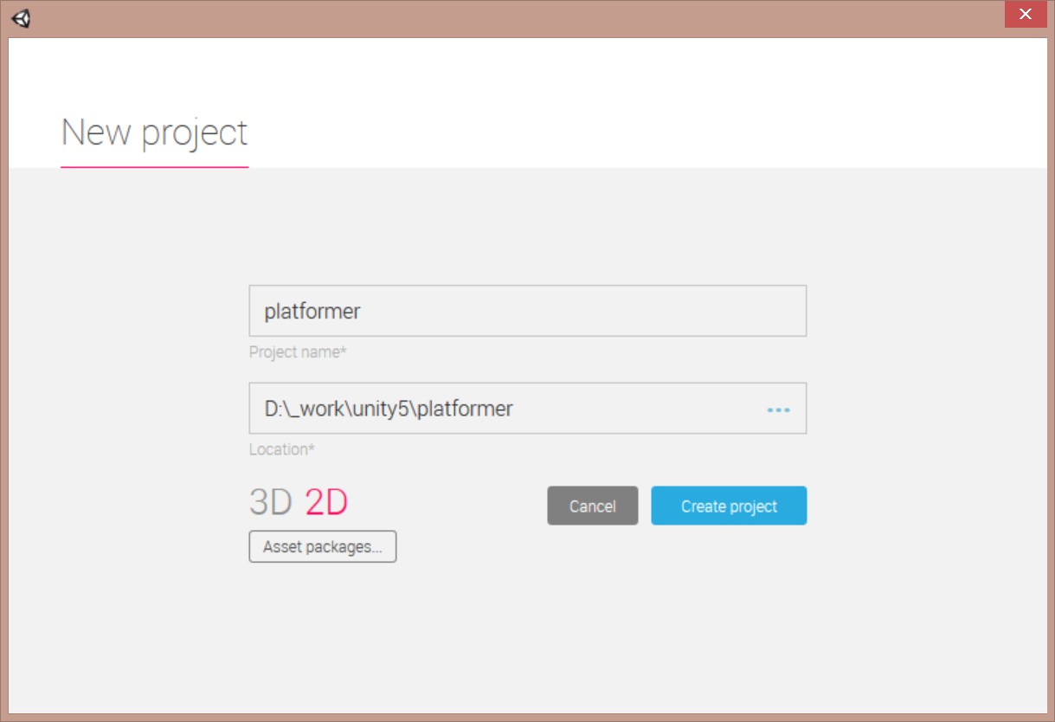
Create New 2D Project for Platformer Game
Click File → New Project…
Name your project…
… choose 2D, then click “Create project”

Slide 14
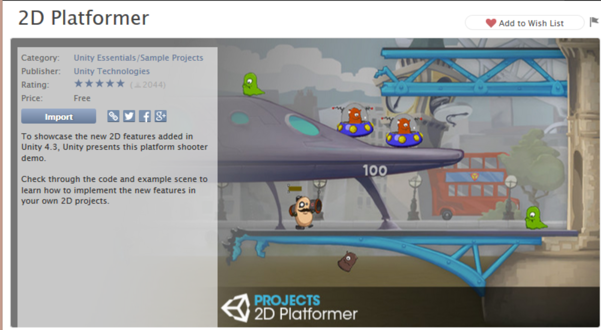
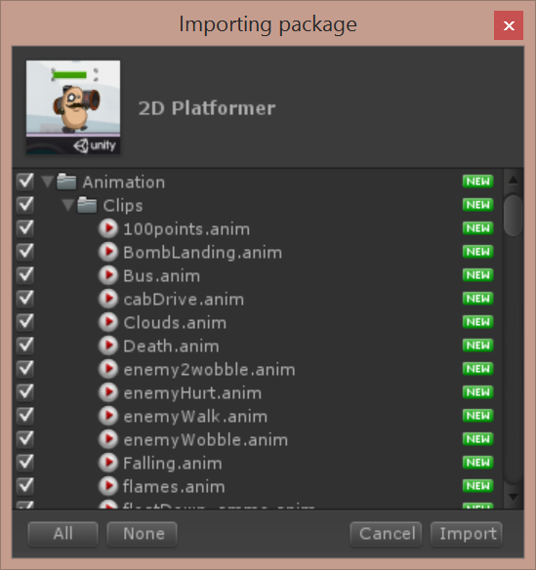
Download and Import “2D Platformer”
1. Click Download
2. Click Import
3. Import All!

Slide 15
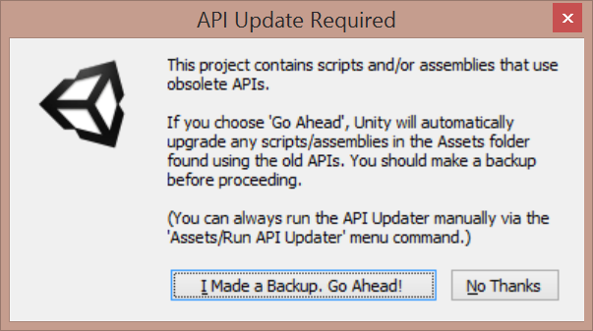
Proceed Through Upgrade Prompt (optional)
Go Ahead!

Slide 16
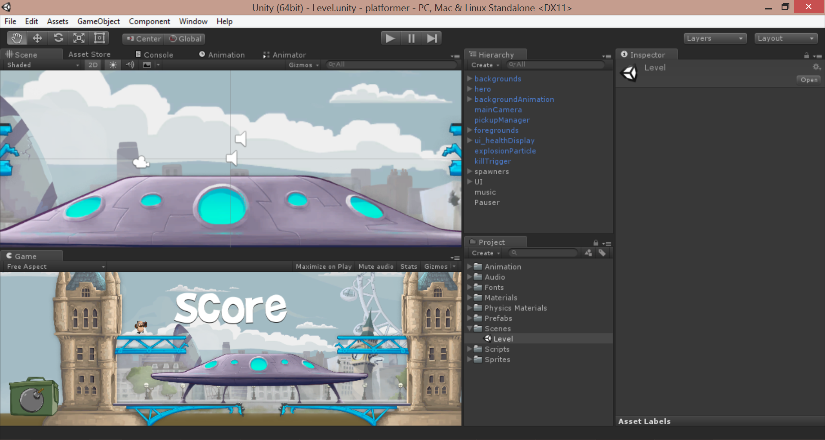
Run the game!
Click Play button

Slide 17
First Person Game
Add a first-person controller

Slide 18
Create New 3D Project
Click File → New Project…
Name your project…
… choose 3D, then click “Create project”

Slide 19
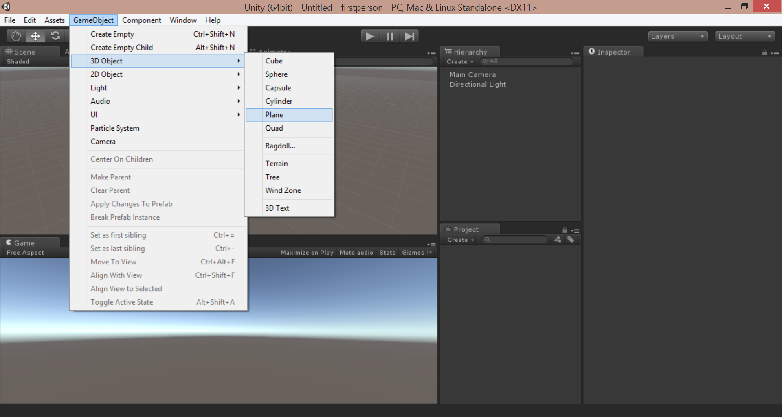
Create Ground
From top menu, click GameObject → 3D Object → Plane

Slide 20
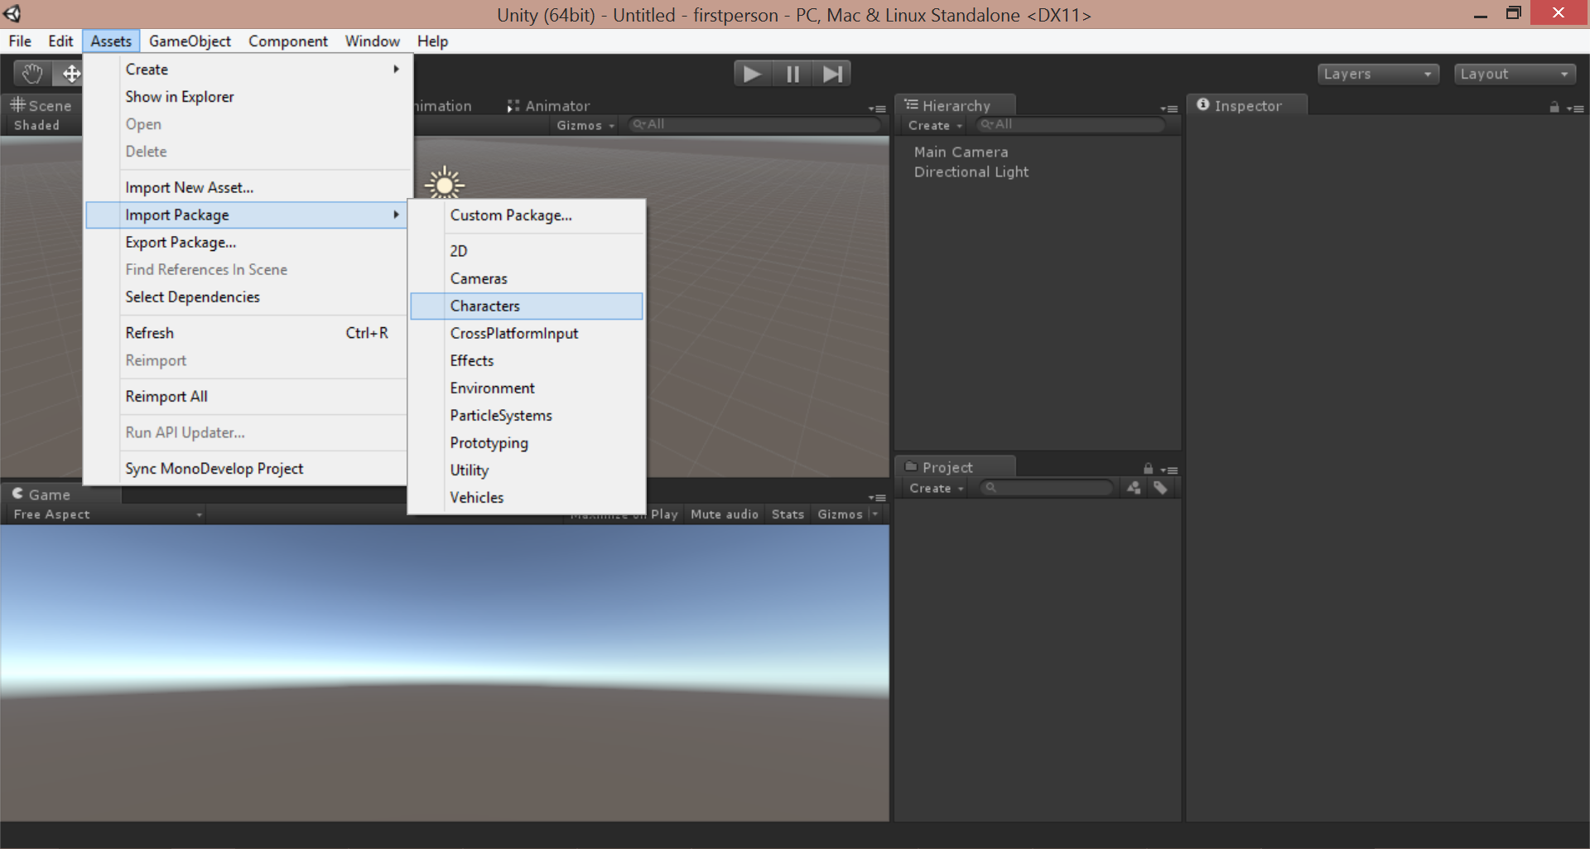
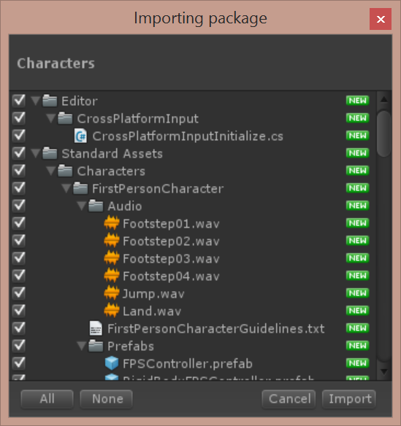
Import Characters Package
Click Assets → Import Package → Characters
Import All!

Slide 21
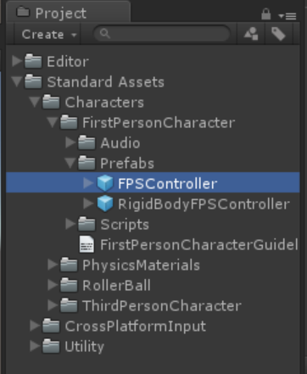
Locate FPS Controller in Project Panel
In the Project Panel,
Open the following:
Standard Assets
Characters
FirstPersonCharacter
Prefabs
FPSController

Slide 22
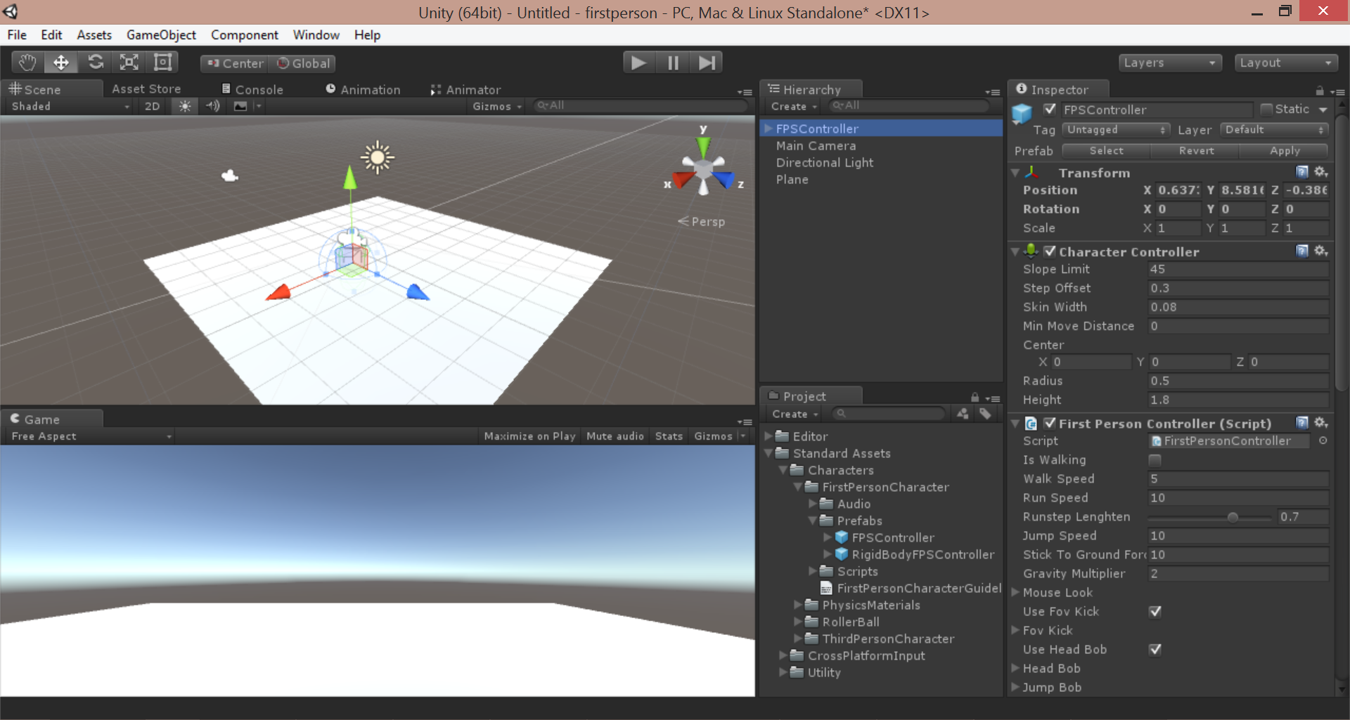
Drag FPSController to Scene

Slide 23
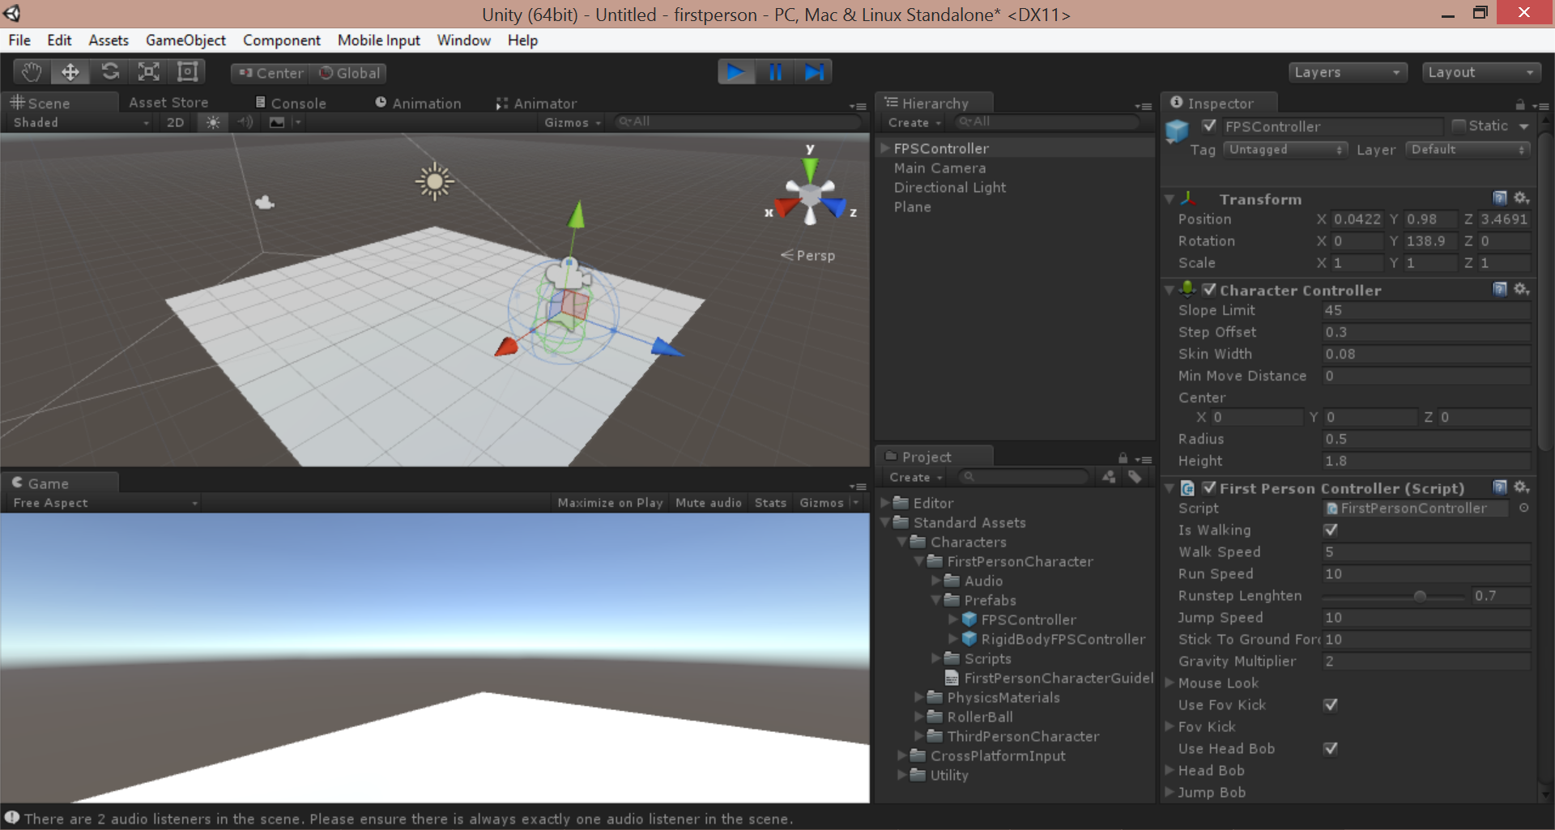
Run the Game!
Click Play button, move with arrow keys
Notice
FPSController
in Hierachy

Slide 24
Terrain
Build your own terrain

Slide 25
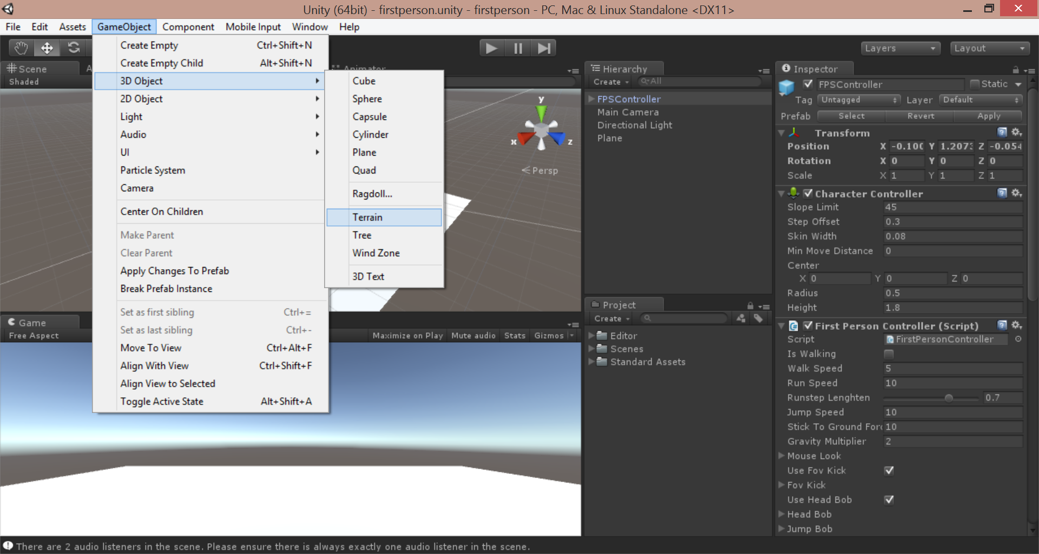
Add Terrain
From top menu, click GameObject → 3D Object → Terrain

Slide 26
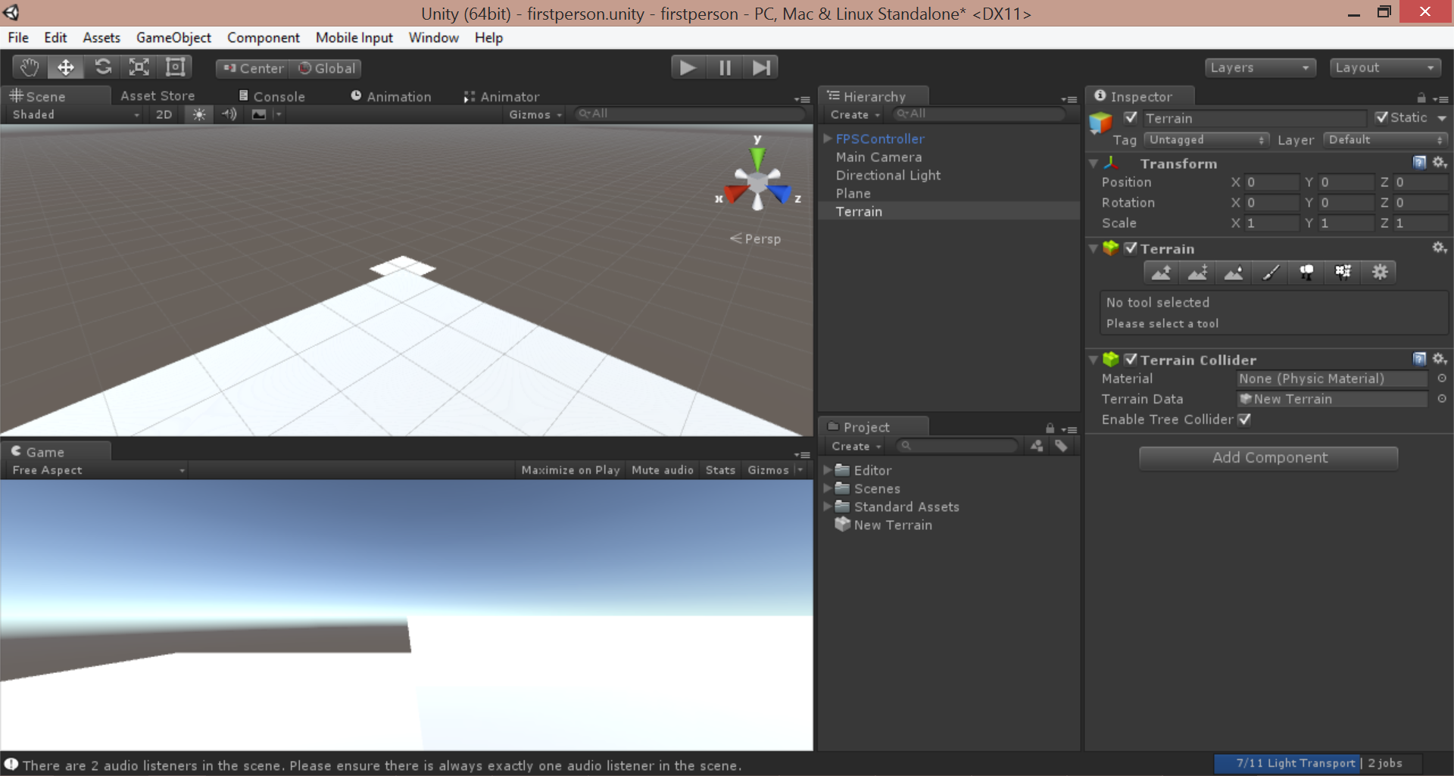
Zoom Out and Focus on Terrain

Slide 27
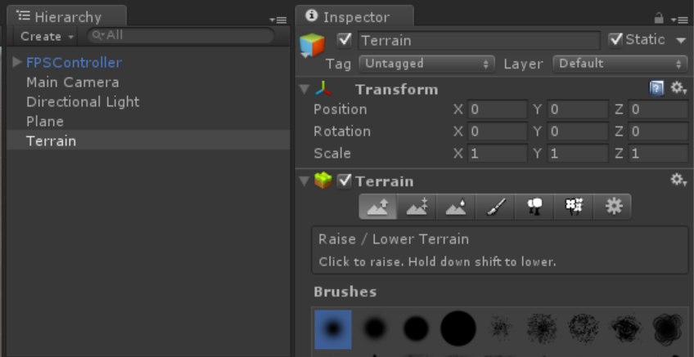
Select Tool to Raise/Lower Terrain

Slide 28
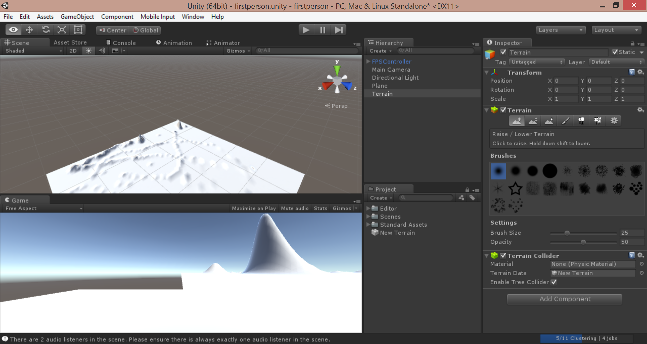
Drag Mouse on Terrain in Scene

Slide 29
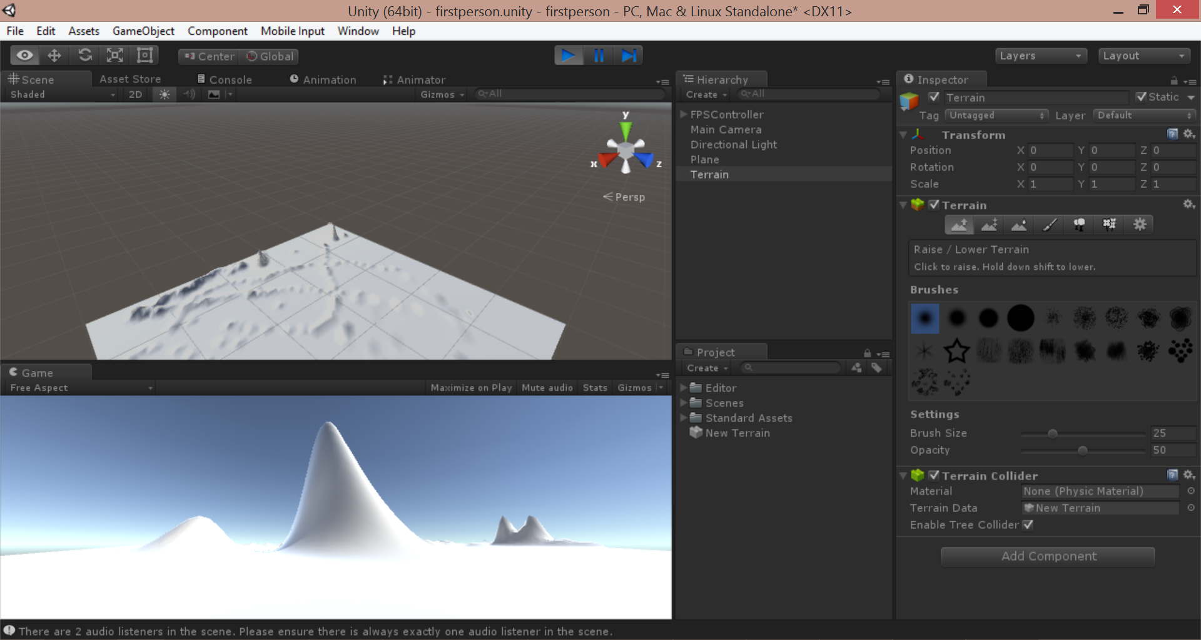
Run the game!
Click Play button, move with arrow keys

Slide 30
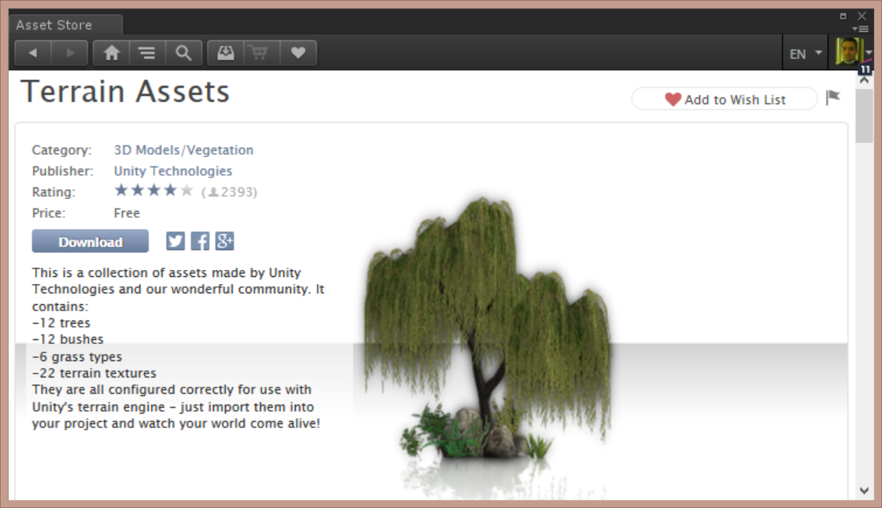
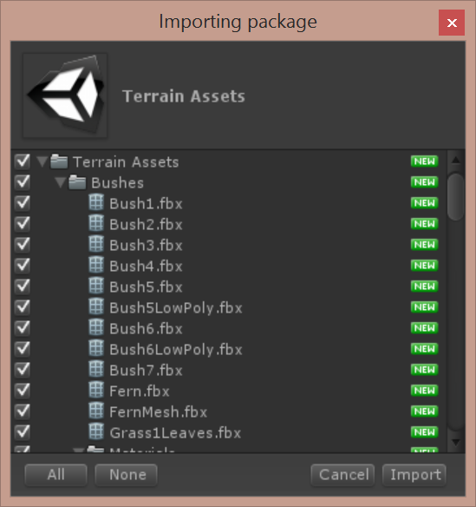
Download and Import Unity’s Terrain Assets

Slide 31
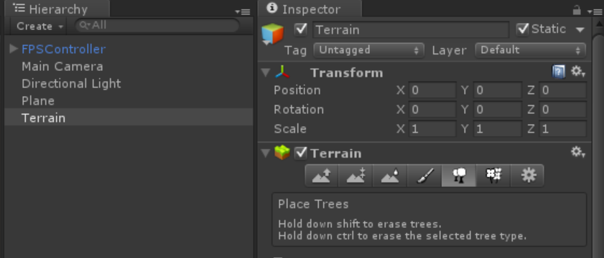
Select Tool to Place Trees

Slide 32
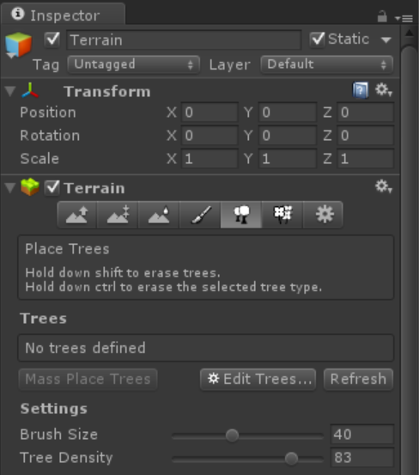
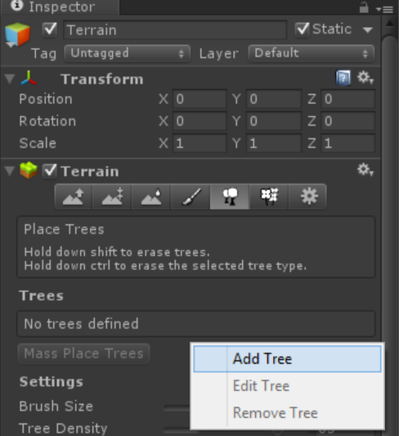
Edit Trees for Terrain to Add Tree
In the Terrain’s Inspector window, click Edit Trees → Add Tree

Slide 33
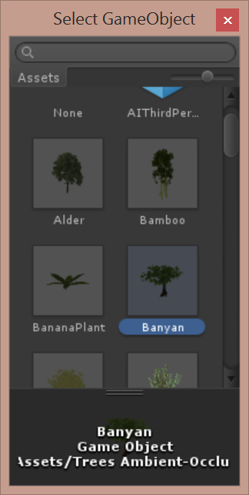
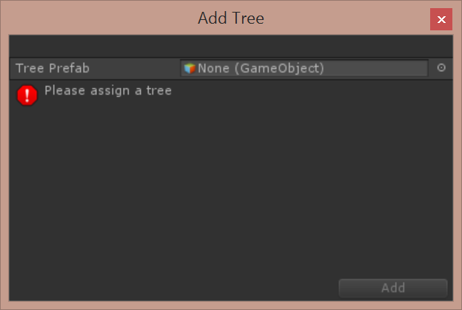
Assign Tree Prefab to Add Tree
In the Add Tree dialog, click the tiny circle, then choose a tree, e.g. Banyan

Slide 34
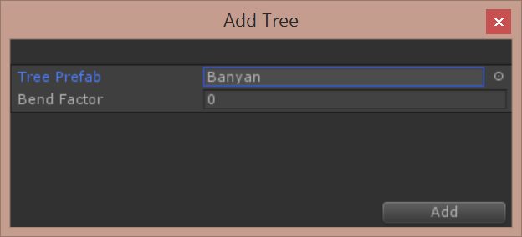
Confirm Add
Click the Add button to confirm.

Slide 35
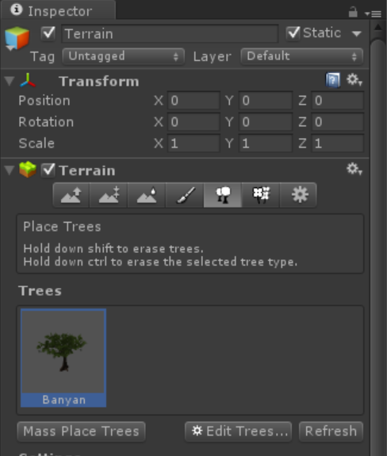
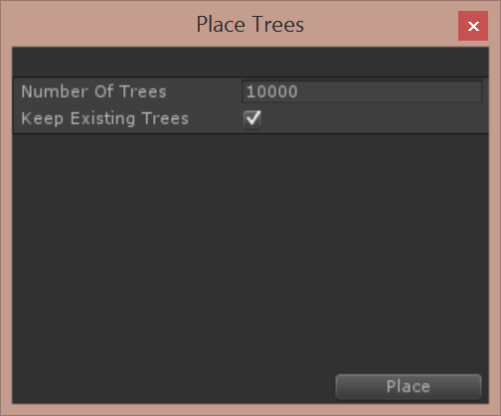
Mass Place Trees
Click “Mass Place Trees, then click Place to confirm

Slide 36
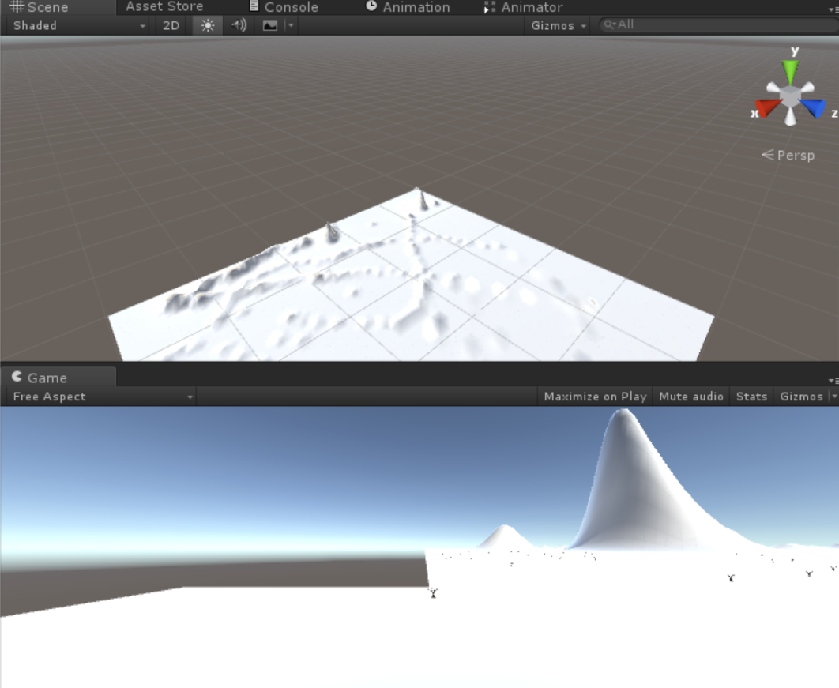
Trees Too Small…?
Too Small!

Slide 37
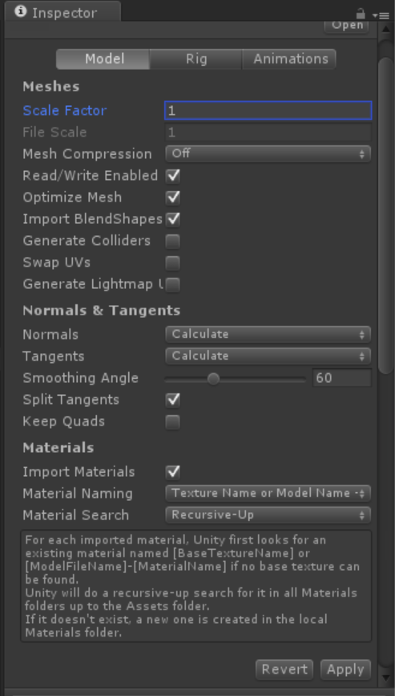
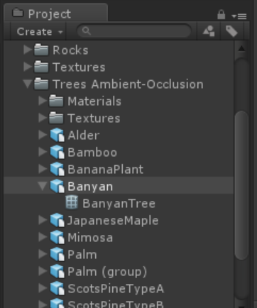
Update Scale for Tree Prefab
In the
Project panel,
click the Prefab
for the tree you
selected,
e.g. Banyan
Enter a larger
Scale Factor
e.g. 1
Click Apply to
update all trees!

Slide 38
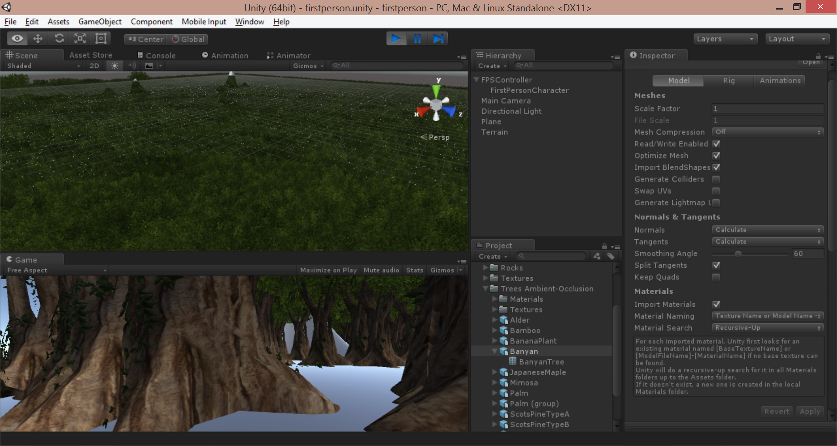
Enjoy Larger Trees!

Slide 39
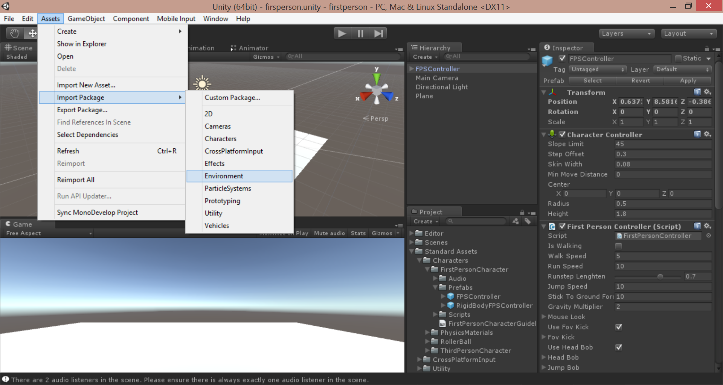
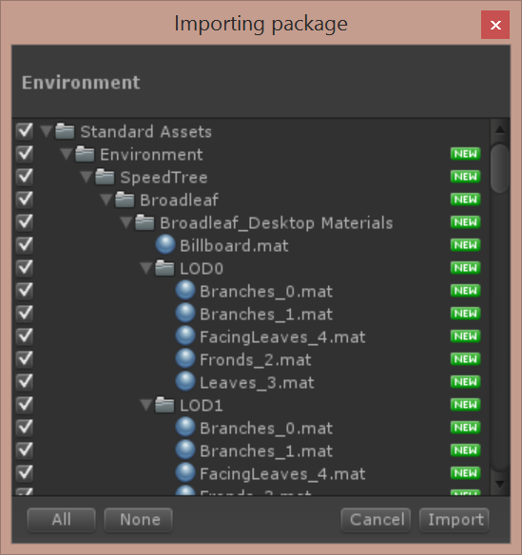
Optional: Import Environment Package
Click Assets → Import Package → Environment
Import All!

