Slide 1
Unity 2D: Step by Step, Part 1
Derived from Kirill Muzykov’s Rocket Mouse Tutorial
http://www.raywenderlich.com/69392/make-game-like-jetpack-joyride-unity-2d-part-1
By Shahed Chowdhuri
Sr. Technical Evangelist
WakeUpAndCode.com
@shahedC
Notes:
Title Page: Unity 2D: Step by Step
Based on Kirill Muzykov’s Rocket Mouse Tutorial
http://www.raywenderlich.com/69392/make-game-like-jetpack-joyride-unity-2d-part-1
By Shahed Chowdhuri
Senior Technical Evangelist
Blog: WakeUpAndCode.com
Twitter: @shahedC

Slide 2
Agenda
Getting Started
> Adding the Player
> Adding Code
> Ups & Downs
Effects & Objects
Notes:
Agenda
Getting Started
> Adding the Player
> Adding Code
> Ups & Downs
Effects & Objects

Slide 3
Getting Started
Notes:
Getting Started

Slide 4
Download Resources
Unity UI Basics (see slides 10 to 20 of past presentation)
http://wakeupandcode.com/public_downloads/ms-UnityGameDev-ShahedChowdhuri-Meetup-2014-06-11.pptx
Ninja Cat Flyer resources (Ninja Cat graphics added to Rocket Mouse)
Location: http://WakeUpAndCode.com/u
File: NinjaCatFlyerResources.zip
FYI, Kirill’s original Rocket Mouse resources:
http://cdn4.raywenderlich.com/wp-content/uploads/2014/03/RocketMouse_Unity_Resources.zip
Notes:
Download Resources
Kirill’s original Rocket Mouse resources:
http://cdn4.raywenderlich.com/wp-content/uploads/2014/03/RocketMouse_Unity_Resources.zip
Ninja Cat Flyer resources (Ninja Cat graphics added to above)
Location: http://WakeUpAndCode.com/u
File: NinjaCatFlyerResources.zip

Slide 5
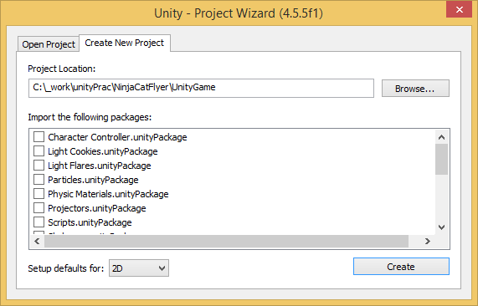
Create New Project
Enter project location (empty folder)
… Select 2D…
… then, click “Create”

Slide 6
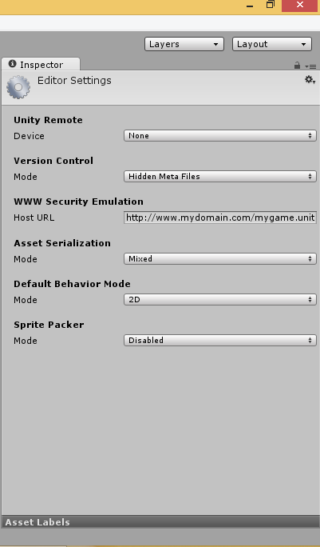
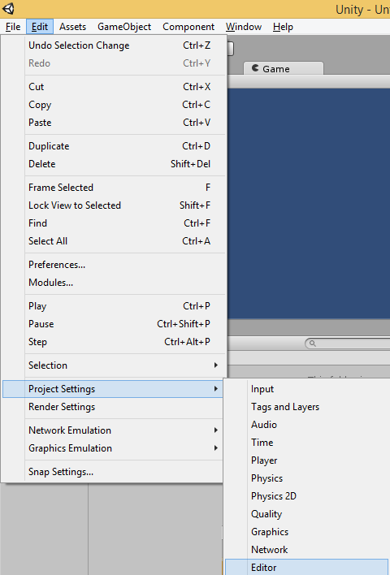
Verify 2D Mode
Verify 2D in
Inspector
Click Edit → Project Settings → Editor

Slide 7
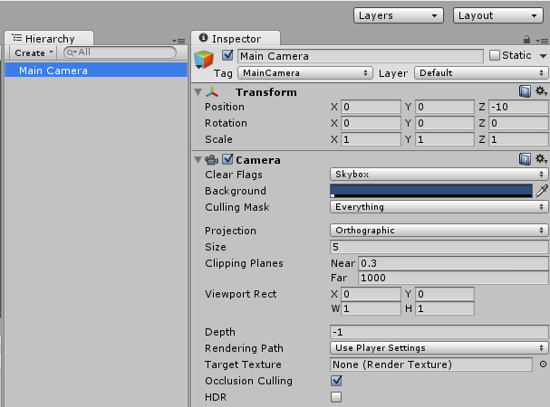
Verify 2D Camera
Verify
Transform
Position
(0, 0, -10)
Select
“Main Camera”
in hierarchy
Verify
“Orthographic”
Projection

Slide 8
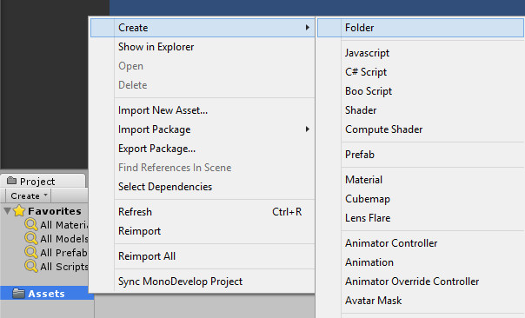
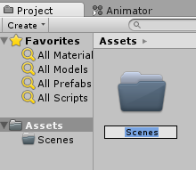
Create “Scenes” Folder
Click Create, then Folder
In Project panel,
right-click
“Assets”
folder
Name it “Scenes”

Slide 9
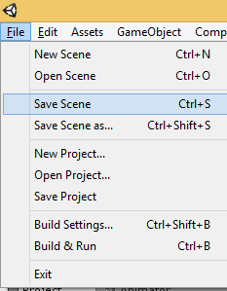
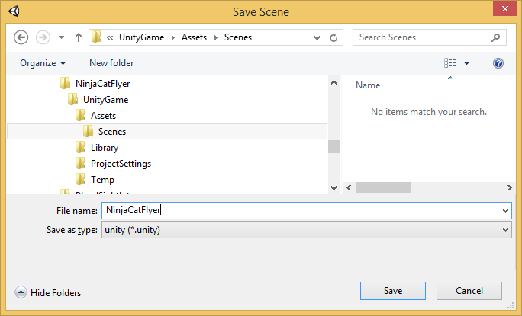
Save Scene
Click File → Save Scene
Inside “Scenes” subfolder…
Name your scene, click Save

Slide 10
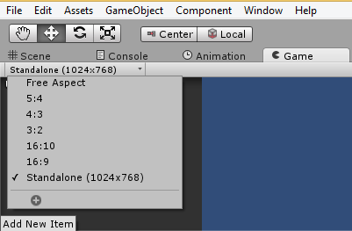
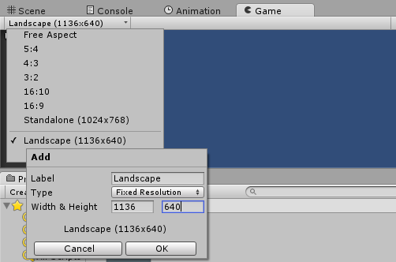
Set Dimensions (Width & Height)
1
2
3
In the Game panel…
Click the list of dimensions
Click [+] to “Add New Item”
Label it “Landscape”
Width & Height = 1136 x 640
Click OK.

Slide 11
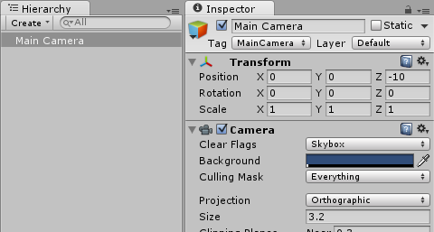
Update Camera Size
Select Main Camera
in Hierarchy
Update Size to 3.2

Slide 12
Adding the Player
Notes:
Adding the Player

Slide 13
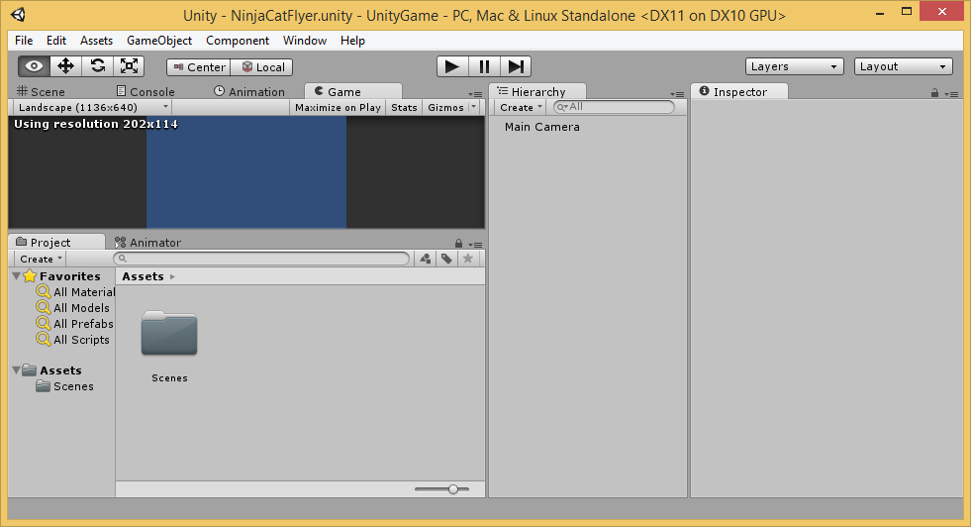
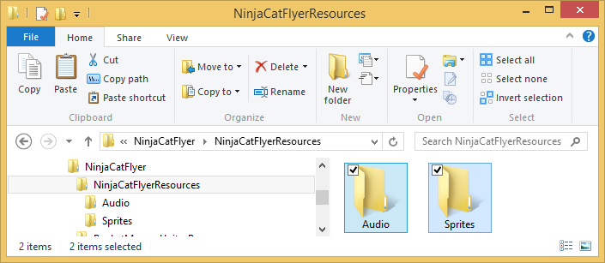
Add Audio & Sprites to Assets
Drag to Assets

Slide 14
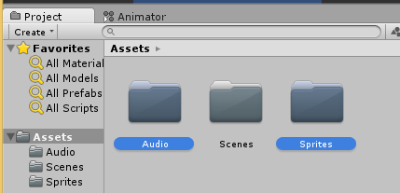
Verify Audio & Sprites subfolders
Audio and Sprites
subfolders

Slide 15
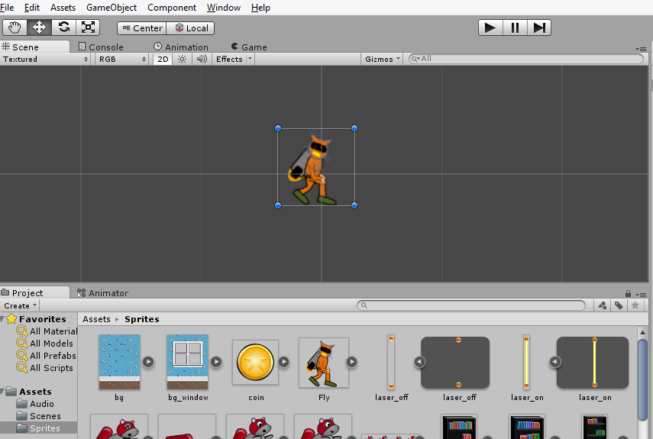
Add “Fly” Sprite to Scene
Drag into Scene

Slide 16
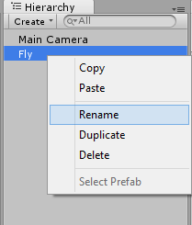
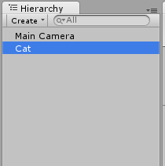
Rename the Character
Right-click
“Fly”
then click
Rename
Name it
“Cat”

Slide 17
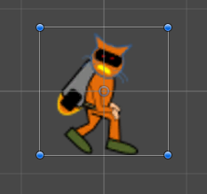
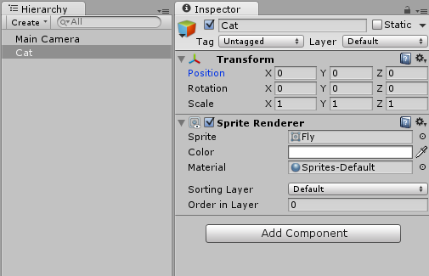
Position the Character
In the Inspector panel,
update Position:
X = 0
Y = 0
Z = 0
Select “Cat”
in the
Hierarchy

Slide 18
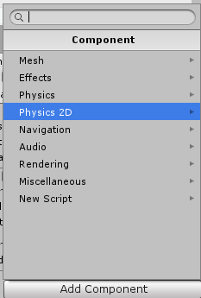
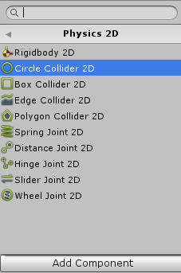
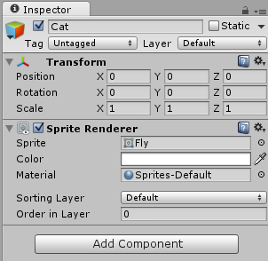
Add Circle Collider 2D Component
Click “Add Component” → Physics 2D → Circle Collider 2D

Slide 19
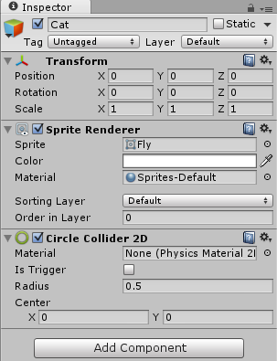
Update Radius for Circle Collider 2D
In the Inspector panel,
update Radius
for Circle Collider 2D
Radius = 0.5

Slide 20
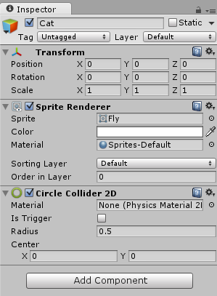
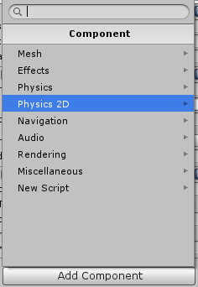
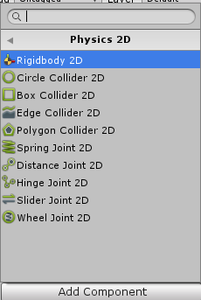
Add Rigidbody 2D Component
Click “Add Component” → Physics 2D → Rigidbody 2D

Slide 21
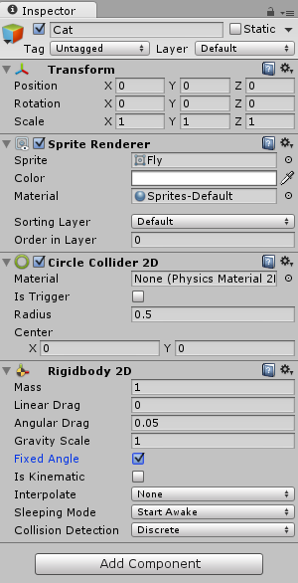
Enable Fixed Angle for Rigidbody 2D
In the Inspector panel,
check “Fixed Angle”

Slide 22
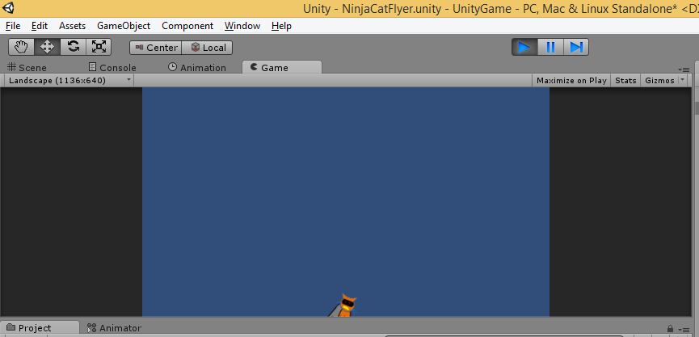
Run the Game!
Run
The cat falls down!

Slide 23
Adding Code
Notes:
Adding Code

Slide 24
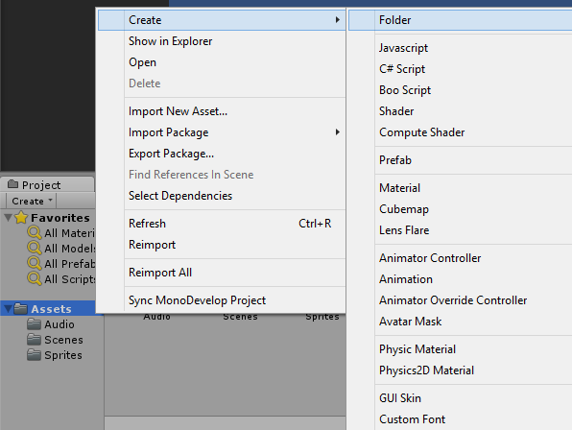
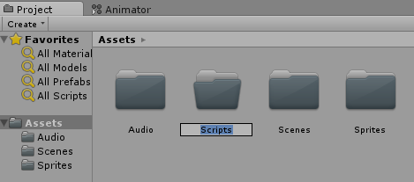
Create Scripts Folder
Right-click Assets, click Create → Folder
Name it “Scripts”

Slide 25
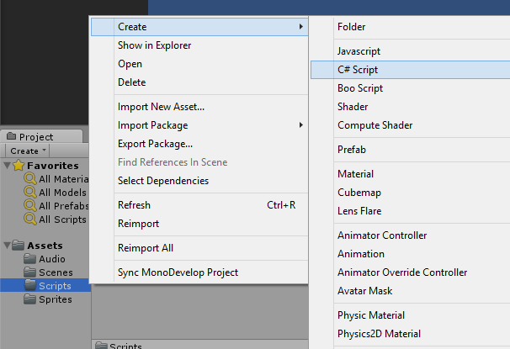
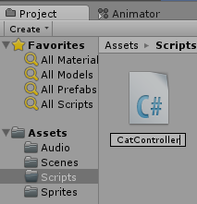
Create CatController Script
Right-click Scripts, click Create → C# Script
Name it “CatController”

Slide 26
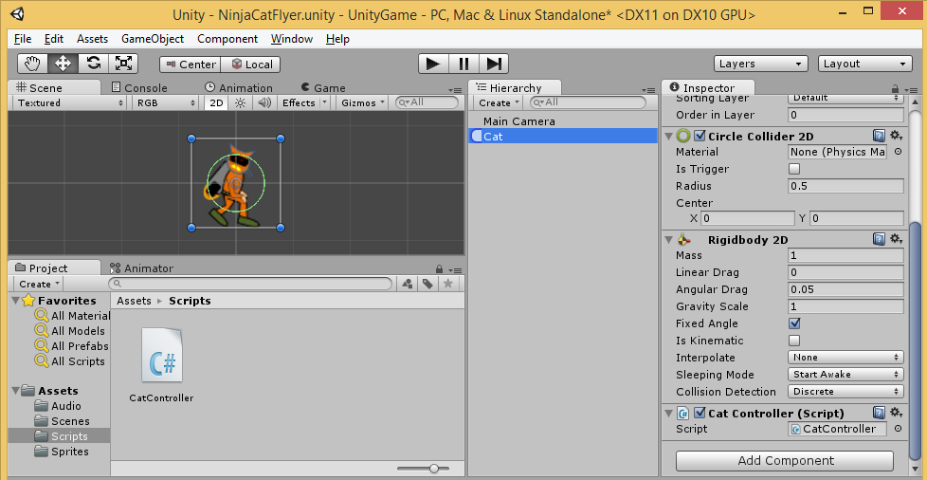
Apply Script to Cat
Drag Script
to Cat
Verify Script Component

Slide 27
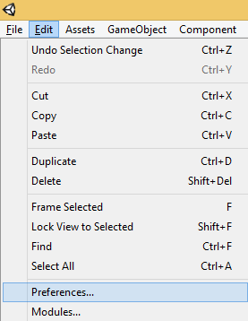
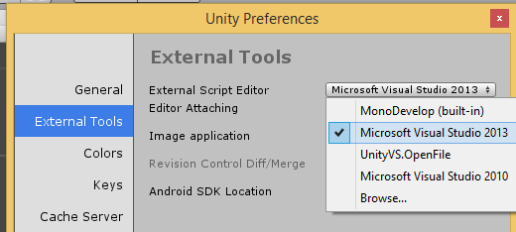
Assign Code Editor
Click Edit → Preferences
Under External Tools, select your Script Editor
e.g. MonoDevelop or Visual Studio
Tip: Browse for devenv.exe in your Program Files folder if you don’t see Visual Studio

Slide 28
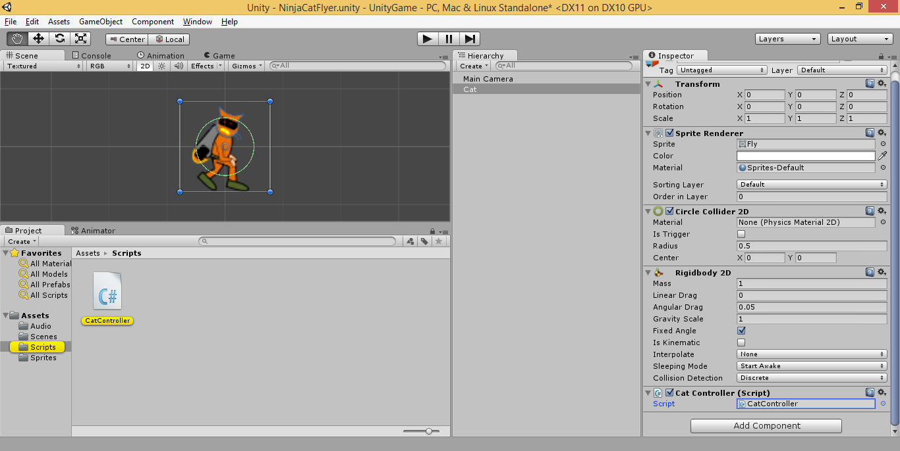
Launch Script for Editing
Double-Click Script Name

Slide 29
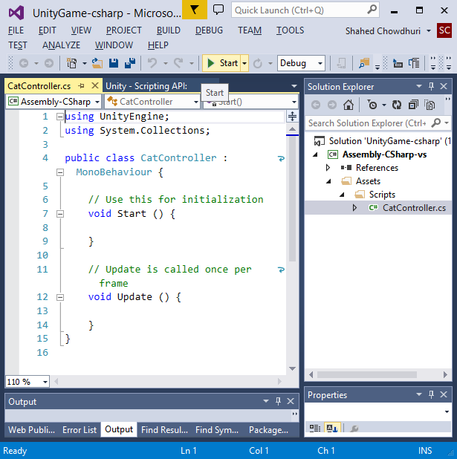
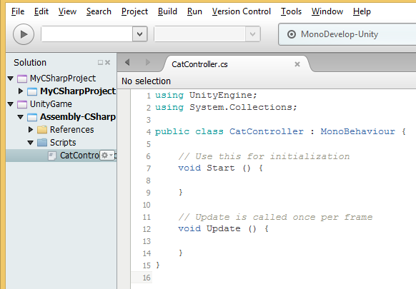
Update Script Code
Script should launch in MonoDevelop or Visual Studio

Slide 30
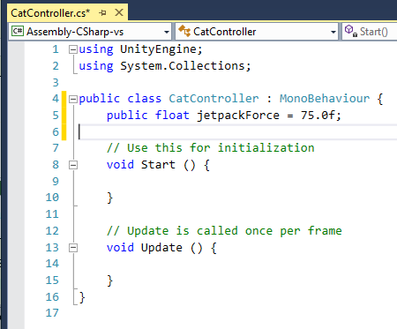
Add Public Variable Inside Class
Class Begins {
NOTES:
this initializes the jetpack force at 75 “units”
Start() method is called when script is initialized (if enabled)
Update() method is called once per frame
} Class Ends

Slide 31
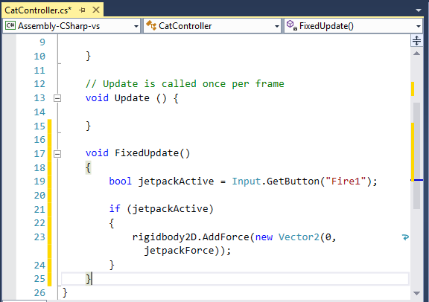
Add FixedUpdate() Method
NOTES:
FixedUpdate() method is called at fixed intervals
The code does the following:
Get “Fire1” button state
Check if is jetpackActive
If Yes, add upward force:
x = 0
y = jetpackForce (i.e. 75)
} Class Ends

Slide 32
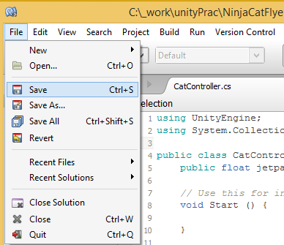
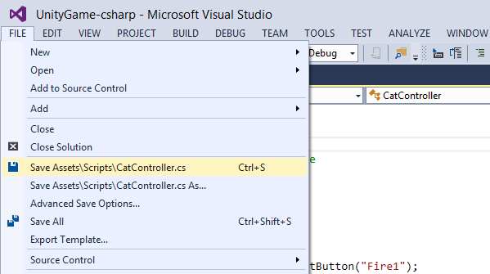
Save Your Code
From top menu, click File → Save
Or, click Ctrl S on your keyboard.

Slide 33
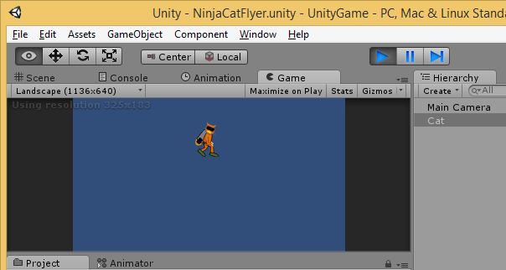
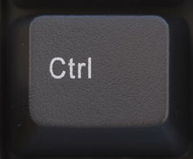
Run the Game in Unity
Run
To trigger “Fire1”:
Click Ctrl on keyboard
OR
Left-click on mouse
Make the cat jump up as it falls!

Slide 34
Ups and Downs
Notes:
Ups and Downs

Slide 35
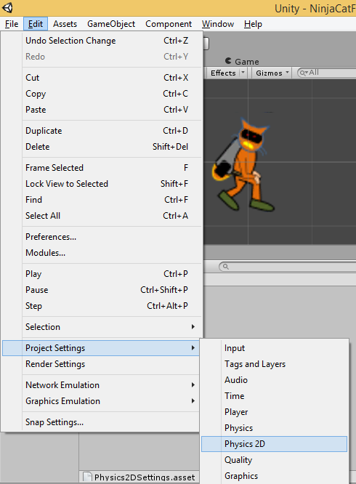
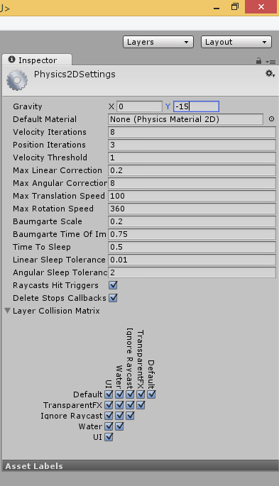
Adjust Gravity
Click Edit
Project Settings
Physics 2D
Update Gravity
X = 0
Y = -15

Slide 36
Run the Game Again!
Run
Does the cat stay down with more force?

Slide 37
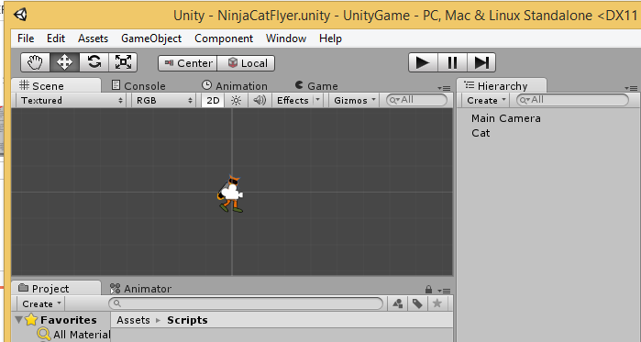
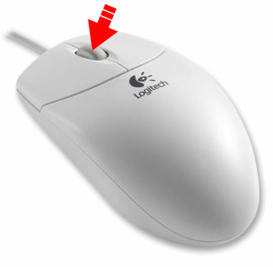
Zoom Out
In the Scene tab:
Scroll down on mouse

Slide 38
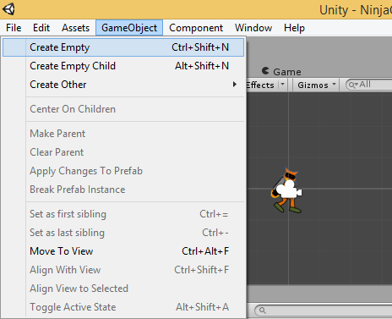
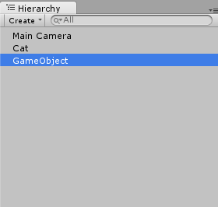
Create Empty Game Object
Click “Game Object” → Create Empty
Verify Game Object
in Hierarchy

Slide 39
Rename GameObject to Floor
In Hierarchy tab,
right-click empty Game Object
click Rename
name it “Floor”

Slide 40
Update Floor Properties
With Floor selected in Hierarchy:
Update Transform properties:
Position:
X = 0
Y = -3.5
Z = 0
Scale:
X = 14.4
Y = 1
Z = 1

Slide 41
Add Box Collider 2D to Floor
Click “Add Component” → Physics 2D → Box Collider 2D

Slide 42
Verify Floor is Visible in Scene
Floor is selected
in Hierarchy
Green Box Collider for Floor

Slide 43
Create Another Empty Game Object
Click “Game Object” → Create Empty
Verify Game Object
in Hierarchy

Slide 44
Rename New GameObject to Ceiling
In Hierarchy tab,
right-click empty Game Object
click Rename
name it “Ceiling”

Slide 45
Update Ceiling Properties
With Floor selected in Hierarchy:
Update Transform properties:
Position:
X = 0
Y = 3.7
Z = 0
Scale:
X = 14.4
Y = 1
Z = 1

Slide 46
Add Box Collider 2D to Ceiling
Click “Add Component” → Physics 2D → Box Collider 2D

Slide 47
Verify Floor+Ceiling in Scene
Green Box Collider for Ceiling
Both are selected
in Hierarchy
Green Box Collider for Floor

Slide 48
Run the Game Again!
Run
The cat should stop at the ceiling and floor!

Slide 49
Effects & Objects
Notes:
Effects & Objects

Slide 50
Add Particle Effects
Click “Game Object” → Create Other → Particle System

Slide 51
Verify Particle Effects
Verify Particle System
in Hierarchy
Verify Particle System
in Scene

Slide 52
Drag Particle System into Cat
Drag Particle System
to Cat in Hierarchy
Verify Particle System
is a child of Cat

Slide 53
Rename the Particle System
Right-click
“Particle System”
then click
Rename
Name it
“jetpackFlames”

Slide 54
Update Particle Properties
In the Inspector panel for jetpackFlames, update:
Transform:
Position:
X = -0.62
Y = -0.33
Z = 0
Rotation:
X = 50
Y = 270
Z = 270
Particle System
Start Lifetime = 0.5
Start Size = 0.3
Start Color:
RGB = 255, 135, 40
Emission
Rate = 300
Shape
Shape = Cone
Angle = 12
Radius = 0.1
Random Direction 

Slide 55
Improve the Flames
3. Select
top-right
slider
1. Scroll down,
then check
“Color over
Lifetime”
4. Set value
to 0 (zero)
2. Click the color box

Slide 56
Add Background
Drag Mountains
into Scene

Slide 57
Add Background, Set Position
Drag Mountains
into Scene
Set Transform
Position:
X = 0
Y = 0
Z = 0

Slide 58
Add Sorting Layers…
Select
Cat in
Hierarchy
Click to
Add Sorting Layer…

Slide 59
Add New Layers
Add Layers for
Background
Decorations
Objects
Player
Click + icon
to add each
new layer

Slide 60
Assign Cat to “Player” Sorting Layer
Assign Sorting Layer
Select Player

Slide 61
Assign Mountains to “Background” Layer
Assign Sorting Layer
Select Background

Slide 62
Create “PartingSortingLayerFix” Script
Name it
“ParticleSortingLayerFix”
Right-click Scripts, click Create → C# Script

Slide 63
Apply Script to jetpackFlames
Verify Script
Component
Drag Script
to jetpackFlames

Slide 64
Launch Script for Editing
Double-Click
Script Name

Slide 65
Add Code in Start() Method
Start() Begins {
NOTES:
this assigns the flames to the “Player” sorting layer to place it above the background
then it lowers the sorting order to place it behind the player
} Start() Ends

Slide 66
Run the Game!
Run

Slide 67
End of Part 1
Notes:
Contact
Web: OnekSoft.com
Email: games@OnekSoft.com
Twitter: @OnekSoftGames
Microsoft email: shchowd@microsoft.com
Personal Twitter: @shahedC
R&D: OnekSoftLabs.com
Dev Blog: WakeUpAndCode.com

