Slide 1
Unity 2D: Step by Step, Part 2
Derived from Kirill Muzykov’s Rocket Mouse Tutorial
http://www.raywenderlich.com/69392/make-game-like-jetpack-joyride-unity-2d-part-1
By Shahed Chowdhuri
Sr. Technical Evangelist
WakeUpAndCode.com
@shahedC
Notes:
Title Page: Unity 2D: Step by Step
Based on Kirill Muzykov’s Rocket Mouse Tutorial
http://www.raywenderlich.com/69392/make-game-like-jetpack-joyride-unity-2d-part-1
By Shahed Chowdhuri
Senior Technical Evangelist
Blog: WakeUpAndCode.com
Twitter: @shahedC

Slide 2
Moving the Cat
Notes:
Moving the Cat

Slide 3
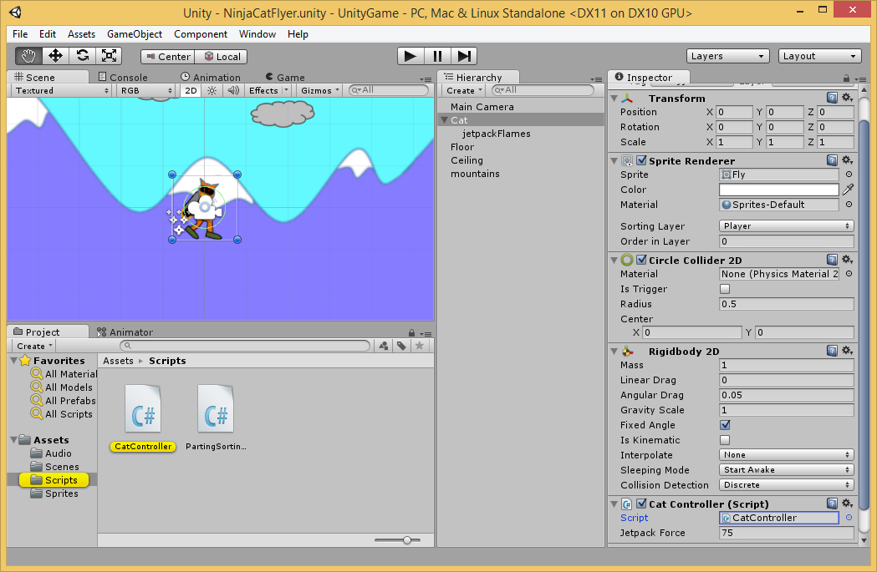
Launch CatController Script
Double-click Cat Controller in Scripts subfolder

Slide 4
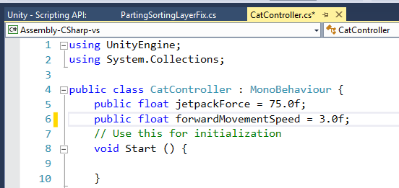
Add Movement Variable
Type this inside the class before the Start() method

Slide 5
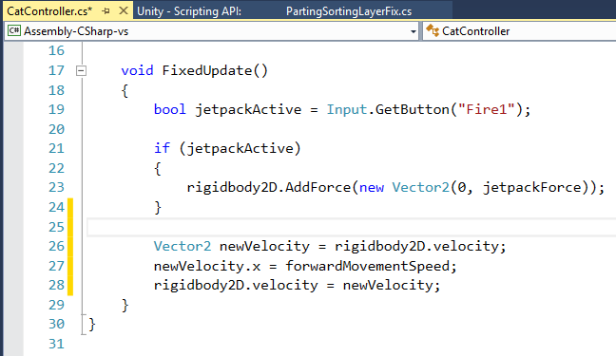
Update Velocity
Type these 3 lines
inside FixedUpdate()
just before it ends

Slide 6
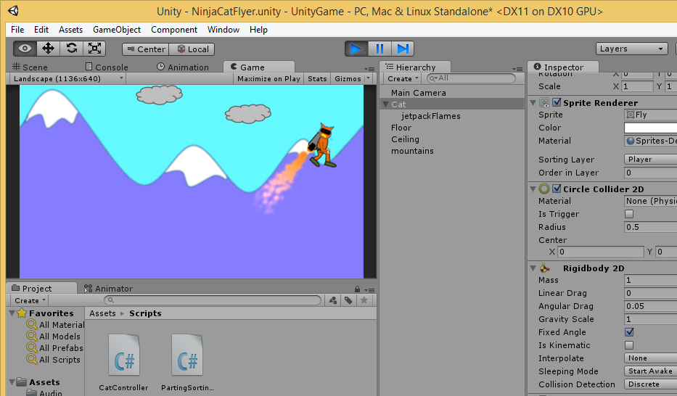
Run the Game!
Run
Where
does the
cat go?

Slide 7
Directing the Camera
Notes:
Directing the Camera

Slide 8
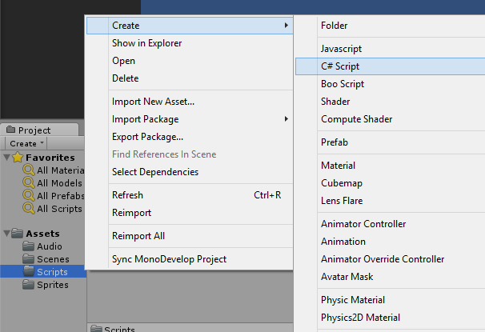
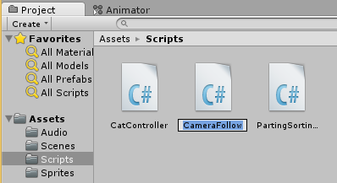
Create CameraFollow Script
Right-click Scripts, click Create → C# Script
Name it “CameraFollow”

Slide 9
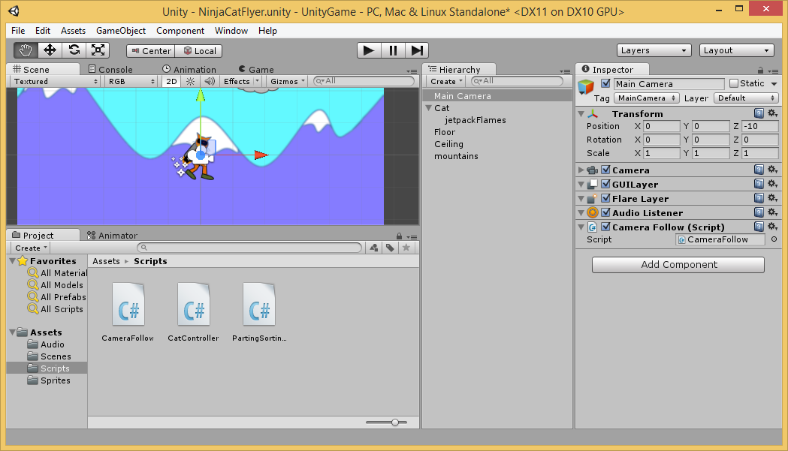
Apply Script to Camera
Verify Script
Component
Drag
Script to
Main Camera

Slide 10
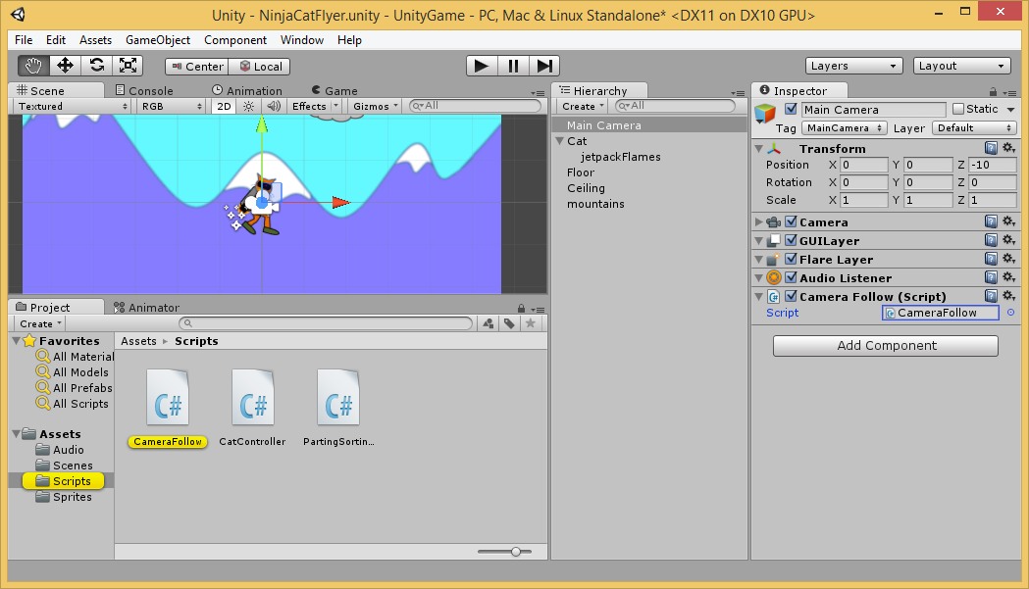
Launch CameraFollow Script
Double-click CameraFollow in Scripts subfolder

Slide 11
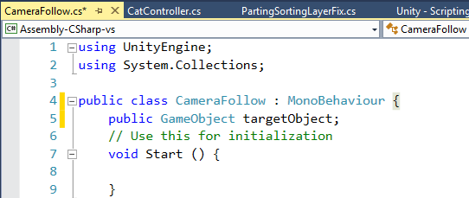
Add GameObject to Follow
Type this inside the class before the Start() method

Slide 12
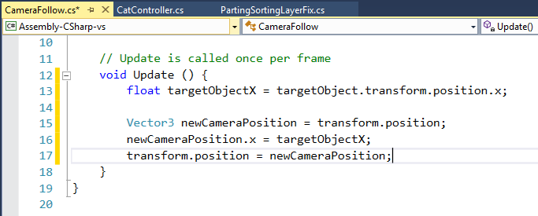
Update Camera Position
Type these 4 lines inside the Update() method before the class ends

Slide 13
Verify Empty Target Object for Camera
Target Object: None

Slide 14
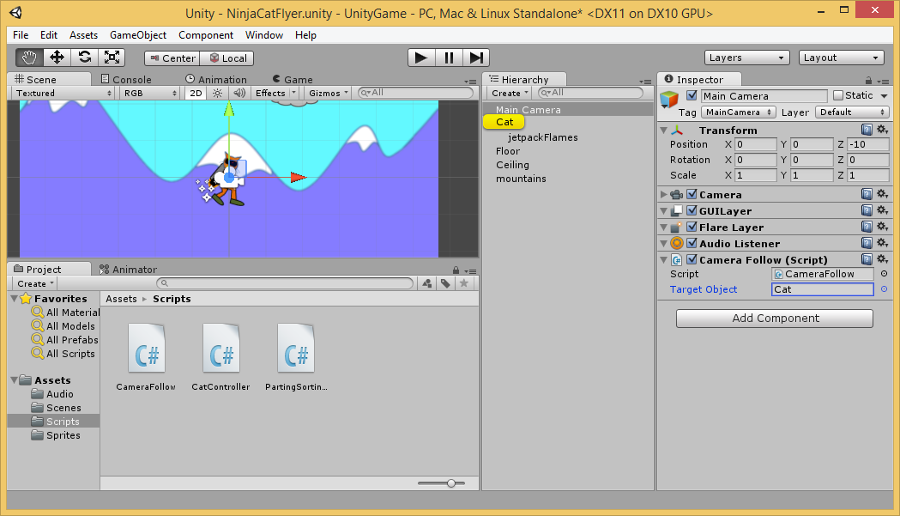
Assign Cat to Target Object
Drag
Cat to
Camera’s
Target
Object

Slide 15
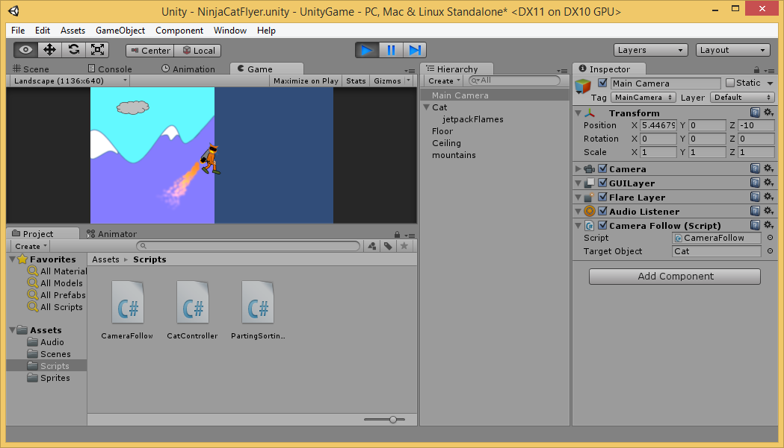
Run the Game!
Run
Does the
camera
follow
the cat?

Slide 16
Repositioning the Cat
Notes:
Repositioning the Cat

Slide 17
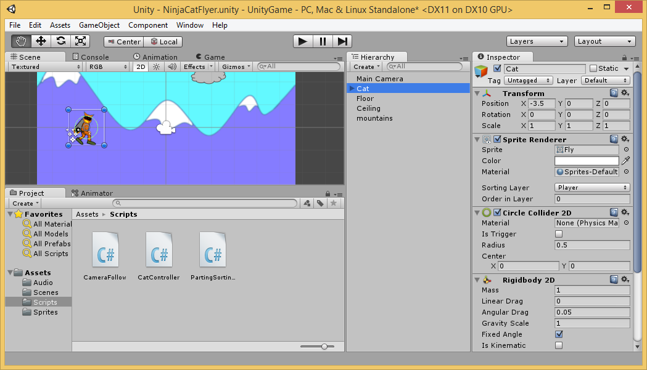
Set the Cat’s Transform Position
Position:
X = -3.5
Y = 0
Z = 0

Slide 18
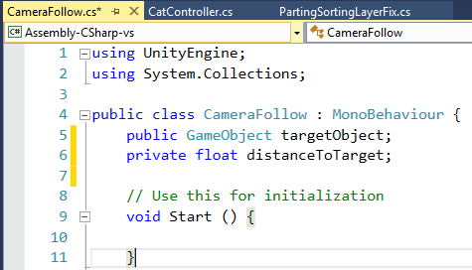
Add Distance to CameraFollow Script
Type this inside the class before the Start() method

Slide 19
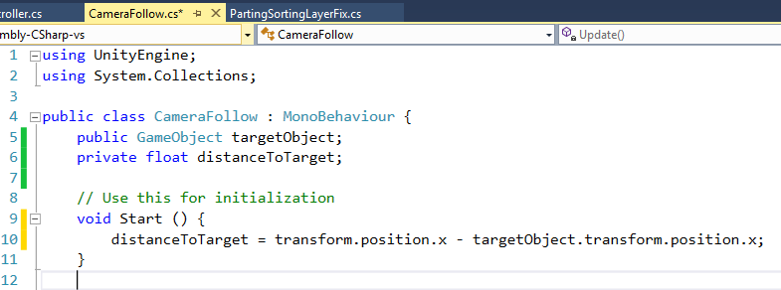
Initialize the Distance
Type this inside Start() method

Slide 20
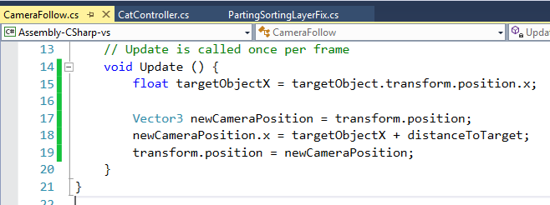
Add Target in Update Method
Add distanceToTarget to newCameraPosition

Slide 21
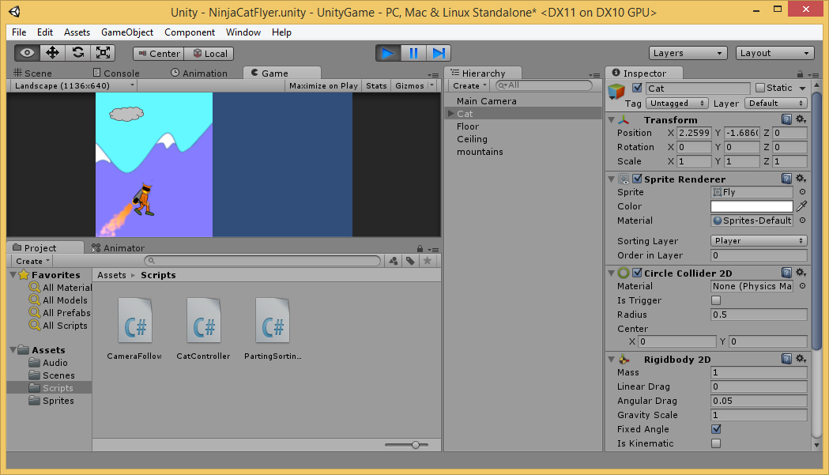
Run the Game!
Run
The cat
should
stay to
the left

Slide 22
Prefabs
Notes:
Prefabs

Slide 23
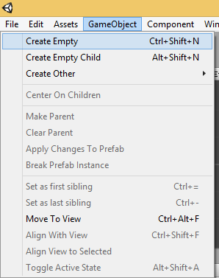
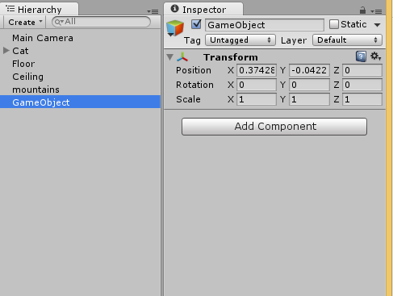
Create Empty Game Object
Click “Game Object” → Create Empty
Verify Game Object in Hierarchy

Slide 24
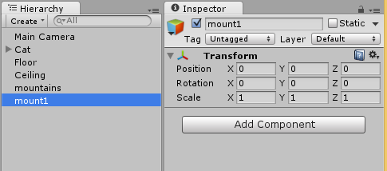
Rename and Reposition GameObject
Rename to “mount1”
Set Position: 0, 0, 0

Slide 25
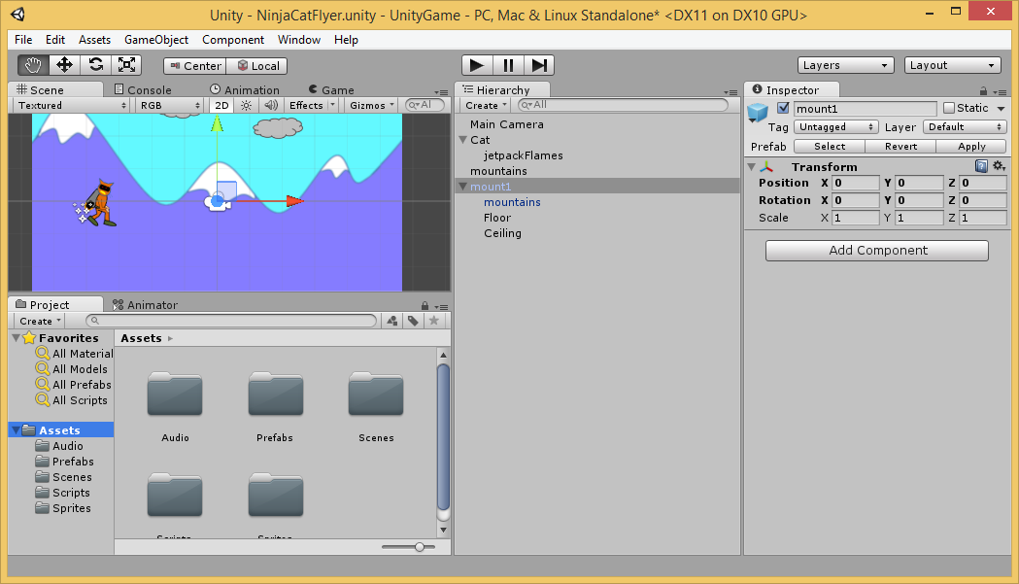
Drag Backgrounds Into “mount1”
NOTE: you can also add other objects that you may have added as part of the background.
Drag
“mountains”,
“floor” and
“ceiling” into
“mount1”

Slide 26
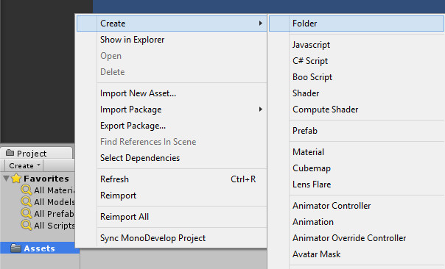
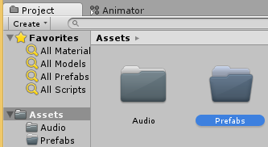
Create “Prefabs” Folder
Click Create, then Folder
In Project panel,
right-click
“Assets”
folder
Name it “Prefabs”

Slide 27
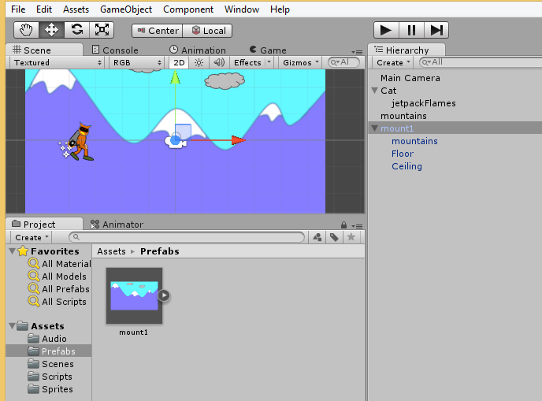
Drag “mount1” into Prefabs Folder
NOTE: the “mount1” in the hierarchy should turn blue.
Drag
“mount1”
into
“Prefabs”

Slide 28
Scrolling the Mountains
Notes:
Scrolling the Mountains

Slide 29
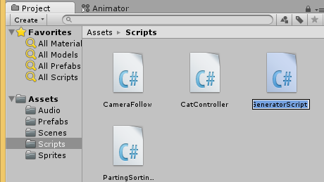
Create “GeneratorScript” Script
Right-click Scripts, click Create → C# Script
Name it “GeneratorScript”

Slide 30
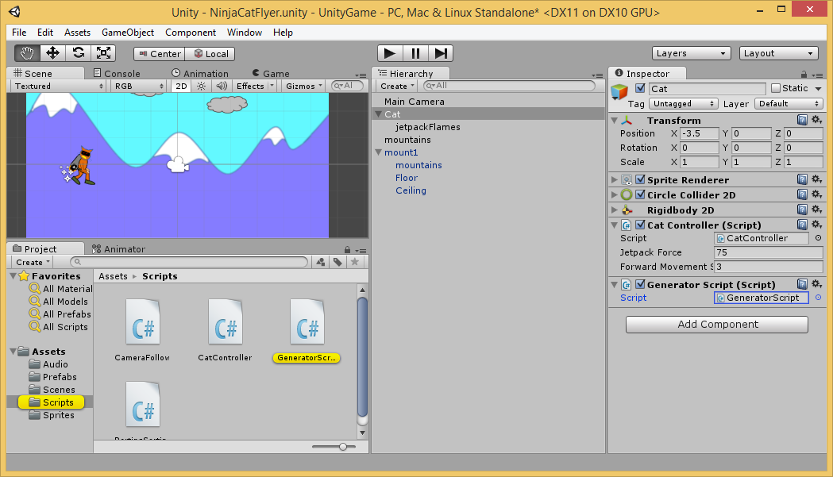
Apply “GeneratorScript” to Cat
Verify Script
Component
Drag
Script
to Cat

Slide 31
Launch “GeneratorScript” Script
Double-click “GenerateScript” in Scripts subfolder

Slide 32
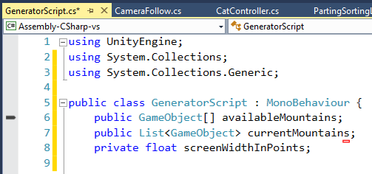
Update “GeneratorScript” Script
Add “using” statement
above the class
Add 3 instance variables
inside the class

Slide 33
Update Start() Method
Add 2 lines of code
inside the Start() method

Slide 34
Adding Endless Mountains
Notes:
Adding Endless Mountains

Slide 35
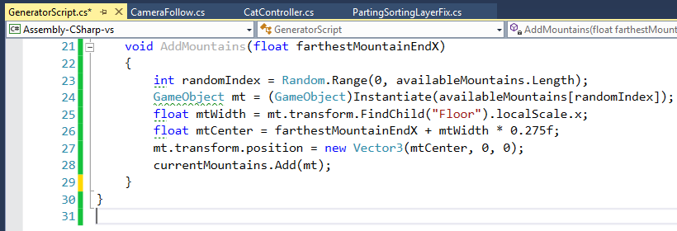
Write AddMountains() Method
Write AddMountains() method
with these 6 lines of code

Slide 36
Write GenerateMountainIfRequired()
Create new method, add variables, initialize them

Slide 37
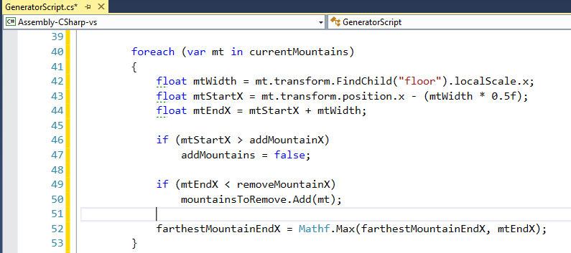
GenerateMountainIfRequired() …continued…
Add foreach loop to figure out mountains

Slide 38
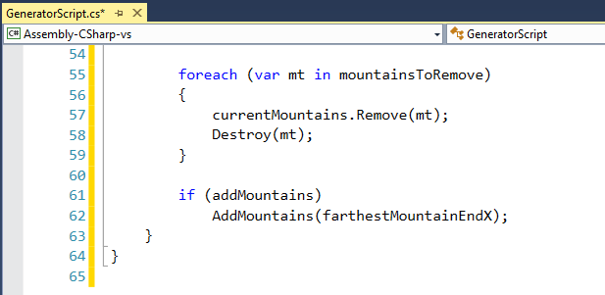
GenerateMountainIfRequired() … done!
Add foreach loop to destroy/add mountains

Slide 39
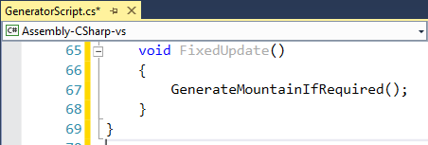
Finally, add FixedUpdate() method
Create FixedUpdate() Method, add 1 line of code

Slide 40
Applying Items to Script Objects
Notes:
Applying Items to Script Objects

Slide 41
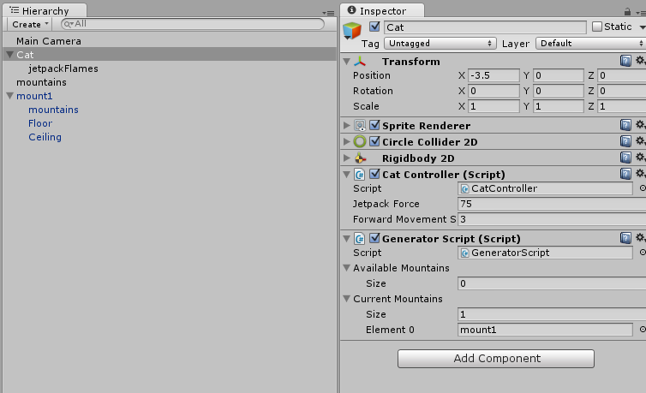
Apply “mount1” to Current Mountains
Select “Cat” in
Hierarchy
Drag “mount1”
to Current Mountains
Under GeneratorScript

Slide 42
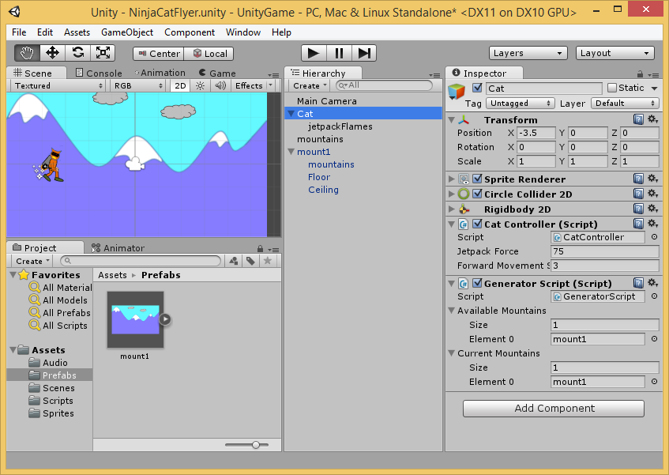
Apply PreFab to Available Mountains
Select “Cat” in
Hierarchy
Drag “mount1”
PreFab
to Available Mountains
Under
GeneratorScript

Slide 43
Optional: Remove Extra Mountains
Do you have
extra mountains
in hierarchy?
(not part of
“mount1”)
Remove them!

Slide 44
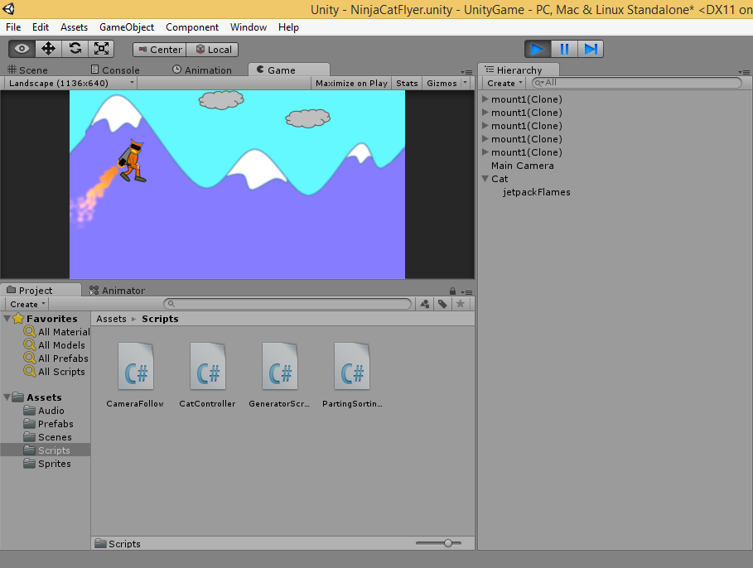
Run the Game!
Run
The background
should scroll now!

Slide 45
End of Part 2
Notes:
Contact
Web: OnekSoft.com
Email: games@OnekSoft.com
Twitter: @OnekSoftGames
Microsoft email: shchowd@microsoft.com
Personal Twitter: @shahedC
R&D: OnekSoftLabs.com
Dev Blog: WakeUpAndCode.com

