Slide 1
Unity 2D: Step by Step, Part 4
Derived from Kirill Muzykov’s Rocket Mouse Tutorial
http://www.raywenderlich.com/69392/make-game-like-jetpack-joyride-unity-2d-part-1
By Shahed Chowdhuri
Sr. Technical Evangelist
WakeUpAndCode.com
@shahedC
Notes:
Title Page: Unity 2D: Step by Step
Based on Kirill Muzykov’s Rocket Mouse Tutorial
http://www.raywenderlich.com/69392/make-game-like-jetpack-joyride-unity-2d-part-1
By Shahed Chowdhuri
Senior Technical Evangelist
Blog: WakeUpAndCode.com
Twitter: @shahedC

Slide 2
Adding Lasers
Notes:
Moving the Mouse

Slide 3
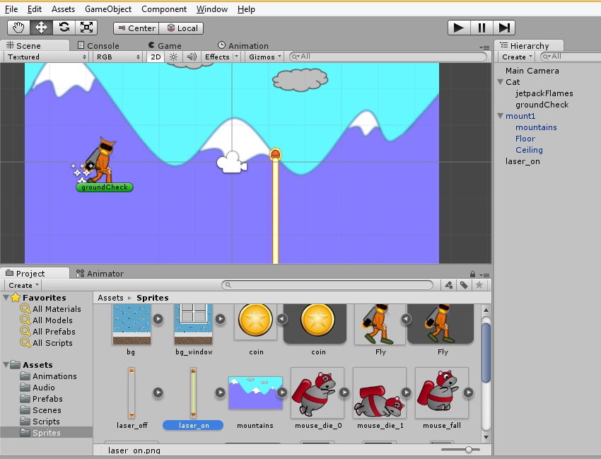
Add Laser to Scene
Drag “laser_on”
from “Sprites”
subfolder into
Scene

Slide 4
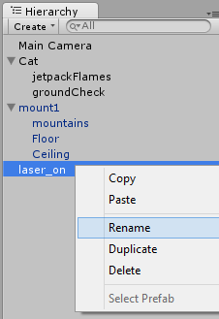
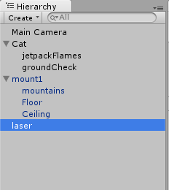
Rename the Laser
Rename
“laser_on”
to just “laser”

Slide 5
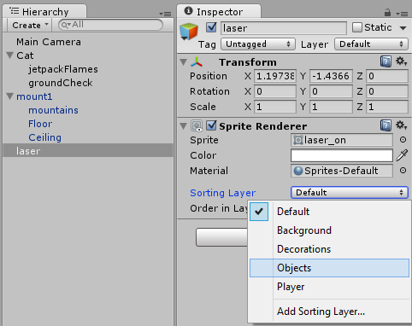
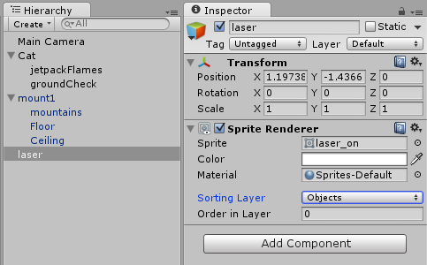
Update the Laser’s Sorting Layer
Set the laser’s Sorting Layer to “Objects”

Slide 6
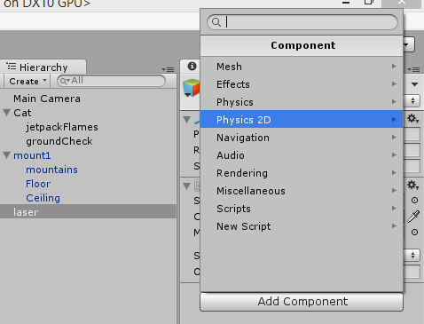
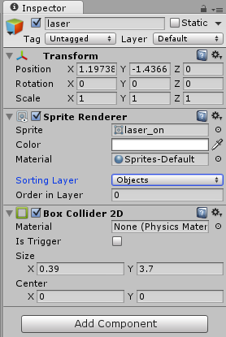
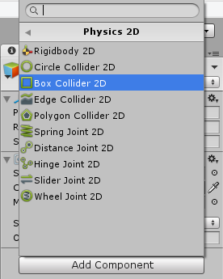
Add a Box Collider 2D Component
For the laser object, click
Add Component → “Physics 2D”
Click “Box Collider 2D”
Verify “Box Collider 2D”

Slide 7
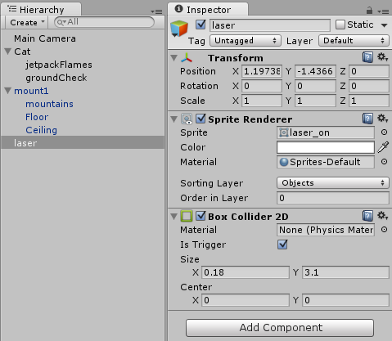
Enable “Is Trigger” and Update Size
Enable “Is Trigger” Checkbox
(This allows you to handle collisions
in your code instead of the Physics engine)
Update Size:
X = 0.18
Y = 3.1

Slide 8
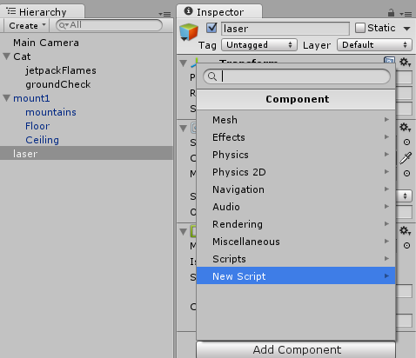
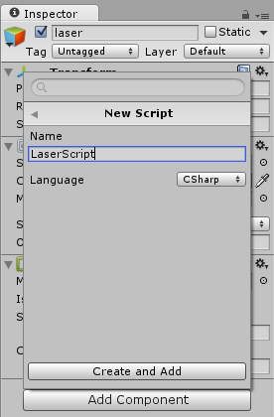
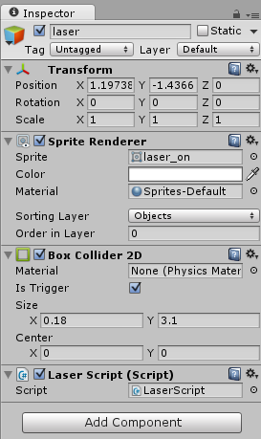
Add a Script named “LaserScript”
For the laser object, click
Add Component → “New Script”
Enter “LaserScript”,
click “Create and Add”
Verify new script

Slide 9
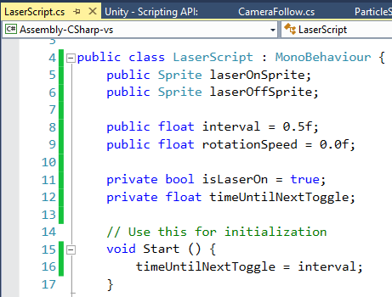
Update “LaserScript” Code
Add these 6
instance
variables
inside
LaserScript
Add 1 line
in Start()
method

Slide 10
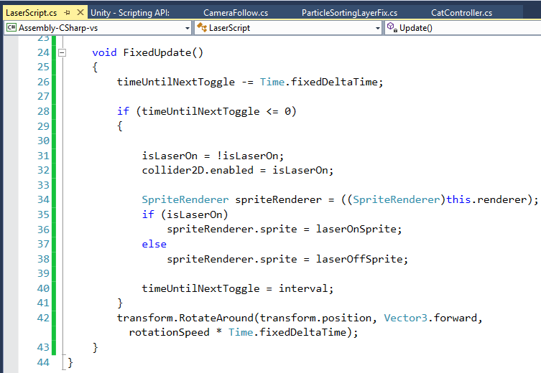
Add FixedUpdate() Method
Add FixedUpdate()
method just before
the class ends

Slide 11
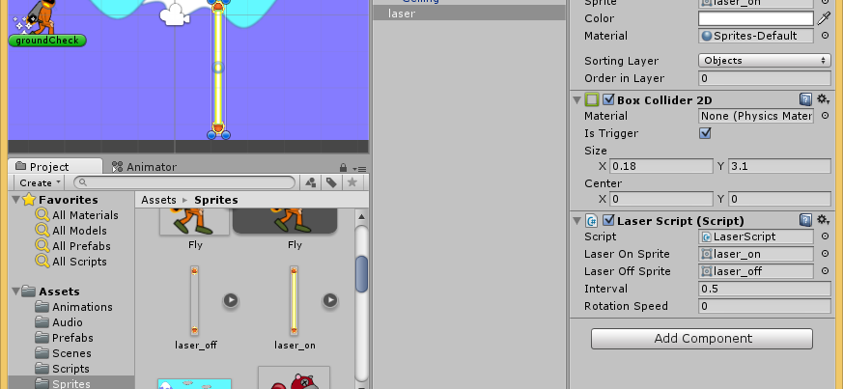
Drag Laser On/Off Into Script Properties
With “laser”
selected,
drag on/off
sprites
into script
properties

Slide 12
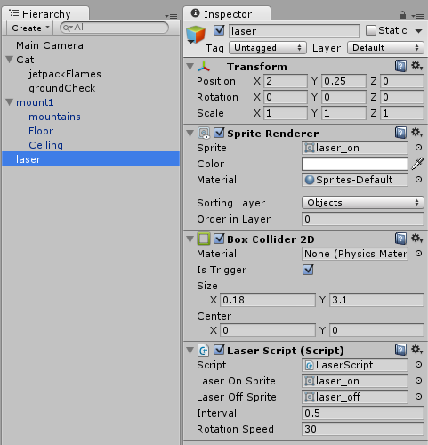
Update Laser Properties
Position:
X = 2
Y = 0.25
Z = 0
Laser Script
Rotation Speed = 30

Slide 13
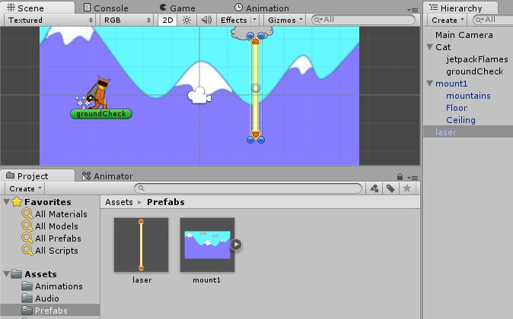
Create a Laser Prefab
Drag “laser”
from Hierarchy
to Prefabs folder

Slide 14
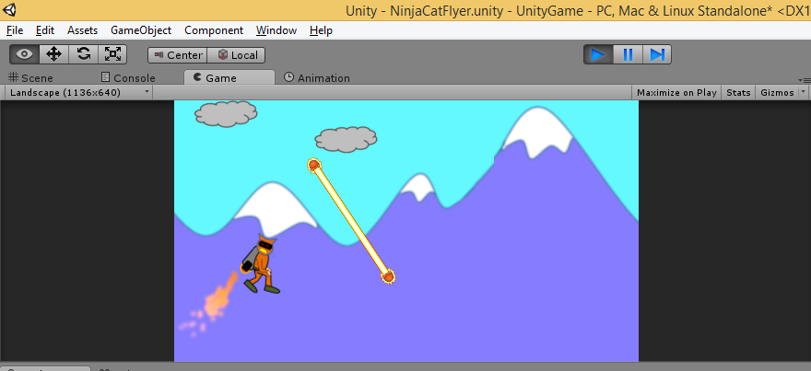
Run the Game!
Run
You should see a rotating laser!

Slide 15
Handling Dying & Falling
Notes:
Moving the Mouse

Slide 16
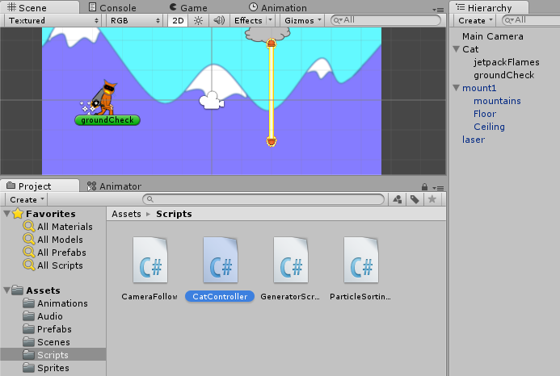
Launch “CatController” Script

Slide 17
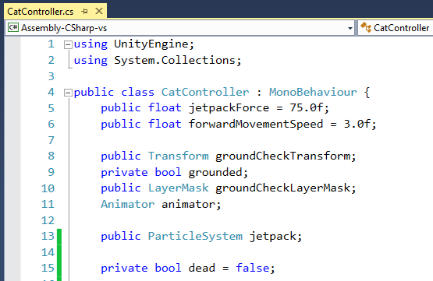
Add New Instance Variable
Add 1
new
instance
variable

Slide 18
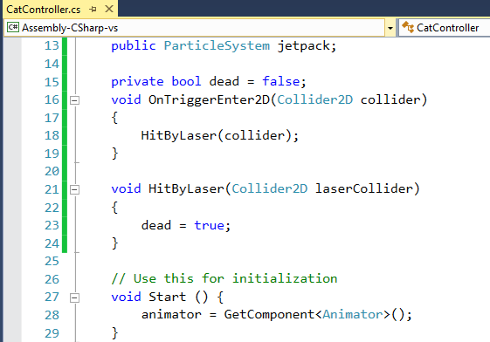
Add New Methods
Add 2
new
methods
just before
Start()

Slide 19
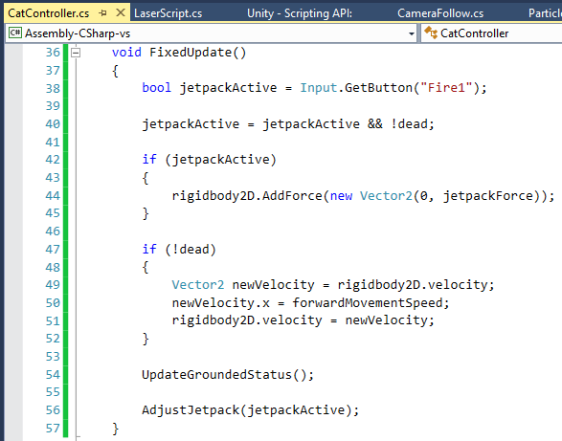
Revise FixedUpdate() Method
Reassign jetPackActive
boolean
Check if (!dead)
i.e. not dead

Slide 20
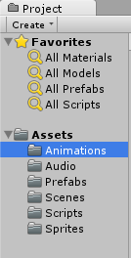
Select Animations Folder in Project
All your animation clips
will be created here

Slide 21
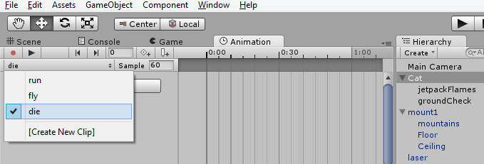
Create New Animation for Dying
In the Animation tab, with Cat selected in Hierarchy…
Create New Clip, “die”
under Animations subfolder

Slide 22
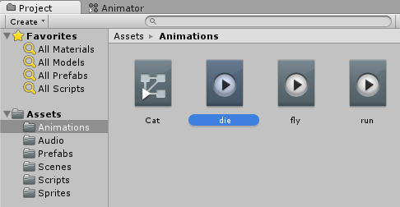
Verify New Animation
Verify “die” animation in Animations subfolder

Slide 23
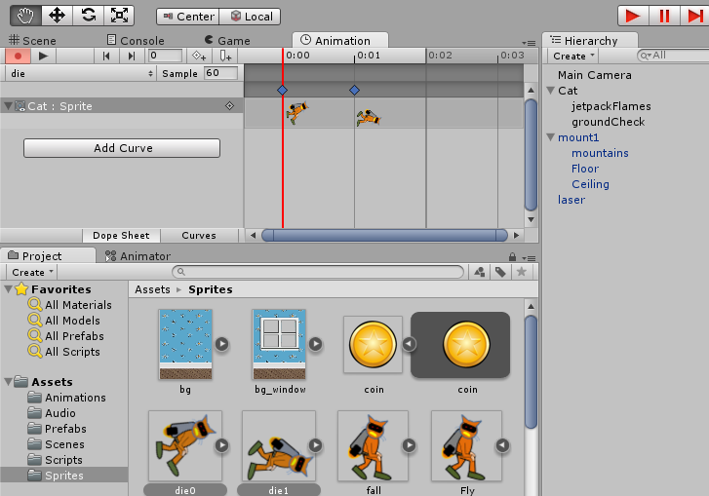
Drag In Animation Frames
Ctrl-Select “die0” and “die1”, then
drag animation
frames into
Animation
window

Slide 24
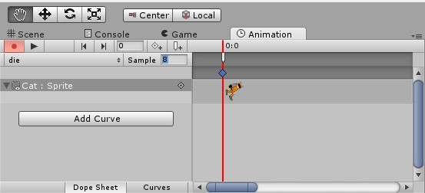
Update Sample Value
Change Sample Value to 8 for “die” animation

Slide 25
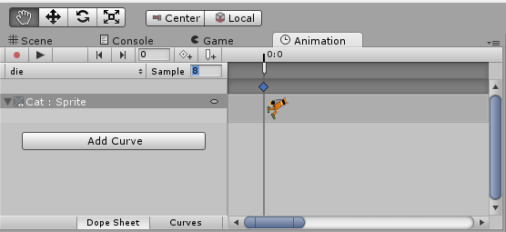
Stop Recording
Click “Record” button to stop recording

Slide 26
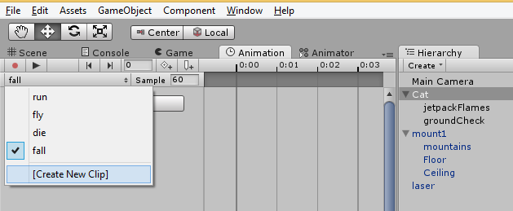
Create New Animation for Falling
In the Animation tab, with Cat selected in Hierarchy…
Create New Clip, “fall”
under Animations subfolder

Slide 27
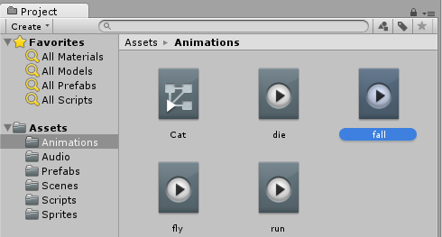
Verify New Animation
Verify “fall” animation in Animations subfolder

Slide 28
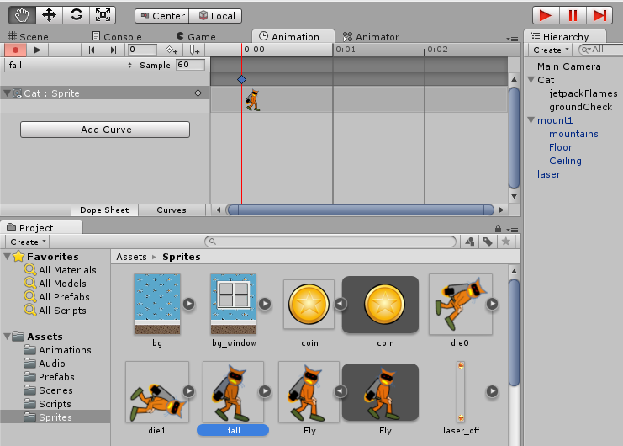
Drag In Animation Frame
Select “fall”, then
drag animation
frame (just one) into
Animation
window

Slide 29
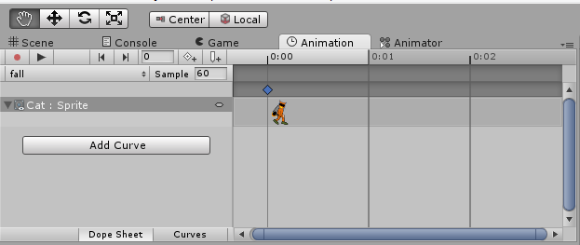
Stop Recording Again
Click “Record” button to stop recording

Slide 30
Creating Transitions
Notes:
Moving the Mouse

Slide 31
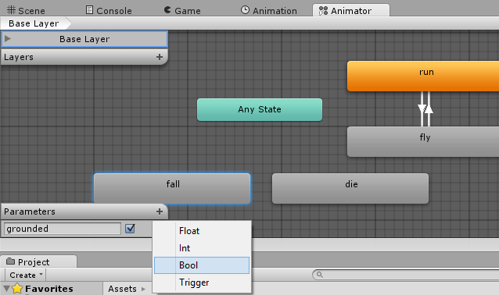
Create New Bool Parameter
In the
Animator tab
Click the +
next to Parameters,
Then add a
new Bool

Slide 32
Name the Parameter
Name the new
parameter
“dead”

Slide 33
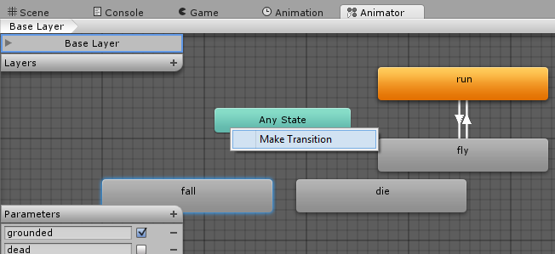
Make a Transition from Any State
Right-click “Any State”, then click “Make Transition”

Slide 34
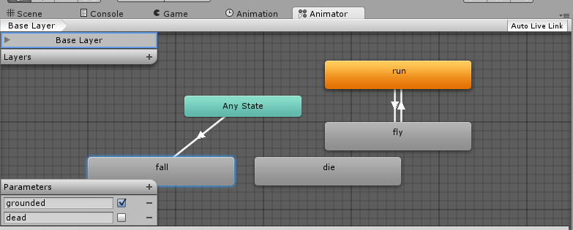
Complete Transition to Fall
Click the “fall” state to complete the transition from “Any State” to “Fall”

Slide 35
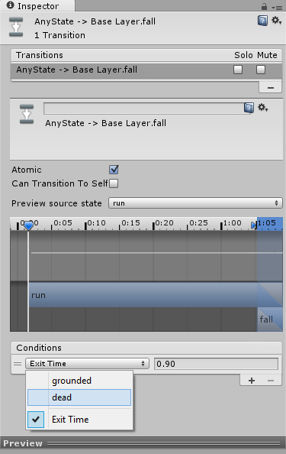
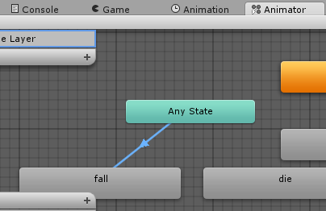
Create Condition
Click the new Transition in the Animator tab,
Then, select “dead” under Conditions in Inspector

Slide 36
Set Condition for “dead”
Set “dead” to true, then…
Click + to “Add to list”

Slide 37
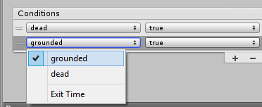
Create Another Condition
Select
“grounded”
for the
new condition…
Set “grounded “
to false
NOTE: For this transition, “dead” is true, but “grounded” is false

Slide 38
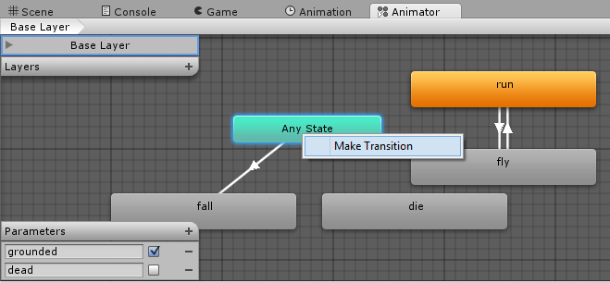
Make Another Transition from Any State
Right-click “Any State”, then click “Make Transition”

Slide 39
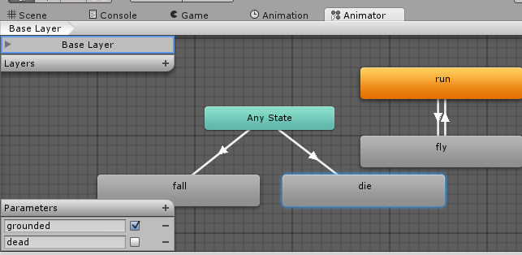
Complete Transition to Die
Click the “die” state to complete the transition from “Any State” to “Die”

Slide 40
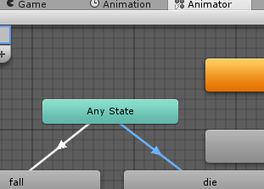
Create Condition
Click the new Transition in the Animator tab,
Then, select “dead” under Conditions in Inspector

Slide 41
Set Condition for “dead”
Set “dead” to true, then…
Click + to “Add to list”

Slide 42
Create Another Condition
Select
“grounded”
for the
new condition…
Set “grounded “
to true
NOTE: For this transition, BOTH conditions are true! (“dead” AND “grounded”)

Slide 43
Launch “CatController” Script

Slide 44
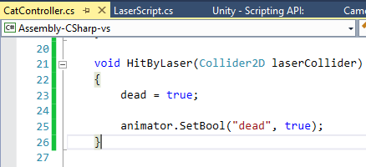
Update HitByLaser() Method
Add 1 line of code
inside HitByLaser()
NOTE: This ensures that “dead” condition is set to true when HitByLaser() is called

Slide 45
Handling Triggers
Notes:
Moving the Mouse

Slide 46
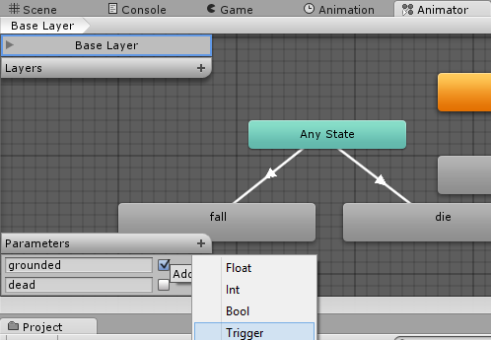
Create New Trigger
In the
Animator tab
Click the +
next to Parameters,
Then add a
new Trigger

Slide 47
Name the Trigger Parameter
Name the new
Trigger parameter
“dieOnceTrigger”

Slide 48
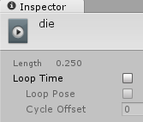
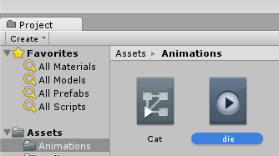
Disable Dying Loop
Select the “die” animation in the Project panel
Uncheck Loop Time

Slide 49
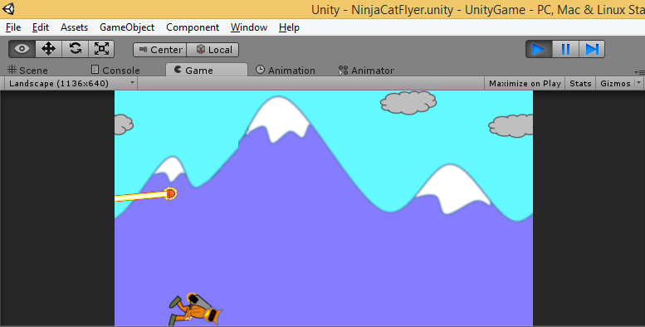
Run the Game!
Run
What happens when the cat touches the laser?

Slide 50
End of Part 4
Notes:
Contact
Web: OnekSoft.com
Email: games@OnekSoft.com
Twitter: @OnekSoftGames
Microsoft email: shchowd@microsoft.com
Personal Twitter: @shahedC
R&D: OnekSoftLabs.com
Dev Blog: WakeUpAndCode.com

