Slide 1
Unity 2D: Step by Step, Part 5
Derived from Kirill Muzykov’s Rocket Mouse Tutorial
http://www.raywenderlich.com/69392/make-game-like-jetpack-joyride-unity-2d-part-1
By Shahed Chowdhuri
Sr. Technical Evangelist
WakeUpAndCode.com
@shahedC
Notes:
Title Page: Unity 2D: Step by Step
Based on Kirill Muzykov’s Rocket Mouse Tutorial
http://www.raywenderlich.com/69392/make-game-like-jetpack-joyride-unity-2d-part-1
By Shahed Chowdhuri
Senior Technical Evangelist
Blog: WakeUpAndCode.com
Twitter: @shahedC

Slide 2
Adding Gems
Notes:
Moving the Mouse

Slide 3
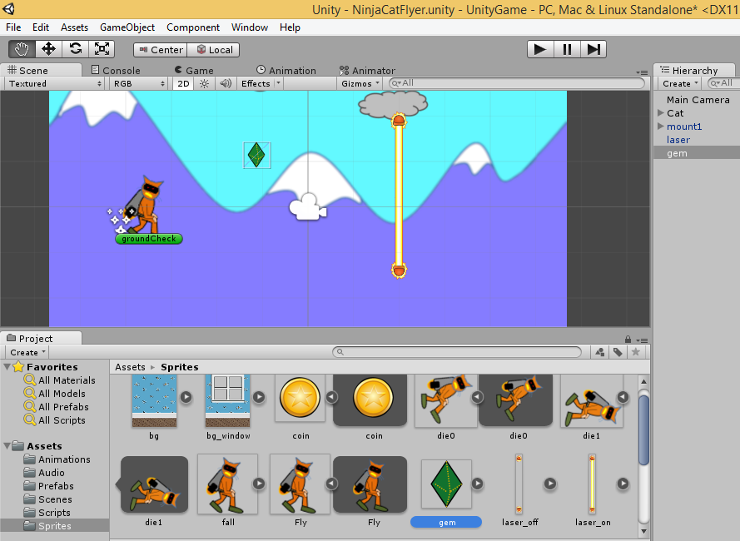
Drag Gem into Scene
Drag “gem”
from Sprites
folder into
Scene
Select “gem”
in Hierarchy

Slide 4
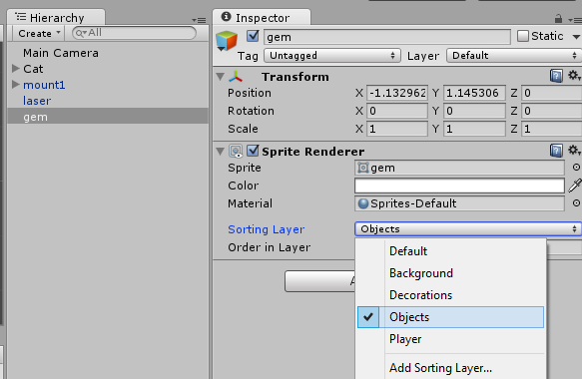
Set Sorting Layer
With “gem” selected
in the Hierarchy…
Set “Sorting Layer”
to “Objects” in
the Inspector panel

Slide 5
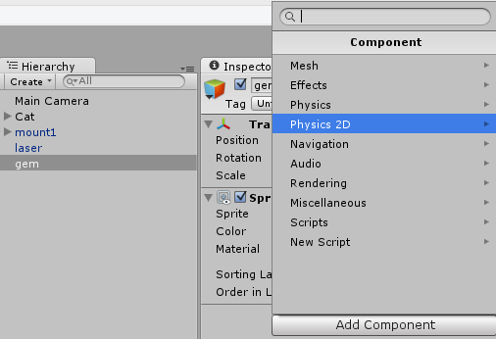
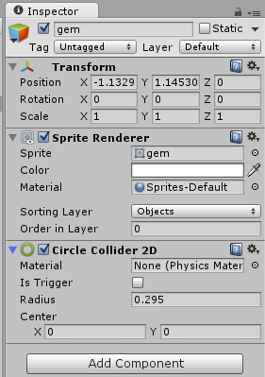
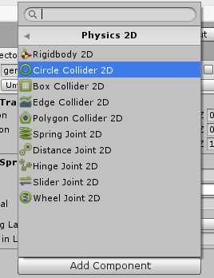
Add a Circle Collider 2D Component
For the gem object, click
Add Component → “Physics 2D”
Click “Circle Collider 2D”
Verify “Circle Collider 2D”

Slide 6
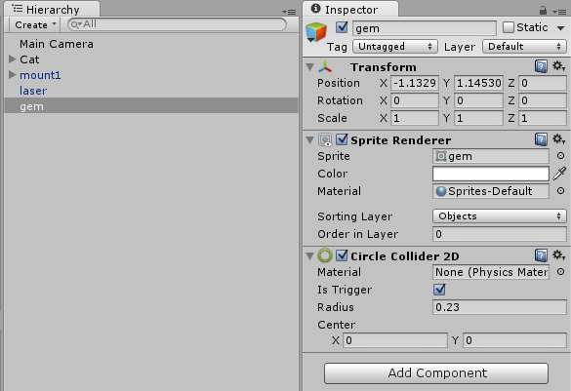
Set Gem Properties in Inspector
Enable
“Is Trigger”
Checkbox
Update Radius
to 0.23

Slide 7
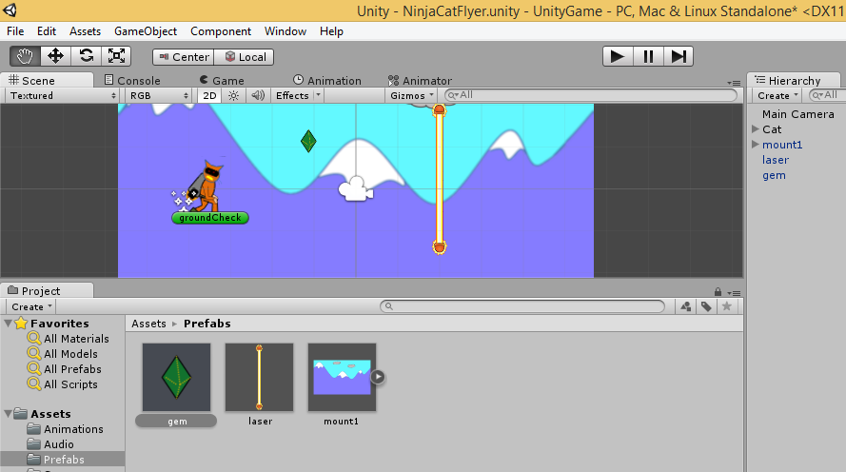
Create Gem Prefab
Drag “gem”
from Hierarchy
into Prefabs
folder

Slide 8
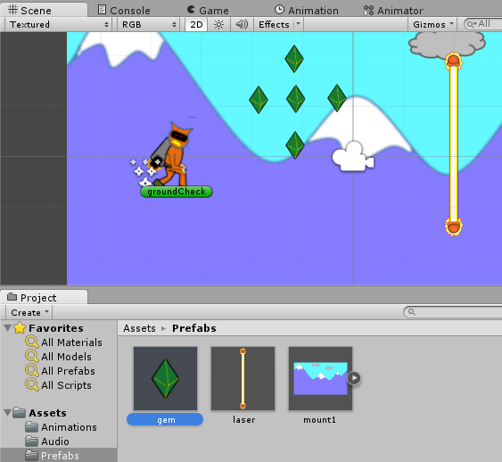
Create More Gems From Prefab
Keep dragging
the Prefab “gem”
into the Scene
multiple times,
in different
positions

Slide 9
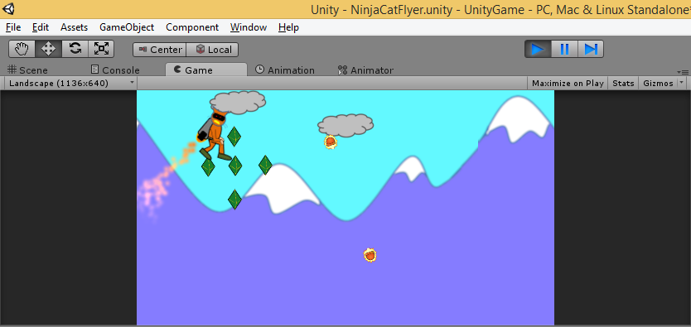
Run the Game!
Run
What happens after the cat touches the gems?

Slide 10
Fixing the Collisions
Notes:
Moving the Mouse

Slide 11
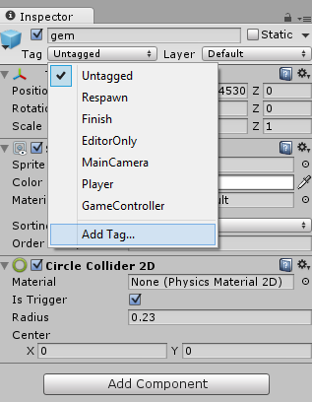
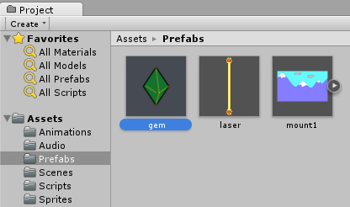
Add Tag for Gem Prefab
Select “gem”
in “Prefabs”
folder
In Inspector panel,
click Tag dropdown
to “Add Tag…”

Slide 12
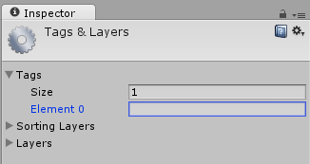
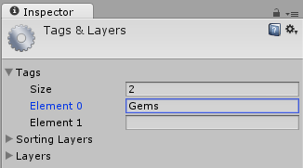
Enter New Tag Name for Gems
Start typing “Gems” in Element 0
NOTE: A new field for Element 1
will automatically appear.

Slide 13
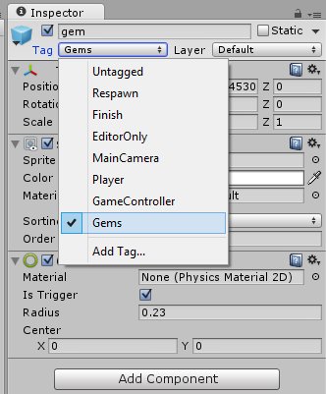
Apply Tag for Gem Prefab
Select “gem”
in “Prefabs”
folder
In Inspector panel,
select “Gems” tag

Slide 14
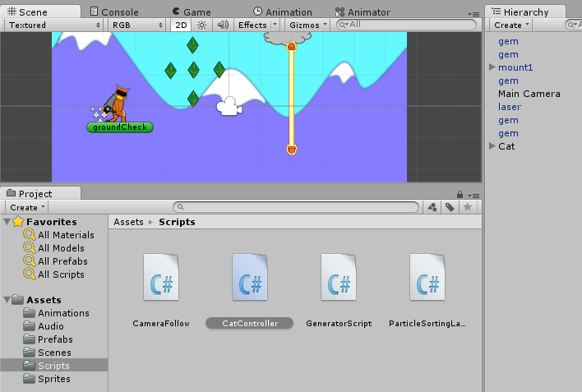
Launch “CatController” Script

Slide 15
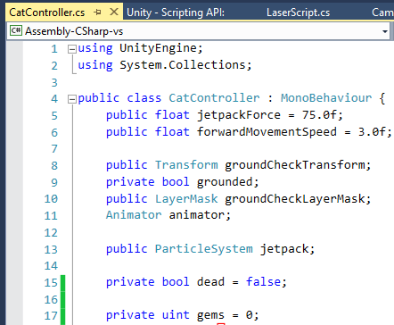
Add New Instance Variable
NOTE: New “gems” variable will count number of gems. It is an “unsigned integer” (uint) which means that it will only hold positive values.

Slide 16
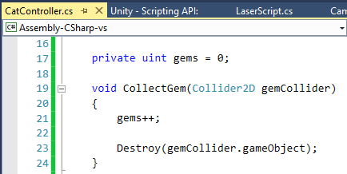
Add CollectGem() Method
NOTE: You can add it directly below the instance variables.

Slide 17
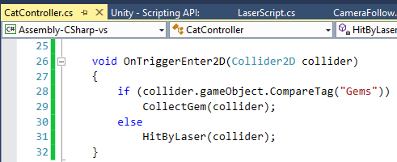
Update OnTriggerEnter2D() Method
NOTE: Add if/else condition to collect gem or get hit by laser.

Slide 18
Run the Game!
Run
What happens when the cat touches the gems?

Slide 19
Preparing for Auto-Generation
Notes:
Moving the Mouse

Slide 20
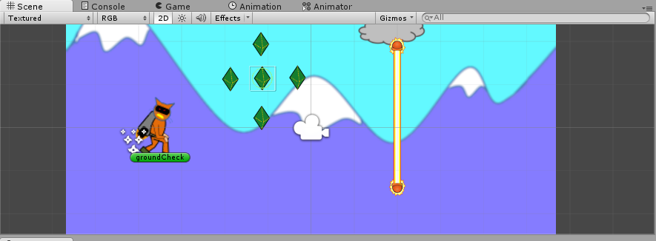
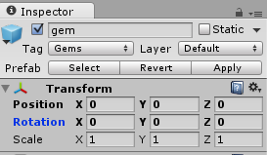
Reposition the Center Gem
Select the
center gem
and place it
at (0, 0, 0)
Set its Position
X = 0
Y = 0
Z = 0

Slide 21
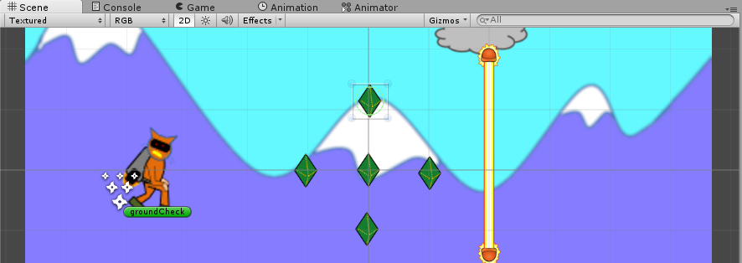
Reposition All the Gems
Place all the other gems
around the center gem
to make a nice pattern

Slide 22
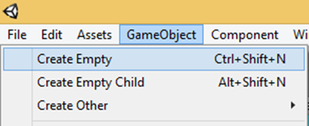
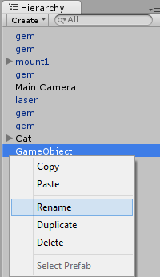
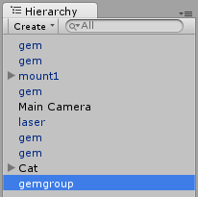
Create Empty Game Object
In the top menu, click
Game Object → Create Empty
Right-click it,
then rename it
“gemgroup”
in the Hierarchy

Slide 23
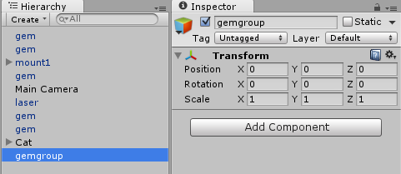
Center the Gem Group
Set its position:
X = 0
Y = 0
Z = 0
Select “gemgroup in Hierarchy

Slide 24
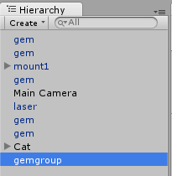
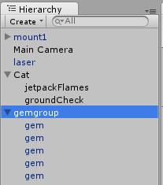
Drag All Gems into Gem Group
Drag each “gem”
into “gemgroup”
Each “gem” should become
a child of “gemgroup”

Slide 25
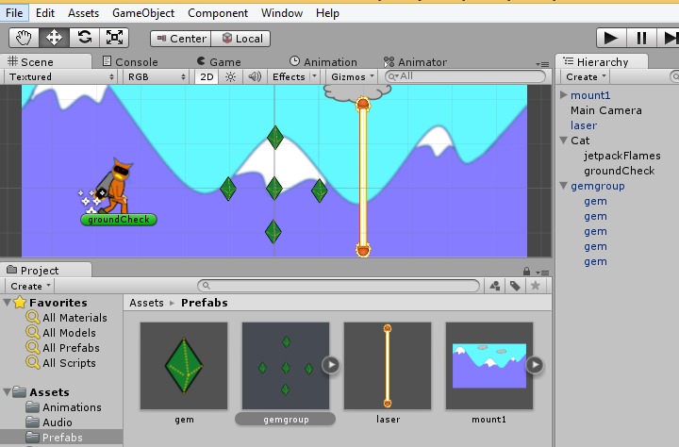
Create Gem Group Prefab
Drag “gemgroup”
from Hierarchy
into Prefabs
folder

Slide 26
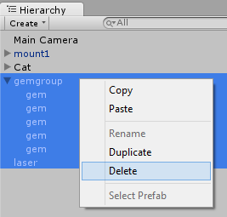
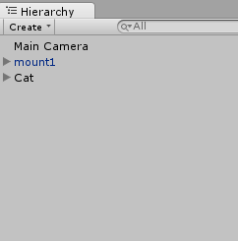
Remove Gems & Lasers from Hierarchy
Select all gems and laser,
then right-click to Delete
You should only be left with
Main Camera
mount1
Cat

Slide 27
Generating Gems and Lasers
Notes:
Moving the Mouse

Slide 28
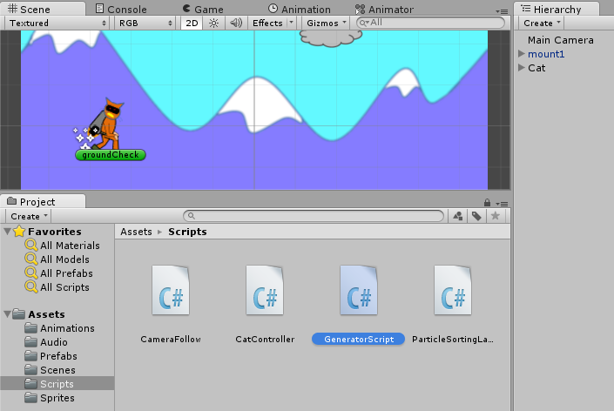
Launch “GeneratorScript”

Slide 29
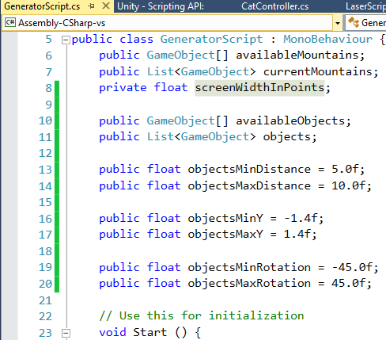
Add Instance Variables
Add 8 instance variables,
just before Start() method

Slide 30
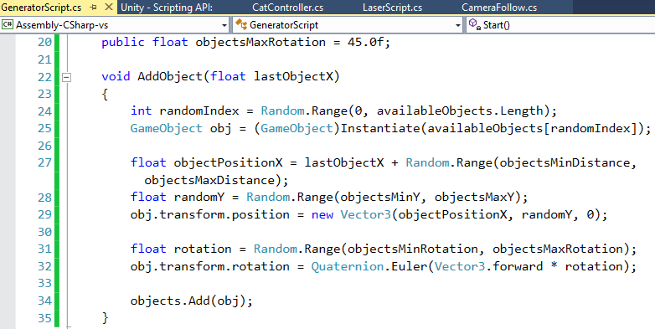
Add New Method AddObject()

Slide 31
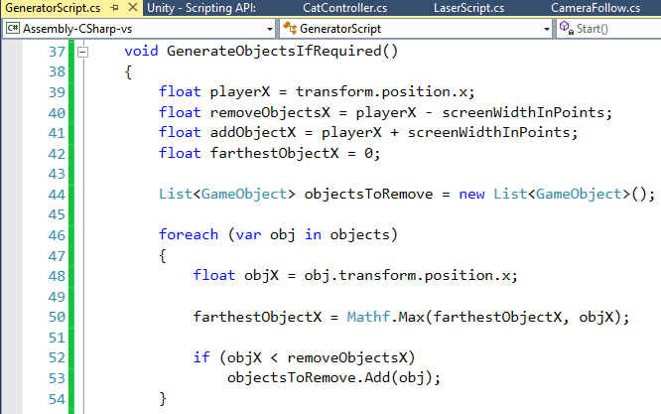
Add New Method to Generate Objects
continued on
next page…!

Slide 32
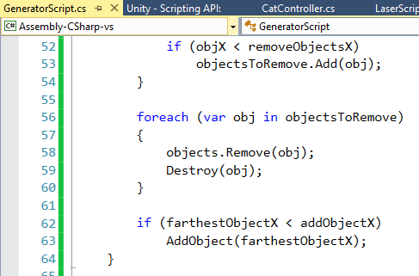
Wrap Up Method to Generate Objects
… done!

Slide 33
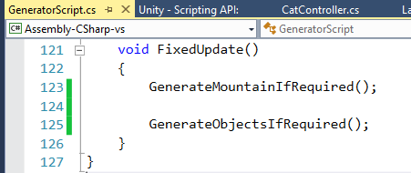
Call Your New Method
Inside FixedUpdate(), add a call to the new method to Generate Objects

Slide 34
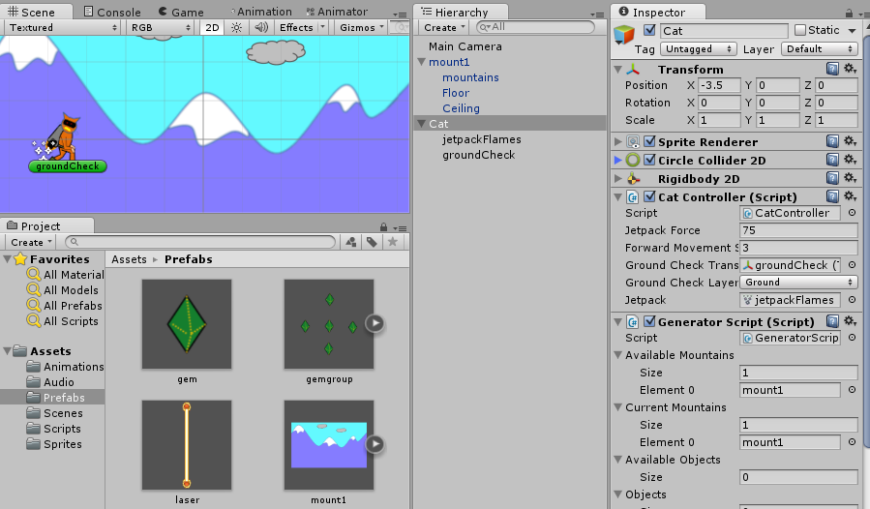
Initialize Script Parameters
While “cat” is selected…
Drag
“laser” and
“gemgroup”
into
“Available
Objects”
(one by one)

Slide 35
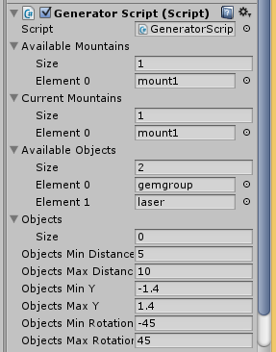
Verify Available Objects
You should have 2 items under Available Objects:
Element 0: gemgroup
Element 1: laser

Slide 36
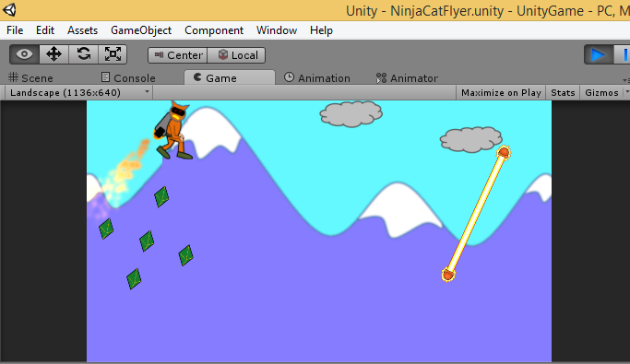
Run the Game!
Run
You should now have auto-generated lasers and gems!

Slide 37
What’s Next?
Notes:
Moving the Mouse

Slide 38
Up Next
Adding UI Elements (Score, etc)
Adding Sound/Music
Adding Parallax
Exporting and Publishing

Slide 39
End of Part 5
Notes:
Contact
Web: OnekSoft.com
Email: games@OnekSoft.com
Twitter: @OnekSoftGames
Microsoft email: shchowd@microsoft.com
Personal Twitter: @shahedC
R&D: OnekSoftLabs.com
Dev Blog: WakeUpAndCode.com

