Slide 1


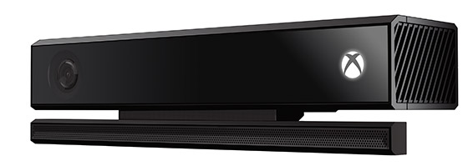
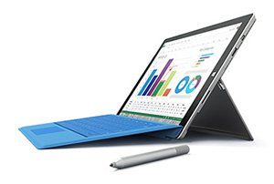




@ VT Hacks 2015
Kinect loaners + workshop
Surface Pro 3 + keyboard prizes
Azure (cloud) Workshop
Unity Pro licenses
Shahed Chowdhuri
David Crook
Amanda Lange
WakeUpAndCode.com
@shahedC
IndieDevSpot.com
@davidcrook1988
SecondTruth.com
@second_truth
Notes:
Microsoft @ VT Hacks 2015
Kinect v2 loaner devices
Surface Pro 3 + keyboard prizes
Kinect Workshop, before Hackathon
Azure (cloud) Workshop, during Hackathon
Shahed Chowdhuri
Sr. Technical Evangelist
WakeUpAndCode.com
@shahedC

Slide 2

Enter your hack to the US Imagine Cup 2015 fast-track*
Microsoft’s global student
technology competition
Enter by March 24, 2015
http://aka.ms/imaginecupvip
*valid for this weekend’s hackathon participants only

Slide 3
Download Slides Here
http://WakeUpAndCode.com/vt

